Slide 1
Biomedical Therapy
You know, drugs and stuff

Slide 2
Topics for Today
Drug therapy
Anti-psychotic drugs
Anti-anxiety drugs
Anti-depressant drugs
Mood-stabilizers
Brain stimulation
ECT
TMS
Psychosurgery
Alterative Therapies

Slide 3
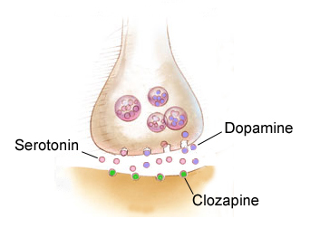
Anti-Psychotic Drugs
Treats symptoms of psychosis
Schizophrenics use these
Block dopamine receptor sites (antagonists)
1st Gen Anti-Psychotics = chlorpromazine (Thorazine)
Effective, but lots of side effects
Tardive dyskinesia
Atypical anti-psychotics = clozapine (Clozaril)
Still effective, still has side effects (not as severe)

Slide 4
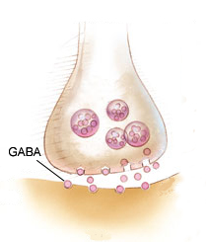
Anti-Anxiety Drugs
Used for anxiety and related disorders
Depressants
Elevate GABA
Key examples: Xanax, Klonopin, Valium, Ativan
Negative side effects: addictive
Being replaced with anti-depressants

Slide 5
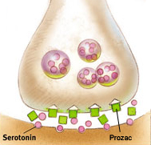
Anti-Depressant Drugs
Used to treat depression and related disorders
Block the reuptake of serotonin
Selective-serotonin reuptake inhibitors (SSRIs)
Older ones blocked norepinephrine too
Examples: Prozac, Paxil, Zoloft, Lexapro
Side effects: dry mouth, weight gain, hypertension

Slide 6
Mood-Stabilizers
Balance out moods
Used to treat mania
Lithium carbonate and Depakote
Unclear how it works
Side effects: drowsiness, thirst

Slide 7
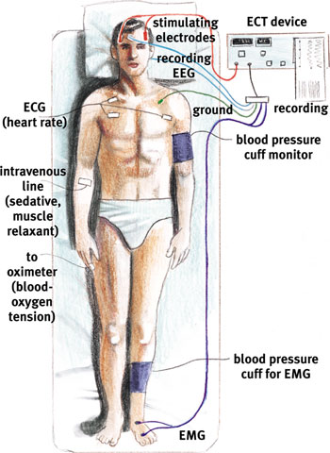
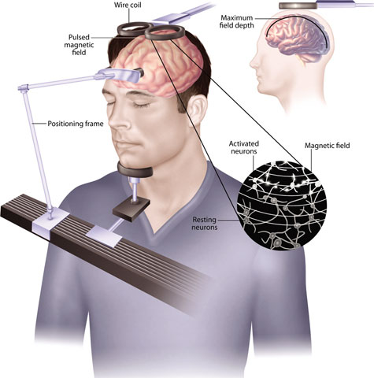
Brain stimulation
Transcranial Magnetic Stimulation
Using magnetic waves to stimulate the brain
Used to treat severe depression
No side effects
Electro-convulsive Therapy
Used to treat severe depression
Side effects: muscle pain, memory loss

Slide 8
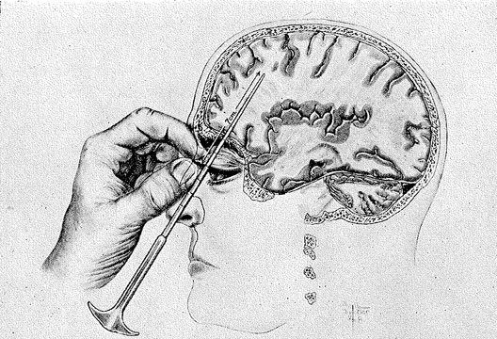
Psychosurgery
A.k.a. lobotomy
Surgery on the brain
Very risky
Permanent changes in the brain
Used commonly in the past
Not common treatment today
Often used to treat severe cases

Slide 9
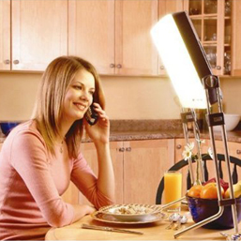
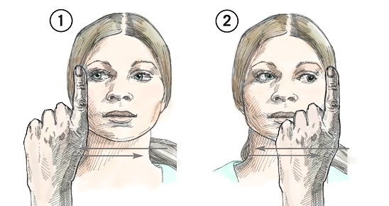
Alternative Therapies
Any therapy that lacks research
Many supporters; many haters
Do they work?
Light Exposure Therapy
Eye Movement Desensitization and Reprocessing

