Slide 1
The Ford and Carter Presidencies
(Few) Successes and (Many) Struggles

Slide 2
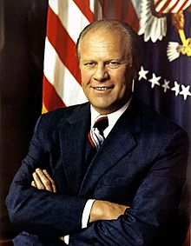
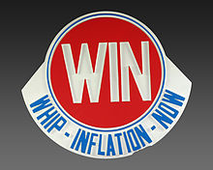
Gerald Ford (1974-1977)
Didn’t accomplish much
Stagflation occurs
Stagflation = stagnant economy + inflation
Attempts to repair the economy were unsuccessful

Slide 3
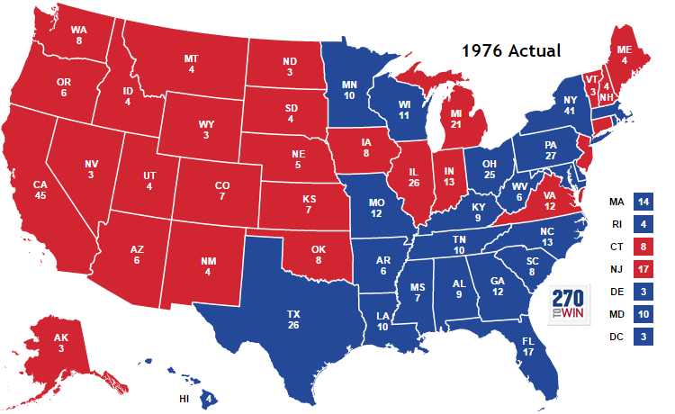
1976 Election
Gerald Ford (Chump) vs Jimmy Carter (Nobody)
Govt distrust and economy = main issues

Slide 4
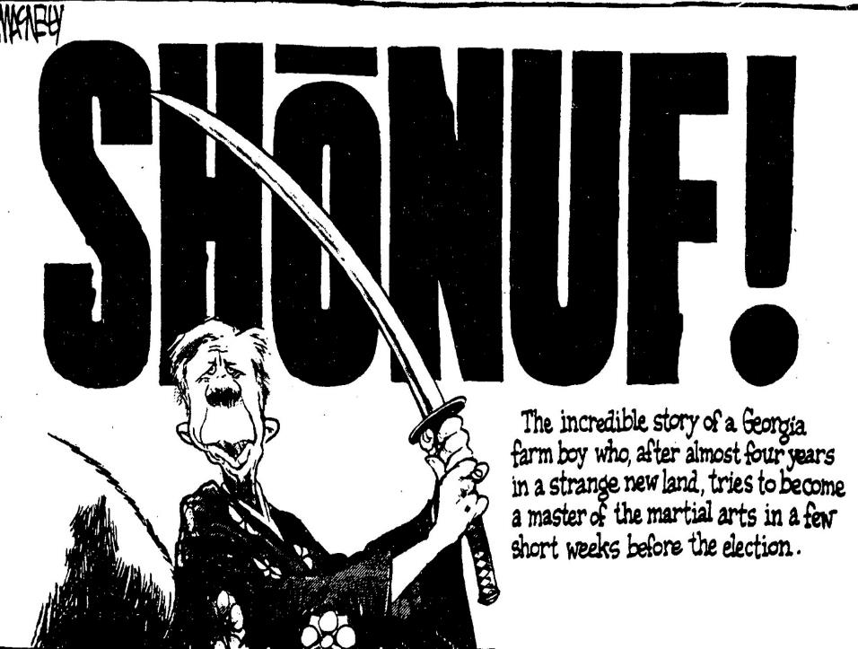

Slide 5
Stagflation Continues
The economy continues slide downward
Inflation and unemployment continue to rise
Deindustrialization begins to happen in US
Beginning of the Rust Belt
Carter inept at Washington politics
prevents solution to problems

Slide 6
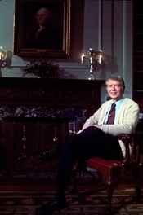
Energy Crisis
Oil prices rose even after embargo ends
Carter asks public to make sacrifices
Wear a sweater inside…
Attempts made to expand nuclear energy
1979 Three Mile Island nuclear plant has a crisis

Slide 7
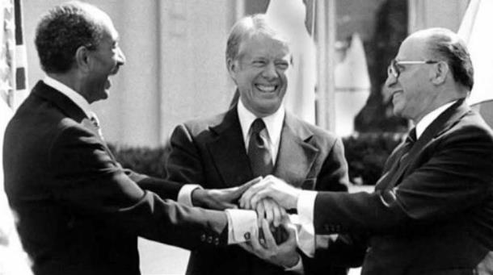
Camp David Accords
Conflict between Israel and Egypt ongoing
Carter tries to get them to sign peace treaty
He succeeds at Camp David

Slide 8
Malaise Speech
July 19, 1979 – Carter gives the “Malaise Speech”
Malaise = feeling of discomfort or uneasiness with no identified cause
Meaningful message, but public dislikes Carter’s message

Slide 9
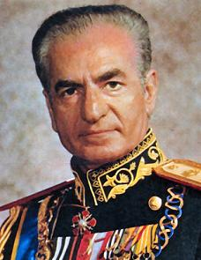
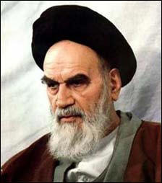
Chaos in Iran
Iranian Revolution removes the Shah of Iran
The Ayatollah Khomeini comes to power
Shah goes to US for cancer treatment
Iran wants US to send him back for trial

Slide 10
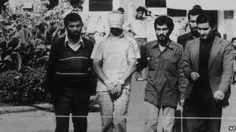
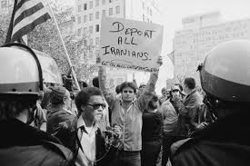
Iranian Hostage Crisis
Nov. 4, 1979 - Iranian students storm US embassy and take hostages
Carter unable to free hostages
Contributes to Carter’s loss in 1980 election

Slide 11
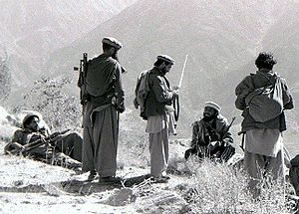
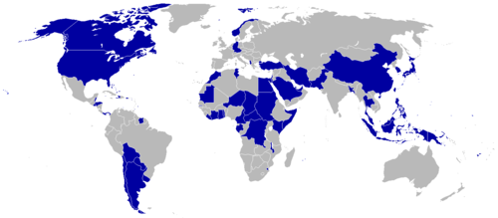
USSR Invades Afghanistan (1979)
Soviets try to put communist in power
Becomes USSR version of Vietnam War
Carter decides US will boycott 1980 Olympics because of invasion
Unpopular with the public

