Slide 1
The Clinton Years and Y2K

Slide 2
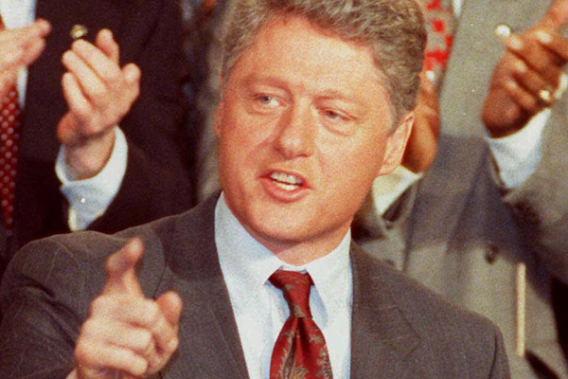
The New Liberal
Bill Clinton represented the Neo-Liberal
Neo-Liberal = moderate liberals that favored…
Smaller federal govt
Free market economy
Moderate approach to social welfare

Slide 3
Clinton’s Early Successes
Passed tax bill that reversed Reaganomics tax policies
Improved funding for college
Passed Family and Medical Leave Act

Slide 4
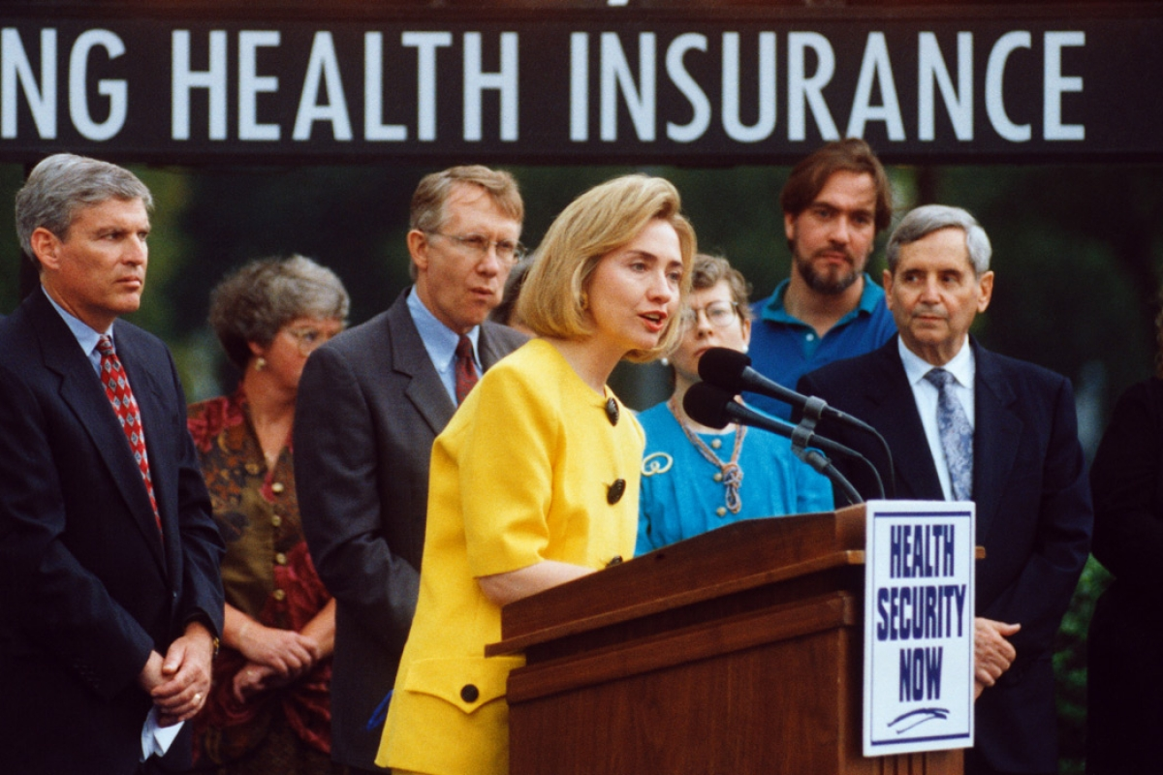
The Clintons and Healthcare
Hillary Clinton focused on expanding healthcare to everyone in US
Popular but faced lots of opposition
Healthcare law never passed

Slide 5
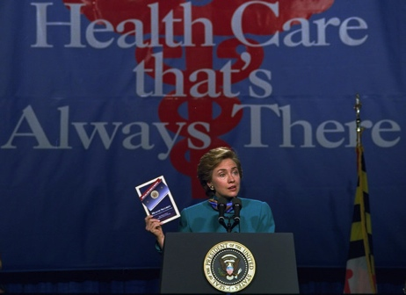

Slide 6
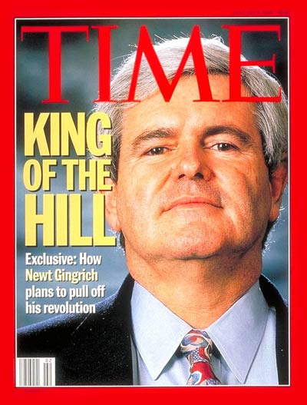
Conservatives Strike Back
Congress controlled by Republicans in 1994
Tried to pass Contract With America
Force a Govt Shutdown in 1995
Clinton passed moderate approach to Welfare called Temporary Assistance to Needy Families (TANF)

Slide 7
Rising Terrorism
Major, public terrorist attacks spike in the 1990s:
Bombing of World Trade Centers (1993)
Siege at Waco, Texas (1993)
Oklahoma City Bombing (1995)

Slide 8
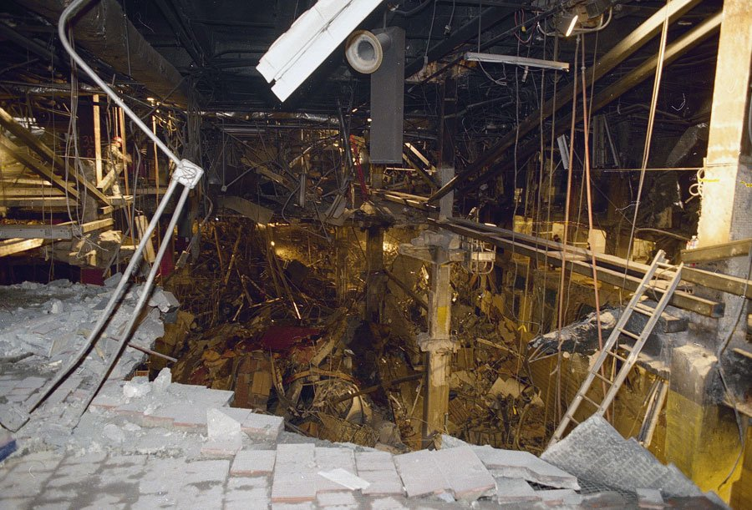
World Trade Center 1993

Slide 9
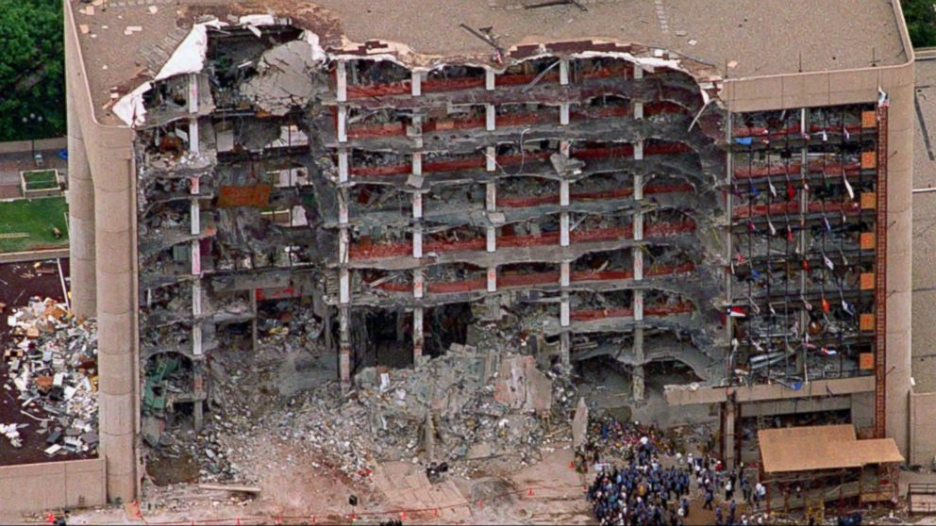
Oklahoma City Bombing (1993)

Slide 10
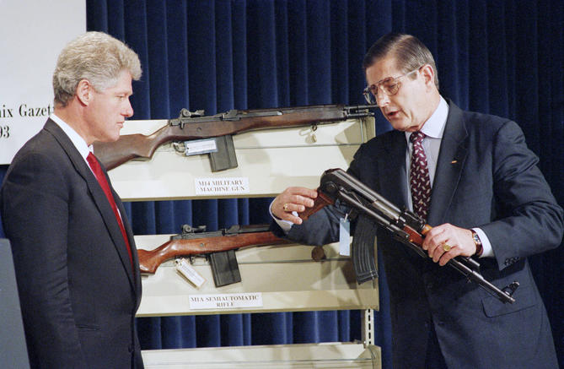
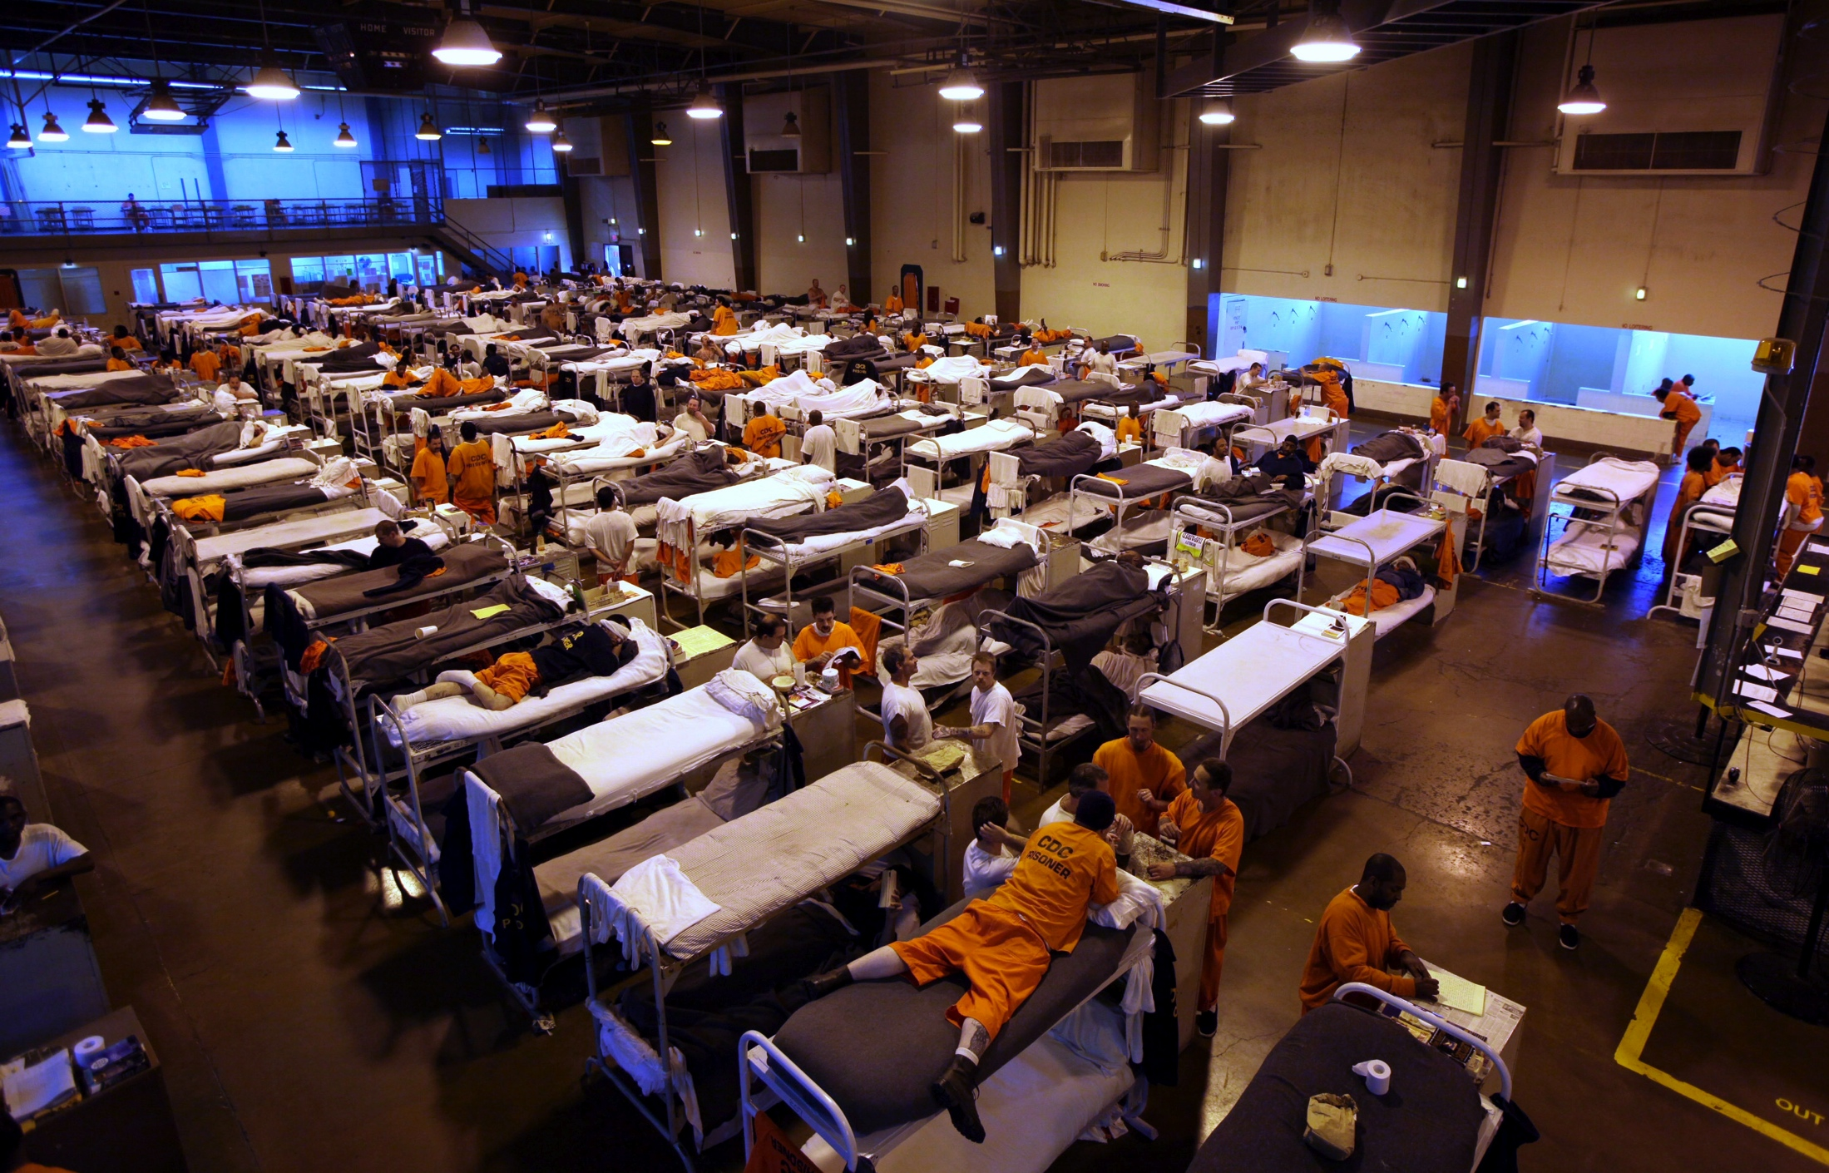
Gun Control and Crime
Crime rates rose throughout 1980s
Peak in 1991 leads to:
Clinton passes stricter gun control measure
Federal and State increases in imprisonment
Leads to massive overcrowding of prisons

Slide 11
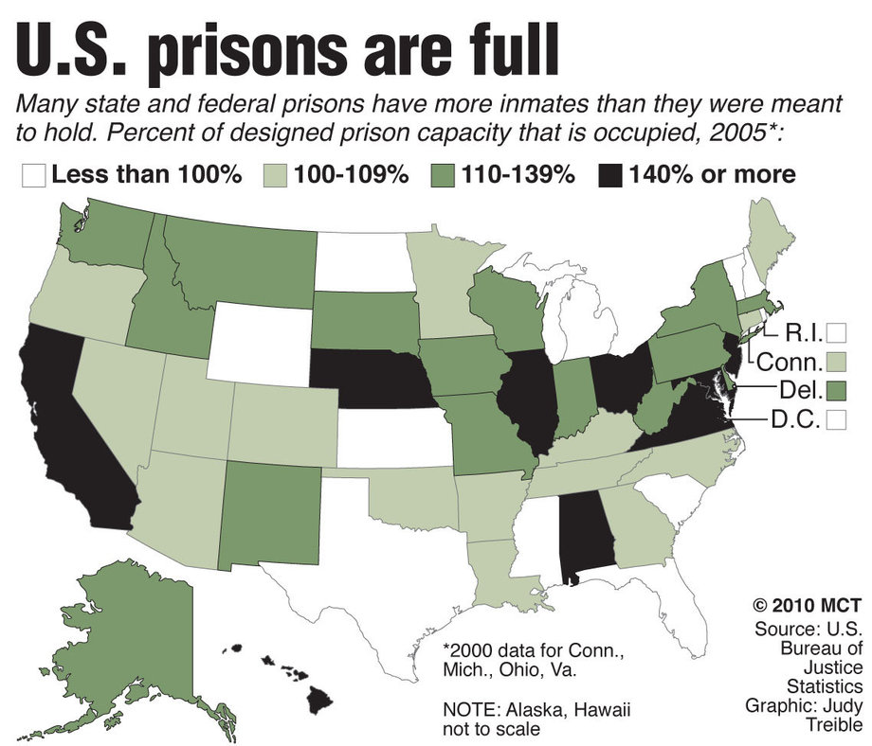

Slide 12
Booming Economy
Economy improves in the 1990s
Service industries boom
Internet and technology firms grow
Globalization grows
North American Free Trade Agreement signed 1994

Slide 13
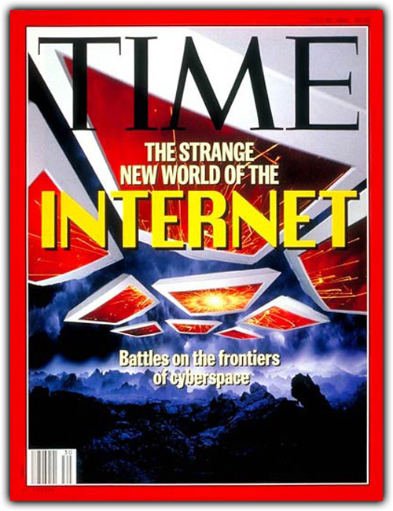
Internet
Internet started as defense project during Cold War
Becomes developed in 1980s and 1990s
Becomes commercialized in the 1990s
Changes the world forever…

Slide 14
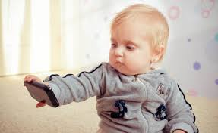
“Insta-Generation”
Speed in society increases
Society adapts to instant results
Cell phones, texting, instant messaging all contributing factors

Slide 16
Clinton’s Impeachment
Republicans wanted to investigate Whitewater Real Estate deal
Found Clinton had affair with Monica Lewinsky
Impeached him in 1998 for perjury
Clinton wasn’t removed in Senate vote

Slide 17
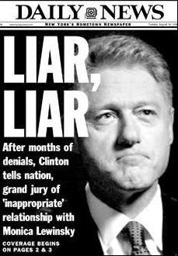
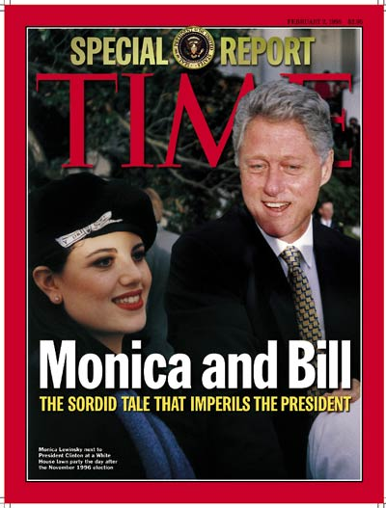
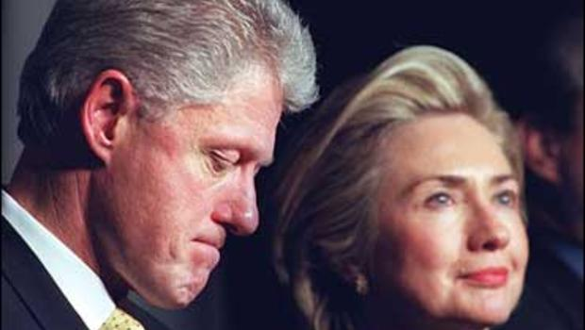

Slide 18
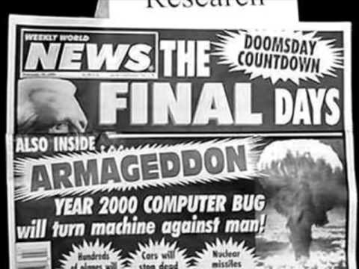
Y2K
People thought there would be a technological collapse on Jan. 1, 2000
There wasn’t

Slide 19
Election of 2000
George W. Bush vs Al Gore
Close election → comes down to Florida’s popular vote
Unclear winner on election night
Recounting of votes starts but is flawed
Eventually Supreme Court decides winner of the election
Bush vs. Gore (2000)
Gore won popular vote, lost electoral vote

Slide 20
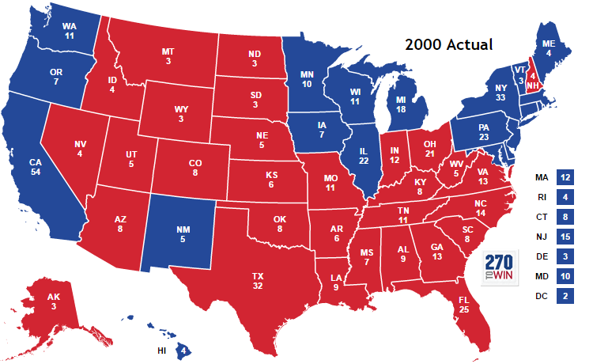

Slide 21
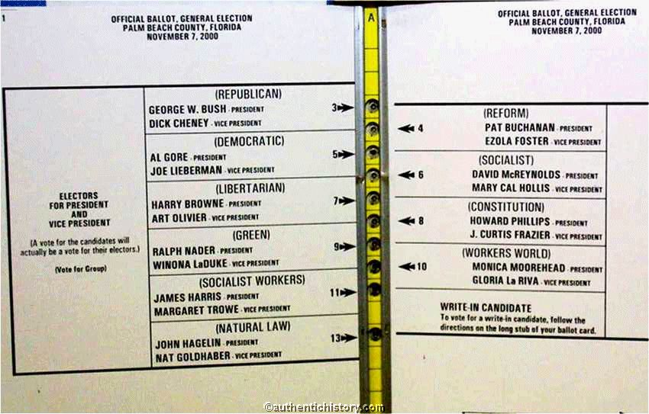

Slide 22
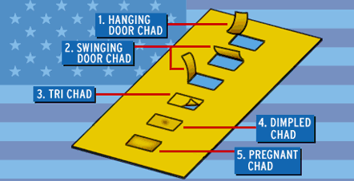

Slide 23
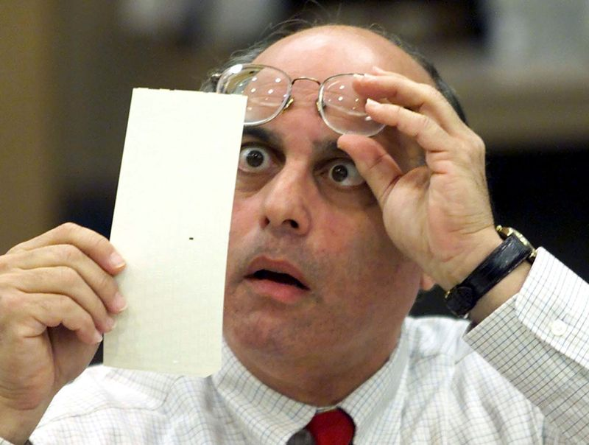

Slide 24
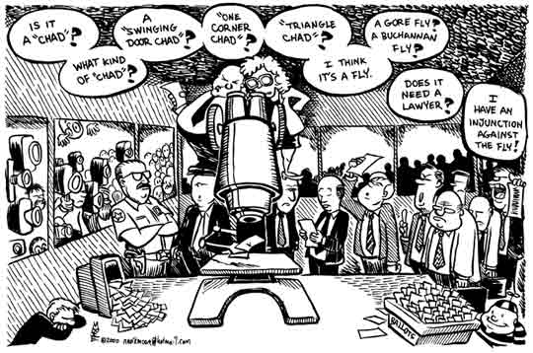

Slide 25
