Slide 1
Depression, Bipolar Disorder, and Schizophrenia

Slide 2
Topics for today
Major Depressive Disorder
Bipolar Disorder
Biopsychosocial Approach
Schizophrenia
Symptoms
Causes
Suicide

Slide 3
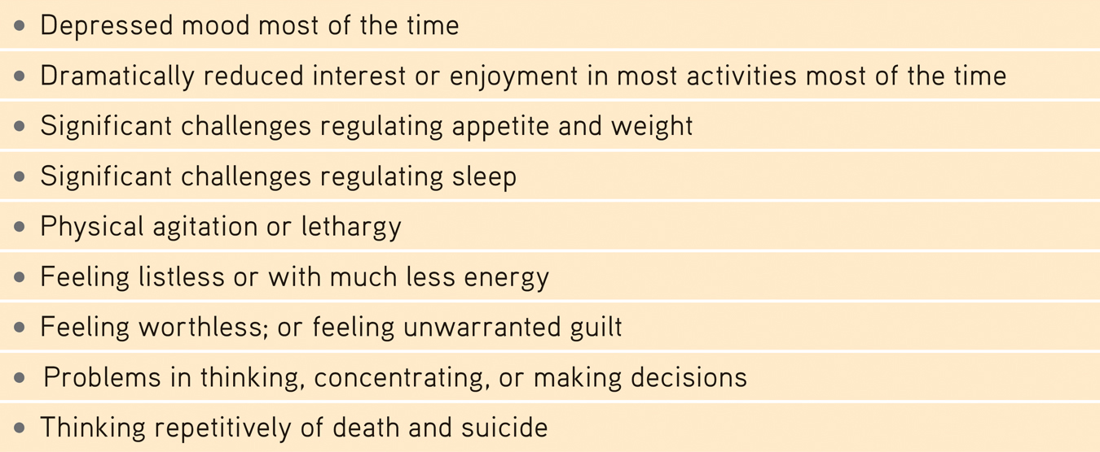
Major Depressive Disorder
A.k.a. – Clinical depression
Must have at least 5 symptoms for 2 weeks

Slide 4
Major Depressive Disorder
Mild depression = persistent depressive disorder (dysthymia)
Depression as a cycle:
Negative, stressful events interpreted through
a ruminating, pessimistic explanatory style create
a hopeless, depressed state that
hampers the way the person thinks and acts
and fuels

Slide 5
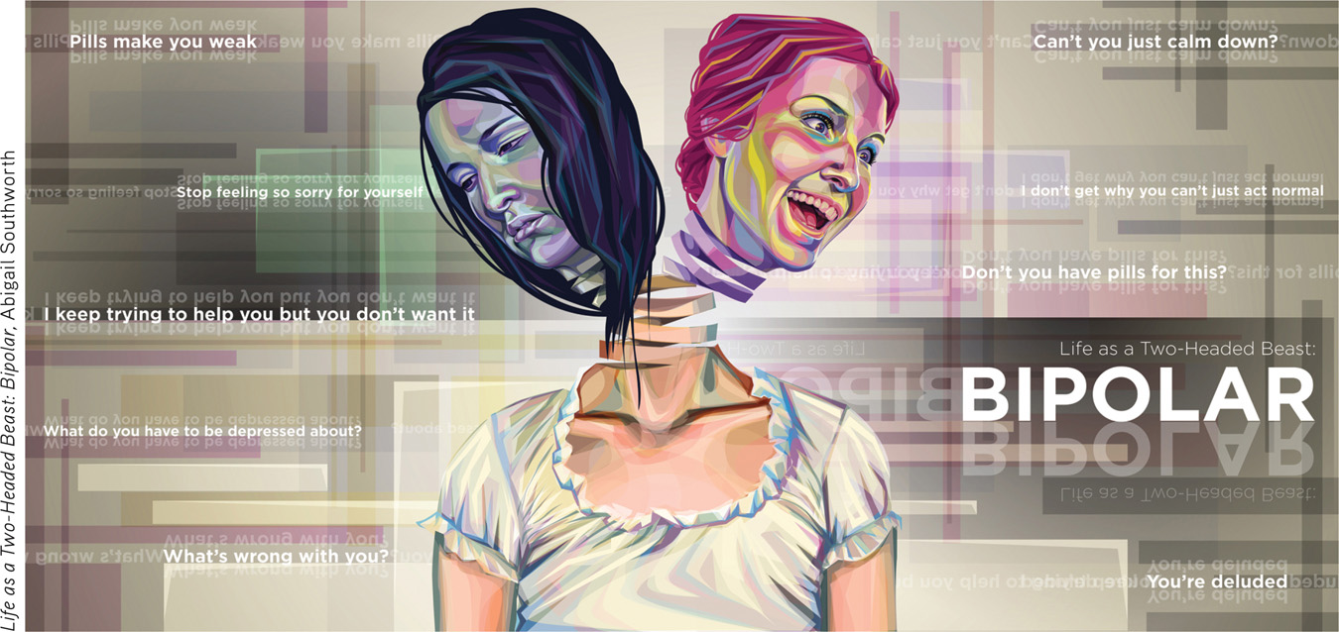
Bipolar Disorder
Formerly manic depressive disorder
Alternate between mania and depression
Mania = confidence, high energy, recklessness, creativity

Slide 6
Biopsychosocial Approach
Apply the biopsychosocial approach to Depression and Bipolar Disorder:
What are the biological components of the disorder?
What are the psychological components of the disorder?
What are the social-cultural components of the disorder?

Slide 7
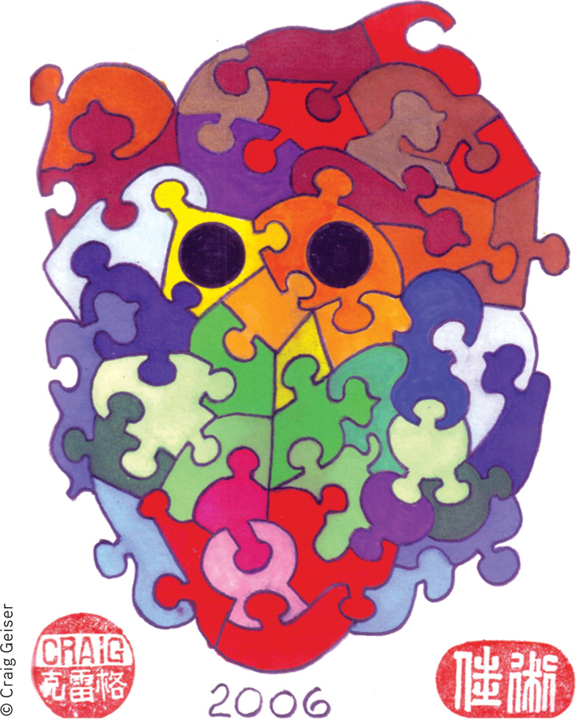
Schizophrenia
Does NOT involve split personalities
Key symptoms:
Positive symptoms
Inappropriate emotions
Delusions
Hallucinations
Disorganized speech
Inability to control attention
Negative symptoms:
Catatonia
Flat affect
Chronic vs Acute

Slide 8
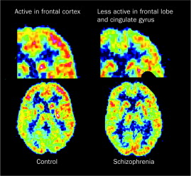
Roots of Schizophrenia
Onset late teens to early twenties
Strong indications of biological causes
Biological:
Excess dopamine
Frontal lobe inactivity
Pre-natal Environmental:
Virus in prenatal environment

Slide 9
Suicide
Most people have thought of suicide
Only a fraction have made a plan and/or attempt
More likely to occur with diagnosis of depression
Comparing the suicide rates of different groups, researchers have found:
National differences
Racial differences
Gender differences
Age differences and trends

Slide 10
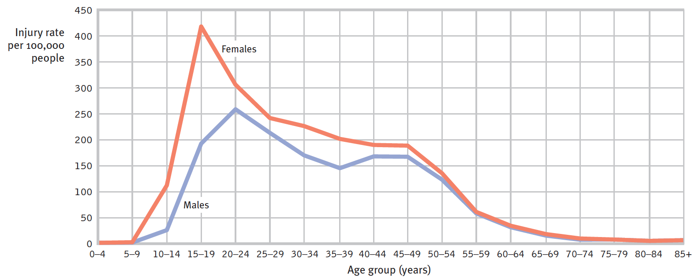
Self Harm
RATES OF NONFATAL SELF-INJURY IN THE U.S.
Self-injury rates peak higher for females than for males (CDC, 2009).

