Slide 1
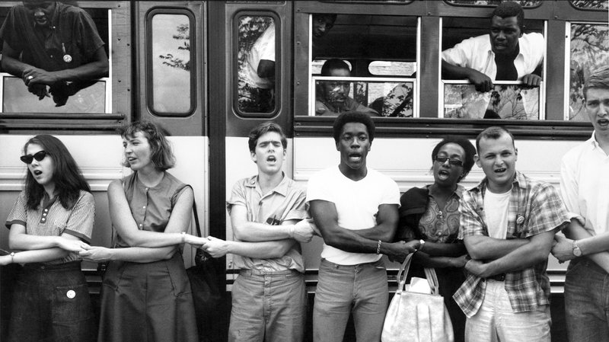
Freedom Summer

Slide 2
Civil Rights Act of 1964
Lyndon Johnson becomes President in 1963
Focuses on economics AND civil rights
Equal Employment Opportunity Commission (EEOC)
Job Corps, Head Start, VISTA (Volunteers in Service to America

Slide 3
Continued…
Civil Rights Act of 1964 initially proposed by Kennedy
Law prohibited segregation in public accommodations such as hotels, restaurants, gas stations, theaters, and parks.
Equal Employment Opportunity Commission (EEOC)

Slide 4
Freedom Summer
Voter Registration Drive
Explicit goal to increase number of African-American voters
Put middle class white college students in the line of fire.

Slide 5
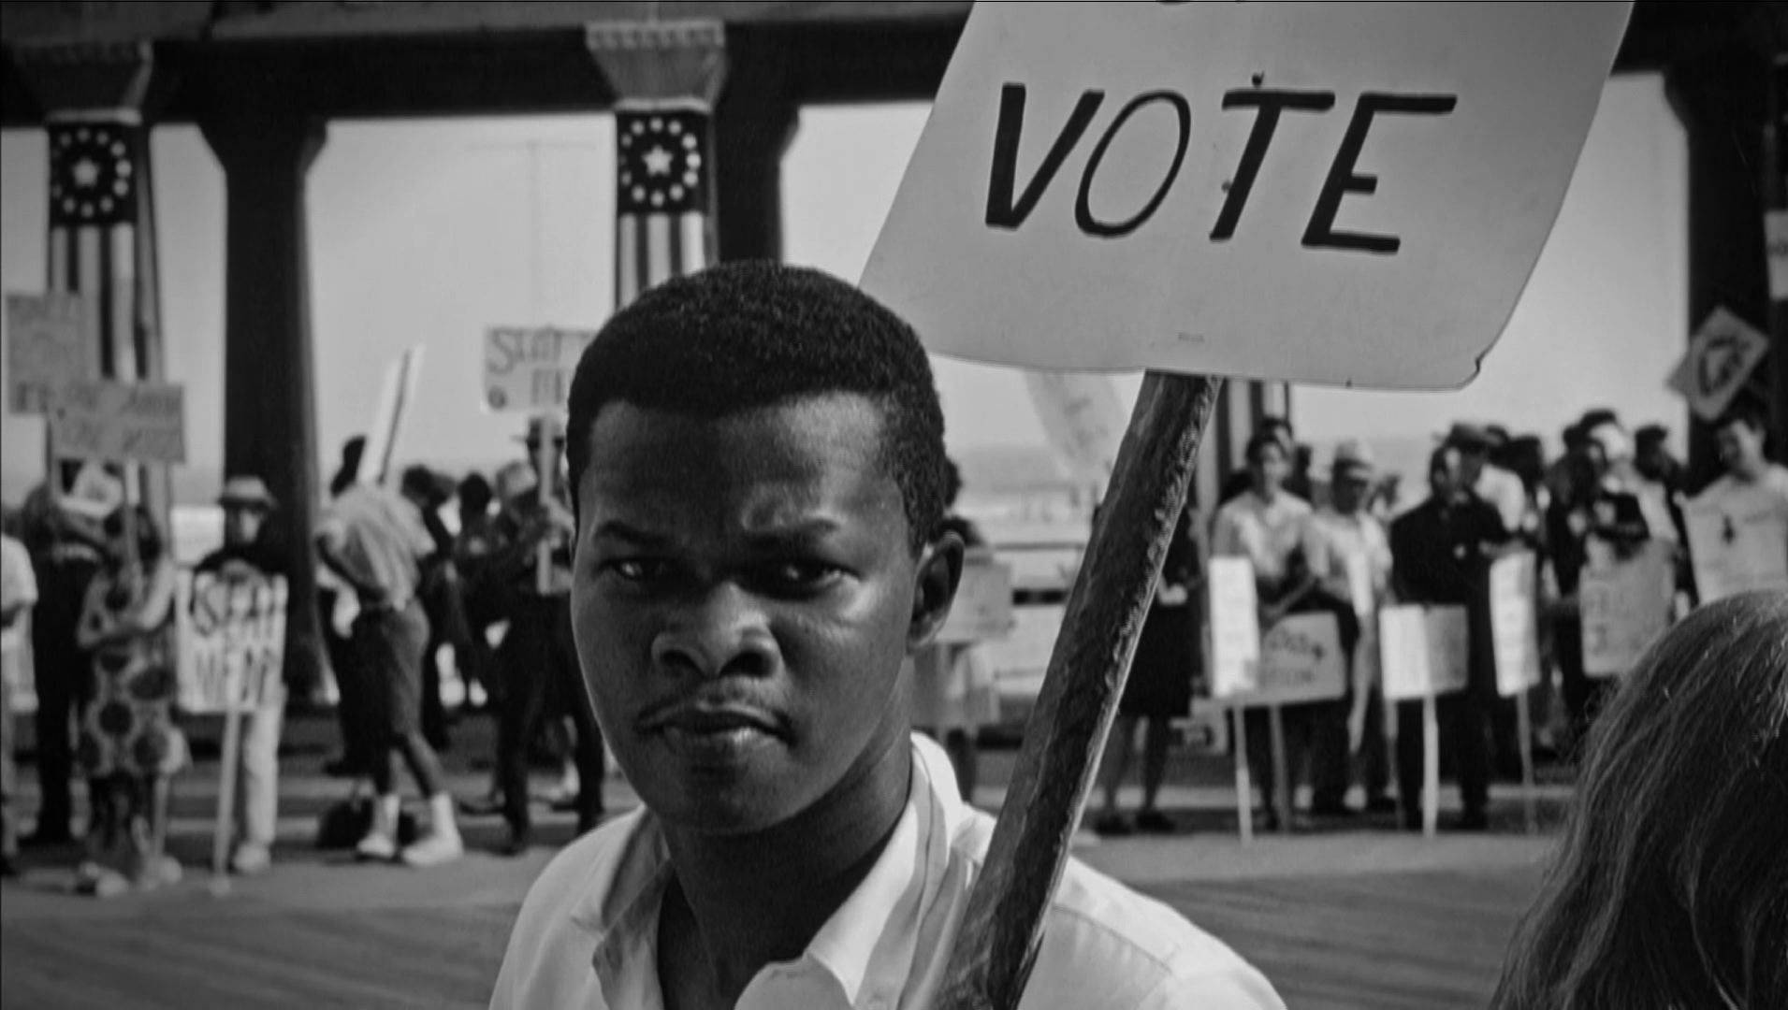
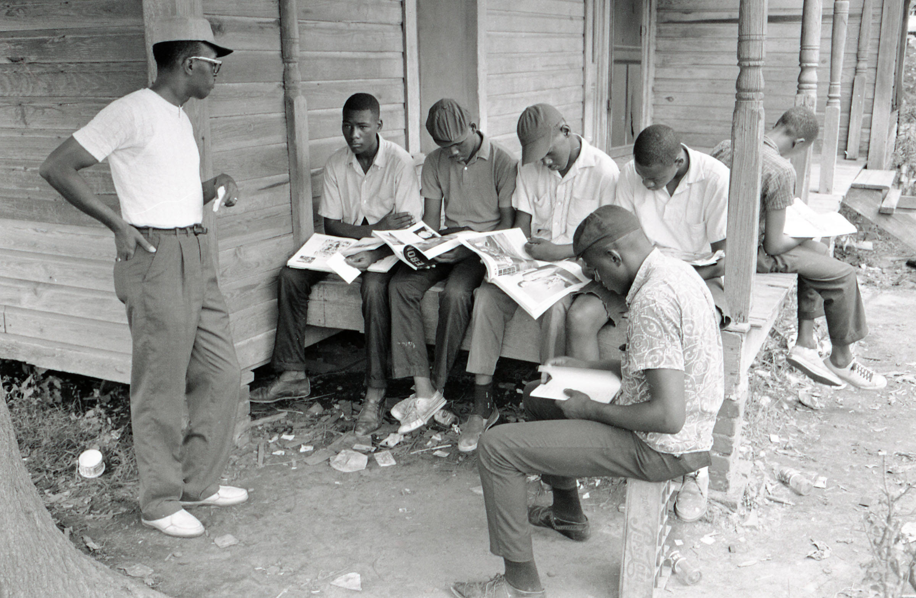
Continued..
Freedom Schools
Community Centers
Voter Registration
Special Projects
Legal Project
White Communities
Theater Project

Slide 6
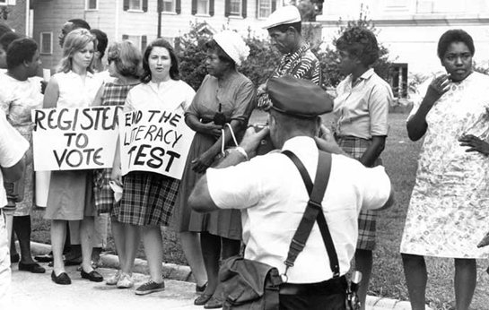
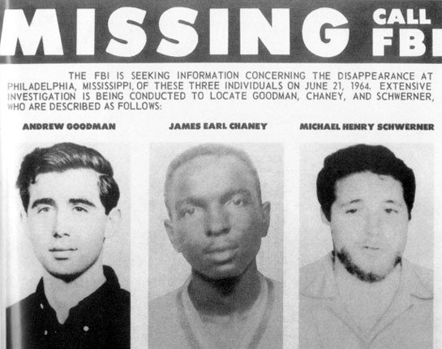
By the Numbers
1,600 new voters
2,000 children in SNCC Freedom Schools
Countless number of beatings, bombings, church fires, and the murder of three project workers.

Slide 7
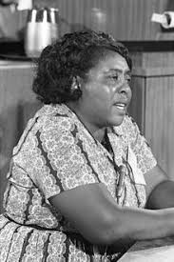
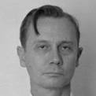
Fannie Lou Hamer
Voting and woman’s rights activist
Founder of the Freedom Democratic Party
Sam Bower
Committed White Supremacist
Leader of the KKK in Mississippi during the Civil Rights Movement

Slide 8
Instructions:
Read the two primary source documents
On a separate sheet of paper, compare and contrast the faith commitments of Fannie Lou Hamer and Sam Bowers. [You can write a short paragraph OR create a Venn Diagram]

