Slide 1
Freud and Personality

Slide 2
Topics for today
Freud’s personality structure
Psychoanalytic perspective: How Personality Develops
Psychosexual Stages
Defense mechanisms

Slide 3
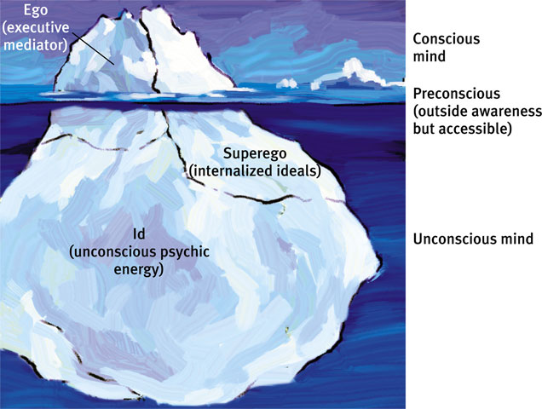
The Personality Structure: The Iceberg

Slide 4
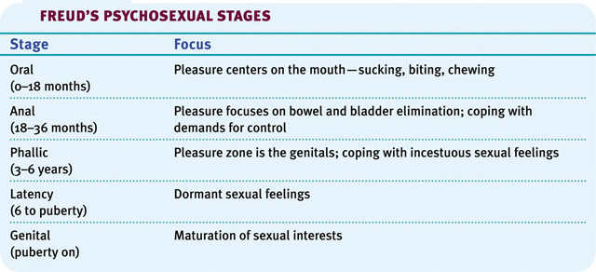
Personality Development: Psychosexual Stages
Erogenous zone is focus of sexual energy for each stage
Inability to deal w/unconscious conflict creates fixation

Slide 5
Defense Mechanisms
DMs = protection from unconscious anxiety
Repression = basis of all defense mechanisms
Defense Mechanism | Unconscious Process Employed to Avoid Anxiety-Arousing Thoughts or Feelings
Regression | Retreating to a more infantile psychosexual stage.
Reaction formation | Switching unacceptable impulses into their opposites.
Projection | Disguising one’s own threatening impulses by attributing them to others.
Rationalization | Offering self-justifying explanations instead of real unconscious reasons for one’s actions.
Displacement | Shifting sexual or aggressive impulses toward a less threatening object or person.
Denial | Refusing to believe or even perceive painful realities.

Slide 6
Practice
Come up with an example (that we haven’t talked about and isn’t mentioned in the textbook) for each defense mechanism.

