Slide 1
Personality: Humanistic and Trait Perspectives

Slide 2
Topics for today
Humanistic psychology’s view on personality
Key people
Key ideas
Methods of assessing personality
Strengths and weaknesses
Trait perspective of personality
Key ideas
Methods of assessing personality
Strengths and weaknesses

Slide 3
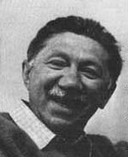
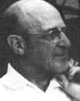
Humanistic Psychology
Studied personal growth and self-fulfillment of ppl
Rxn. to negativity of psychoanalysis and behaviorism
Abraham Maslow
(1908-1970)
Carl Rogers
(1902-1987)

Slide 4
Humanists: Big ideas
Maslow’s Hierarchy of Needs
Self-actualization = fulfilled person
Rogers → Ppl are good, but environment can interfere
Keys to the positive self-concept:
Genuineness
Acceptance → Unconditional Positive Regard
Empathy

Slide 5
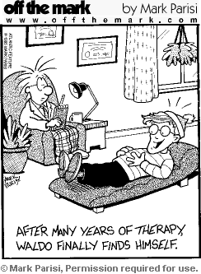
Humanistic Personality Assessment
Interviews will provide insight of personality
Idealized self vs actual self

Slide 6
Humanistic Perspective
Strengths
Weaknesses
Important to value positives
Highly influenced childcare and education
Can you think of them?

Slide 7
Trait Perspective: Big ideas
Personality is made up of specific traits
Describes personality → Doesn’t explain personality
Different psychologists focus on different traits

Slide 8
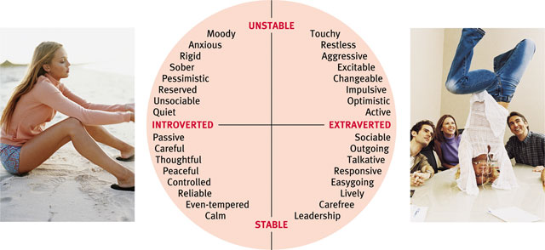
Eysencks’ 2-Dimensional Trait Theory

Slide 9
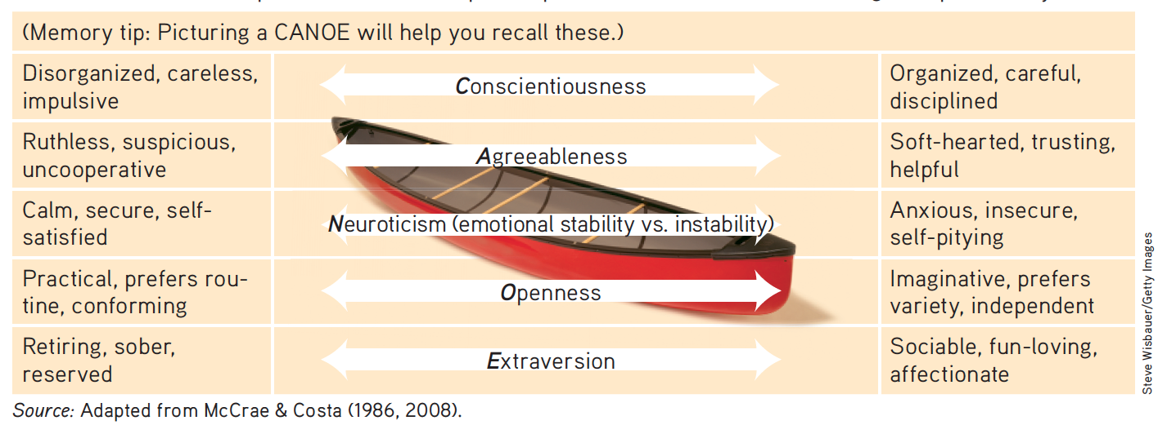
Big Five Personality Theory

Slide 10
Trait Perspective: Assessing Personality
Personality inventories = surveys of your personality
Famous PIs:
Myers-Briggs Personality Inventory
Minnesota Multiphasic Personality Inventory (MMPI)

Slide 11
Trait Perspective: Weaknesses
What weaknesses can you identify for this perspective?

