Slide 1
Hunger
12/14

Slide 2
Topics for Today
Hunger
Physiological causes
Hormones
Hypothalamus
Psychological causes

Slide 3
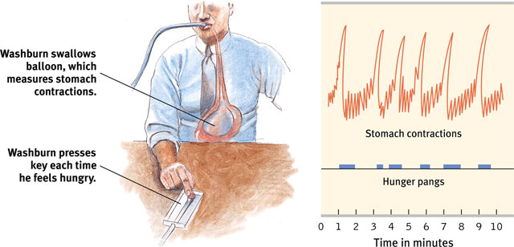
Physiological Causes of Hunger
Stomach contractions indicate hunger (through hunger pangs)

Slide 4
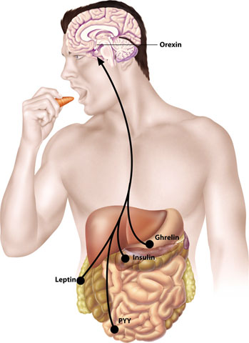
Appetite Hormones
Hormone | Tissue | Response
Orexin increase | Hypothalamus | Increases hunger
Ghrelin increase | Stomach | Increases hunger
Insulin increase | Pancreas | Increases hunger
Leptin increase | Fat cells | Decreases hunger
PPY increase | Digestive tract | Decreases hunger

Slide 5
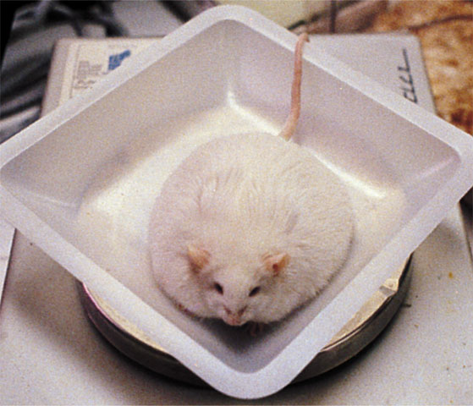
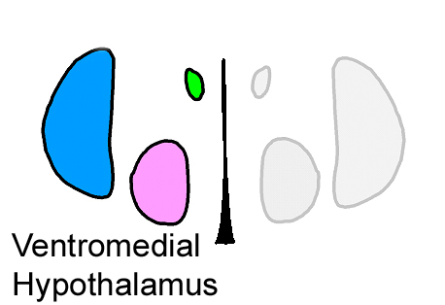
The Hypothalamus
The lateral hypothalamus (LH) brings on hunger (when stimulated).
The ventromedial hypothalamus (VMH) depresses hunger (when stimulated).

Slide 6
Other Biological Factors
Set Point: a person’s weight thermostat
Change in weight impacts hunger and basal metabolic rate
Basal Metabolic Rate: base rate of energy consumption
Subject to environmental changes

Slide 7
Environmental Influences on Hunger
Role of memory
Role of culture
Taste preferences
Emotions and hunger
Conditioning
Boredom
Portion sizes

Slide 8
