Slide 1
Causes of American Imperialism: Three Countries are Better than One

Slide 2
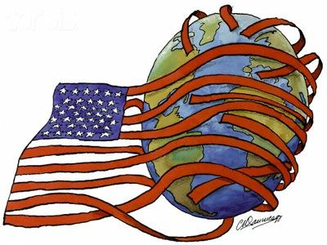
What is imperialism?
When a stronger country exerts political, military, social and/or economic influence over a weaker country.

Slide 3
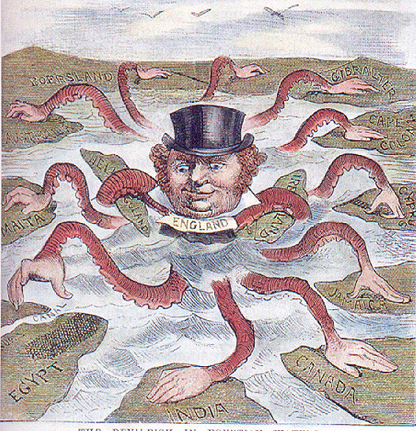
Economic Reasons for Imperialism
Need for:
New markets
Raw materials
Competition with Europe

Slide 4
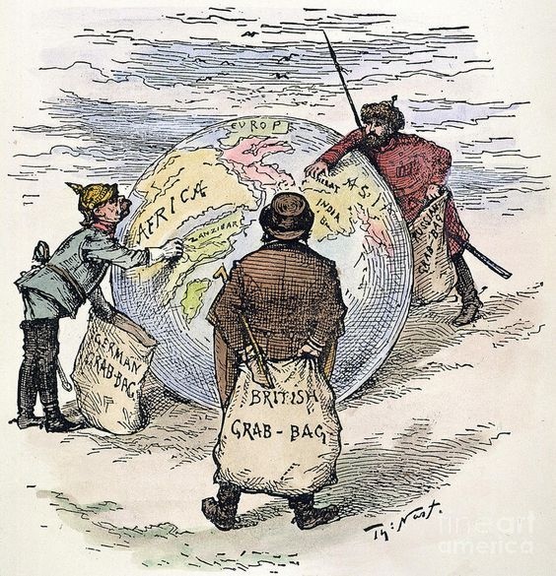
Political Reasons for Imperialism
Competition with Europe
Extend sphere of influence
Show of military strength
Expand military influence in the world

Slide 5
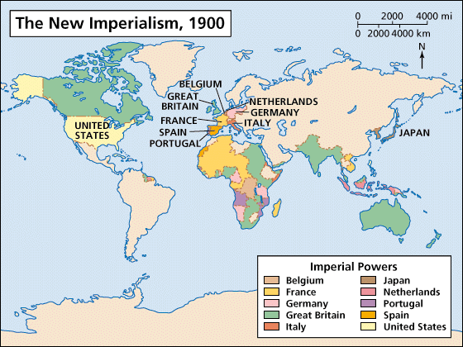

Slide 7
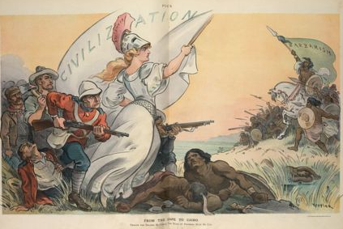
Social Reasons for Imperialism
Spreading American values and “civilization”
Religious conversion

Slide 8
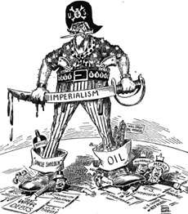
The American Anti-Imperialist League
An organization devoted to opposing American expansion overseas
Key Figures:
Mark Twain
Jane Addams
Andrew Carnegie
Samuel Gompers

