Slide 1
The Gilded Age
Robbers Barons and Labor Unions and Strikes, Oh My

Slide 2
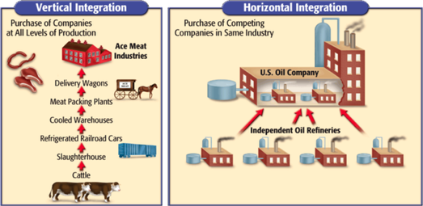
How to make a monopoly…

Slide 3
What is considered wealthy to you (salaries, individuals, etc.)?
What is considered poor to you?

Slide 4
Financial Statistics in the US Today
Median Household Income for US: $53,889
Median Household Income for Durham: $50,420
Poverty Guidelines in US:
1 Person = $12,060
2 People = $16,240
4 People = $24,600
6 People = $32,960
Percentage of Durham living in poverty: 19.2%

Slide 5
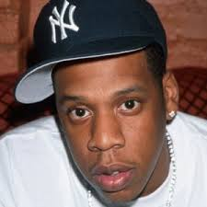
Jay - Z
Business:
Various
Wealth:
$810 Million

Slide 6
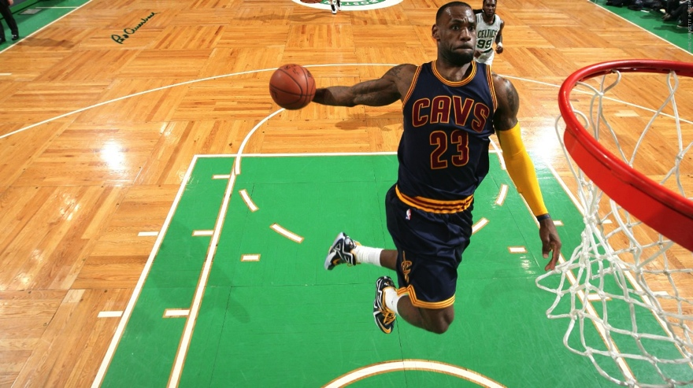
LeBron James
Business:
Basketball and Various Others
Wealth:
$440 Million

Slide 7
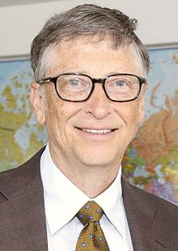
Bill Gates
Business:
Microsoft
Wealth:
$98 Billion

Slide 8
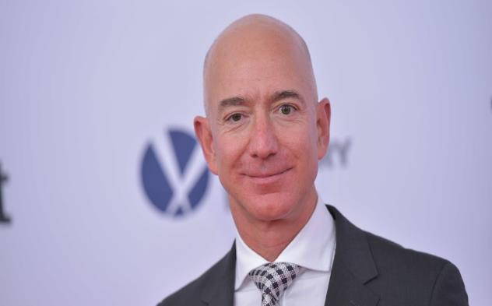
Jeff Bezos
Businesses:
Amazon
Net Worth:
$108 Billion

Slide 9
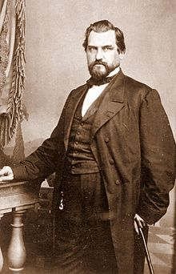
Leland Stanford
Business:
Central and Southern Pacific Railroad
Wealth:
$1.3 Billion

Slide 10
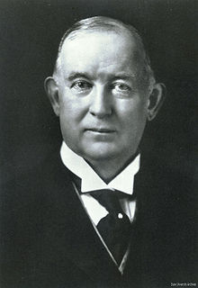
James B. Duke
Business:
American Tobacco Company
Wealth:
$2 Billion

Slide 11
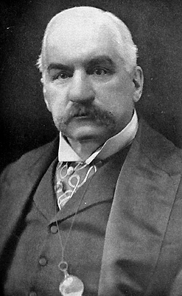
JP Morgan
Business:
J.P. Morgan and Company
Wealth:
$49 Billion

Slide 12
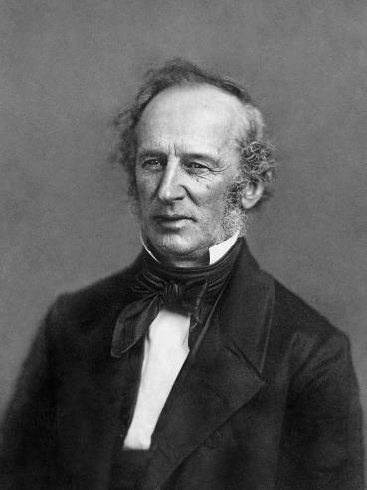
Cornelius Vanderbilt
Business:
Several Steamboat Businesses
NY and Harlem RR
NY Central and Hudson River RR
Wealth:
$185 Billion

Slide 13
Andrew Carnegie
Business:
US Steel
Wealth:
$309 Billion

Slide 14
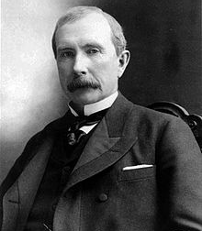
John D. Rockefeller
Business: Standard Oil
Wealth:
$336 Billion

Slide 15
Big Question
How did these people get that wealth?

Slide 16
“Robber Barons”
“Captains of Industry”
Used unethical businesses practices
Gained wealth at the expense of the public
Innovators in their business
Used strategic businesses practices to lead an industry
Created progress

Slide 17
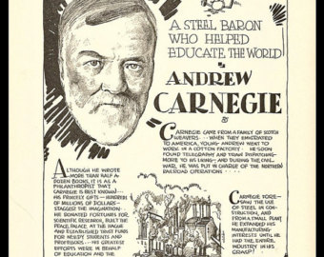

Slide 18
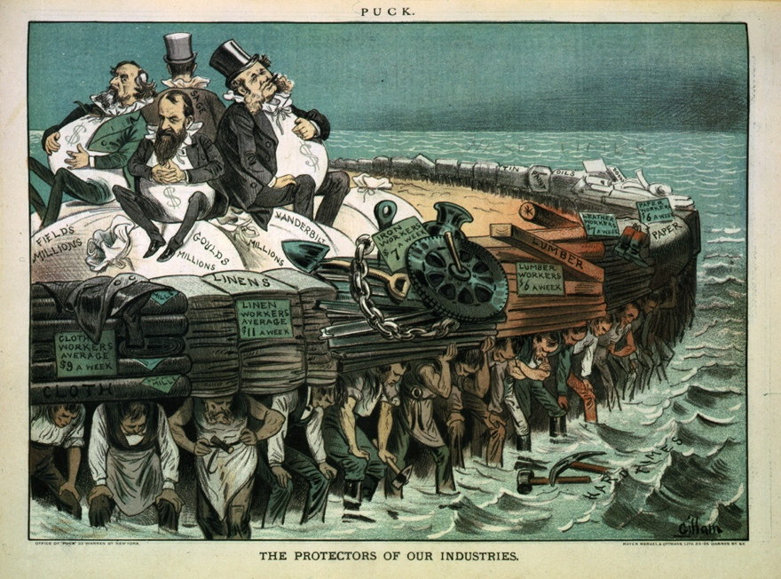

Slide 19
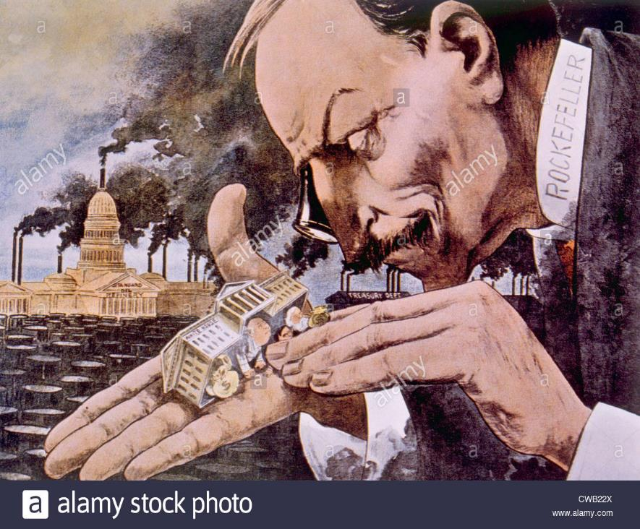

Slide 20
Famous Labor Conflicts
Great Uprising/Great Railroad Strike (1877)
Haymarket Square Affair (1886)
Homestead Steel Strike (1892)
Pullman Car Strike (1894)

Slide 21
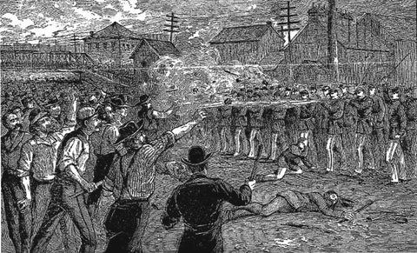
Great Railroad Strike of 1877 (Great Uprising)
Why?
Wages cut by B&O RR
Tactics?
Protesters strike
Violence breaks out on both sides
States called in militias
Results?
Workers lose
Govt sides with RR companies
1st major national strike

Slide 22
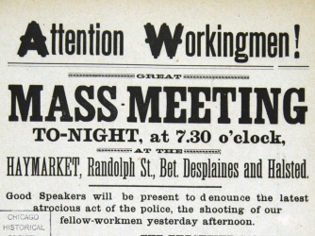
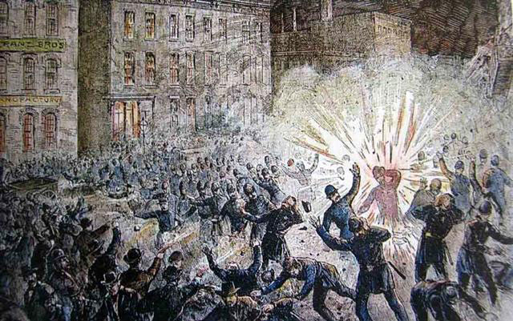
Haymarket Affair
Why?
Meeting to protest mistreatment of strikers @ RR
Tactics?
Protesters strike
Bomb goes off
Strikers and police killed and injured
Results?
Workers arrested and charged
Govt sides with RR companies, executes 4
Public turns against labor unions

Slide 23
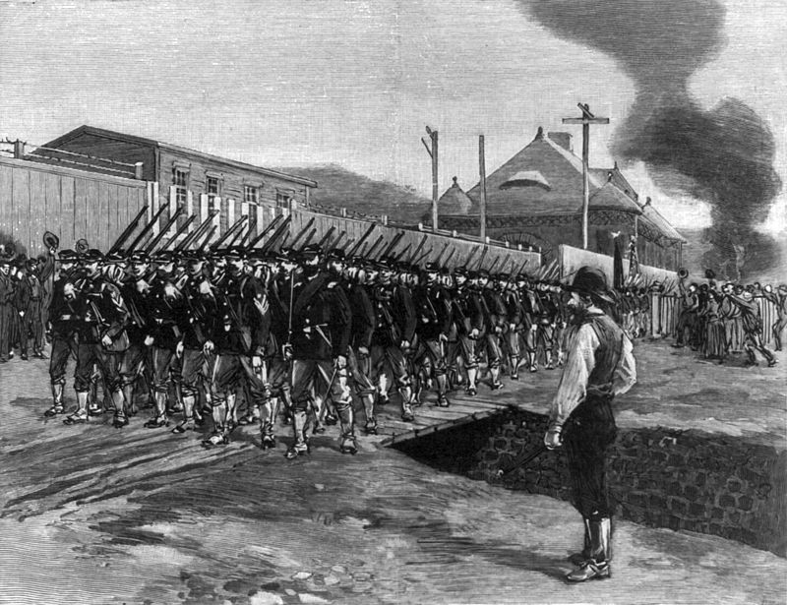
Homestead Steel Strike
Why?
Workers protest wage cuts
Illegally fired union workers
Tactics?
Protesters strike
Violence breaks out on both sides
Results?
Workers lose
Govt sides brings National Guard to stop strike
Public turns against labor unions

Slide 24
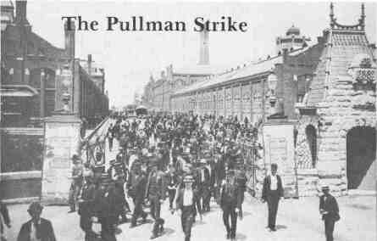
Pullman Car Strike
Why?
George Pullman cut wages
Tactics?
Protesters strike
Violence breaks out on both sides
Results?
Workers lose
Govt sides with RR companies
Businesses turn to Govt when strikes happen

