Slide 1
Perception

Slide 2
All of the following are examples of top-down processing…

Slide 3
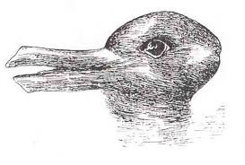

Slide 5
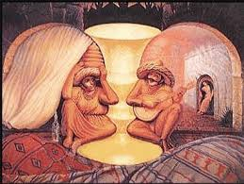

Slide 7
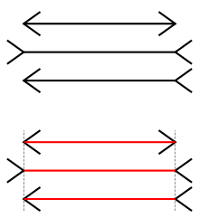
Which horizontal line is longer?

Slide 9
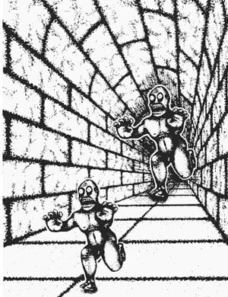

Slide 10
Selective Attention
Try focusing on different perspectives on this image
Notes:
OBJECTIVE 1| Describe the interplay between attention and perception.

Slide 12
Gestalt Psychology
We have a tendency to perceive something as a gestalt (or whole).

Slide 13
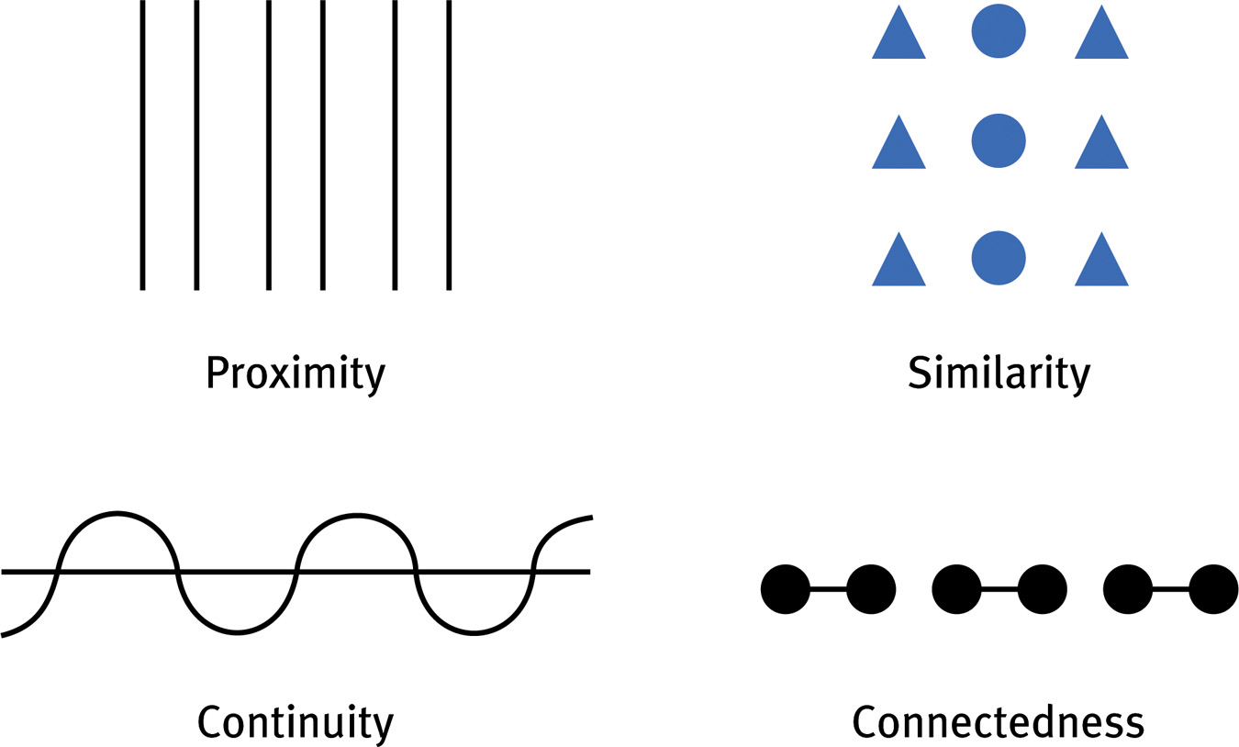
We group things by 4 basic methods

Slide 14
We also have figure-ground organization

