Slide 1
Thinking
Lecture 12/3

Slide 2
Topics for today…
Concepts and Prototypes
Types of Heuristics
Creativity
Problems in problem solving: Fixation
Mo’ problems in problem solving: Biases

Slide 3
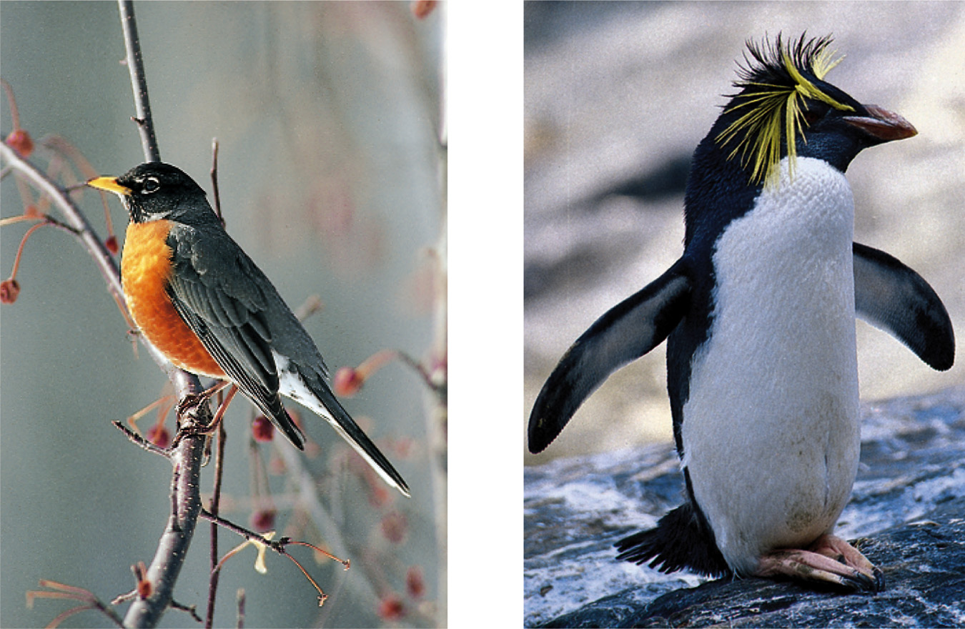
Concepts and Prototypes
For each concept we have a mental image exemplifying it (prototype).
Concept = Bird, Prototype = Robin

Slide 4
Representativeness Heuristic
Judging the likelihood of things or objects in terms of how well they seem to represent, or match, a particular prototype.
If you meet a slim, short, man who wears glasses and likes poetry, what do you think his profession would be?
An Ivy league professor or a truck driver?
Probability that that person is a truck driver is far greater than an ivy league professor just because there are more truck drivers than such professors.

Slide 5
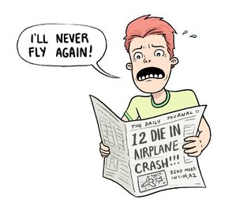
Availability Heuristic
Basing likelihood of events on the availability in memory.
Example:
Your parents read a news article about a teenager that was killed in a car accident
Then, they take away your car keys claiming that “teenagers are reckless and dangerous.”

Slide 6
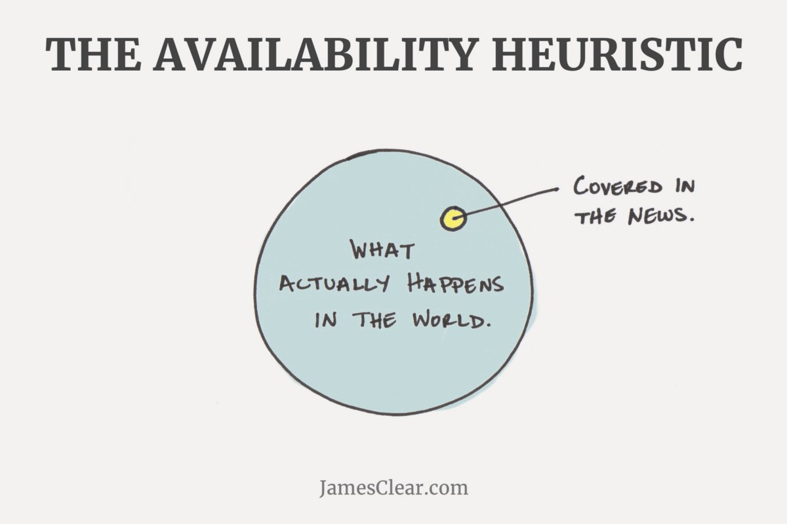

Slide 7
Rank these places by their levels of poverty (highest to lowest):
Chapel Hill
Durham (city)
New York (city)

Slide 8
New York (city) – 20.3%
Chapel Hill – 20.1%
Durham (city) – 18.5%

Slide 9
Rank these places by their median income (highest to lowest).
New York (city)
Durham (city)
Chicago
Raleigh

Slide 10
Raleigh - $58,641
New York (city) - $55,191
Durham (city) - $52,115
Chicago - $50,434

Slide 11
According to the 2010 Census
What are the racial demographics for the city of Durham (in percentages)?
White (Non-Hispanic/Latino)
Black (Non-Hispanic/Latino)
Latino/Hispanic
Asian (Non-Hispanic/Latino)

Slide 12
According to the 2010 Census
Durham (city)
White (Non-Hispanic/Latino) – 37.9
Black (Non-Hispanic/Latino) – 40.4
Latino/Hispanic – 14.2%
Asian (Non-Hispanic/Latino) – 5%

Slide 13
According to the 2010 Census
What are the demographics for the US (in percentages)?
White (Non-Hispanic/Latino)
Black (Non-Hispanic/Latino)
Latino/Hispanic
Asian (Non-Hispanic/Latino)

Slide 14
According to the 2010 Census
Amerrrrrrca
White (Non-Hispanic/Latino) – 63.7%
Black (Non-Hispanic/Latino) – 12.2%
Latino/Hispanic – 16.3%
Asian (Non-Hispanic/Latino) – 4.7%

Slide 15
Creativity
Combination of a novel and useful idea
Convergent thinking = problems that have singular solution
Test questions
Divergent thinking = problems that have multiple solutions
Real life

Slide 16
Fixation: Getting Stuck
Fixation
Mental Set: Using an old solution on a new problem
Functional Fixedness: A tendency to think only of the familiar functions of an object.

Slide 17
Other problems in problem solving…
Confirmation Bias: Liberals reading the NY Times…
Belief Bias: “All cops are corrupt. Frank is a cop. Frank is corrupt
Belief Perserverance: “I still think I’m right…”
Framing:
“You have a 85% chance of survival” OR
“You have a 15% chance of dying”

