Slide 1
Memory Encoding, Storage, and Retrieval

Slide 2
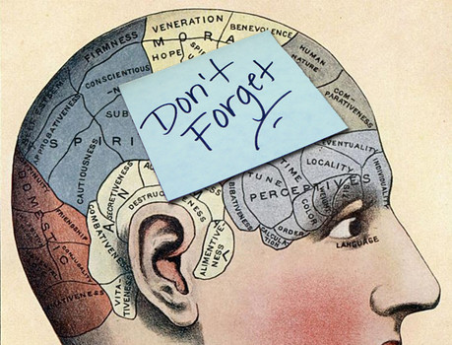
What is Memory?
Any indication that learning has persisted over time.
Notes:
OBJECTIVE 1| Define memory, and explain how flashbulb memories differ from other memories.

Slide 3
Stages of Memory

Slide 4
Information Processing
The Atkinson-Schiffrin (1968) three-stage model of memory…
Notes:
OBJECTIVE 2| Describe Atkinson-Schiffrin’s classic three-stage model of memory and explain how contemporary model of working memory differs.

Slide 5
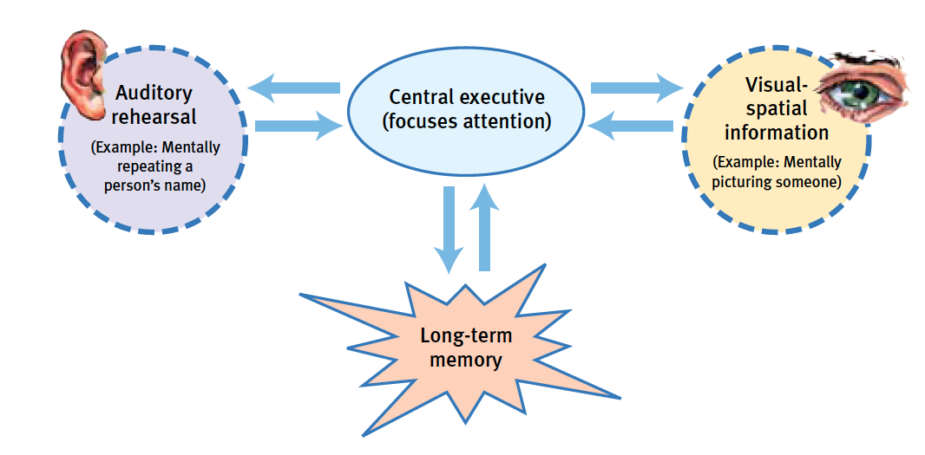
Working Memory
Baddeley’s model of working memory…

Slide 6
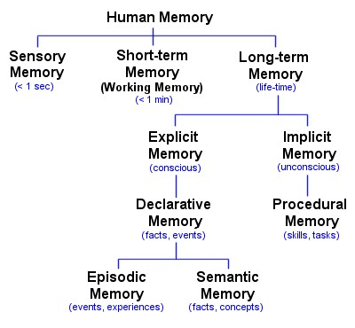
Types of Memory

Slide 7
Types of Processing
Spencer Grant/ Photo Edit
Notes:
OBJECTIVE 4| Contrast effortful processing with automatic processing, and discuss the next-in-line effect, the spacing effect and the serial position effect.

Slide 8
Types of Encoding
Visual
Acoustic
Semantic

Slide 9
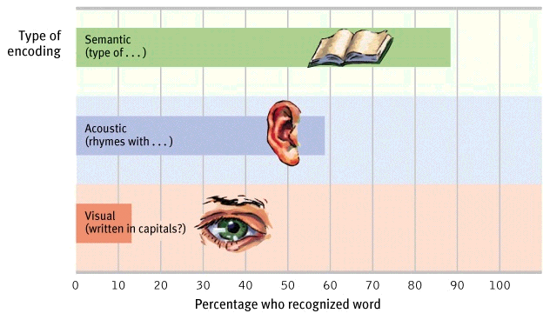
Which type of encoding lasts the longest?

Slide 10
Visual + Semantic = Strong Encoding
Images combined with semantic encoding can lead to strong memories.
Both photos: Ho/AP Photo
Notes:
OBJECTIVE 6| Explain how encoding imagery aids effortful processing, and describes some memory-enhancing strategies that use visual encoding.

Slide 11
Techniques to Aid Encoding
Mnemonics = Memory aids
Method of Loci
Link Method
Chunking
Hierarchies

Slide 12
Encoding Summarized in a Hierarchy

Slide 13
Encoding and Studying
Rehearsal – repetition of info
Hermann Ebbinghaus
Spacing Effect – retaining info better due to distributed rehearsal
Testing Effect – better retention due to quizzing yourself instead of rehearsing
Self-Reference Effect – better retention of info if it relates to you

Slide 14
Sensory Memories
The duration of sensory memory varies for the different senses.
Iconic
0.5 sec. long
Echoic
3-4 sec. long
Haptic
< 1 sec. long

Slide 15
Memory Stores
Feature | Sensory Memory | Working Memory | LTM
Capacity | Unlimited | 7±2 Items | Unlimited
Duration | ¼ - 4 sec. | 20 sec. | Years

Slide 16
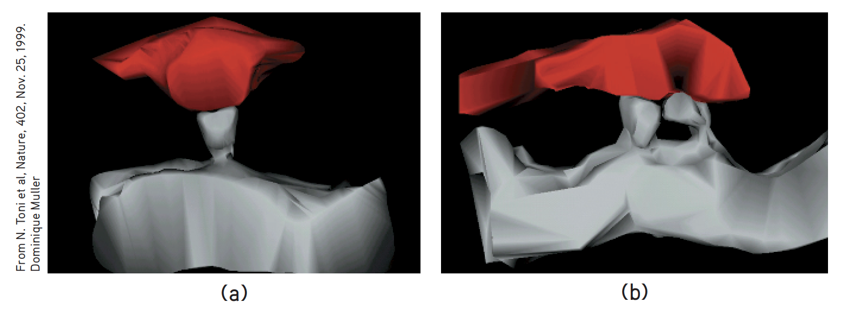
Synaptic Changes
Long-Term Potentiation (LTP) = synaptic enhancement after learning (Lynch, 2002).
An increase in neurotransmitter release or receptors on the receiving neuron indicates strengthening of synapses.

Slide 17
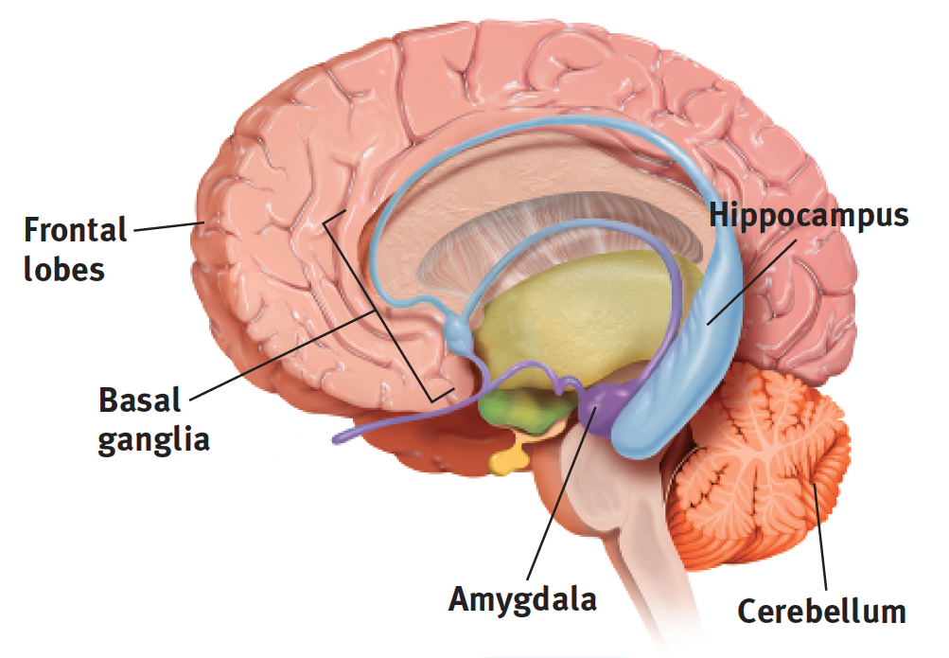
Key Memory Structures in The Brain
Frontal lobes and hippocampus: explicit memory formation
Cerebellum and basal ganglia: implicit memory formation
Amygdala: emotion-related memory formation

Slide 18
Stress Hormones & Memory
Heightened emotions make for stronger memories.
Prolonged stress can disrupt memory.
Notes:
OBJECTIVE 12| Discuss some ways stress hormones can affect memory.

Slide 19
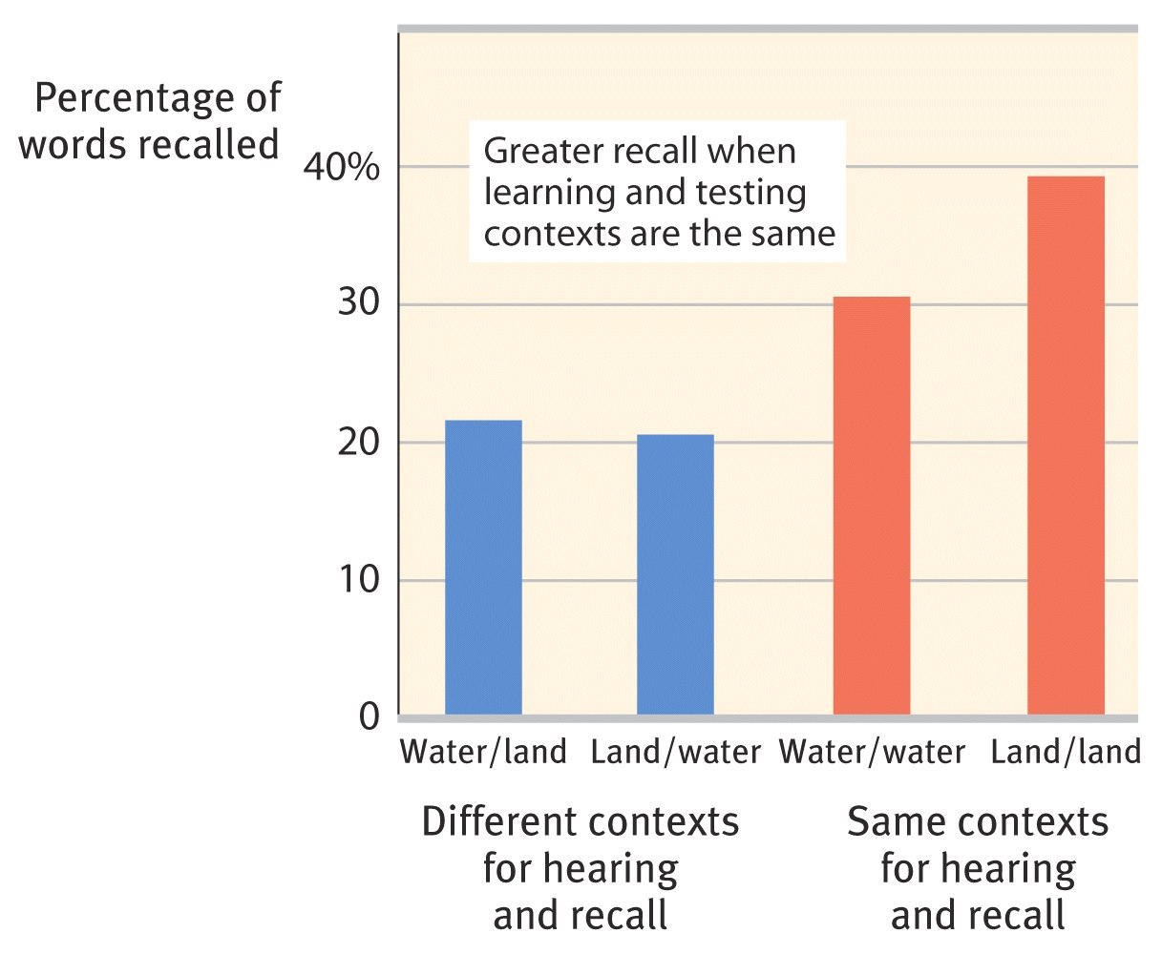
Memory Retrieval
Context-dependent memory
Improved recall of information when the context present at encoding and retrieval are the same
Encoding specificity principle
Suggests cues and contexts specific to a particular memory will be most effective in helping recall

Slide 20
Retrieval
State-dependent memory
We recall memories best in the mental state we created them
Mood-congruent memory
We remember experiences consistent with our current mood
Serial position effect
Tendency to recall the last (recency effect) and first (primacy effect) items in lists

Slide 21
Context Effects
Notes:
OBJECTIVE 16| Cite some ways that context can affect retrieval.

Slide 22
Amnesia
Anterograde Amnesia
inability to recall info before a moment
Retrograde Amnesia
inability to recall info after a moment
Anterograde
Amnesia
(HM)
Memory Intact
No New Memories
Surgery

