Slide 1
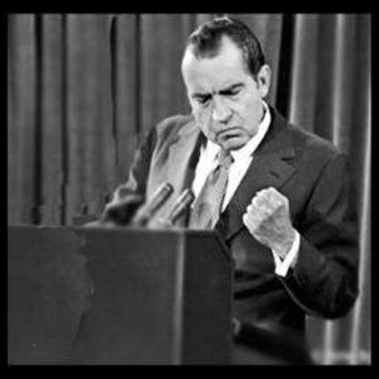
Nixon and the Seventies: Good, Bad, and Everything in Between

Slide 2
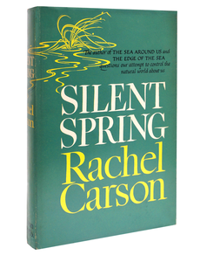
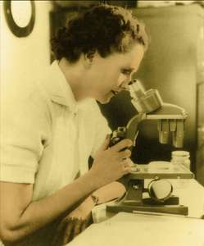
The Rise of Environmentalism
Silent Spring (book) sets off environmentalist movement
Book focuses on dangers of pollutants to ecosystem
1st Earth Day = April 22, 1970
Creates the Environmental Protection Agency (EPA)

Slide 3
Domestic Policies
Can’t get rid of Great Society Programs
Implements “New Federalism”
Lets local govts spend money on welfare programs
Tried to reduce spending on GS programs - unsuccessful

Slide 4
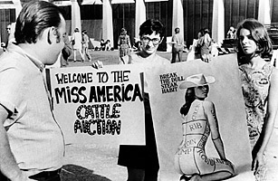
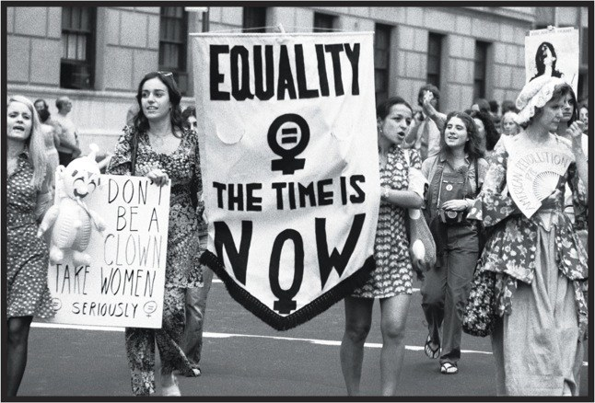
Women’s Rights Gets Attention
Betty Friedan publishes Feminine Mystique in 1962
“The problem that has no name”
National Organization of Women is formed in 1966
Issues of middle class women get attention
Unequal pay
Unfair hiring/firing practices

Slide 5
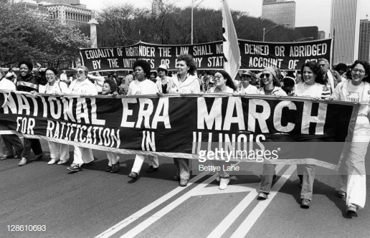
Politics and Women’s Rights
Two Supreme Court decisions expand women’s health rights:
Griswold vs. Connecticut (1964)
Roe vs. Wade (1973)
Women’s rights organizations propose Equal Rights Amendment:
“Equality of rights under the law shall not be denied or abridged by the United States or by any state on account of sex.”
It fails…

Slide 6
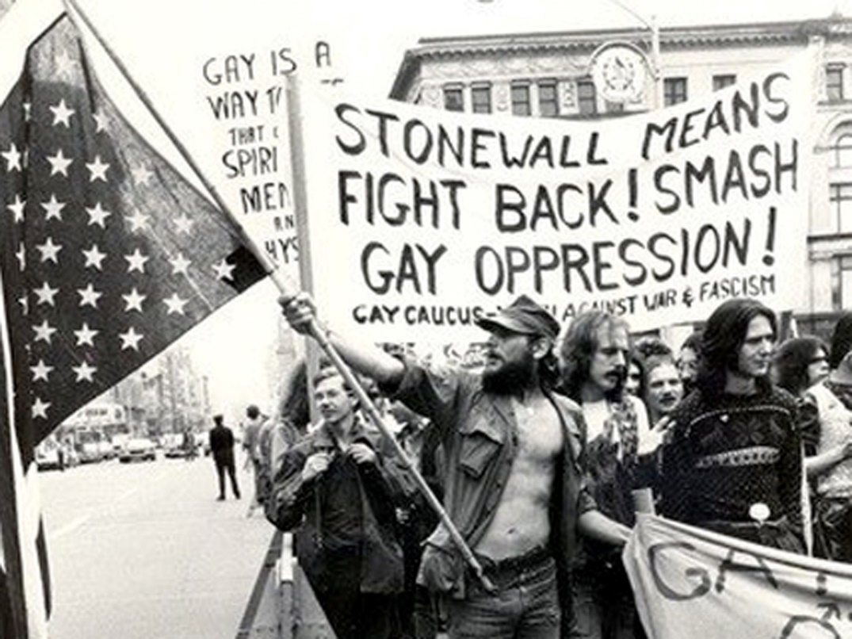
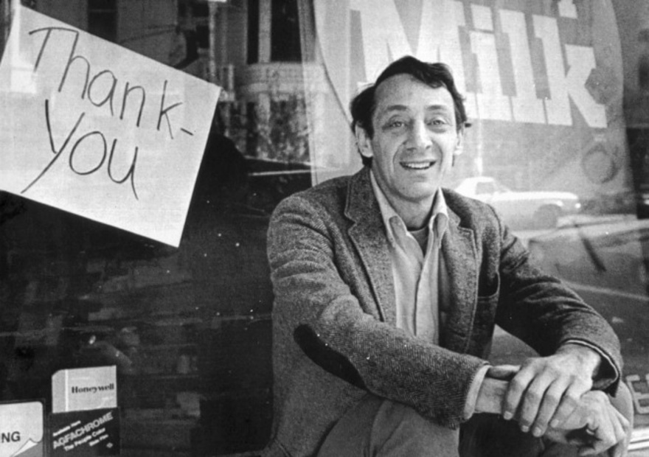
Beginning of the Gay Rights Movement
Prior to the 1970s, homosexuality = mental illness
June 29, 1969 – Cops raid a gay bar in NYC
Patrons of the bar protest for several days
Seen as the beginning of the gay rights movement
1977 – Harvey Milk becomes one of the first openly gay politicians

Slide 7
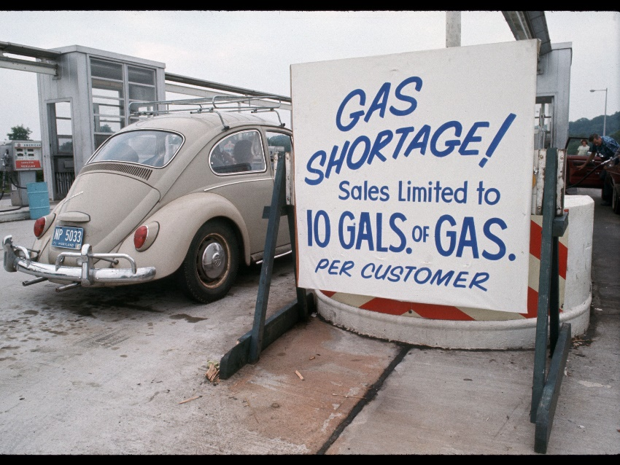
Economic Issues
Stagflation = inflation + stagnant economy
Unemployment rose by late 60s
Inflation high b/c of Vietnam War spending
Vietnam War still not over
1973 – OPEC puts oil embargo on US
OPEC = Org. of Petroleum Exporting Countries

Slide 8
Election of 1972
Nixon has advantages:
Foreign policy successes
Economy = better than earlier in his term
Weak opponents
Democrats go with a more liberal candidate than in 1968
George Wallace runs again as 3rd Party
Nixon still nervous about losing

Slide 9
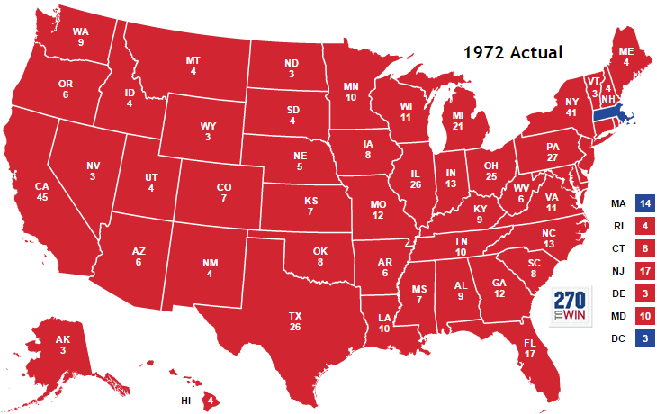
1972 Election Results

