Slide 1
Psychotherapies…continued
Behavior, Cognitive-Behavior, Group, and Family Therapy

Slide 2
Topics for today
How behavior and cognitive-behavior therapists:
View the cause of a disorder
Treat patients
Specific techniques for each perspective
Multi-person therapy
Group therapy
Family therapy
Is psychotherapy effective?

Slide 3
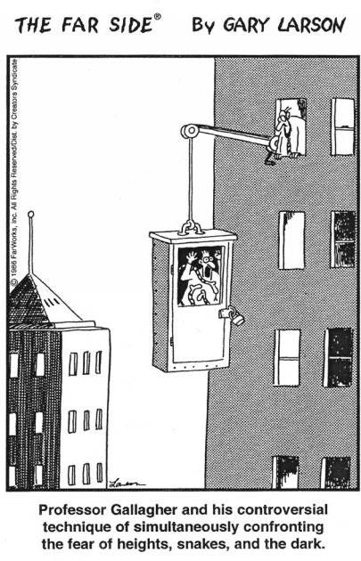
Behavior Therapy
Cause of illness:
Maladaptive behavior
Overall method to treat patient:
Change maladaptive behaviors
“Confronting your fears”

Slide 4
Behavior Therapy - Techniques
Classical Conditioning
Operant Conditioning
Counterconditioning
Exposure therapy
Systematic desensitization
VR exposure therapy
Flooding
Aversive conditioning
Token economies
Contracts

Slide 5
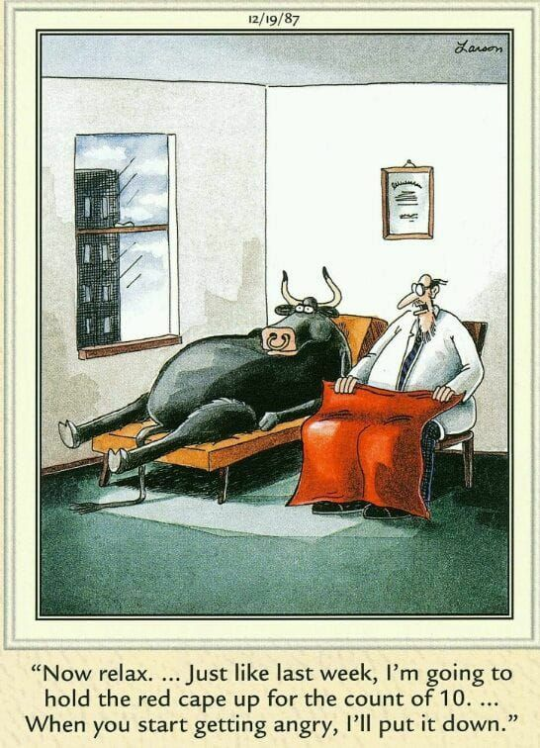
Which form of behavior therapy is this?

Slide 6
Cognitive-Behavior Therapy (CBT)
Cause of illness:
Maladaptive behavior AND maladaptive thoughts
Overall method to treat patient:
Change maladaptive behaviors
Change the way people think

Slide 7
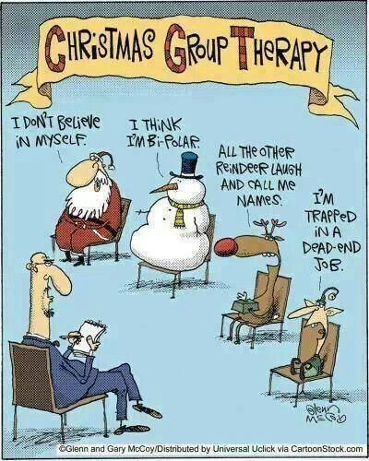
Therapy with Others: Group and Family Therapy
Group Therapy = therapy with strangers
Why would people do this?
Family Therapy = therapy with family
Why would people do this?

Slide 8
Is Psychotherapy Effective?
Patients think it is…
Therapists think it is…
Meta-analysis shows nuanced answer:
Patients who get treatment often get better
People often get better without psychotherapy
So is it effective?

