Slide 1
Reviewing Units 1 - 3
Unit 1 – History, Approaches, and Methods
Unit 2 – Neuroscience
Unit 3 – Developmental Psych.
Flash Lecture: Listen, don’t write stuff down

Slide 2
Early Psych Fields of Psychology
Structuralism → Wundt and Titchener
Functionalism → William James
Psychoanalysis → Sigmund Freud
Behaviorism → John Watson, Pavlov, Skinner
Cognitive Psychology → Jean Piaget
Humanistic Psychology → Rogers and Maslow

Slide 3
Current Psych Perspective
Neuroscience (Biopsychology)
Evolutionary
Behavior Genetics
Psychodynamic
Behavioral
Cognitive
Social-Cultural

Slide 4
Basic Research Subfields
Topics of interest to many different perspectives:
Biology
Human development
Cognition
Personality (formation)
Social Psychology

Slide 5
Psychologist vs Psychiatrist
Differences:
Psychologist – psychotherapy, psychology degree
Psychiatrist – psychotherapy and biomedical therapies, medical degree

Slide 6
Scientific Method
Theory
Hypothesis
Research
Adjust Theory
Repeat 1-4

Slide 7
Descriptive Research
It describes, it doesn’t explain (cause and effect)
Survey
Naturalistic Observation
Case Study

Slide 8
Correlational Studies
REMEMBER, correlation DOES NOT equal causation
Scatterplots and correlation coefficients
Perfect negative
correlation (-1.00)
No relationship (0.00)
Perfect positive
correlation (+1.00)

Slide 9
Experimentation
Shows cause and effect
Parts:
Operational Definition
Independent Variable
Dependent Variable
Random Sampling (also for descriptive research)
Control Group
Experimental Group
Random Assignment

Slide 10
Controls
Prevent Bias
Examples:
Placebos
Placebo Effect
Double-Blind Procedure

Slide 11
Things to avoid in research
False consensus effect
Illusory Correlations
Confounding variables
Biases:
hindsight, confirmation, researchers’, belief, self-serving, sampling biases

Slide 12
Stats
Measures of Central Tendency (3 Ms)
Measures of Variation (Range and Standard Deviation)
Statistical Significance -> results are legit, not caused by random chance

Slide 13
Ethics
For experimenting on people:
Informed consent
Protect from harm
Confidentiality
Explain research afterwards

Slide 14
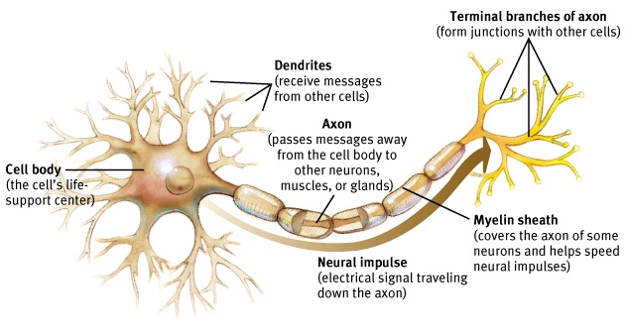
The Neuron

Slide 15
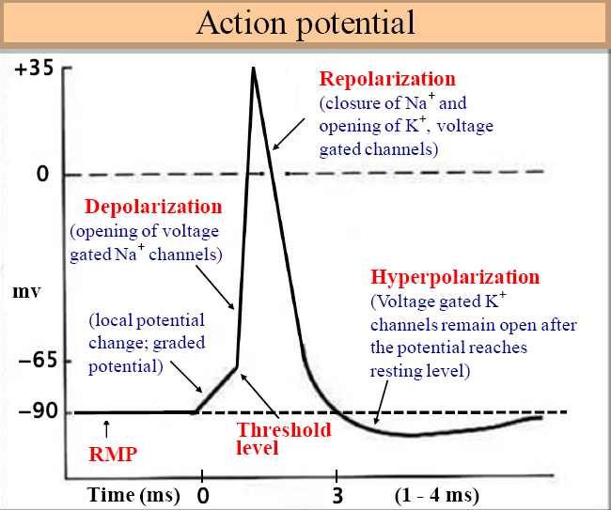
Firing a neuron

Slide 16
Neurotransmitters
ACh – Muscle AChion – lack = Alzheimer’s
Dopamine – excess = schizo, lack = Parkinson’s
Serotonin – mood, sleep – Prozac/SSRIs
Norepinephrine – arousal – lack = depression
GABA – inhibitory – lack = seizures, insomnia
Glutamate – excitatory – excess = migraines
Agonists – mimic nt
antagonists – block nt site

Slide 17
Types of Neurons
Sensory (Afferent)
Motor (Efferent)
Interneurons

Slide 18
The Nervous System
Nervous
system
Peripheral
Central
(brain and
spinal cord)
Autonomic (controls
self-regulated action of
internal organs and glands)
Somatic (controls
voluntary movements of
skeletal muscles)
Sympathetic
(arousing)
Parasympathetic
(calming)

Slide 19
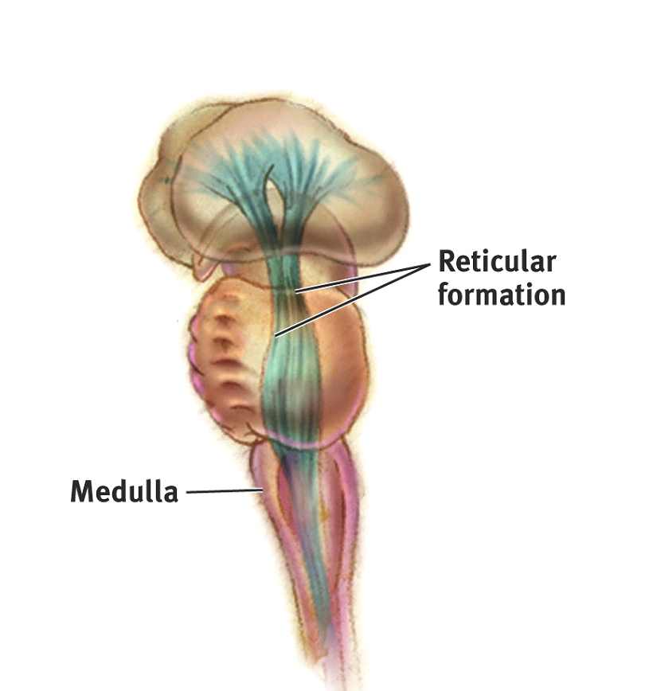
Brainstem
Pons---------→

Slide 20
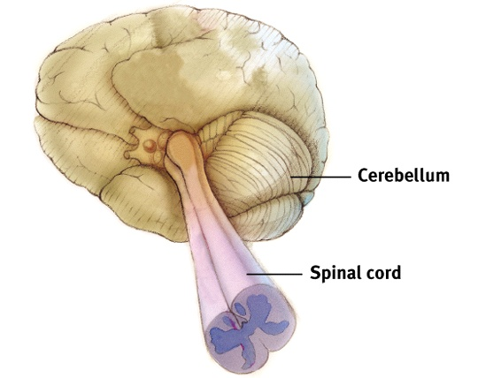
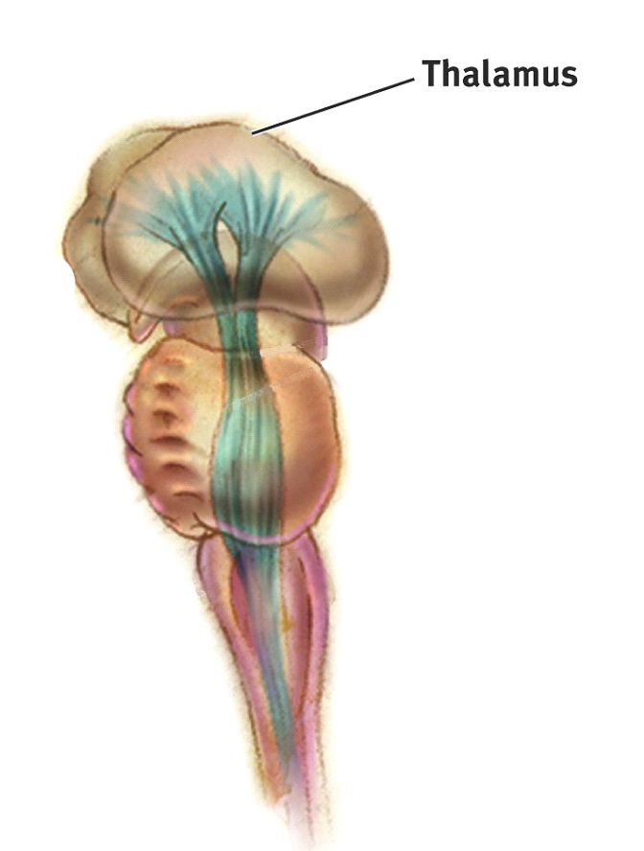
Thalamus and Cerebellum

Slide 21
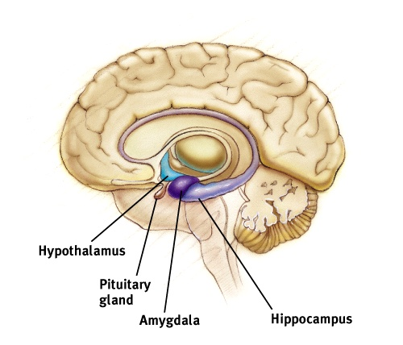
Limbic System

Slide 22
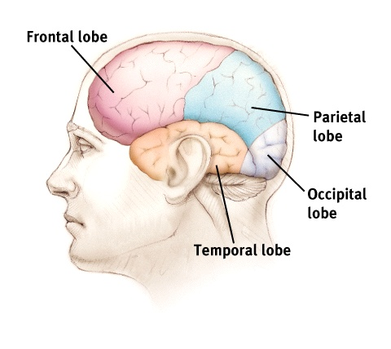
Cerebral Cortex

Slide 23
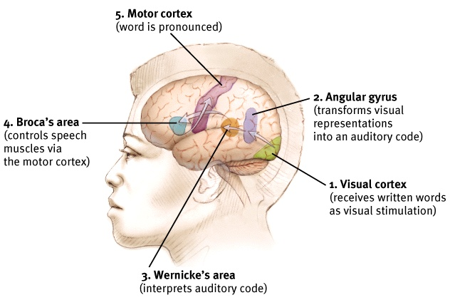

Slide 24
Superhero Assignment
Frontal Lobe
Parietal Lobe
Occipital Lobe
Temporal Lobe
Hippocampus
Amygdala
Hypothalamus
Pituitary Gland
Cerebellum

Slide 25
Prenatal Development and the Newborn
Zygote > Embryo > Fetus
Watch out for teratogens during pregnancy
Maturation
Rooting reflex
Stranger Anxiety

Slide 26
Harlow, Attachment, Parenting
Harlow Monkey studies
physical contact huge for attachment
Attachment
secure, avoidant, and anxious/ambivalent
Parenting:
Authoritarian, Permissive, Authoritative

Slide 27
Cognitive Development
Jean Piaget
Schema, Accommodation, Assimilation

Slide 28
Piaget’s Stages of Cognitive Development
Typical Age
Range
Description
of Stage
Developmental
Phenomena
Birth to nearly 2 years
Sensorimotor
Experiencing the world through
senses and actions (looking,
touching, mouthing)
Object permanence
Stranger anxiety
About 2 to 6 years
Preoperational
Representing things
with words and images
but lacking logical reasoning
Pretend play
Egocentrism
Language development
About 7 to 11 years
Concrete operational
Thinking logically about concrete
events; grasping concrete analogies
and performing arithmetical operations
Conservation
Mathematical transformations
About 12 through
adulthood
Formal operational
Abstract reasoning
Abstract logic
Potential for moral reasoning

Slide 29
Kohlberg’s Moral Ladder
Postconventional
level
Morality of abstract
principles: to affirm
agreed-upon rights and
personal ethical principles
Conventional
level
Morality of law and
social rules: to gain
approval or avoid
disapproval
Preconventional
level
Morality of self-interest:
to avoid punishment
or gain concrete rewards

Slide 30
Erikson’s Psychosocial Developmental Stages
Infancy (1st yr) – Trust vs Mistrust
Toddler (2nd yr) – Autonomy vs Shame
Preschooler (3-5) – Initiative vs Guilt
Elementary (6-puberty) – Competence vs Inferiority
Adolescence (teens to 20s) – identity vs role confustion
Young Adult (20s to early 40s) – intimacy vs isolation
Middle Adult (40s to 60s) – generativity vs stagnation
Late Adult (60s to dead) – integrity vs despair

Slide 31
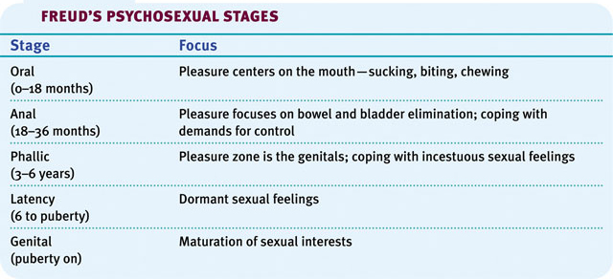
Freud’s Personality Development Stages
Id, Superego, Ego

