Slide 1
Reviewing Units 4 and 5
Unit 4 – Sensation and Perception
Unit 5 – Learning/Behavior
Flash Lecture: Listen, don’t write stuff down

Slide 2
Sensing
Absolute Threshold – 50%
Subliminal
Difference Threshold (JND)
Weber’s Law
Light – 8%
Sound – 2%
Tone – 3%
Signal Detection Theory – background noise

Slide 3
Waves
Light and Sound = Waves
Light Sound
Amplitude Brightness Loudness
Wavelength Hue Pitch

Slide 4
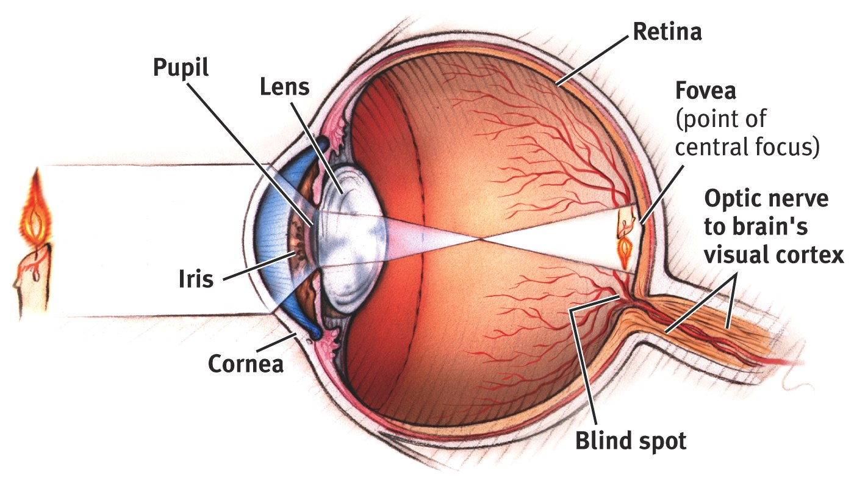
Eyeball!

Slide 5
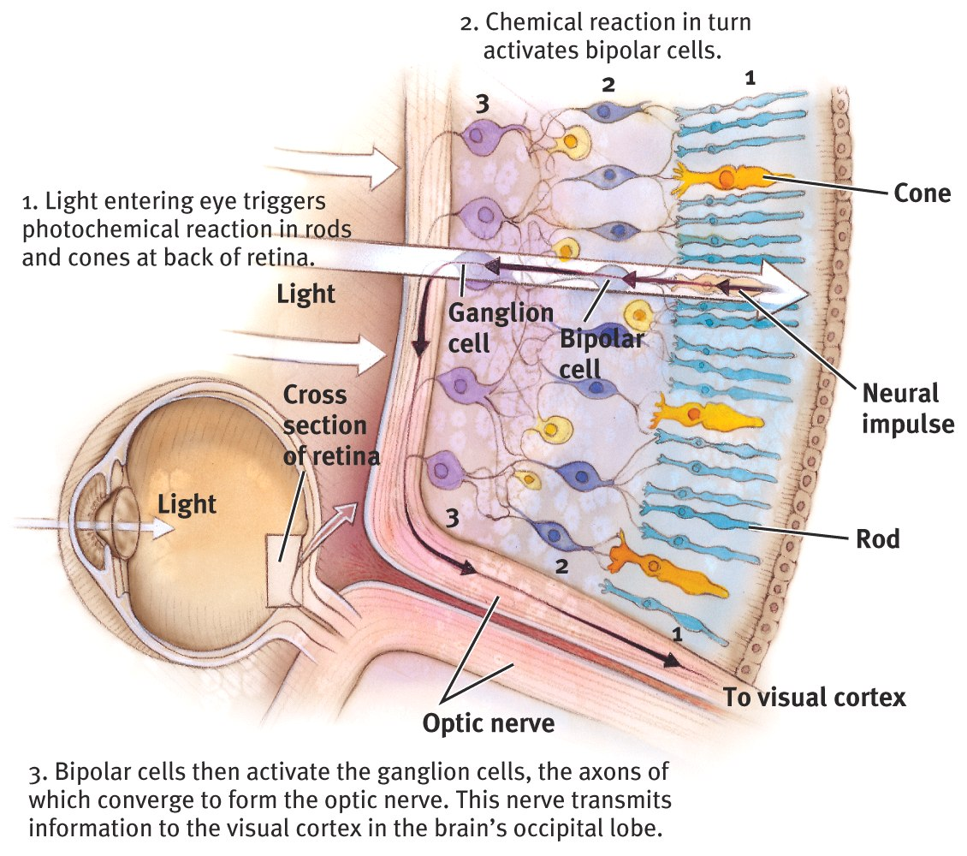
Phototransduction and Photoreceptors

Slide 6
Aspects of Vision
Feature Detectors
Color Vision
Young-Helmholtz Trichromatic Theory
Opponent-Processing Theory
Phi Phenomenon – “moving” lights

Slide 7
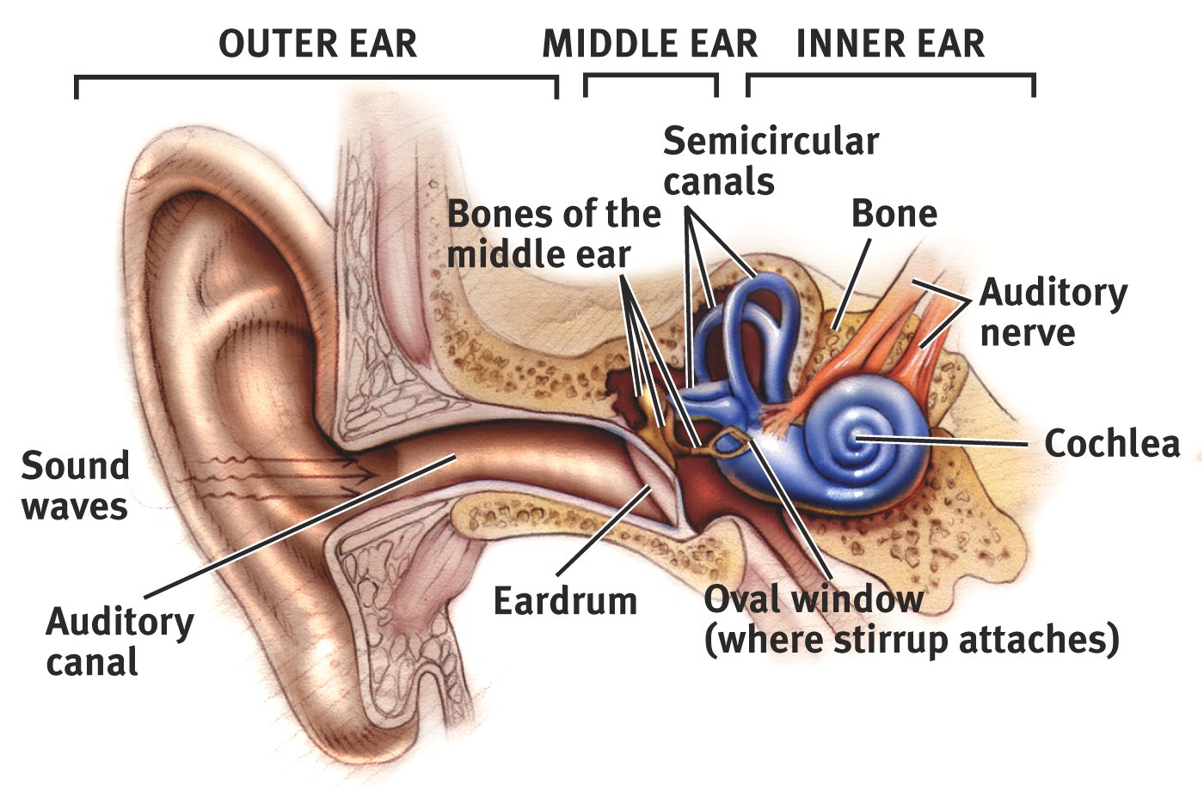
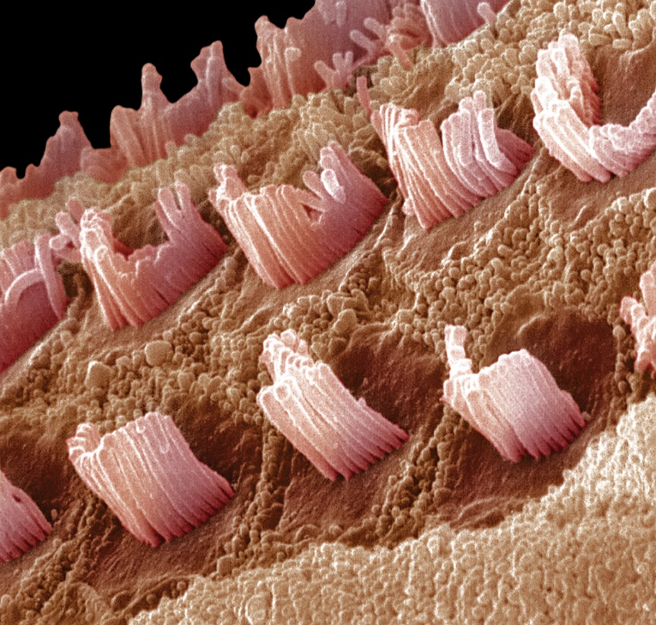
The Ear!

Slide 8
Hearing
Hearing pitch
Place Theory – place on basilar membrane
Frequency Theory – rate of neural impulses
Hearing Loss
Conduction – mechanical problem
Sensorineural – nerve problem

Slide 9
Other senses
Taste
Papillae
Sweet, salty, sour, bitter, umami
Touch
pressure, temperature (heat and cold), pain
Gate-Control Theory: control the pain
Smell
molecule > olfactory receptor cell > olfactory bulb

Slide 10
Other (kinda) senses
Kinesthetic Sense – where are your limbs?
Vestibular Sense - balance

Slide 11
Perceiving
Top-Down Processing
Bottom-Up Processing
Gestalt Rules
proximity, continuity, closure, similarity
Constancy
color, size, shape, brightness

Slide 12
Depth
Monocular Cues
Linear perspective
Interposition
Relative size, height, clarity, and motion
Texture gradient
Shadow
Binocular Cues
Retinal disparity
Convergence

Slide 13
Sensation and Perception
Sensory Adaptation
Do you know what you smell like?
Perceptual Adaptation
Why doesn’t everything change when the room gets darker?
Perceptual Set
You see what you expect to see

Slide 14
Types of Learning
Classical Conditioning – John Watson, Ivan Pavlov, John Garcia
Operant Conditioning – BF Skinner
Observational Learning – Albert Bandura

Slide 15
Classical vs Operant Conditioning
Both involve associating things, but it’s what is being associated and the complexity of the behavior:
Classical Conditioning
Associating 2 stimuli
Basic behaviors
Operant Conditioning
Associating behavior with a consequence
Complex behaviors

Slide 16
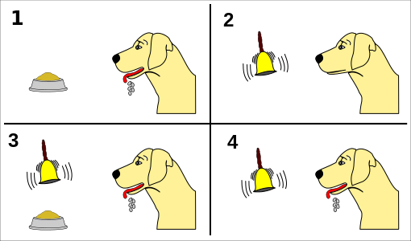
Classical Conditioning
NS
US
UR
CS
CR

Slide 17
Operant Conditioning
Shaping
Reinforcement
Positive
Negative
Punishment
Positive
Negative

Slide 18
Types of Reinforcers
Primary vs Secondary
Immediate vs Delayed

Slide 19
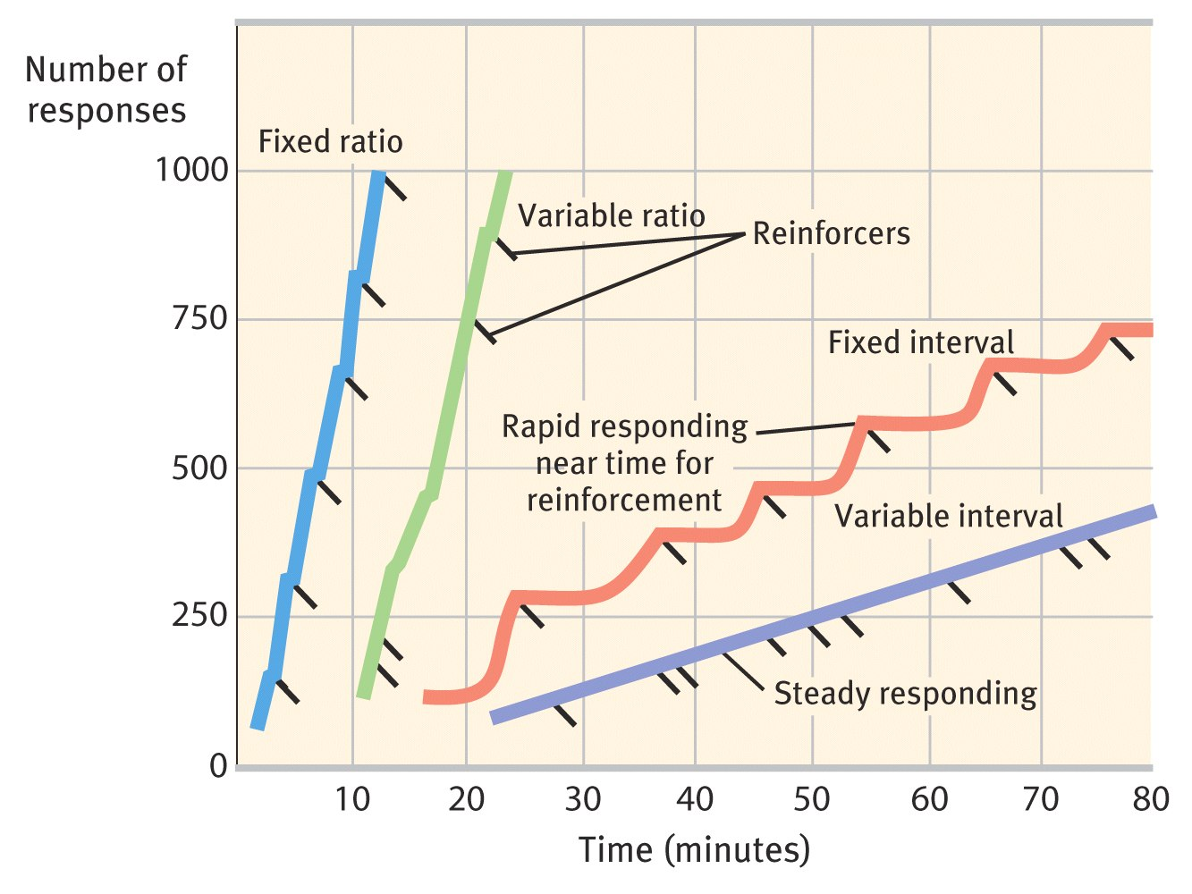
Reinforcement Schedules

