Slide 1
Sensation
Chapter 5

Slide 2

Thresholds
Absolute Threshold = min. intensity to detect stimulus 50% of the time
Subliminal Threshold = stimulus intensity less than absolute threshold
Difference Threshold = min. intensity needed to detect stimulus 50% of the time
Proportion of “Yes” Responses
0.00 0.50 1.00
0 5 10 15 20 25
Stimulus Intensity (lumens)
Notes:
OBJECTIVE 2| Distinguish between absolute and difference thresholds, and discuss whether we can sense stimuli below our absolute thresholds and be influenced by them.

Slide 3
Weber’s Law
Two stimuli must differ by a constant minimum percentage (rather than a constant amount), to be perceived as different.
Stimulus | Constant (k)
Light | 8%
Weight | 2%
Tone | 3%

Slide 4

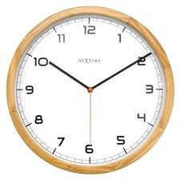
Signal Detection Theory (SDT)
Absolute thresholds are relative to the environment and mental state

Slide 5
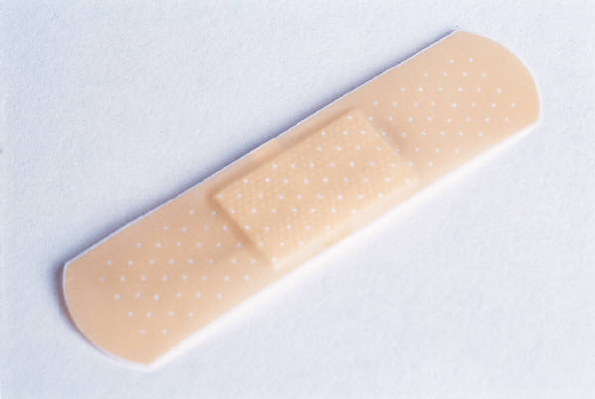
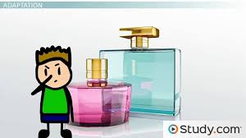
Sensory Adaptation
Are you still wearing clothes?
Put a band aid on your arm and after awhile
you don’t sense it.
What do you smell like?
Notes:
OBJECTIVE 3| Describe sensory adaptation, and explain how we benefit from being unaware of changing stimuli.

Slide 6

Selective Attention
Our attention is finite.
We have difficulty focusing well on more than one stimulus at a time.
Necker Cube
Notes:
OBJECTIVE 1| Describe the interplay between attention and perception.

Slide 7
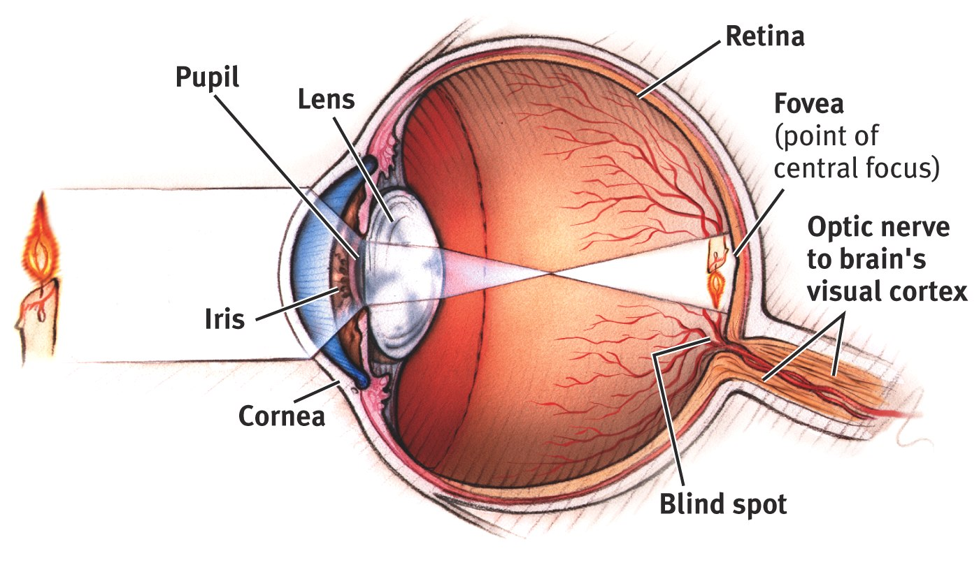
The Eye
Notes:
OBJECTIVE 5| Describe the major structure of the eye, and explain how they guide the incoming ray of light toward the eye’s receptor cells.

Slide 8
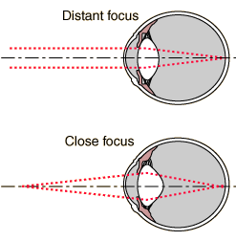
Focusing on Distance
Accommodation: changing the shape of the lens to see at different distances.

Slide 9
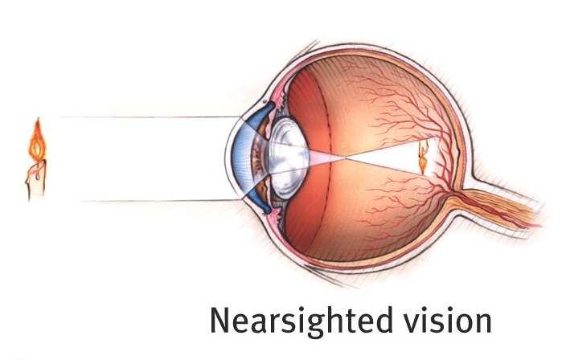
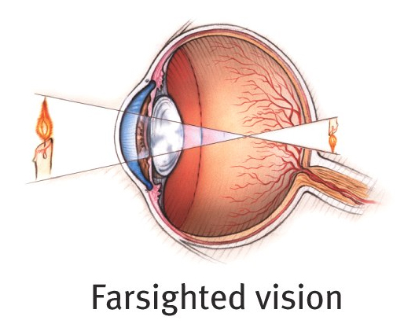
The Lens
Nearsightedness: you can see near objects, but not far ones
Farsightedness: you can see far objects, but not near ones

Slide 10
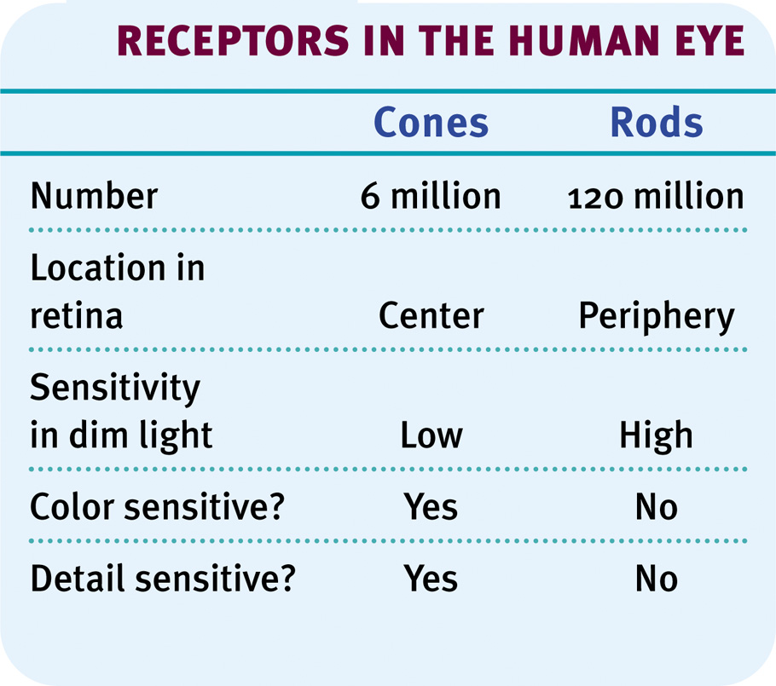
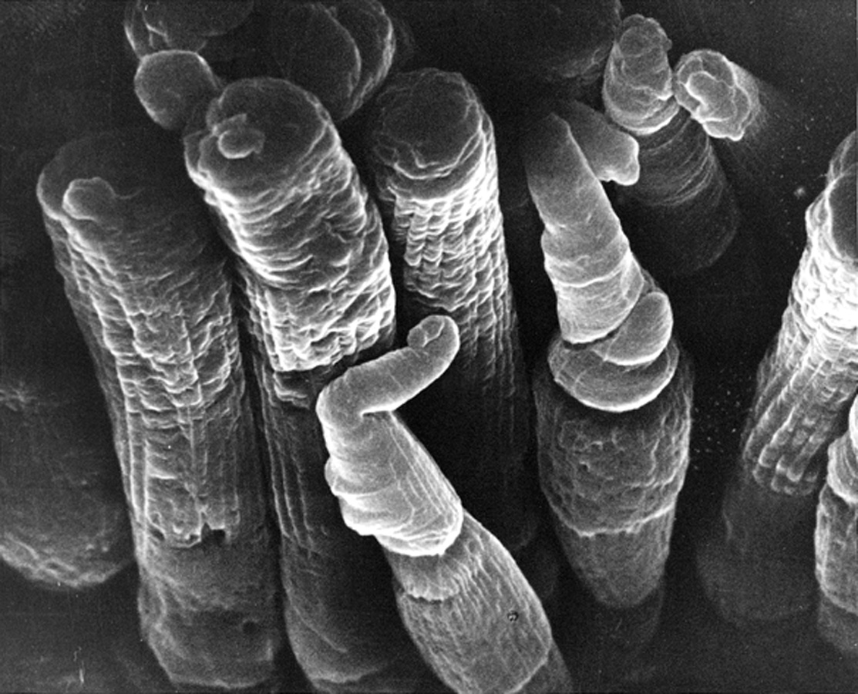
Photoreceptors
E.R. Lewis, Y.Y. Zeevi, F.S Werblin, 1969

Slide 11
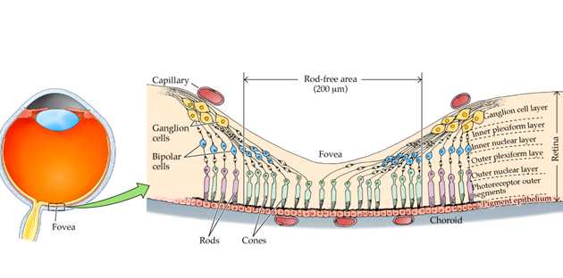
The Fovea

Slide 12
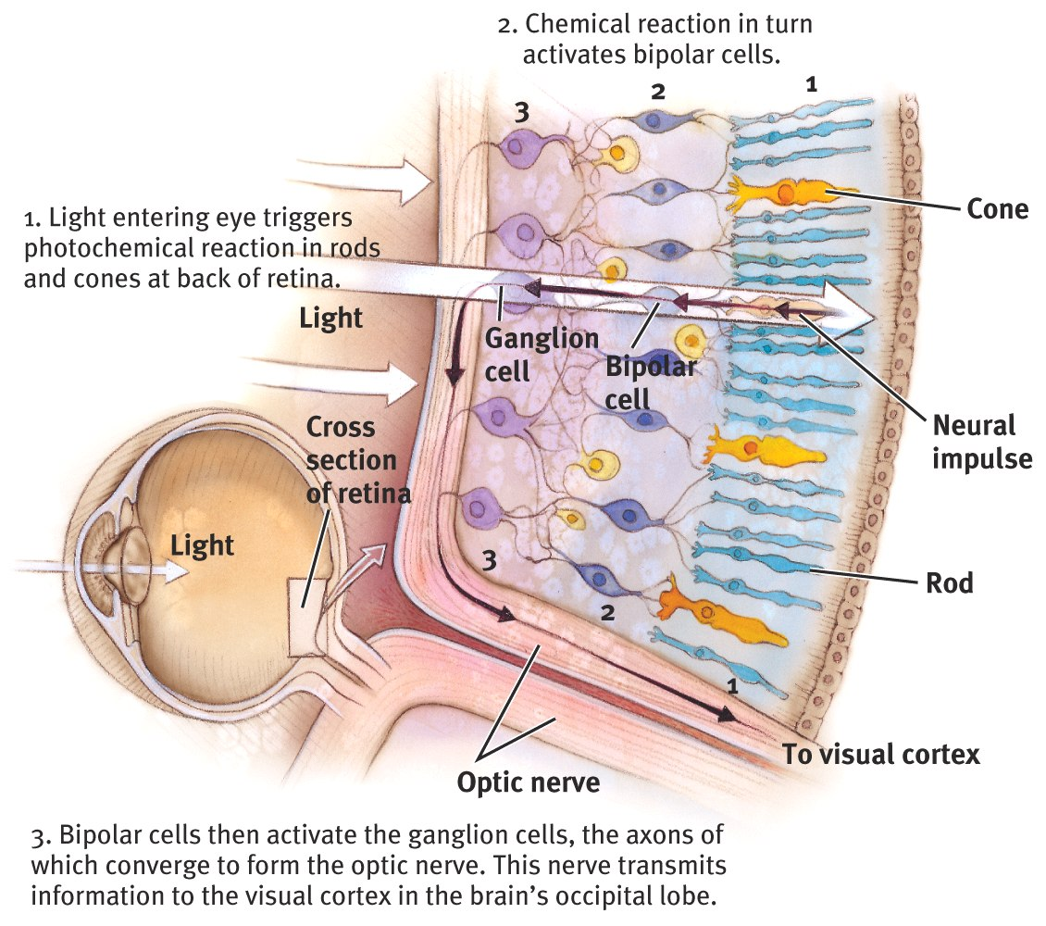
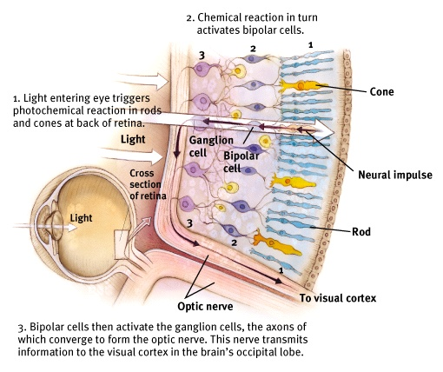
Bipolar & Ganglion Cells
Rods/Cones send >>> Bipolar Cells >>> Ganglion Cells>>>Optic Nerve

Slide 13
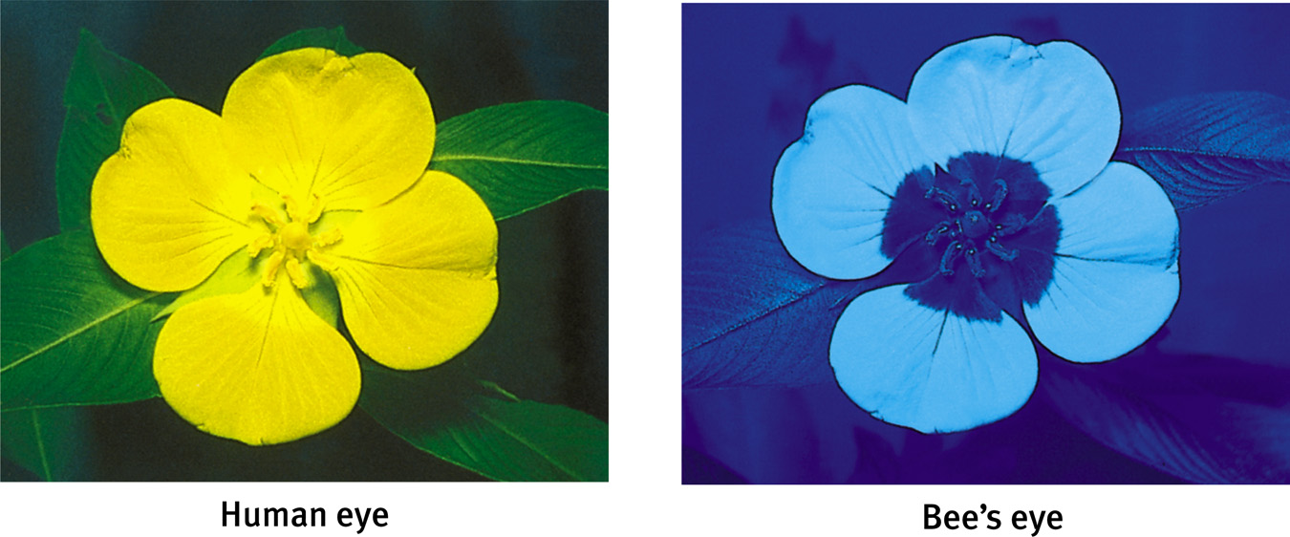
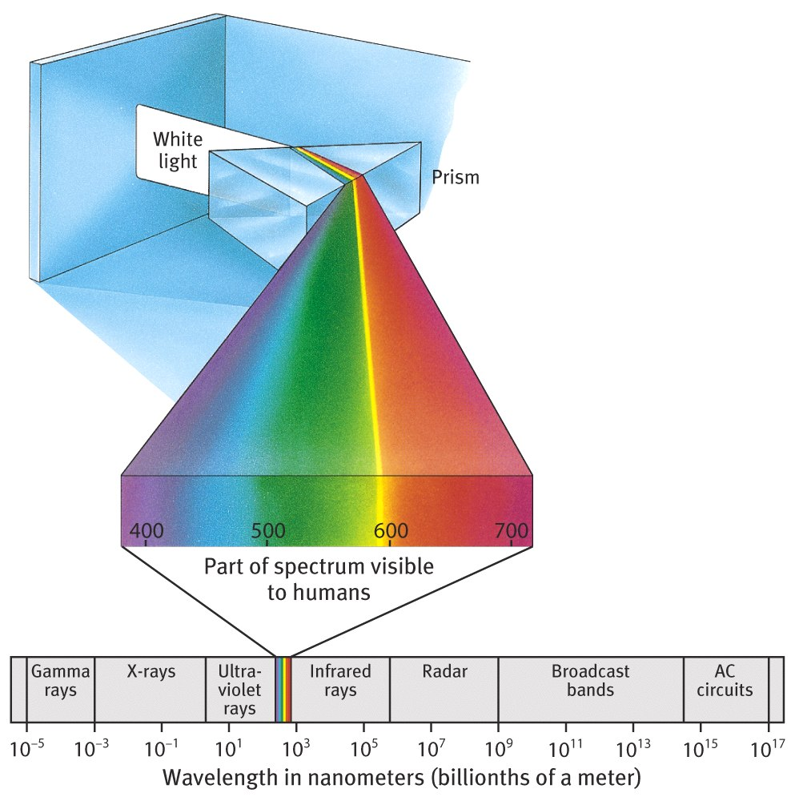
The Stimulus Input: Light Energy
Visible
Spectrum

Slide 14
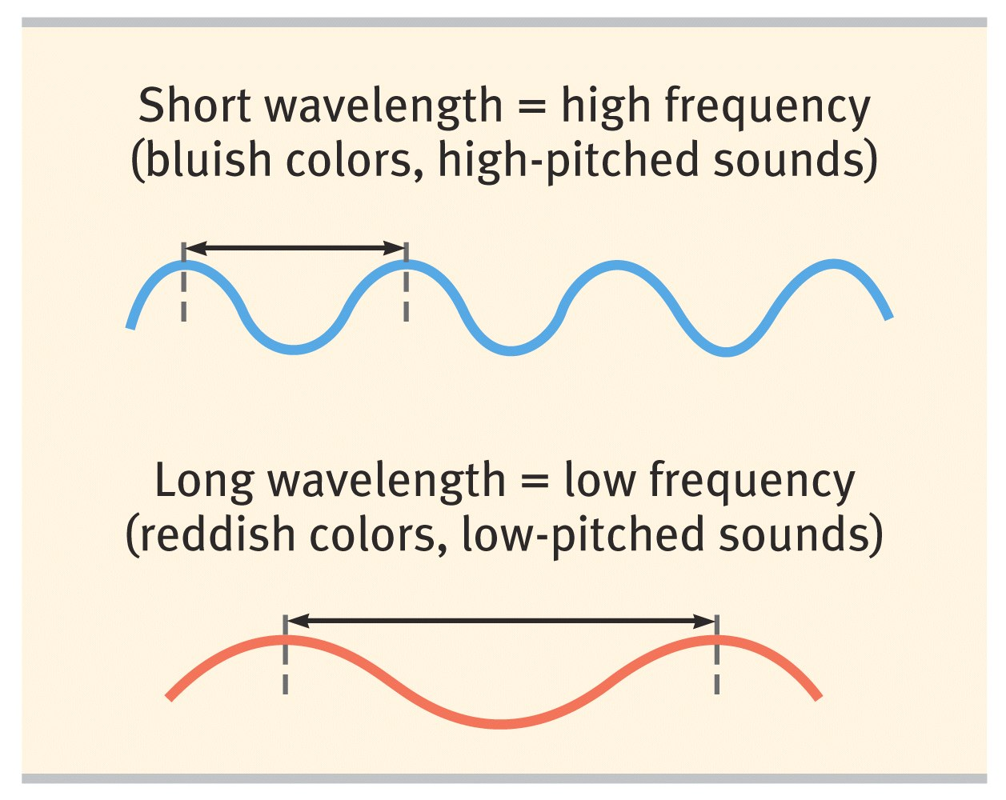
Seeing Hue (Color)

Slide 15
ROY G BIV
Violet
Indigo
Blue
Green
Yellow
Orange
Red
400 nm
700 nm
Short wavelengths
Long wavelengths

Slide 16
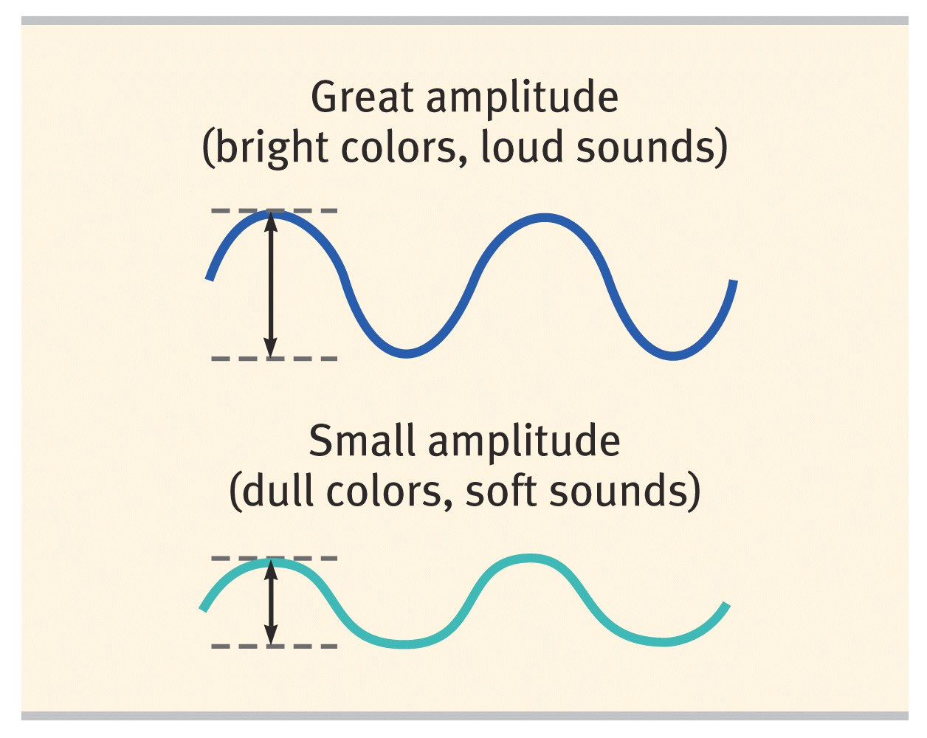
Seeing Brightness (Intensity)

Slide 17
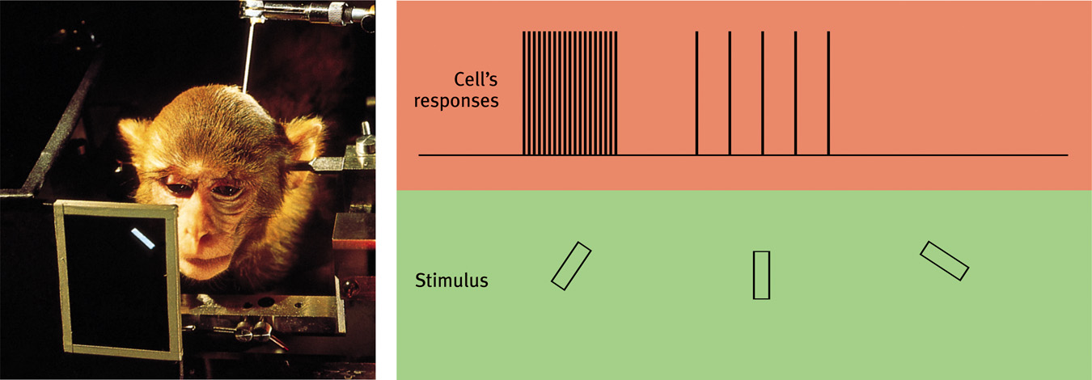
Feature Detection
Nerve cells in the visual cortex respond to specific features, such as edges, angles, and movement.
Ross Kinnaird/ Allsport/ Getty Images

Slide 18
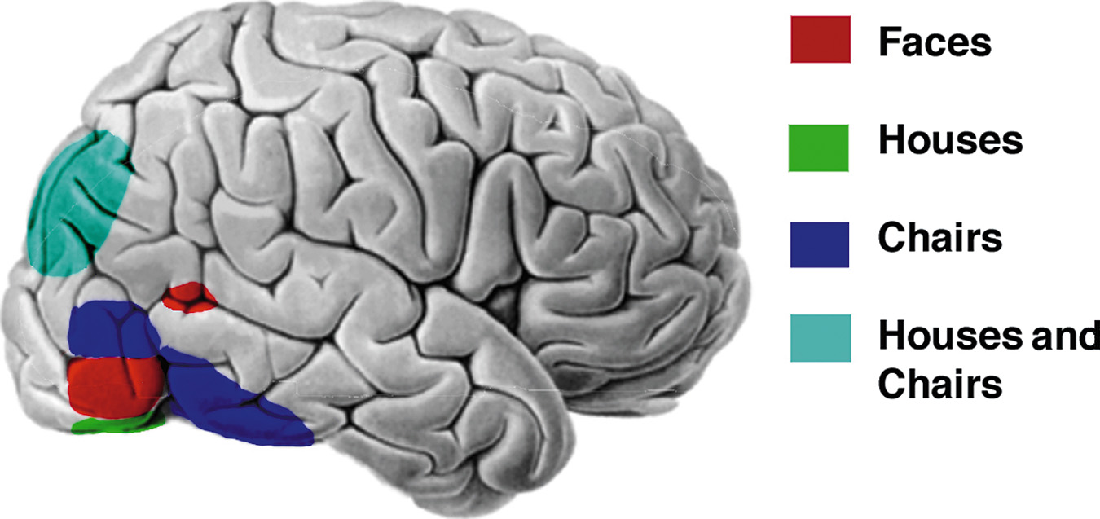
Shape Detection

Slide 19
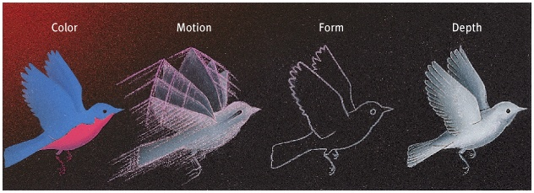
Visual Information Processing
Parallel processing
Notes:
OBJECTIVE 8| Discuss parallel processing and discuss its role in visual processing.

Slide 20
2 Theories of Color Vision
1) Young-Helmholtz Trichromatic theory
The retina contains three photoreceptors that are sensitive to red, blue and green colors.
Blue
Cones
Green
Cones
Red
Cones
Short
wave
Medium
wave
Long
wave

Slide 21
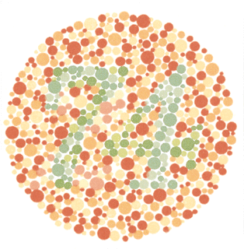
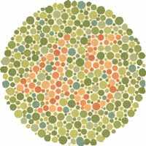
Color Blindness
Most people have difficulty seeing red, green, or both red and green.
Ishihara Test

Slide 22
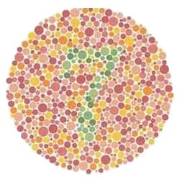

Slide 23
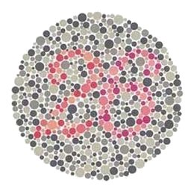

Slide 24
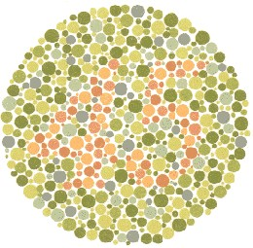

Slide 25
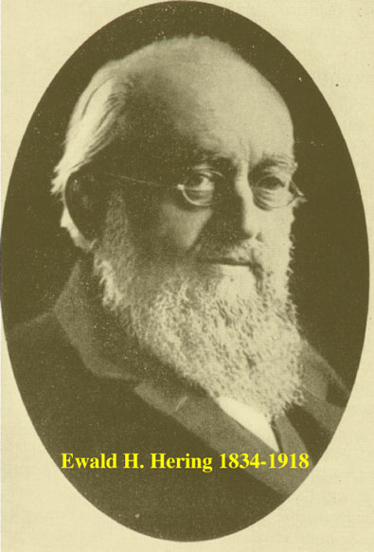
2) Opponent Process Theory
The four primary colors combined in pairs of red-green, blue-yellow, and black-white.
Cones
Retinal
Ganglion
Cells

Slide 26

Opponent Colors
Gaze at the middle of the flag for about 30
seconds then stare at the dot. What are the colors of the after-image?

Slide 27
Frequency (Pitch)
Frequency (pitch): The dimension of frequency determined by the wavelength of sound.
Wavelength: The distance from the peak of one wave to the peak of the next.

Slide 28
Intensity (Loudness)
Intensity (Loudness): Amount of energy in a wave, determined by the amplitude, relates to the perceived loudness.

Slide 29
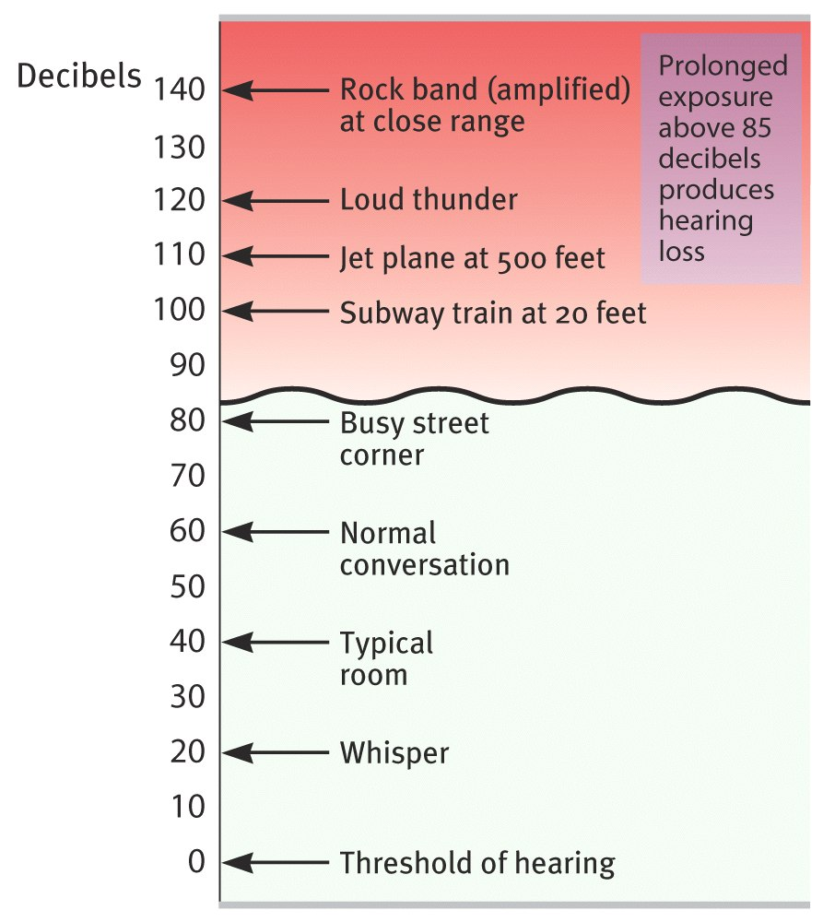


Loudness of Sound
Richard Kaylin/ Stone/ Getty Images
120dB
70dB

Slide 30
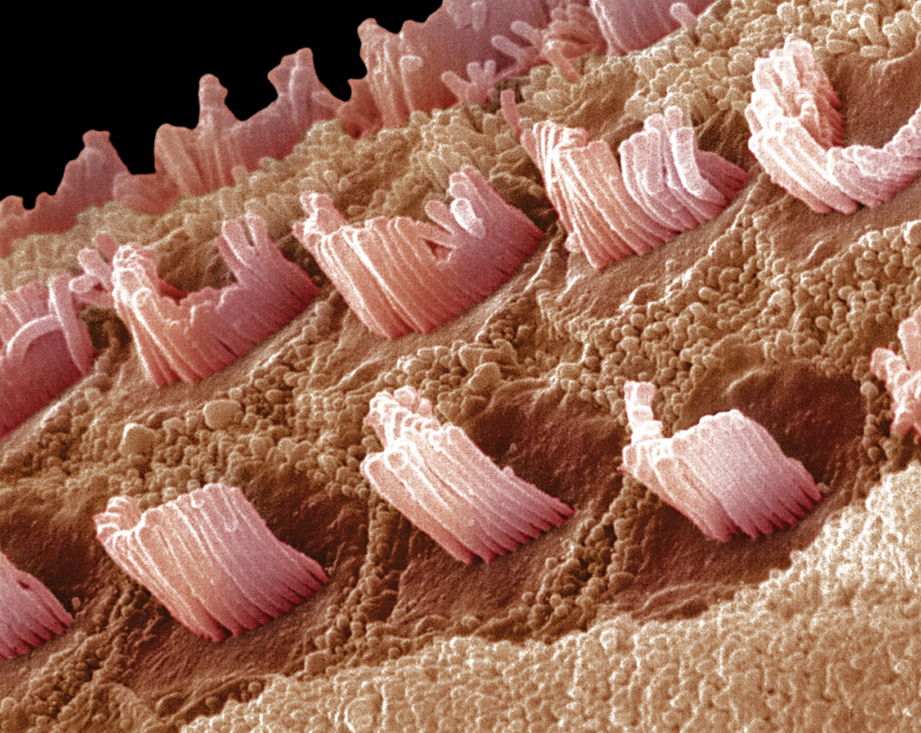
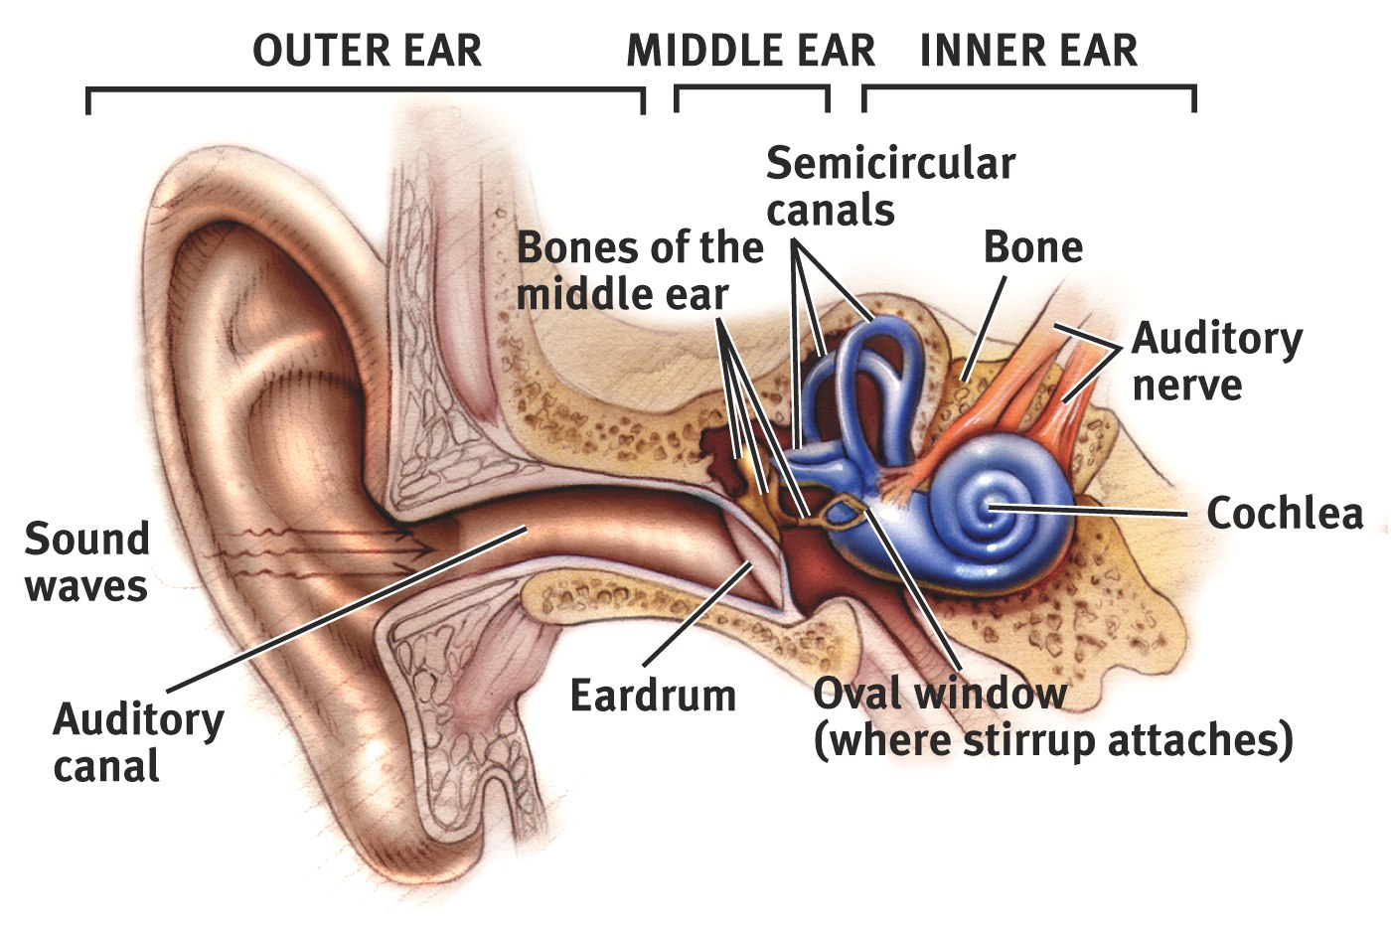
The Ear
Dr. Fred Hossler/ Visuals Unlimited
Notes:
OBJECTIVE 12| Describe the three regions of the ear, and outline the series of events that triggers the electrical impulses sent to the brain.

Slide 31
Hearing Loss
Conduction Hearing Loss: Hearing loss caused by damage to the mechanical system that conducts sound waves to the cochlea.
Sensorineural Hearing Loss: Hearing loss caused by damage to the cochlea’s receptor cells or to the auditory nerve, also called nerve deafness.
Notes:
OBJECTIVE 15| Contrast two types of hearing loss, and describe some of their causes.

Slide 32
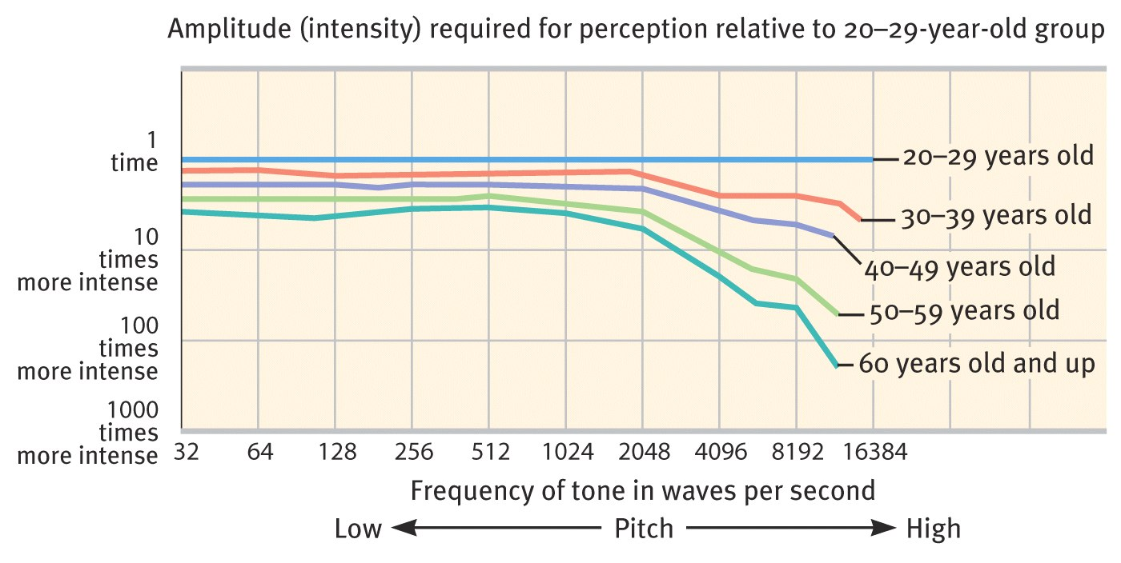
Hearing Deficits
Older people tend to hear low frequencies well but suffer hearing loss when listening for high frequencies.

Slide 33
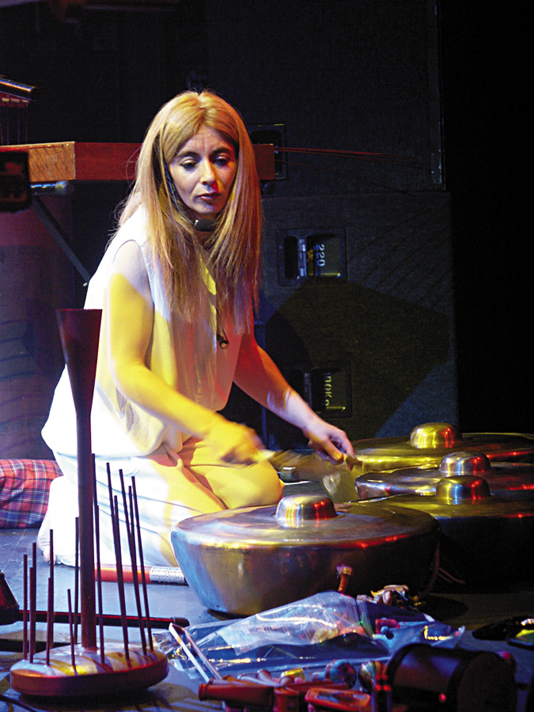
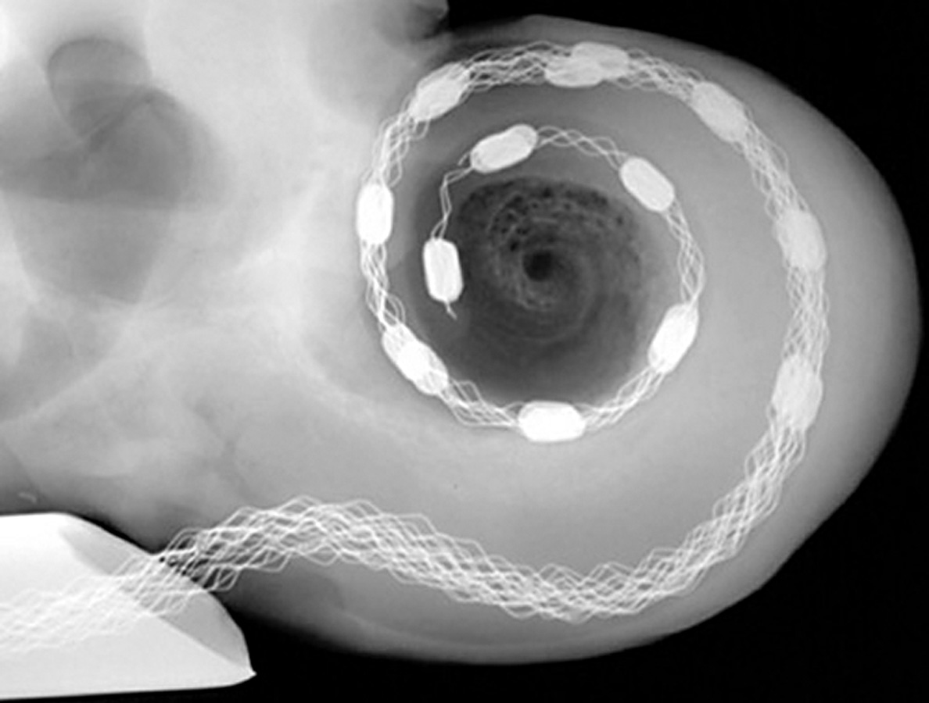
Cochlear Implants
Cochlear implants are electronic devices that enable the brain to hear sounds.
Wolfgang Gstottner. (2004) American
Scientist, Vol. 92, Number 5. (p. 437)
EG Images/ J.S. Wilson ©
Deaf Musician
Cochlear Implant
Notes:
OBJECTIVE 16| Describe how cochlear implants function, and explain why Deaf culture advocates object to these devices. Where these implants are pertinent for hearing parents with deaf children, deaf culture advocate not using them especially on children deafened before learning to speak.

Slide 34
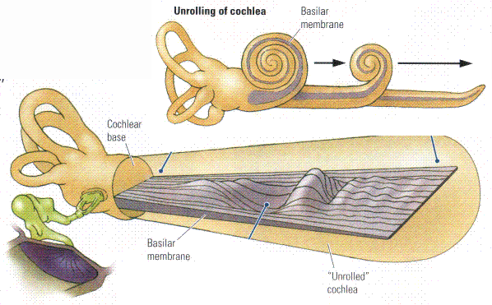
Theories of Audition
Place Theory suggests that sound frequencies stimulate the basilar membrane at specific places resulting in perceived pitch.
Notes:
OBJECTIVE 13| Contrast place and frequency theories, and explain how they help us to understand pitch perception.

Slide 35

Theories of Audition
Frequency Theory states that the rate of nerve impulses traveling up the auditory nerve matches the frequency of a tone, thus enabling us to sense its pitch.
Sound
Frequency
Auditory Nerve
Action Potentials
100 Hz
200 Hz

Slide 36
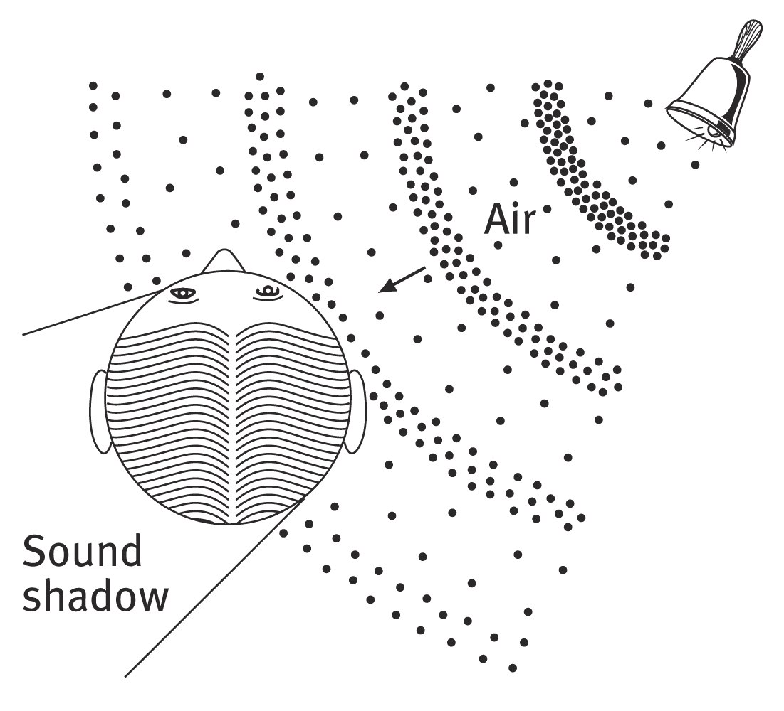
Localization of Sounds
Because we have two ears, sounds that reach one ear faster than the other ear cause us to localize the sound.
Notes:
OBJECTIVE 14| Describe how we pinpoint sounds.

Slide 37
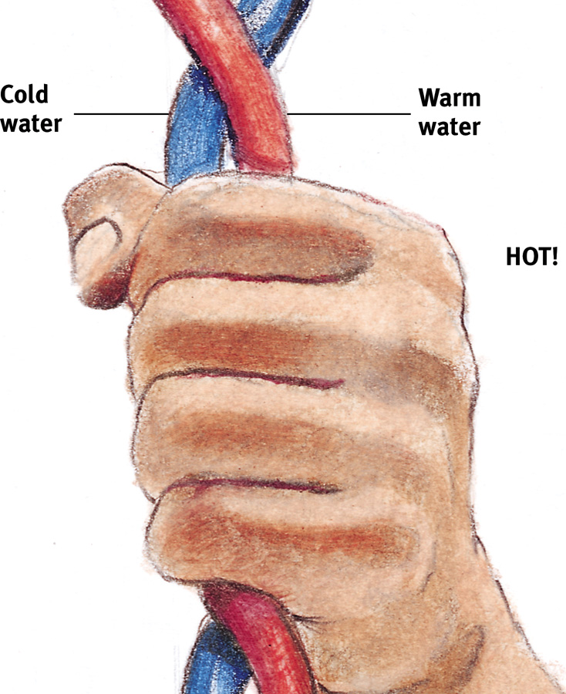
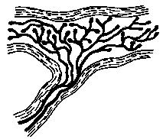
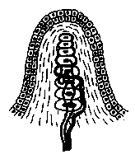

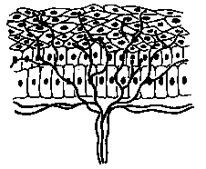
Skin Senses
Only pressure has identifiable receptors. All other skin sensations are variations of pressure, warmth, cold and pain.
Pressure
Vibration
Vibration
Burning hot
Cold, warmth and pain

Slide 38
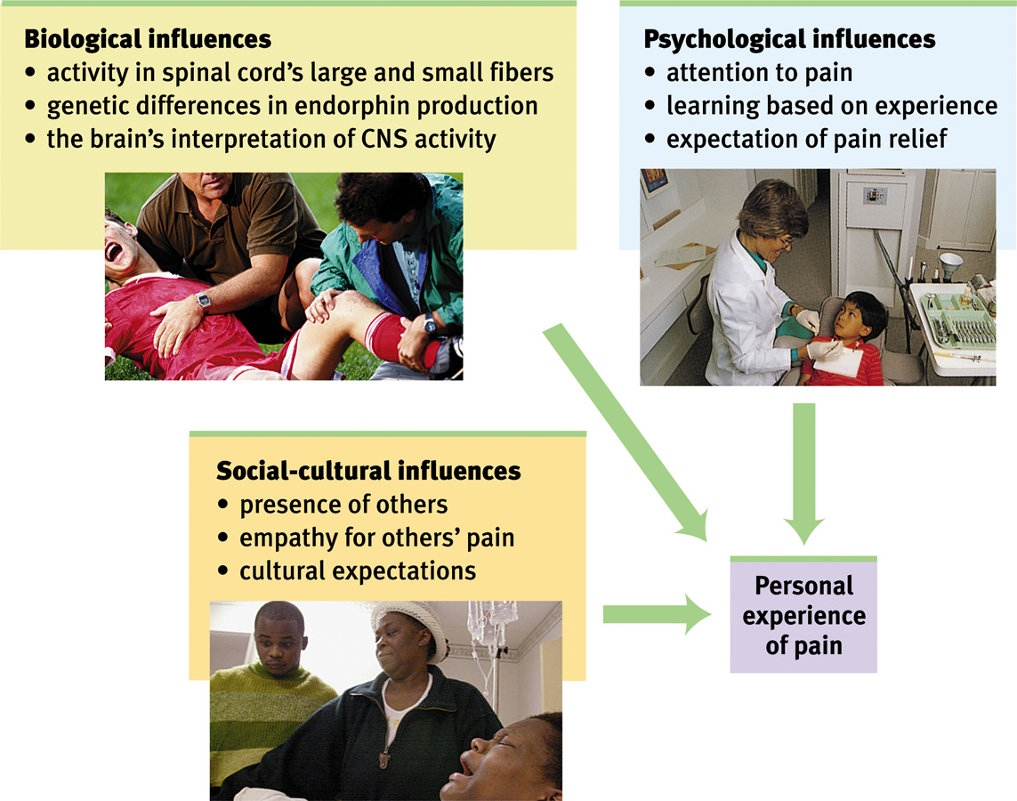
Biopsychosocial Influences of Pain

Slide 39
Gate-Control Theory
  Theory that the spinal cord contains a neurological “gate” that blocks pain signals or allows them to pass on to the brain.
  “Gate” opened by the activity of pain signals traveling up small nerve fibers.
  “Gate” closed by activity in larger fibers or by information coming from the brain.
Notes:
One way to treat chronic pain is to stimulate it through massage by electrical stimulation or acupuncture. Rubbing causes competitive stimulation to pain thus reduces its effect.

Slide 40
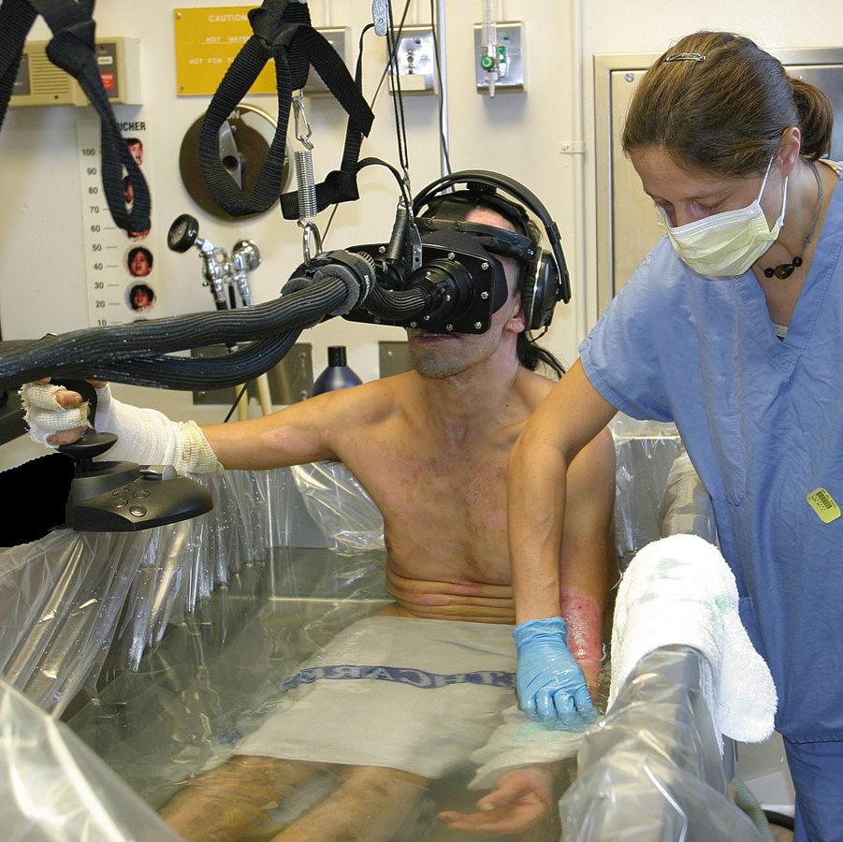
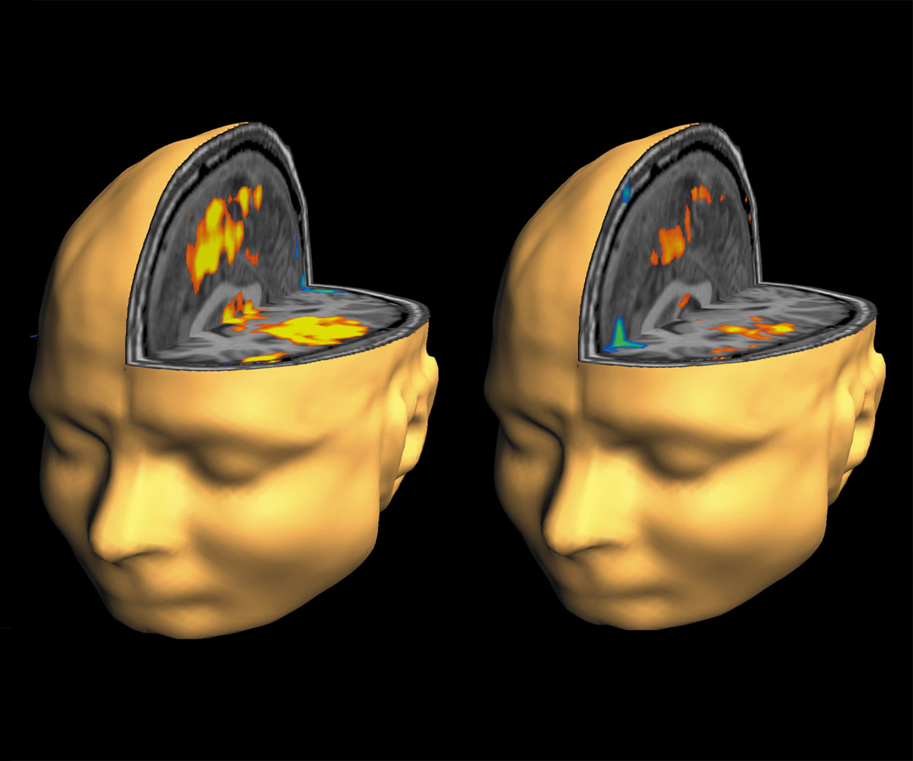
Pain Control
Pain can be controlled by a number of therapies including, drugs, surgery, acupuncture, exercise, hypnosis, and even thought distraction.
Todd Richards and Aric Vills, U.W.
©Hunter Hoffman, www.vrpain.com
Notes:
Burn victims can be distracted by allowing them to engage in illusory virtual reality. Their brain scans show differences in pain perceptions.

Slide 41
Taste
Traditionally, taste sensations consisted of sweet, salty, sour, and bitter tastes.
When one sense affects another sense, sensory interaction takes place.
For instance, when smell interacts with taste.
Sweet
Sour
Salty
Bitter
Umami
(Fresh
Chicken)
Notes:
OBJECTIVE 19| Describe the sense of taste, and explain the principle of sensory interaction.

Slide 42
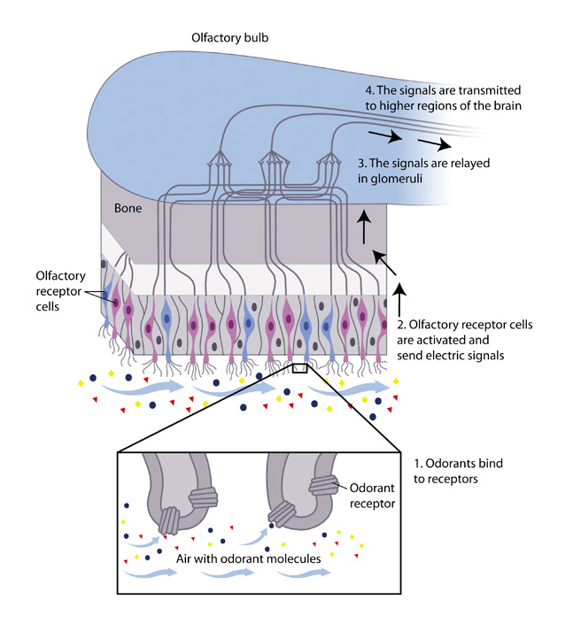
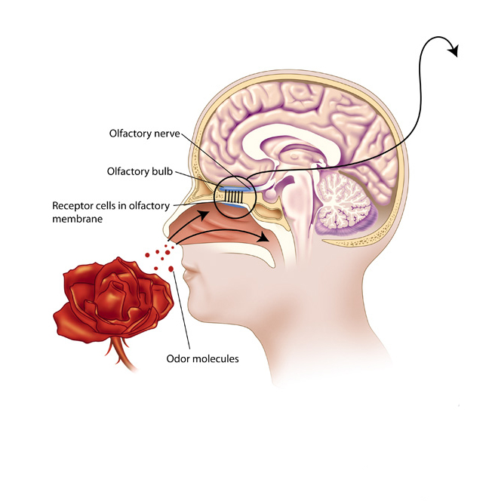
Smell
Like taste, smell is a chemical sense.
Odorants enter the nasal cavity to stimulate 5 million receptors to sense smell.
Unlike taste, there are many different forms of smell.
Notes:
OBJECTIVE 20| Describe the sense of smell and explain why specific odors so easily trigger memories.

Slide 43
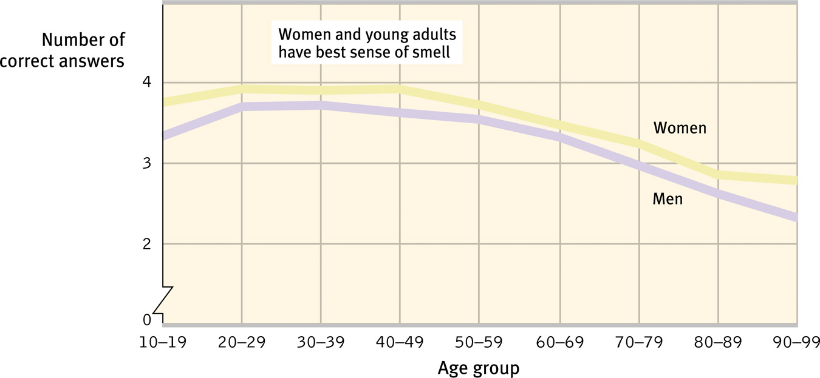
Age, Gender, and Smell
Ability to identify smell peaks during early adulthood, but steadily declines after that. Women are better at detecting odors than men.

Slide 44
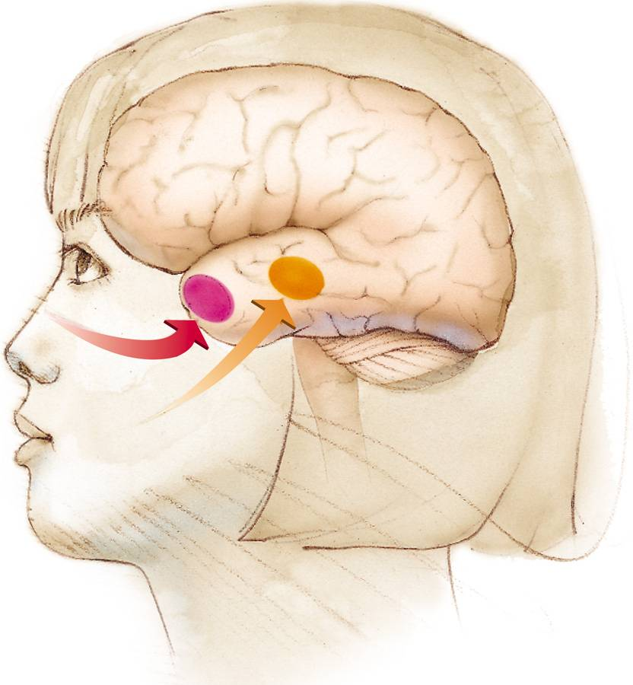
Smell and Memories
The brain region for smell (in red) is closely connected with the brain regions involved with memory (limbic system).
That is why strong memories are made through the sense of smell.

Slide 45
Body Position and Movement
Kinesthesis
  The system for sensing the position and movement of individual body parts
Vestibular Sense
  The sense of body movement, position, and balance
Notes:
Ian Waterman, after viral infection, lost his sense of light touch and body position and movement—can walk but must look at limbs to direct them
When lights go out, he falls and cannot get up again until they come back on
When he is not looking at his body, he moves very little, unlike most of us who move around quite a bit
Synesthesia—sensory condition in which stimulating one modality leads to perception in another (to perceive together)
1 in 2,000 occurrence, females outnumber 6 to 1, seems to run in families so there may be a genetic base

