Slide 1
Sexual Motivation
10/15

Slide 2
Today’s Topics:
Research on Sexual Motivation
The Sexual Response Cycle
Stages
Criticisms
Nature: Sexual Motivation
Nurture: Sexual Motivation
Sex and Health

Slide 3
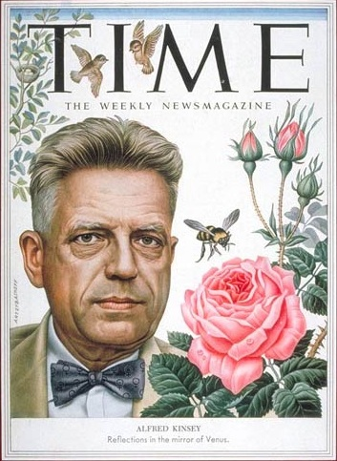
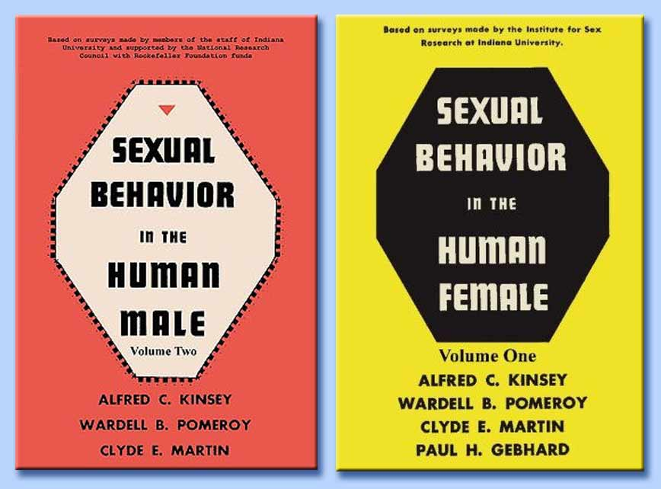
Alfred Kinsey
One of the earliest researchers of sex (1940s)
Found social expectations and personal experiences were different.
Controversial in many ways.

Slide 4
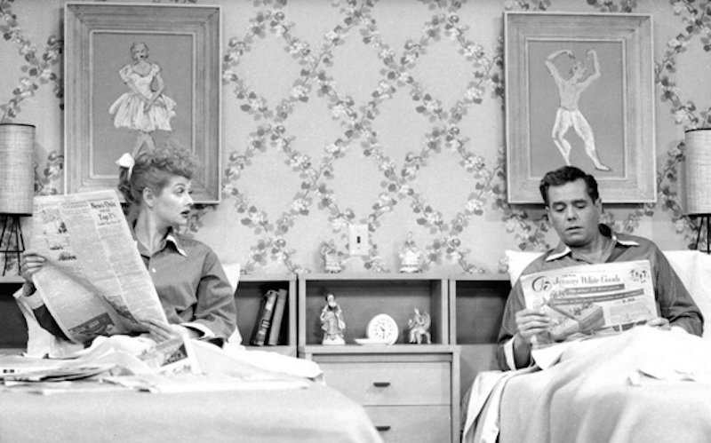

Slide 5
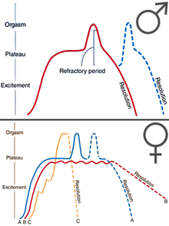
The Sexual Response Cycle
Described by William Masters and Virginia Johnson
4 Stages of sexual responding:
Excitement
Plateau
Orgasm
Resolution

Slide 6
Sexual Response Cycle
Excitement
Genitals become engorged with blood.
Breathing and pulse increase.
Plateau Phase
Breathing and pulse continue to increase.
Orgasm
Muscles contract.
Males ejaculate.
Resolution phase
The male enters the refractory period
Body returns to unaroused state
Women can continue to have orgasms

Slide 7
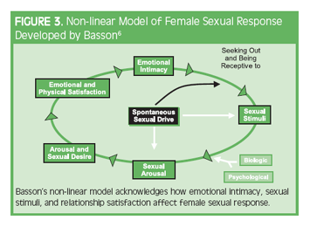
Criticisms of Sexual Response Cycle
SRC doesn’t adequately describe female sexual response.
Some argue SRC doesn’t account for psychological aspects of sex

Slide 8
Nature: Sexual Motivation
Hormones promote and cause sexual arousal in humans
Male | Testes | Testosterone (Small amounts of estrogen)
Female | Ovaries Adrenals | Estrogen (Small amounts of testosterone)

Slide 9
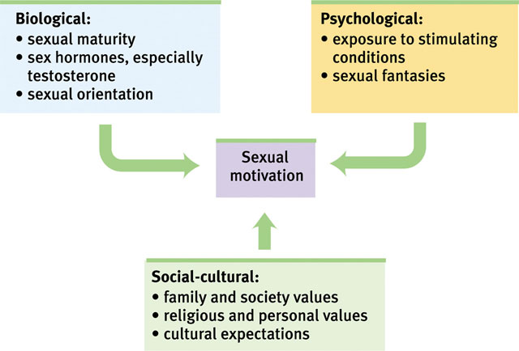

Slide 10
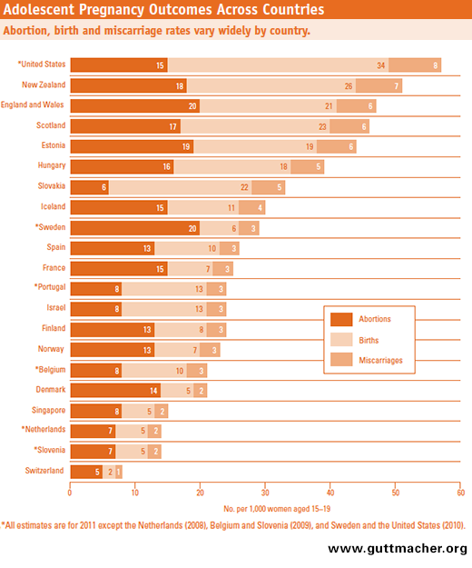
Sex and Health
US has high teen pregnancy rates
It’s been going down, though
Wear a condom!
No, seriously. Don’t be dumb.

