Slide 1
Social Psychology

Slide 2
Topics for Today
How we think about others
How attitudes and actions impact each other
How others affect our behavior

Slide 3
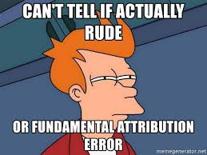
How we think about others
Fundamental Attribution Theory
Fundamental Attribution Error

Slide 4
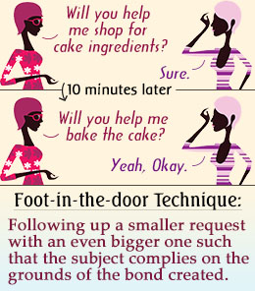
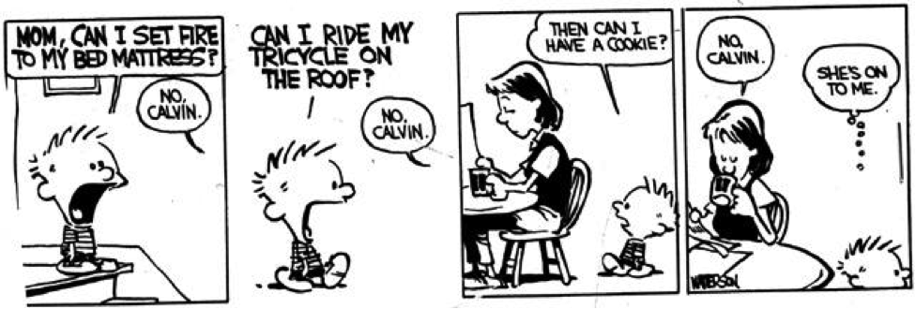
How attitudes and actions impact each other
When ACTIONS impact our ATTITUDES
Role Playing
Cognitive Dissonance Theory
Foot-in-the-door phenomenon
Door-in-the-face phenomenon
When ATTITUDES impact our ACTIONS
Peripheral route to persuasion
Central route to persuasion

Slide 5
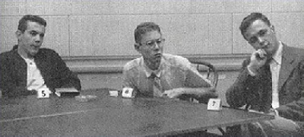
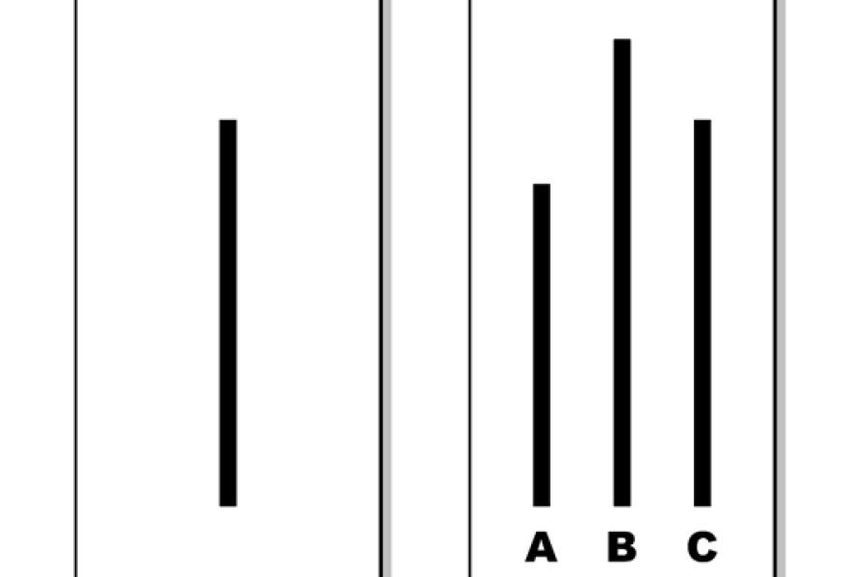
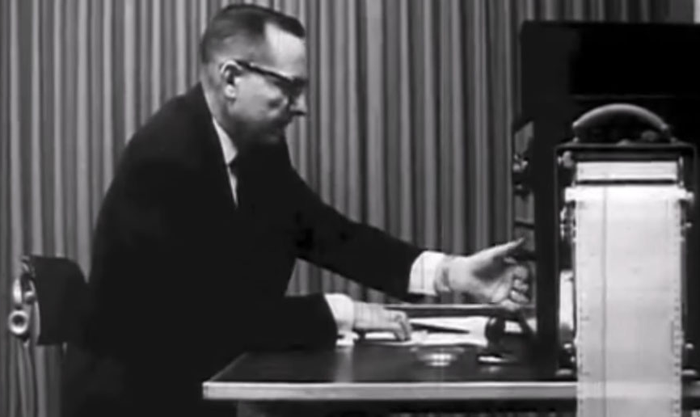
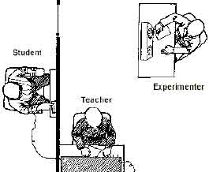
Conformity: How others affect us
Conformity
Automatic Mimicry
Social norms
Normative Social Influence
Informational Social Influence
Obedience
“authority”

Slide 6
Assignment
Come up with an example for one of the following (that’s not mentioned in the textbook):
Social facilitation
Social loafing
Deindividuation
Group polarization
Groupthink
**Don’t just define it, provide and example.**

Slide 7
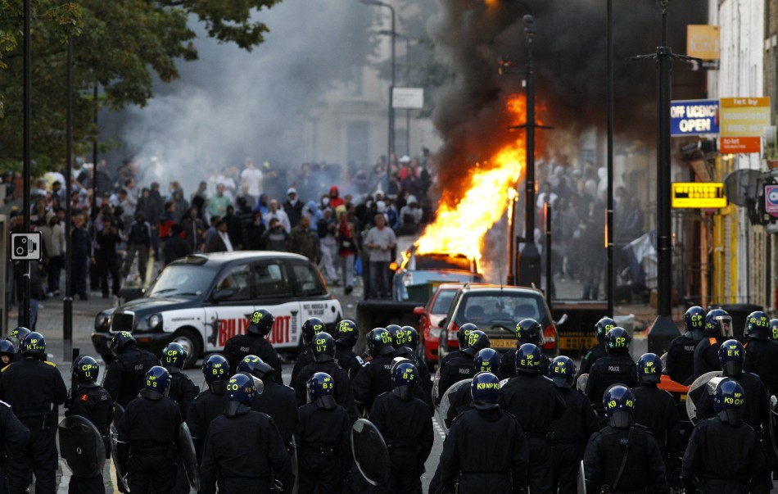
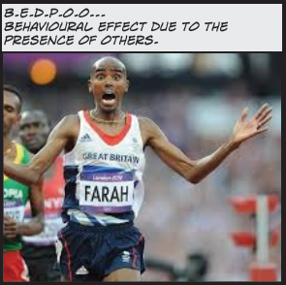
How others affect us
Patterns in group behaviors:
Social facilitation
Social loafing
Deindividuation
Group polarization
Groupthink

