Slide 1
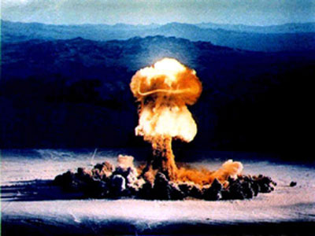
The Cold War Was Never Chill: 8 Things that made the Cold War intense

Slide 2
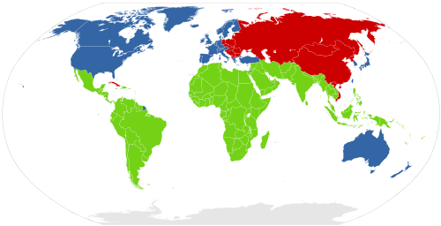
Allies, Enemies, and Frenemies
US Allied Countries (blue) = 1st World Countries
USSR Allied Countries (red) = 2nd World Countries
Un-Allied Countries (green) = 3rd World Countries

Slide 3
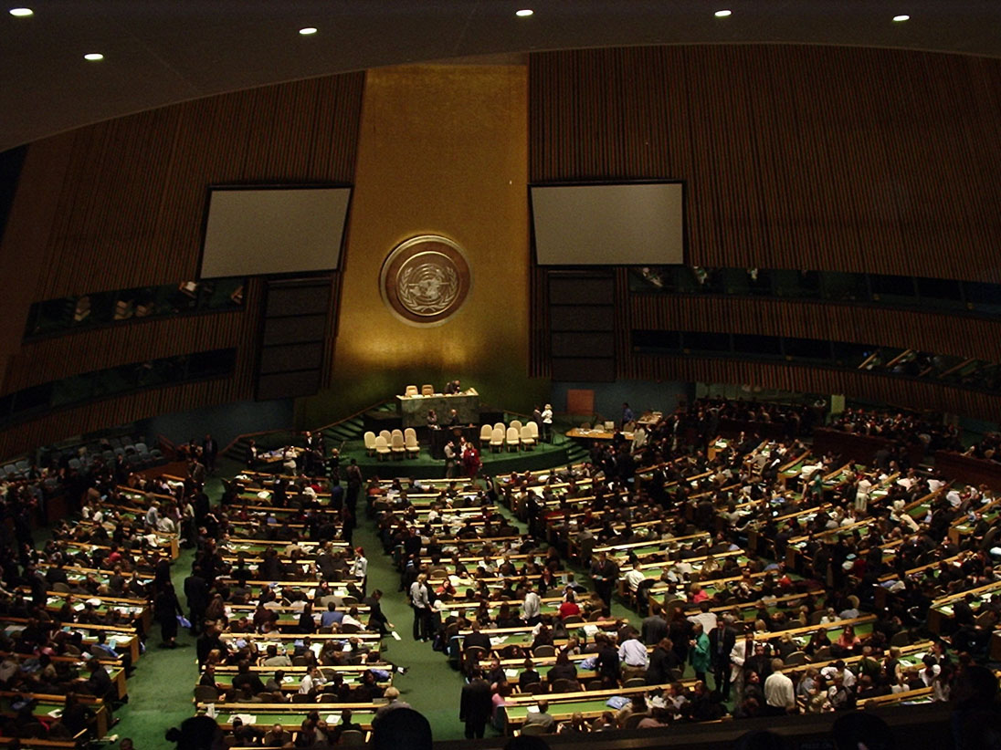
Founding of the United Nations
Founded after WWII
Goal: promote world peace through cooperation
US and USSR got leadership positions

Slide 4
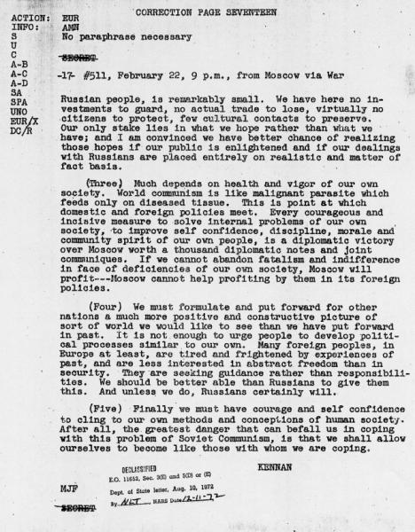
Thing 1: Containment Policy
US Strategy during CW?
“Contain” communism within its present borders.
Founded by George Kennan
Wrote the “Long Telegram”

Slide 5
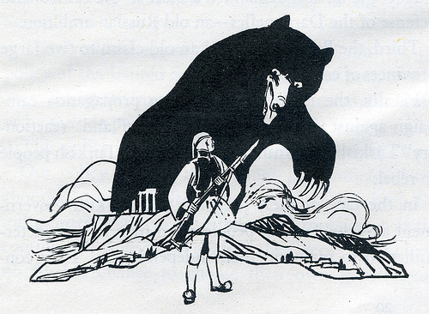
Thing 2: The Truman Doctrine
Greece is threatened by communist rebels and Truman makes a speech stating…
US should stop the spread of communism by providing economic assistance
Builds on containment policy
The Bear is the USSR>>>>

Slide 6
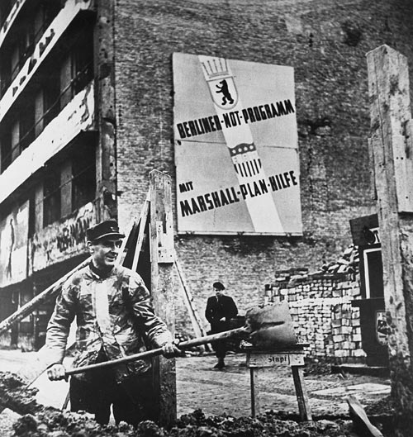
Thing 3: The Marshall Plan
Spend $13 billion in aid to rebuild Europe
Considered highly effective in preventing communist takeover

Slide 7
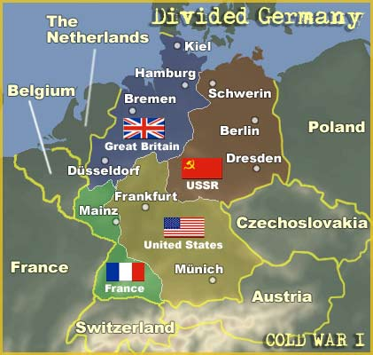
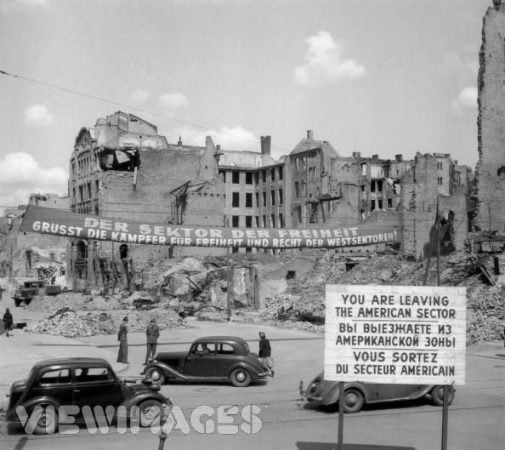
Thing 4: The Berlin Blockade and Airlift
Germany split into 4 occupied zones
Berlin also divided into 4 zones
Soviet Blockade→ Close off access to the city from outside in order to gain control

Slide 8
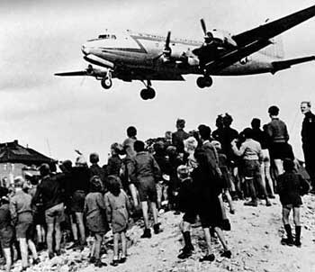
Thing 4: The Berlin Blockade and Airlift
277,000 flights over 327 days delivering food, fuel, medicine, etc. from U.S. and England
Soviets were forced to give up, West Berlin did not fall to communism

Slide 9
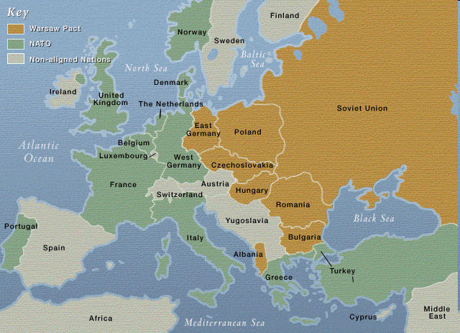
Things 5 : NATO and Warsaw Pact Created
North Atlantic Treaty Organization (created 1949)
Military alliance of capitalist countries
USSR creates Warsaw Pact (1955)
Military alliance of communist nations

Slide 10
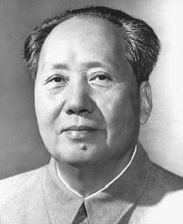
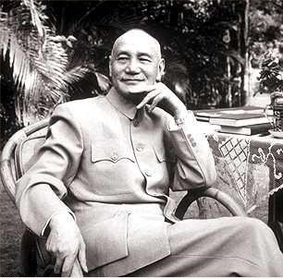
Thing 6: The Chinese Revolution
After WWII, Civil War restarts in China
Communists vs. Nationalists
Mao Tse-Tung
Chiang Kai-shek

Slide 11
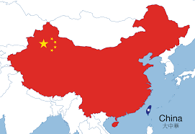
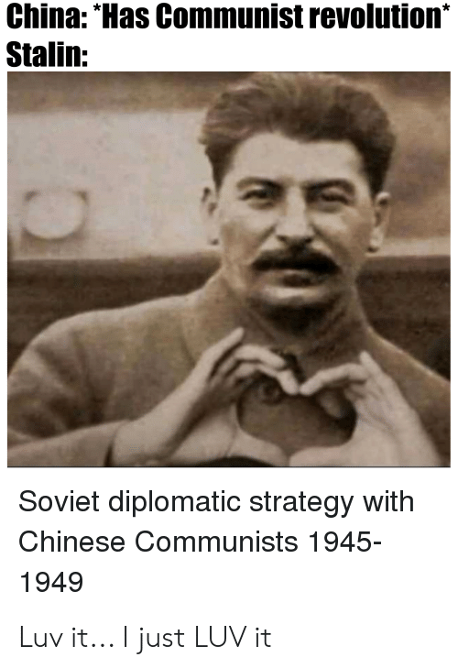
Thing 6: Chinese Revolution
Communists won the war
Nationalists flee to Island of Formosa (now called Taiwan)

Slide 12
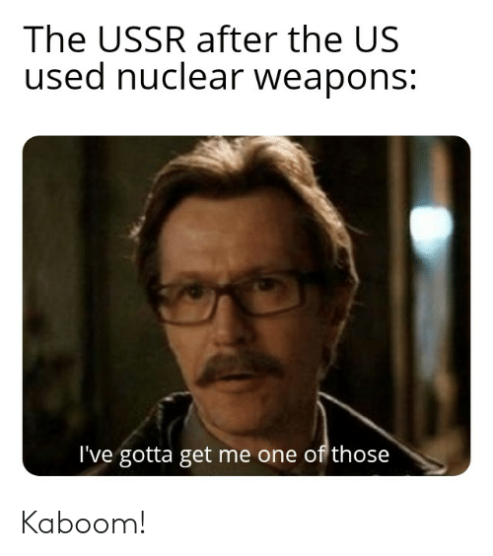
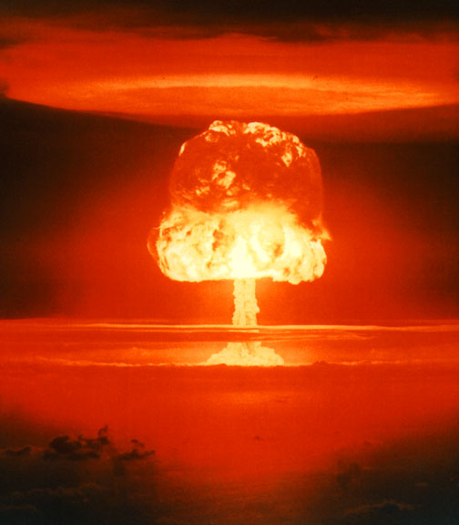
Thing 7: USSR Tests Its First Nuke
1949 – the USSR test their first nuke
Freaks out US govt and public

Slide 13
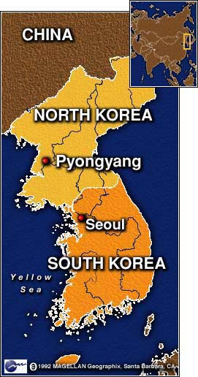
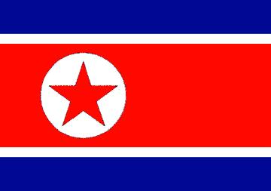
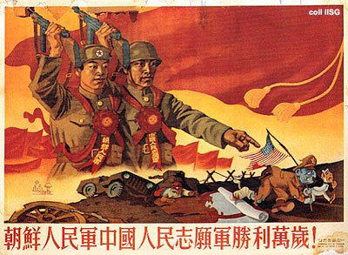
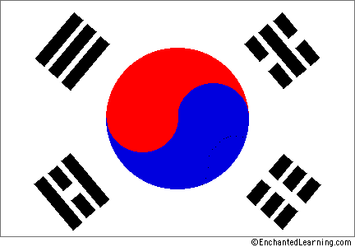
Thing 8: The Korean War
After WWII: US controls South, USSR controls North
North Korea invades South Korea
UN gets involved (b/c of US)
China helps North Korea

Slide 14
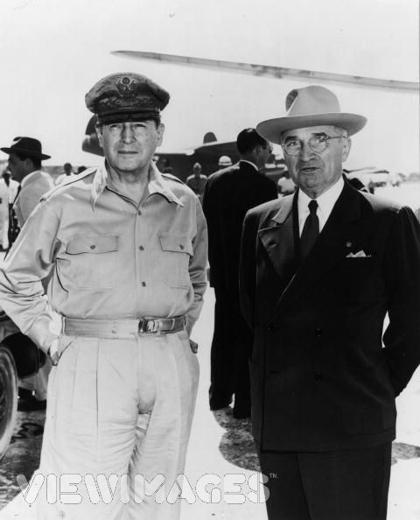
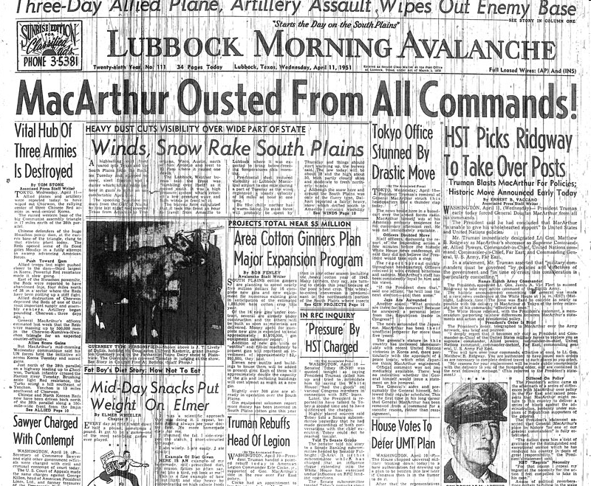
Thing 8: The Korean War
Douglas MacArthur in charge of UN forces
Wants to invade China and nuke major cities
Truman says, “nah”
MacArthur publically criticizes Truman
Truman says, “I don’t want war with China. Yah fired.”
Dougie Fresh
Harry Truman

Slide 15
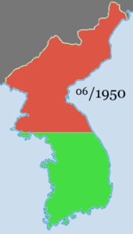
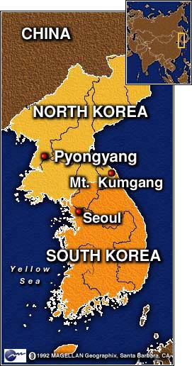
The End of the War
Fighting at a stalemate after 1 year
Treaty signed in 1953
North and South Korea return to pre-war states at 38th Parallel
Many Americans upset about War

