Slide 1
Statistics for Psychology

Slide 2
Measures of Central Tendency
Mean
Median
Mode

Slide 3
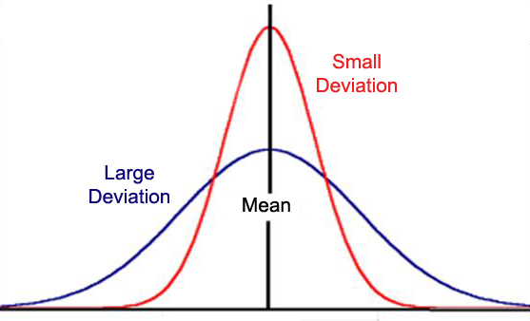
Measures of Variation
Range
Standard Deviation

Slide 4
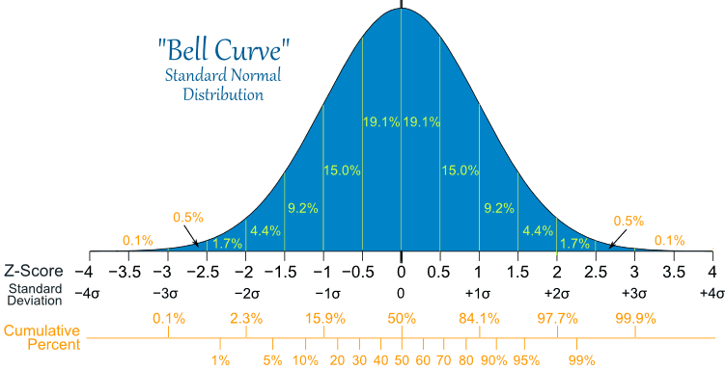
Bell Curve

Slide 5
Statistical Significance
Statistical Significance
A statement of how likely it is that results occurred by chance
When something is statistically significant, it did not occur by chance
Notes:
OBJECTIVE 20| Explain how psychologists decide whether differences are meaningful.

Slide 6
Practice with Standard Deviation
97
97
87
97
99
93
95
98
95
96
99
89
72
96
77
95
96
42

