Slide 1
The Beginning of WWII
Write down the info in yellow…

Slide 2
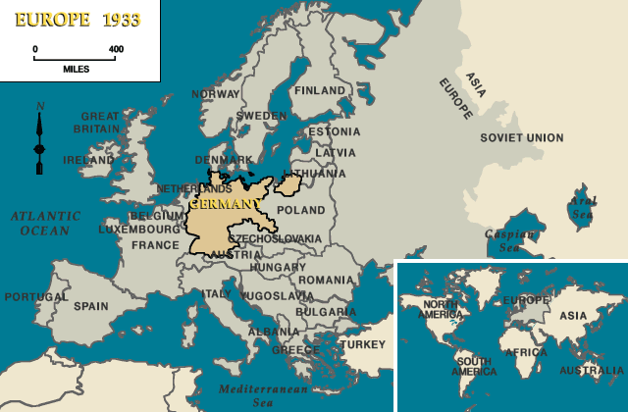

Slide 3
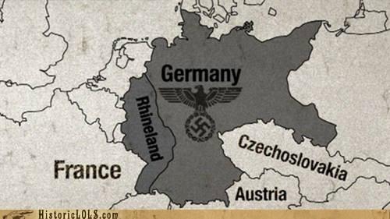
German Aggression Begins
1935 - Hitler starts an army
1936 - Army marched into the Rhineland
Both actions violate Treaty of Versailles

Slide 4
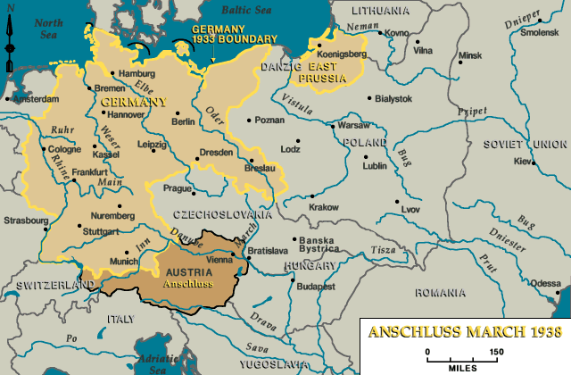
March 1938: Germany annexes Austria

Slide 5
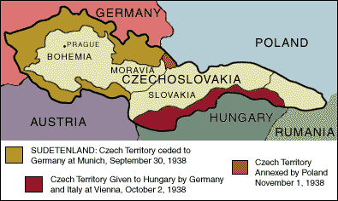
Sept. 1938: Germany demands Sudetenland or another European War

Slide 6
Appeasement
Munich Conference – September 1938
France and Great Britain agree to give Hitler the Sudetenland
Without consent of Czechoslovakia
Hitler agrees to not annex any more places
Neville Chamberlain (Prime Minister of GB)
“My friends, there has come back from Germany peace with honor. I believe it is peace in our time.”

Slide 7
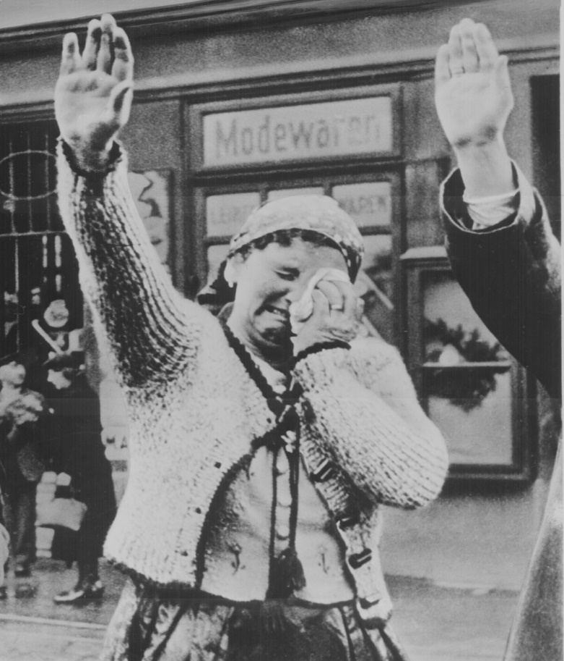
But then…
March 1939: Hitler invades the rest of Czechoslovakia

Slide 8
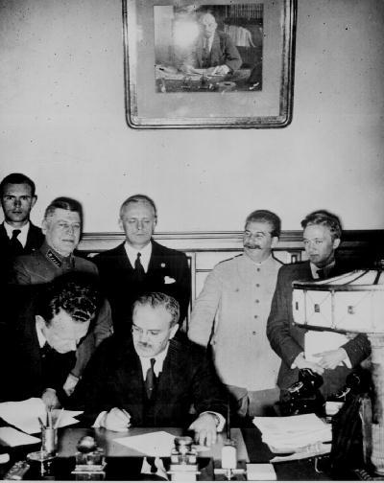
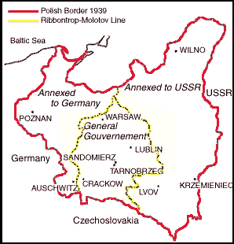
1939 - German-Soviet Non-Aggression Pact (a.k.a. Molotov-Ribbentrop Pact)
Germany and USSR promise not to fight each other
Make plans to divide up Poland
Secret treaty

Slide 9
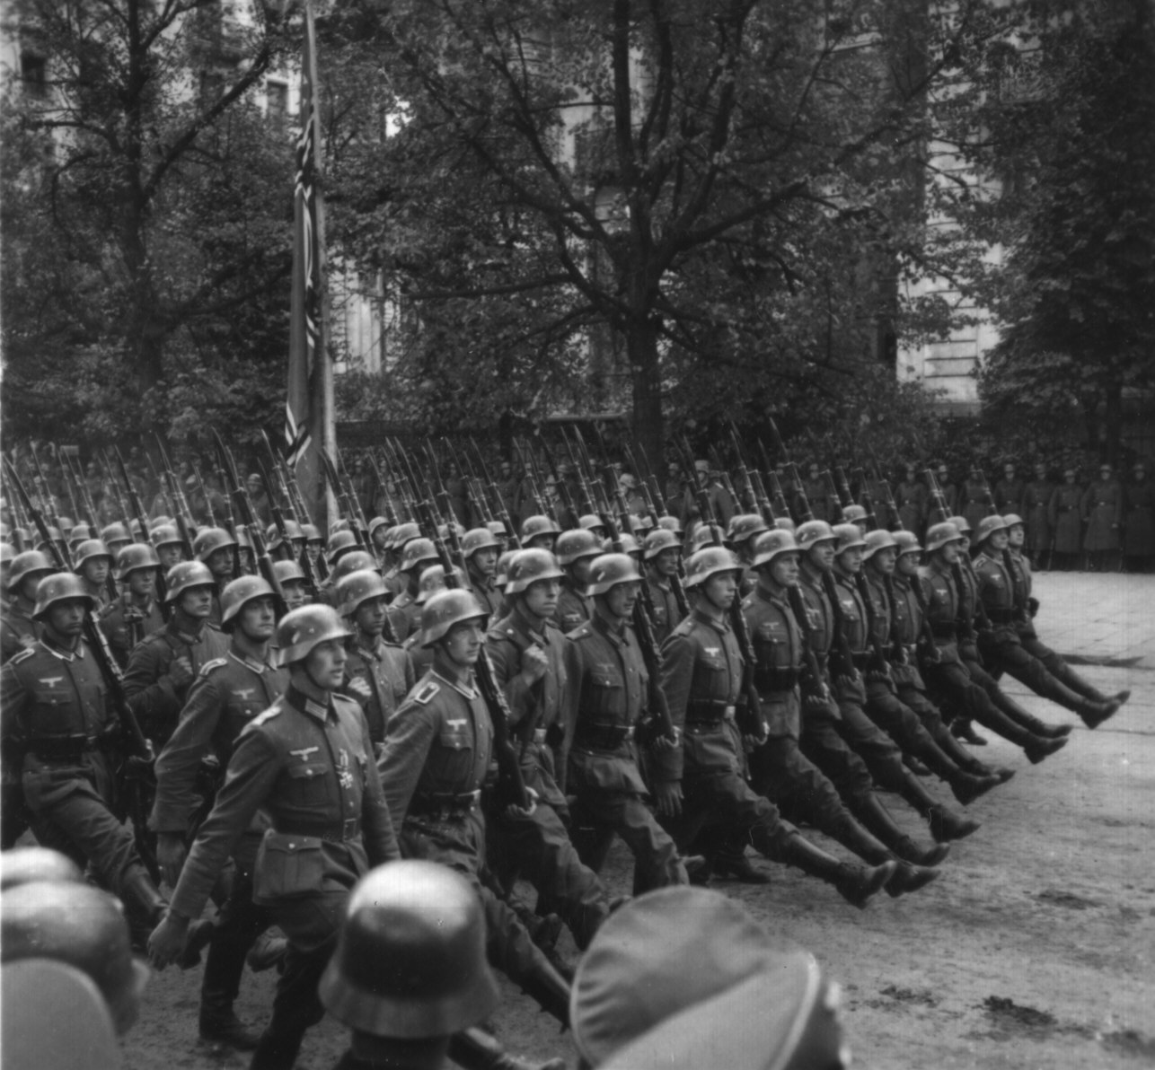
September 1939: Germany invades Poland
Blitzkrieg: “lightning war”
New German strategy using tanks and planes to overwhelm opponent

Slide 10
WWII Starts
Great Britain and France promised to go to war if Poland was attacked
Germany invades and defeats:
Denmark, Norway, Netherlands, Belgium and Luxembourg before invading France
France surrenders in June 1940

Slide 11
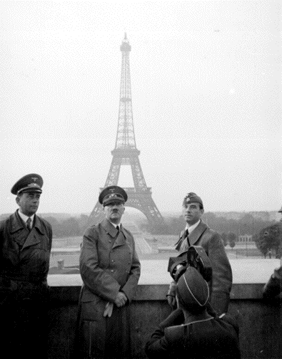
Great Britain the only ally major left until 1941

Slide 12
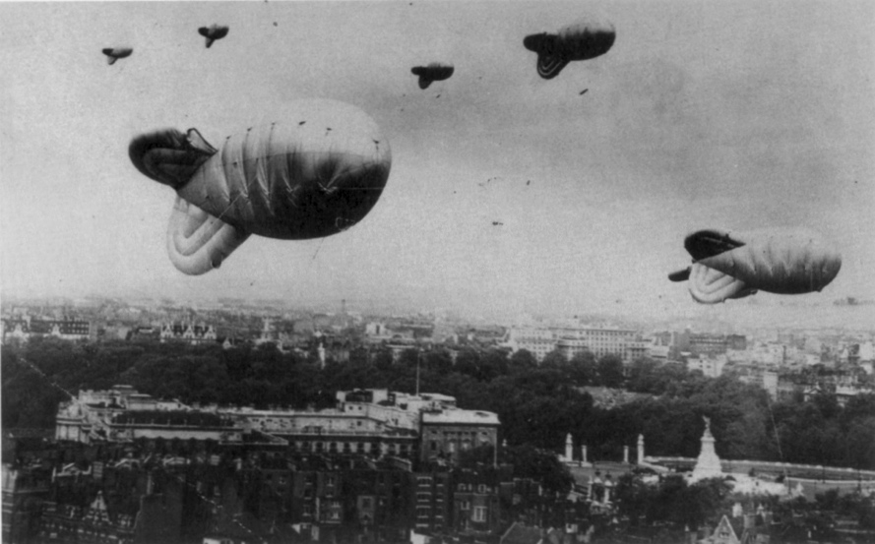
1940-41 - Germany bombs London to get GB to surrender…unsuccessful

Slide 13
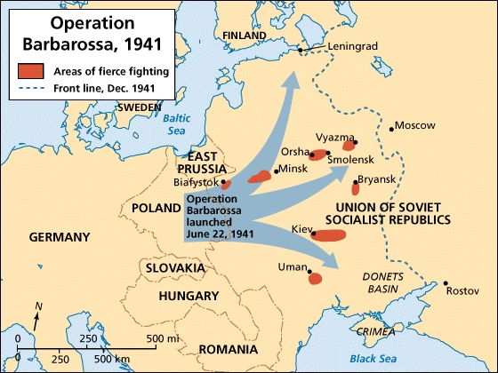
1941 - Germany decides to invade USSR. Violates pact. USSR enters war.

Slide 14
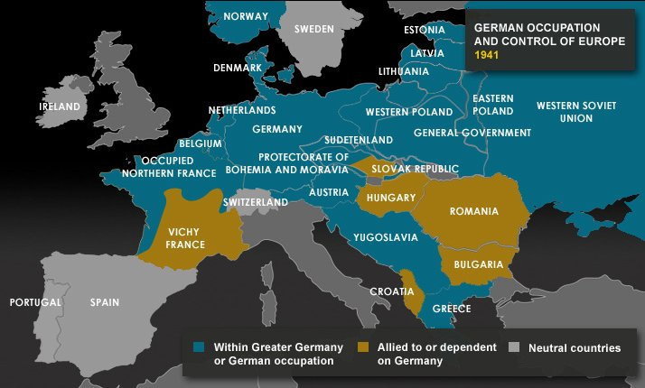
Europe looks so different by the end of 1941

Slide 15
US Remains Neutral
Late 1930s - US passed Neutrality Acts
prevented sale of weapons and involvement
US agrees to appeasement of Germany

Slide 16
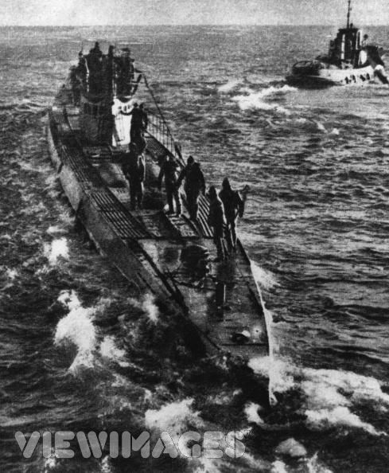
German Aggression
German subs began to attack US ships
US ships began to fight back
But there’s no big military campaign against Germany.

Slide 17
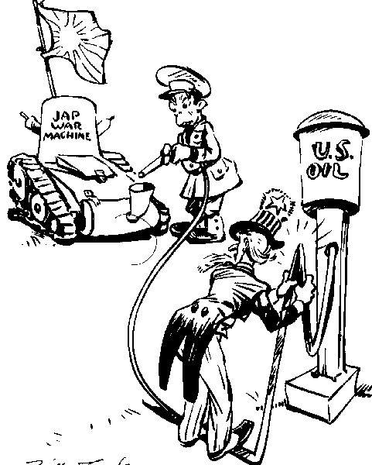
Beef with Japan
Japan takes over more nations in Asia
US places embargo on Japan
Refused to sell oil to Japan

Slide 18
Japanese Response
Japanese attack Pearl Harbor (HI) on December 7, 1941
180 Japanese planes attacked U.S. naval base for an hour and a half
Killed 2,500 Americans, sunk 21 ships, and 300 aircraft destroyed

Slide 19
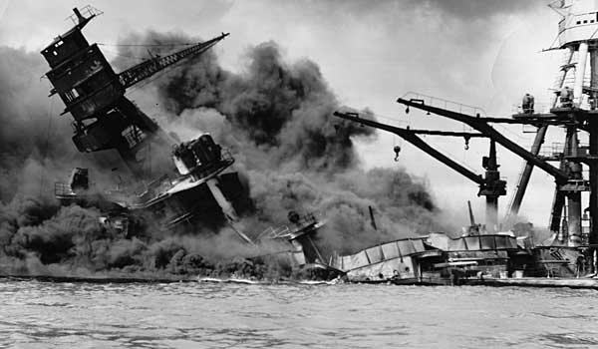

Slide 20
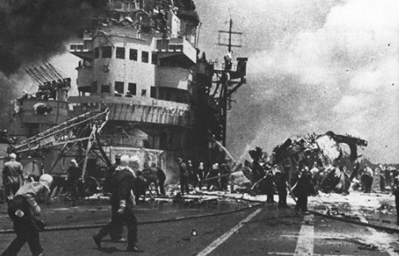

Slide 21
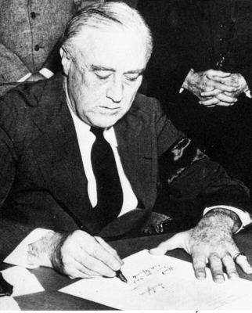
Congress Declares War
Almost unanimous vote brings the U.S. into the war on December 8, 1941

