Slide 1
The Neo-Freudians

Slide 2
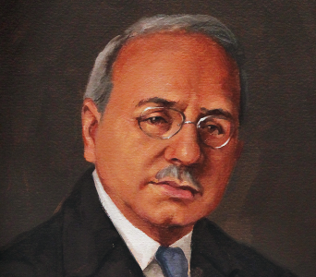
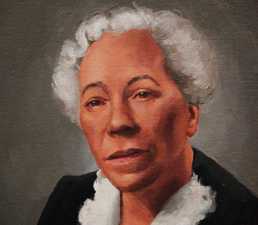
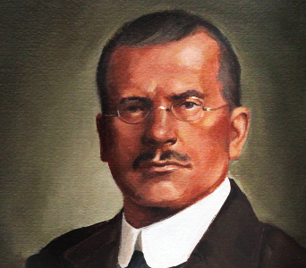
Neo-Freudians
Followers of Freud
Agreed with many of Freud’s beliefs
Disagreed with some key things
Alfred Adler
Karen Horney
Carl Jung

