Slide 1
The New South
Politics
Controlled by Democratic Party
Urbanization
Bigger cities and better schools and jobs
Economics
Diversified economy
Agriculture AND industry (factory jobs)
Issues of race
Blacks had more rights than before
No slavery
Racism still present and oppressive

Slide 2
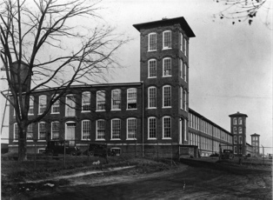

Slide 3
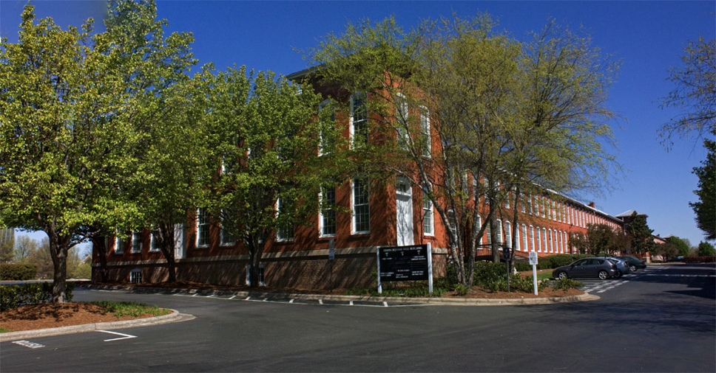

Slide 4
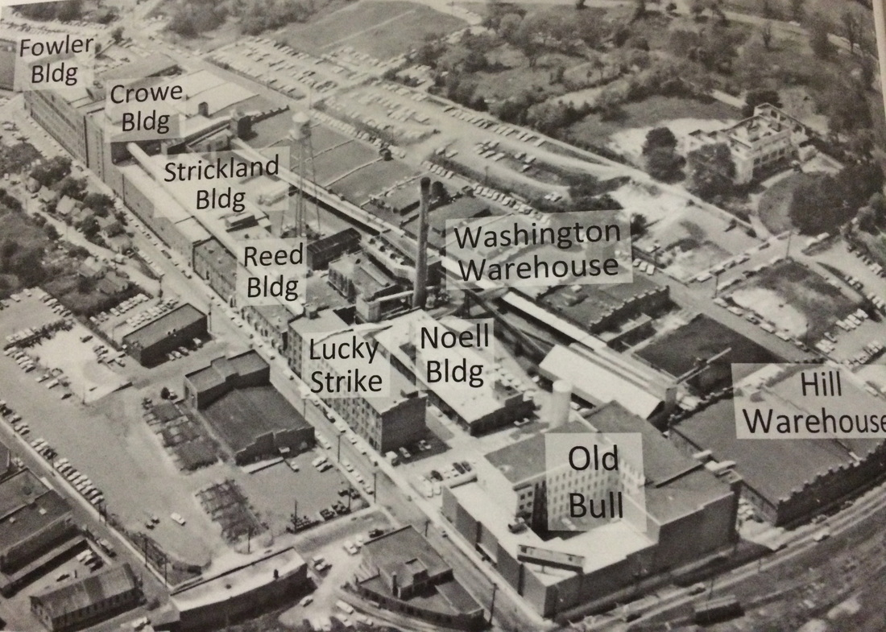

Slide 5
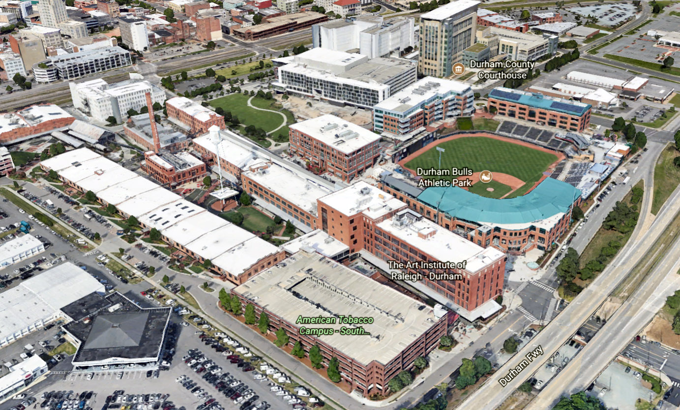

Slide 6
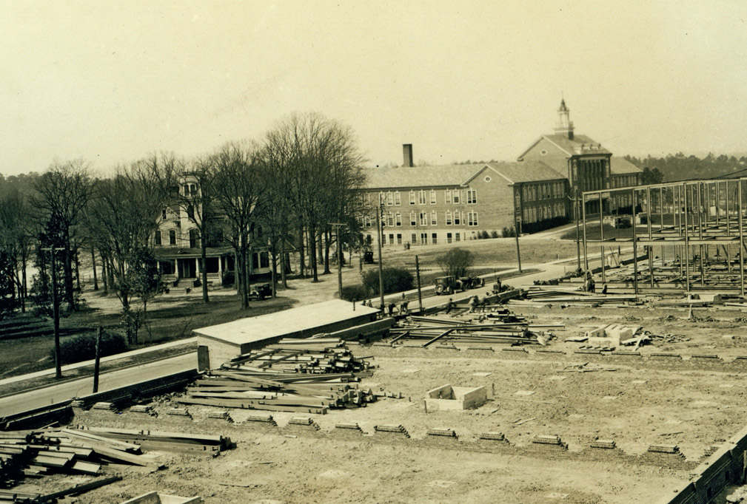

Slide 7
