Slide 1
Emotions

Slide 2
Topics for Today
What are emotions?
Different theories about emotions
James-Lange
Cannon-Bard
Schachter-Singer (Two Factor)
Zajonc and LeDoux
Physiology and emotion

Slide 3
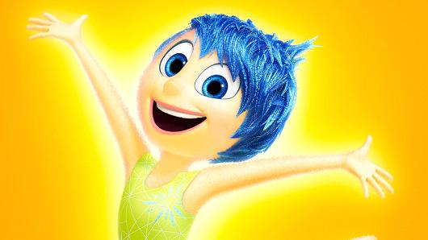
What are emotions?
A response from an organism that involves:
Physical arousal
Expressive behavior
Conscious experience

Slide 4
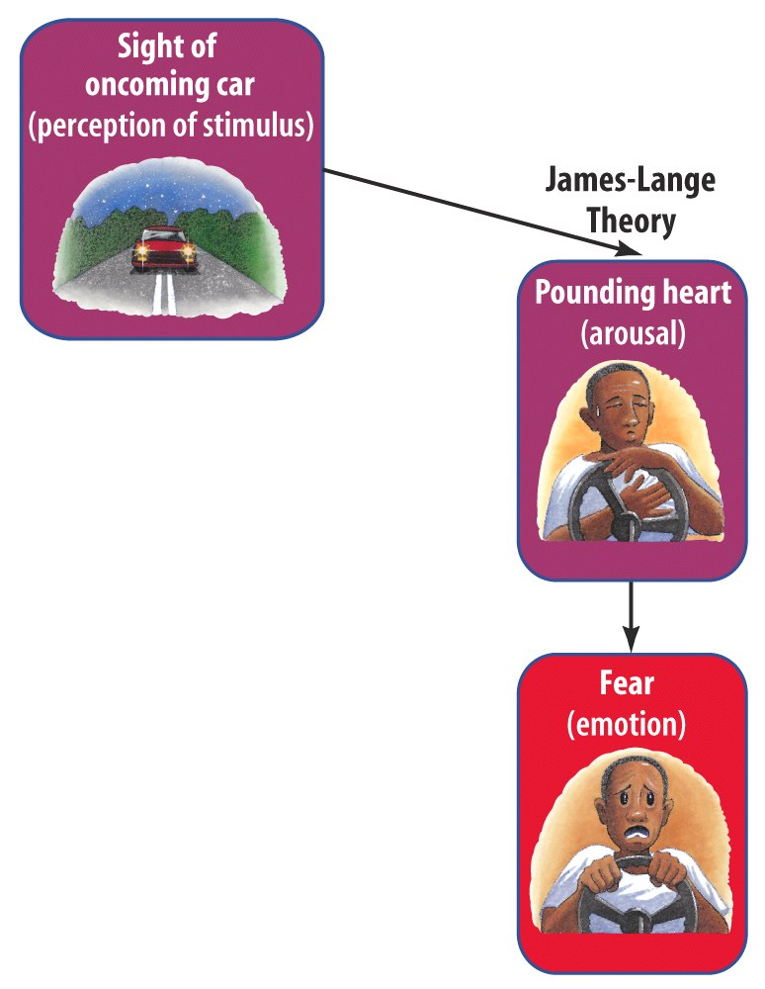
James-Lange Theory
The James-Lange Theory proposes…
Physiological activity precedes the emotional experience.
Evidence = ppl w/ spinal injuries

Slide 5
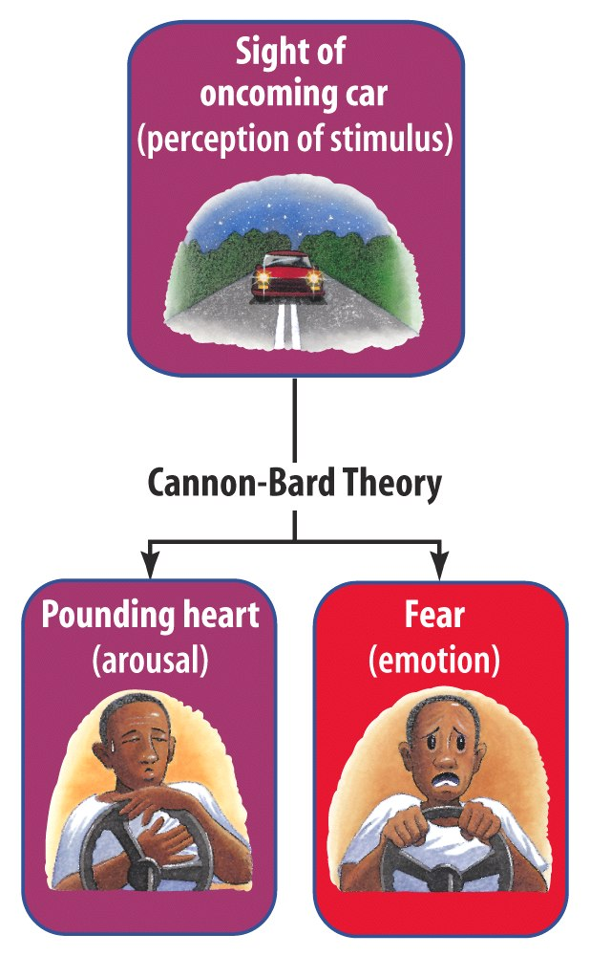
Cannon-Bard Theory
Cannon-Bard Theory proposes…
An emotional experience and the body's arousal take place simultaneously (but separately).
Notes:
1) Cannon suggested that body’s responses were not distinct enough to evoke different emotions. 2) Physiological responses seemed too slow to trigger sudden emotions.

Slide 6
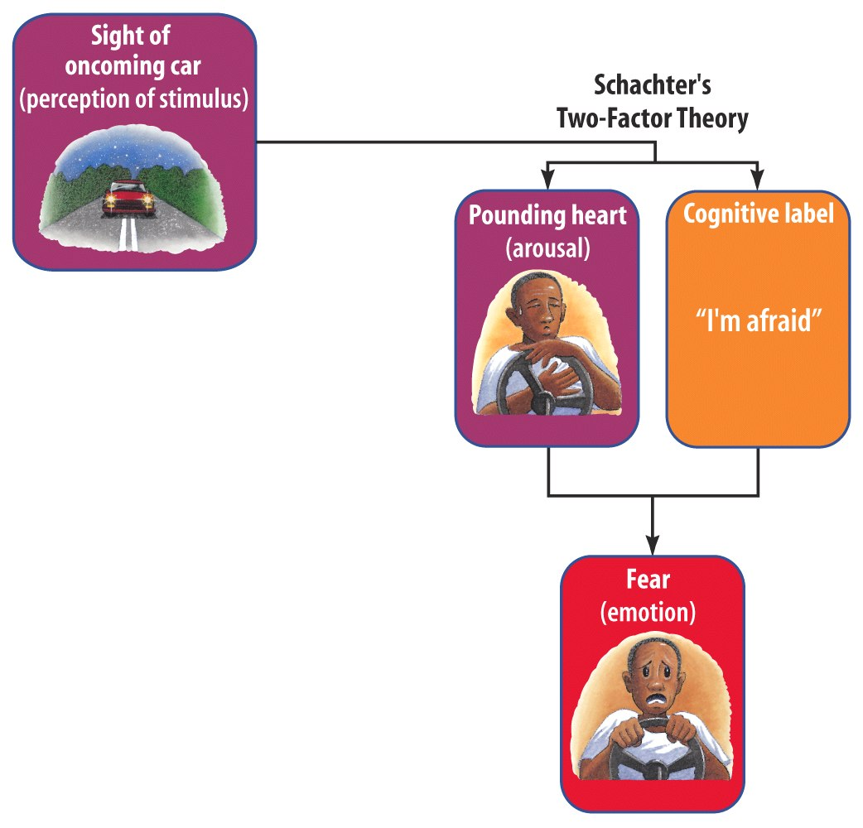
Schachter-Singer Theory
Also known as the Two-Factor Theory
It suggests…
- Emotions have two factors–physical arousal and cognitive label.
-Evidence = Spillover effect
Lazarus argued that appraisal doesn’t have to be conscious.

Slide 7
Zajonc and LeDoux
Both psychologists proposed…
That we experience some emotions BEFORE any cognitive awareness.
Evidence =
People experience anger and fear before conscious awareness
Emotions can be impacted by subliminal messages

Slide 8
Physiology and Emotion
Positive
Low Arousal
High Arousal
Negative

Slide 9
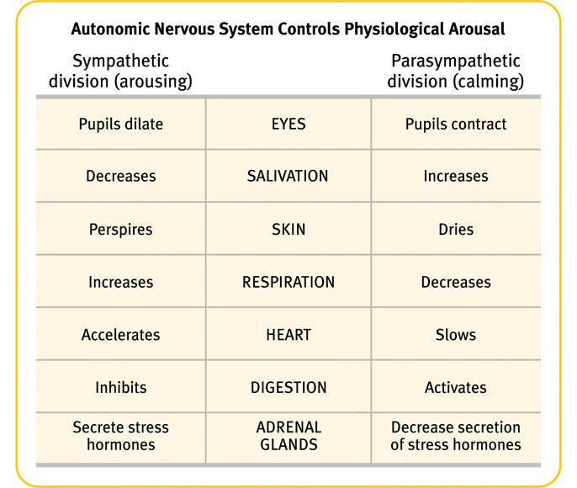
Physiology and Emotion
Which parts of the autonomic nervous system are active when you’re experiencing the following emotions?
Happiness
Sadness
Ecstasy
Rage
Melancholy
Surprise
Excitement
Disgust

