Slide 1
War on the Home Front

Slide 2
Life During the War
War positively impacts economy
War creates social benefits and problems
War increases the role of federal government in everyday lives

Slide 3
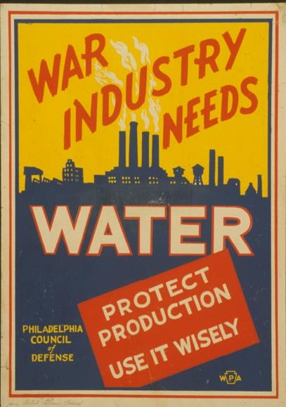
Government Regulates Economy
Federal govt. regulates economy for War
Creates govt. agencies for this purpose:
War Industries Board
War Labor Board
Food Administration

Slide 4
War Industries Board
Provides war materials
Private businesses controlled by govt
Prices increase = Business profits increase
Govt. raises workers pay to keep workers happy

Slide 5
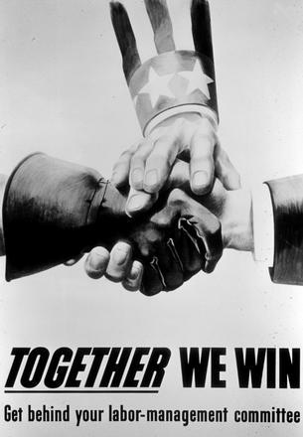
War Labor Board
Created to prevent labor disputes
Higher pay, shorter hours, and better working conditions for workers
Unions that still protested were suppressed by govt.

Slide 6
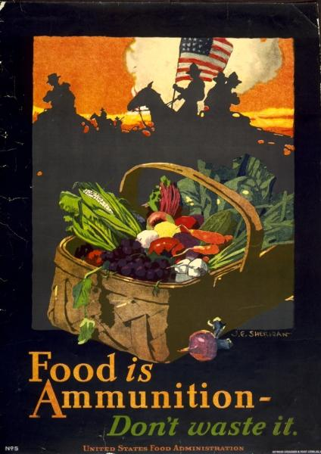
Food Administration
Provides for soldiers’ food
Run by Herbert Hoover
Encouraged:
“Victory Gardens”
Eating less beef and wheat
Food prices increase = farmers profits increase

Slide 7
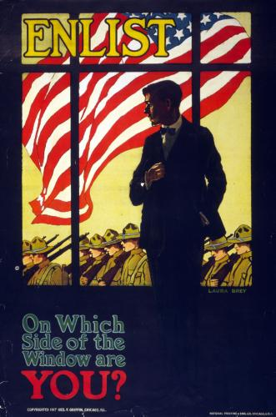
Committee on Public Information
Spread propaganda to support war
Run by George Creel
CPI promoted:
Public support of war
Hatred of enemy
National unity

Slide 8
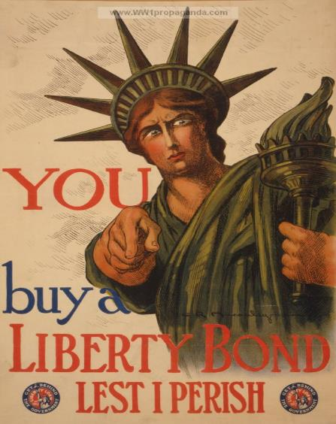
Paying for the War
US increased taxes drastically
Funded 2/3 of war spending
Federal government sold Liberty Bonds
Bonds = loans that govt. pays back over time

Slide 9
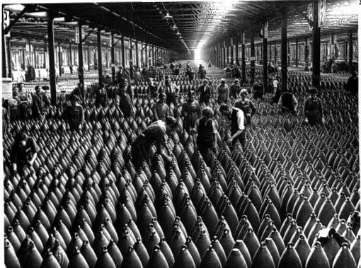
War’s Impact on Society
Women, African Americans, Mexicans provided jobs
Great Migration takes off during WWI
Causes racial tension and riots in cities

Slide 10
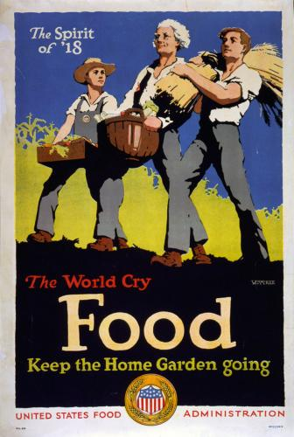

Slide 11
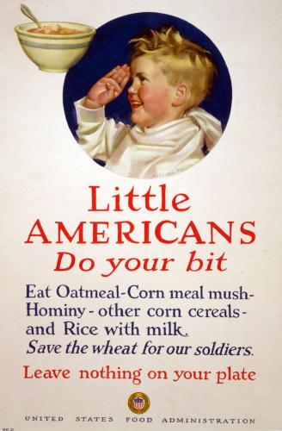

Slide 12
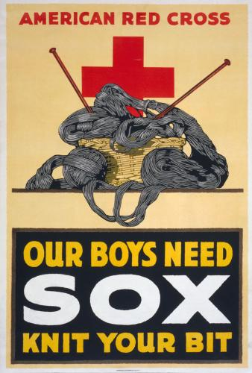

Slide 13
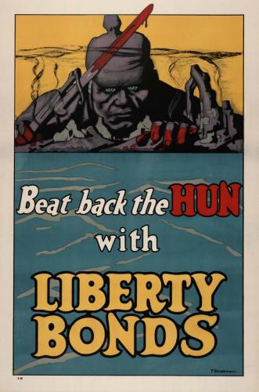

Slide 14
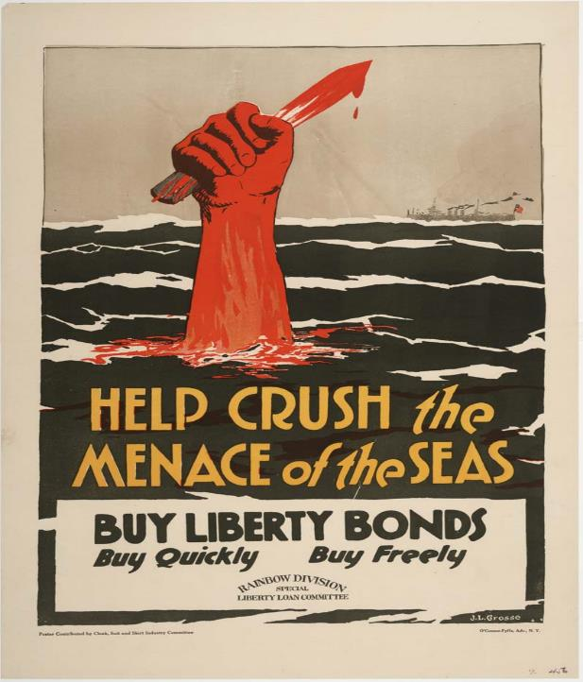

Slide 15
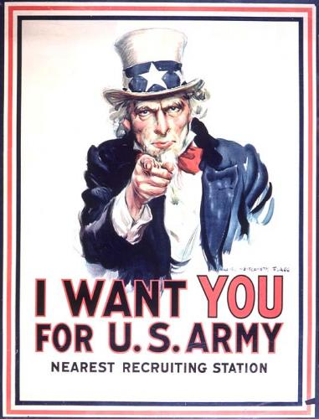

Slide 16
