Slide 1
Two Views on Civil Rights

Slide 2
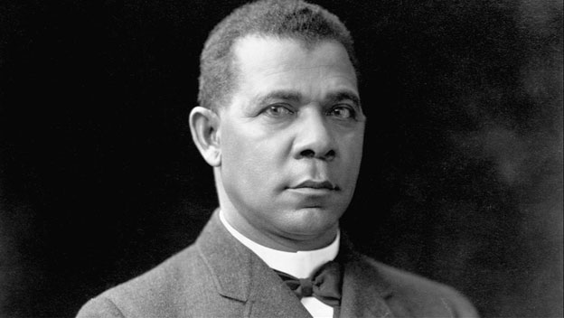
Booker T. Washington

Slide 3
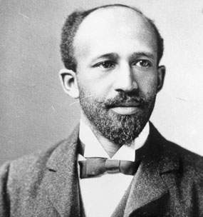
W.E.B. DuBois

