Slide 1
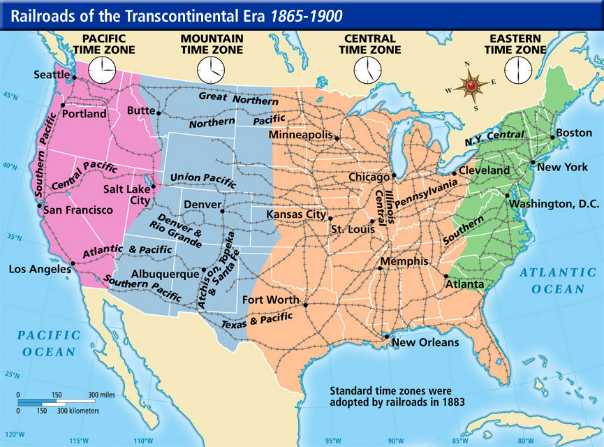
Westward Migration

Slide 2
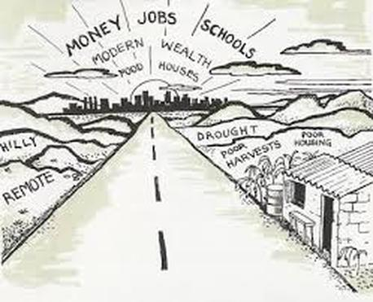
Push and Pull Factors
Push Factors
Negative things that make ppl leave
Examples?
Pull Factors
Positive things that attract ppl
Examples?

Slide 3
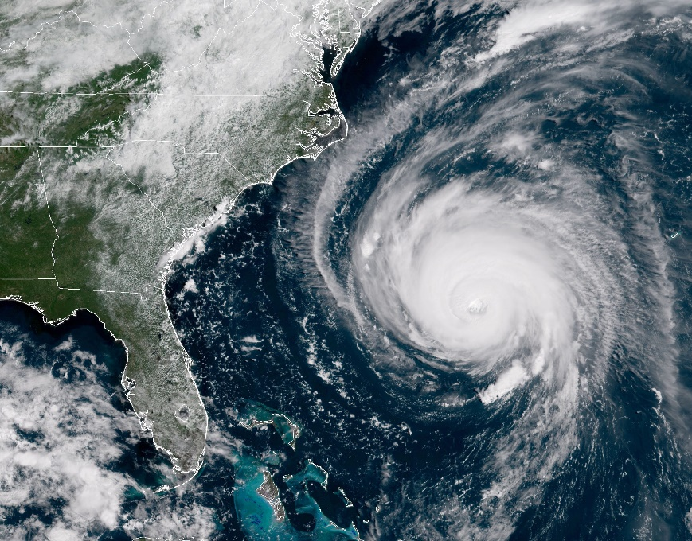
Economic, Social/Political, or Physical Factors?
Economic factors = factors dealing w/$$$
Social/Political factors = factors dealing w/freedoms and acceptance
Physical factors = geographic or environmental factors and natural resources

