Slide 1
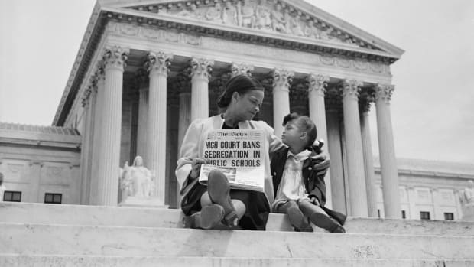
After Brown v Board

Slide 2
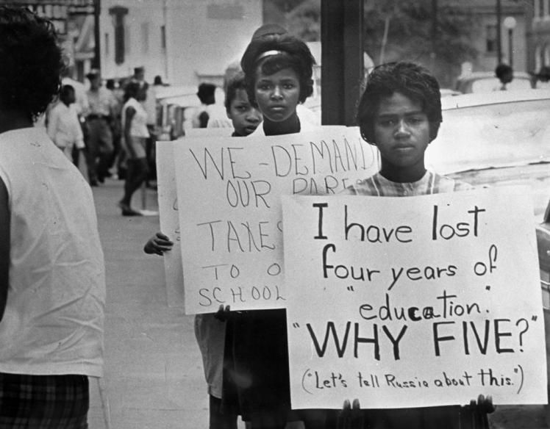
“With all deliberate speed”
Southern Manifesto

Slide 3
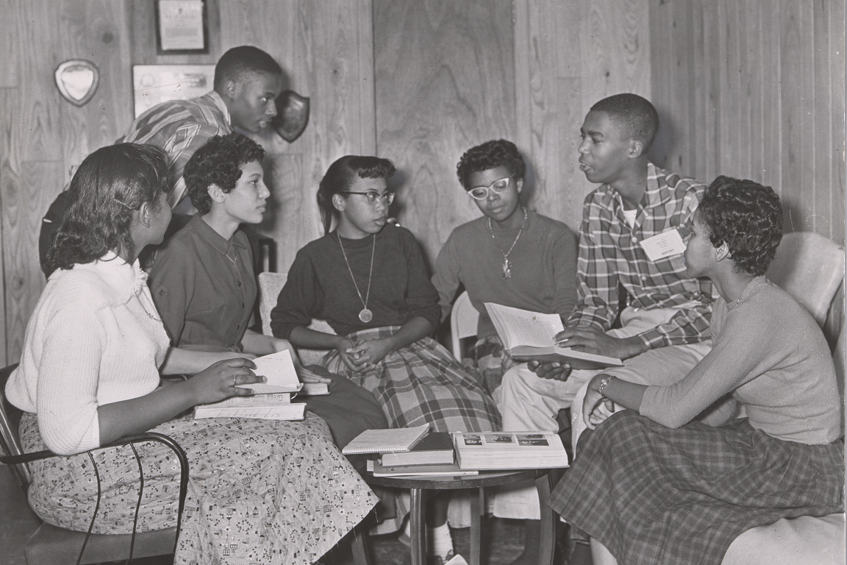
The Little Rock Nine

Slide 4
Continued…
Governor Orval Faubus
President Eisenhower mobilizes the National Guard
Statistics
By 1968, only 6% of African American children in the south attended integrated schools
By 1973, the figure was 90 percent

