Slide 1
Emotions: Anger and Happiness

Slide 2
Topics for Today
Anger
Happinesss
Feel Good, Do Good Phenomenon
Positive Psychology
Subjective Well-Being
Adaptation Level Phenomenon
Relative Deprivation

Slide 3
Anger
Can be harmful and destructive
Catharsis
Promoted more by western cultures
Does it work?
Can be helpful?

Slide 4
Happiness
What we aspire to?
Subjective well-being = Your own perception of happiness and satisfaction

Slide 5
Feel good, do good phenomenon
Positive moods lead to positive actions

Slide 6
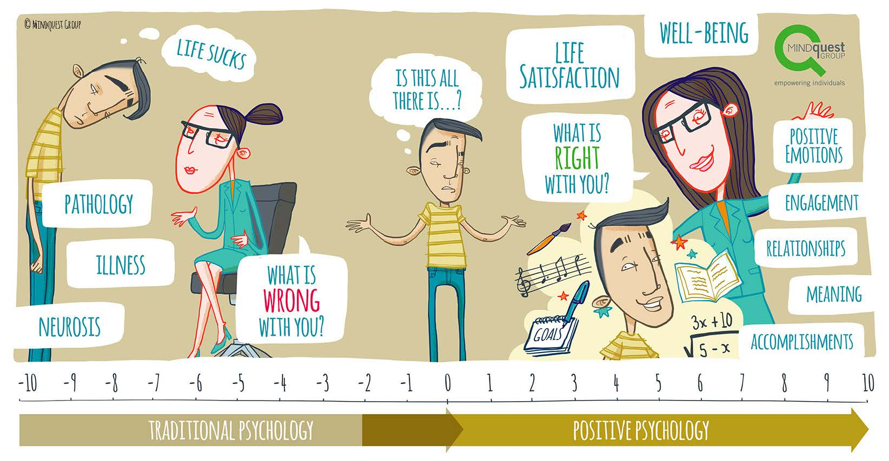
Positive Psychology

Slide 7
Influencers on Happiness
Adaptation Level Phenomenon
Relative Deprivation

Slide 8
David Myers’ Tips for a Happier Life
Take control of your time
Act happy
Seek work and leisure that engage your skills
Buy experiences rather than things
Exercise!
Sleep!
Prioritize close relationships
Do something to benefit others
Get in touch with your spiritual self
Exercise self-control

