Slide 1
Anxiety Disorders, OCD, PTSD

Slide 2
Topics for Today
Anxiety disorders
Obsessive-Compulsive Disorder
Post-Traumatic Stress Disorder
Causes and components

Slide 3
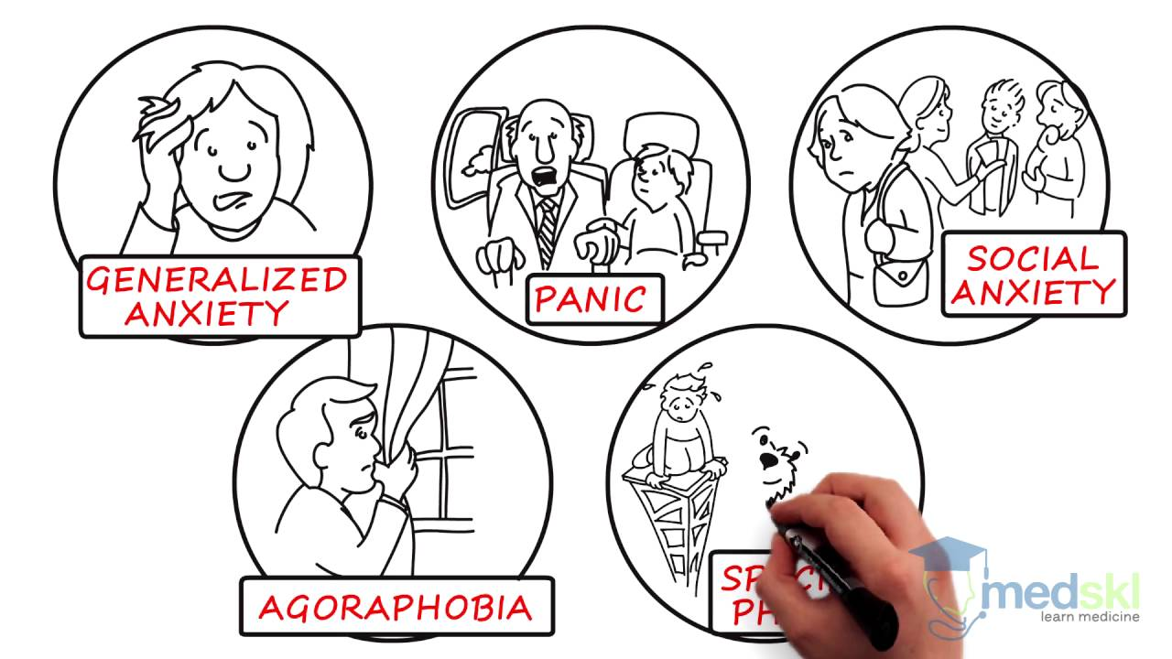
Anxiety Disorders
Categorized by high levels of anxiety
Generalized anxiety disorder
Phobias
Panic disorder
Generally subside with age

Slide 4
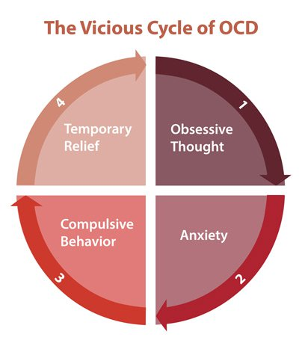
Obsessive-Compulsive Disorder
Now it’s own category of disorders (formerly an anxiety disorder)
Presence of obsession and/or compulsion
Obsession = recurring unwanted thought
Compulsion = recurring behavior to alleviate anxiety
More common in adolescents and young adults

Slide 5
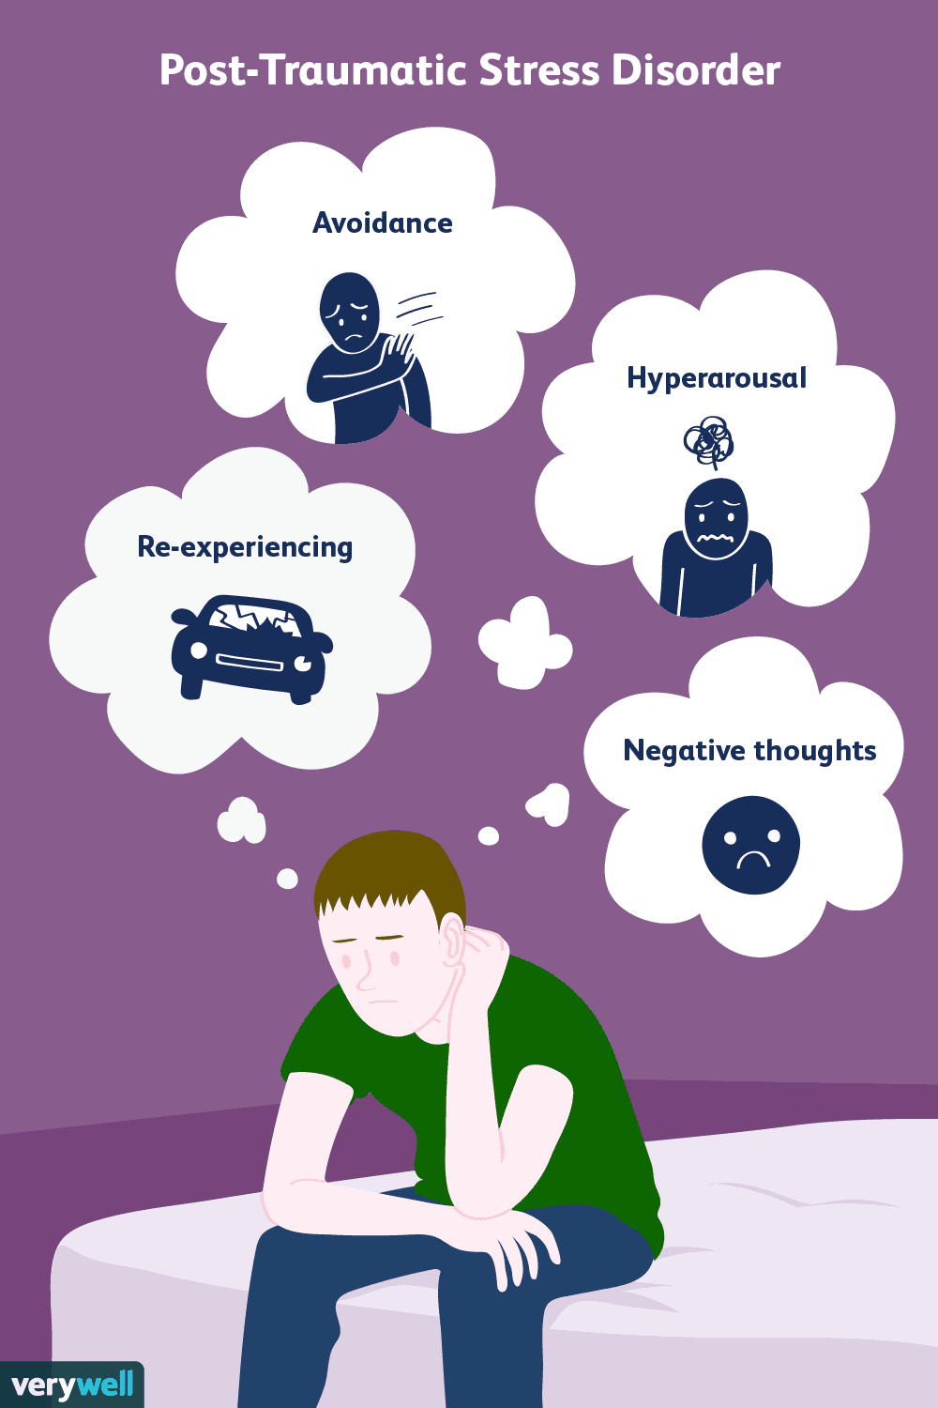
Post-Traumatic Stress Disorder
Present after trauma is experienced
Symptoms:
Recurring memories
Heightened levels of anxiety
Distressing dreams

Slide 6
Causes and components
Biological:
Genes
The brain
Psychological:
Conditioning
Cognition
Environmental

