Slide 1
Prologue: The Story of Psychology
Notes:
“I have made a ceaseless effort not to ridicule, not to bewail, not to scorn human actions, but to understand them.”
Benedict Spinoza, A Political Treatise, 1677.

Slide 2
Psychological Science is Born
Empiricism
Knowledge comes from experience via the senses
1879 - Wilhelm Wundt creates 1st psych lab.

Slide 3
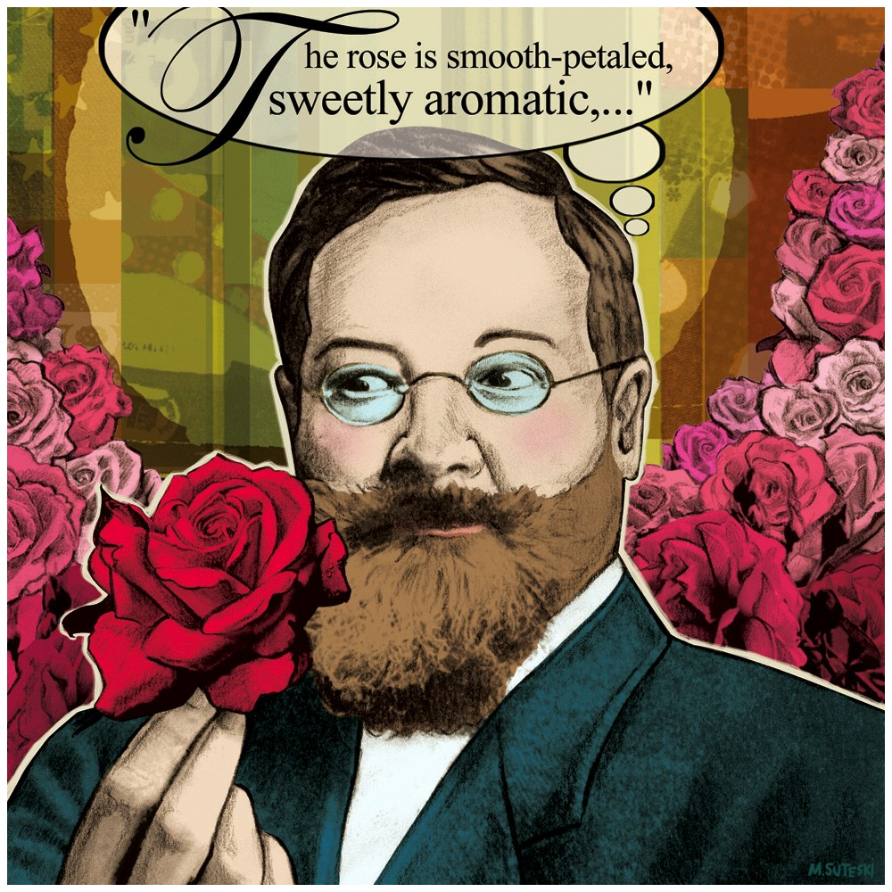
Structuralism
Focused on determining what was the structure of the mind
Used Introspection
Edward Titchner (1867-1927)
Notes:
OBJECTIVE 3| Explain how early psychologists sought to understand the mind’s structure and functions, and identify some of the leading psychologists who worked in these areas. Structuralism: Wundt and his student Titchner focused on the elements of mind, and studied it by using introspection (self-reflection). Wundt established the first laboratory of psychology in 1879 at Leipzig, Germany, and wrote the first textbook of psychology.

Slide 4
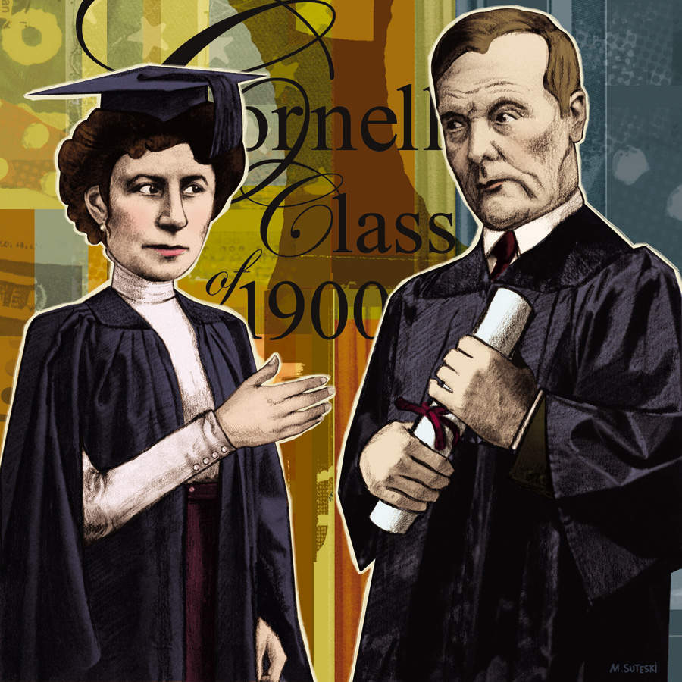
Functionalism
William James (1842-1910)
Mary Calkins
Notes:
Functionalism: James suggested that it would be more fruitful to consider the evolved functions of our thoughts and feelings than simply studying the elements of mind. Based on the theory of evolution, he suggested that the function of these thoughts and feelings was adaptive. James admitted the first woman student Mary Calkins to Harvard and tutored her. Despite his efforts she was not able to attain her PhD from Harvard.

Slide 5
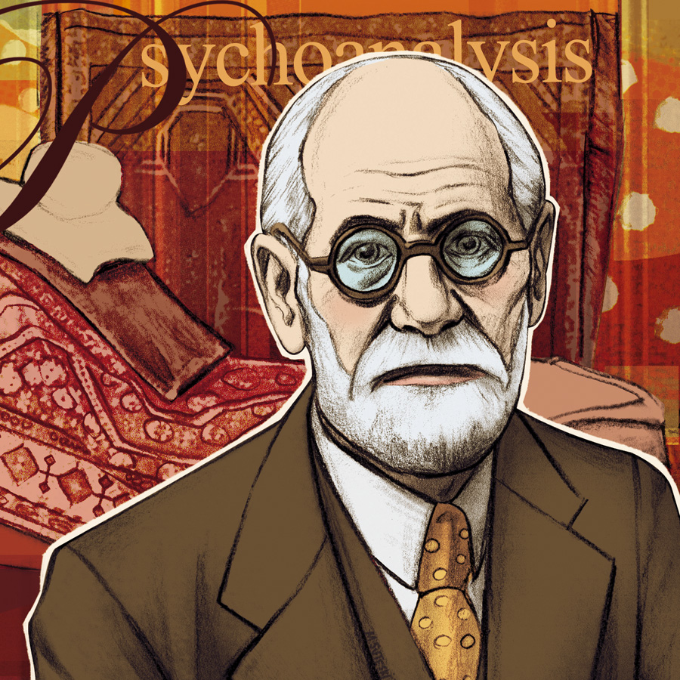
The Unconscious Mind (Psychoanalysis)
Freud (1856-1939)

Slide 6
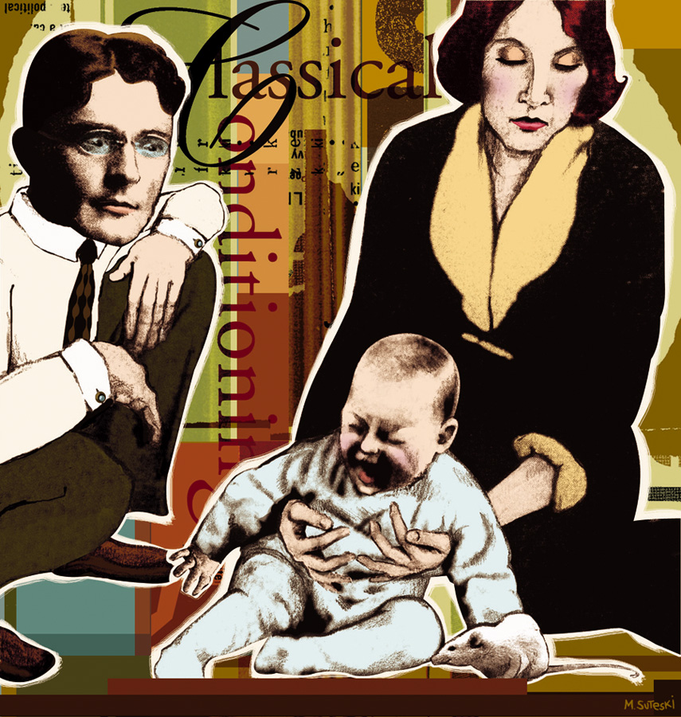
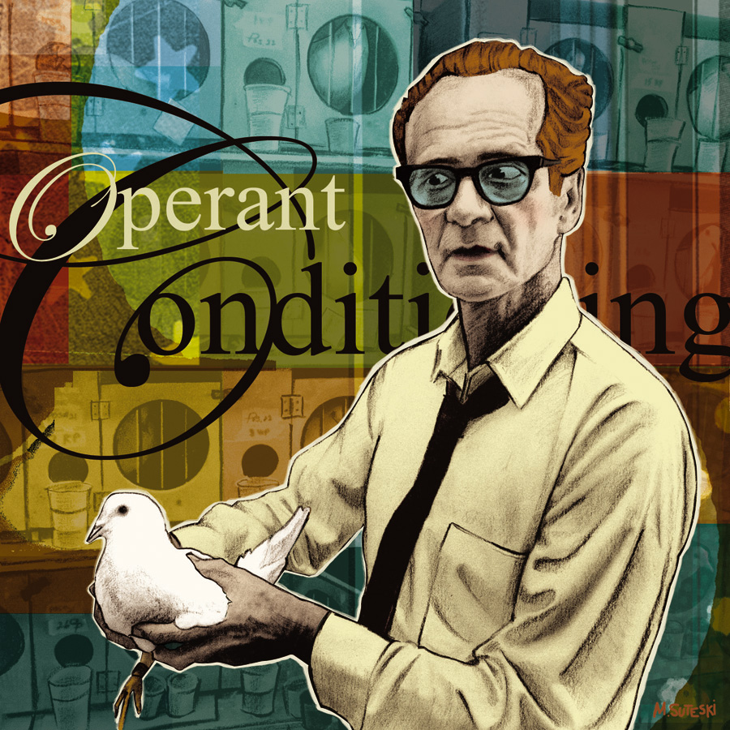
Behaviorism
John Watson (1878-1958)
B.F. Skinner (1904-1990)
Notes:
OBJECTIVE 4| Describe the evolution of psychology as defined from 1920s to through today. Ivan Pavlov a Russian Physiologist, James Watson and Skinner were all instrumental in developing the science of psychology and emphasized behavior instead of mind or mental thoughts. From 1920 to 1960, psychology in the US was heavily oriented towards behaviorism.

Slide 7
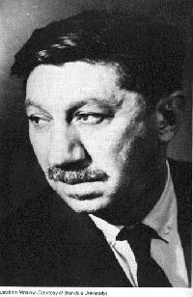
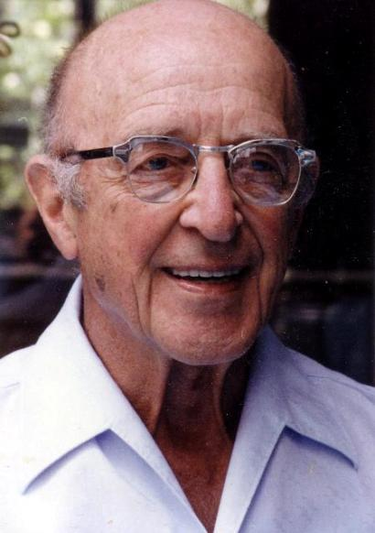
Humanistic Psychology
Abraham Maslow (1908-1970)
Carl Rogers (1902-1987)

