Slide 1
George HW Bush
One and Done

Slide 2
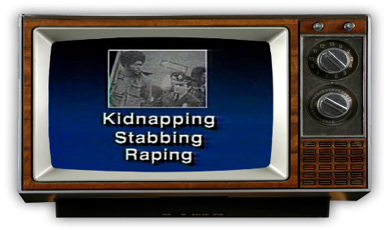
Bush Gets to the White House
Bush uses Reagan’s popularity to win
Uses infamous Willie Horton campaign ad
Promises “No New Taxes”
Wins easily

Slide 3
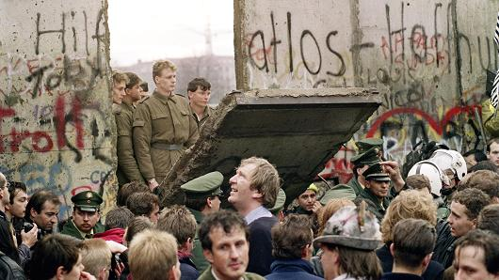
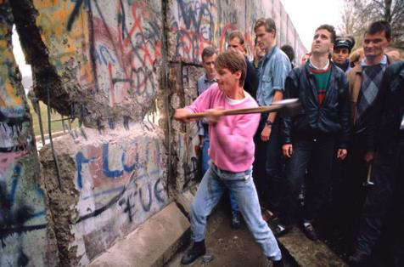
Cold War Ends
USSR dissolves by 1991
Berlin Wall falls in 1990
Cold War ends, most credit goes to Reagan

Slide 4
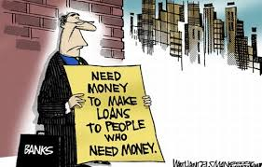
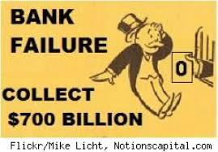
Savings and Loan Crisis
Deregulation = weak bank oversight
S&Ls made risky loans and investments
Economic crash hurts Bush’s presidency

Slide 5
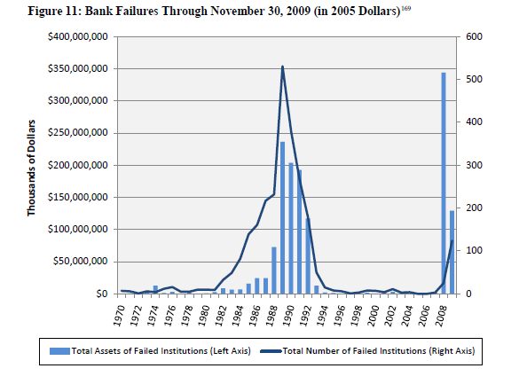

Slide 6
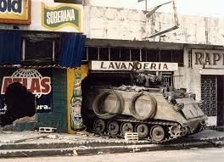
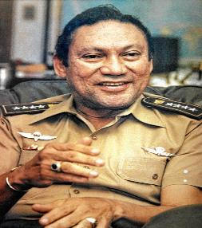
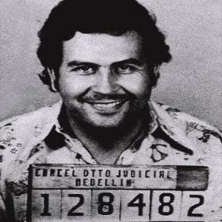
Meanwhile in Panama
Manuel Noriega = dictator
Uses drug cartels and military force to keep power
US invades Panama to remove Noriega (1989)
Noriega brought to US on drug charges

Slide 7
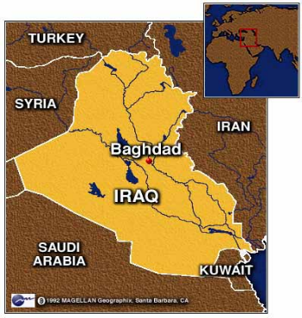
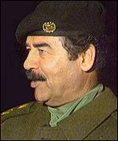
Iraq Attack!
Iraq invades Kuwait (1990)
Dictator Saddam Hussein wanted their oil
Would have given Iraq ½ of the world’s oil supply

Slide 8
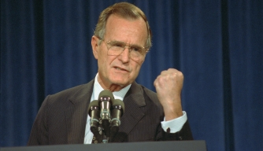
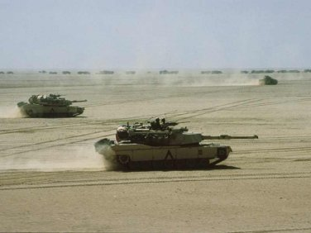
Bush vs Saddam (Round 1)
Bush launches Operation Desert Storm (1991)
US drives Iraq from Kuwait in 6 weeks
Hussein left in power, sanctions were placed on Iraq

Slide 9
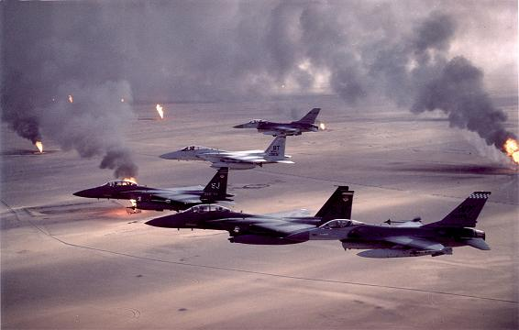

Slide 10
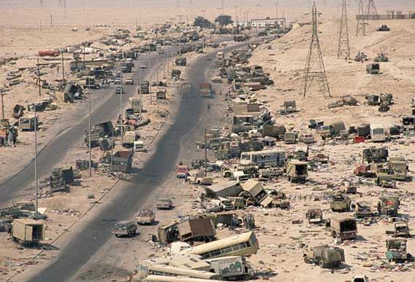

Slide 11
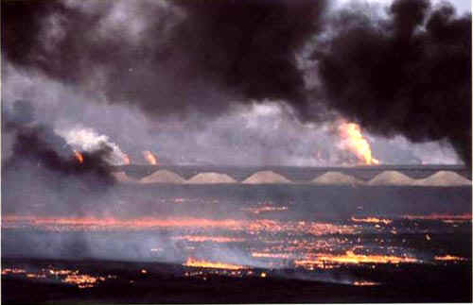

Slide 12
Bush Wins and Loses
Bush’s approval rating goes up after war
Recession persists, Bush raises taxes
Bush’s approval rating drops before 1992 election

Slide 13
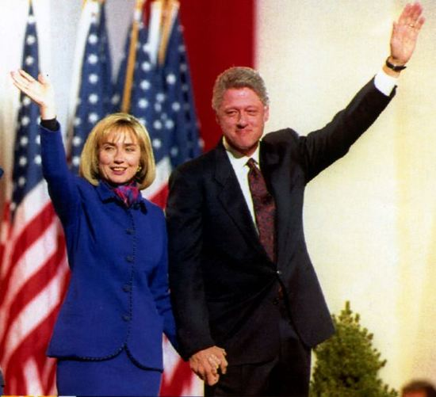
1992 Election

