Slide 1
Cultural Changes of the 1920s
And their consequences…

Slide 2
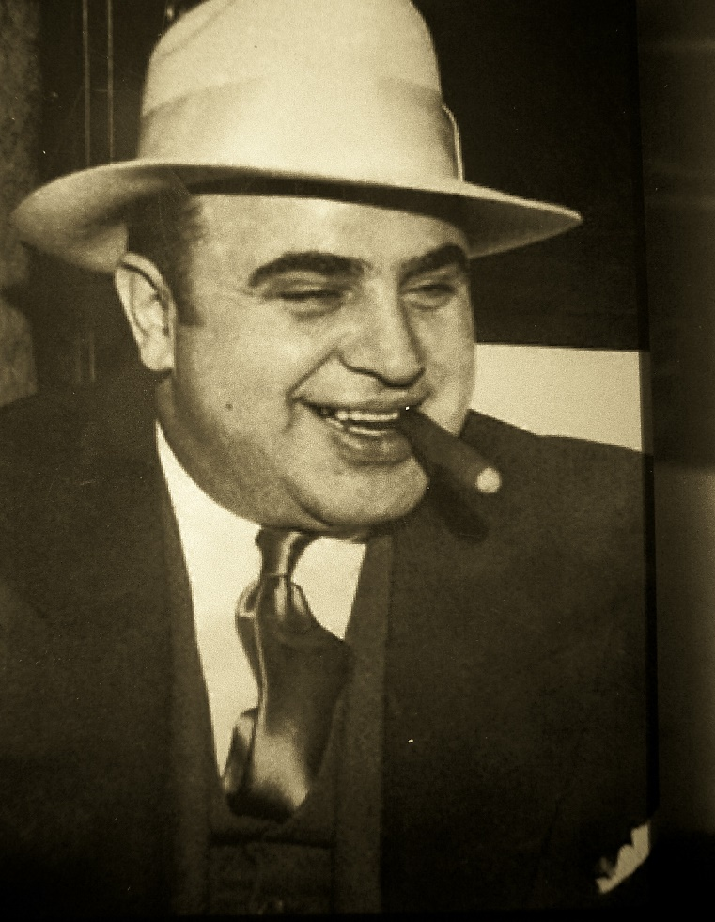
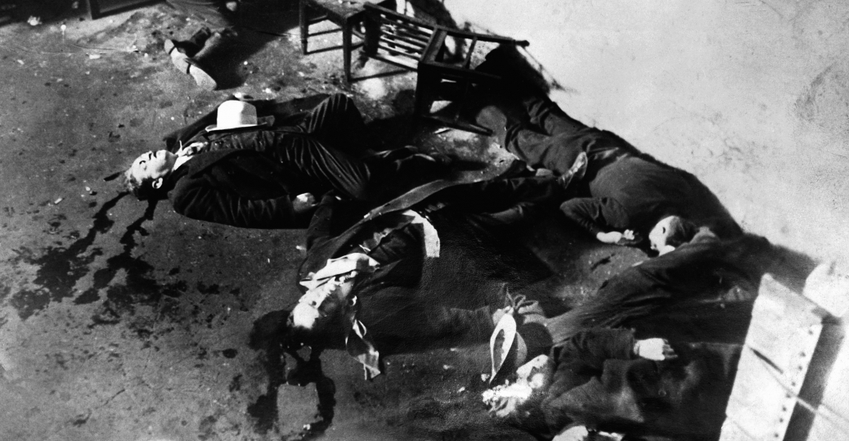
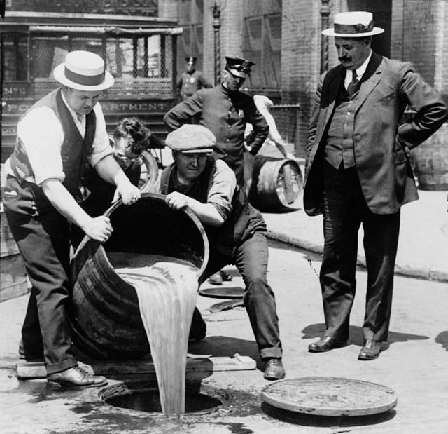
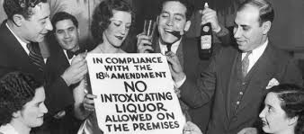
Prohibition
Effects:
Contempt for law
Organized crime
Political corruption

Slide 3
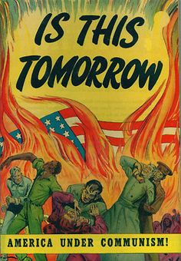
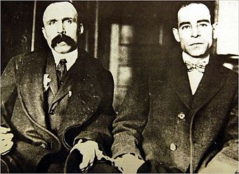
Red Scare
Effects:
Rise in nativism
Sacco and Vanzetti case

Slide 4
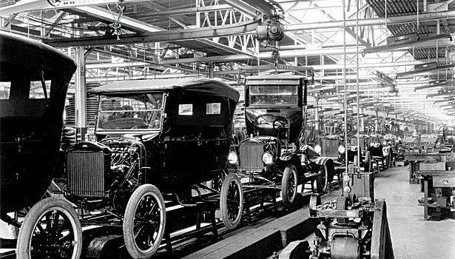
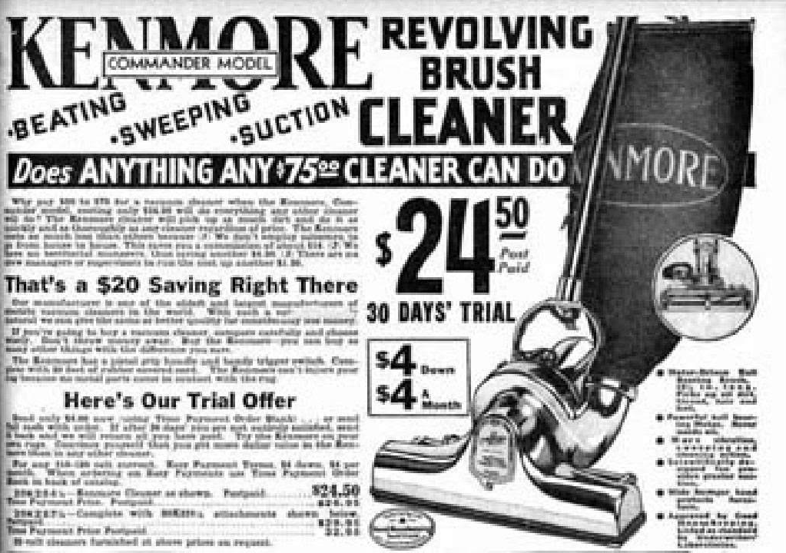
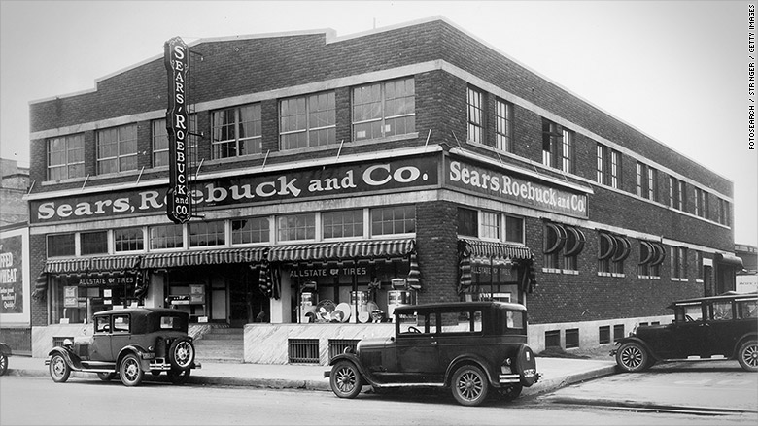
Economic Boom
Effects:
Rise in consumerism
Rise in debt

Slide 5
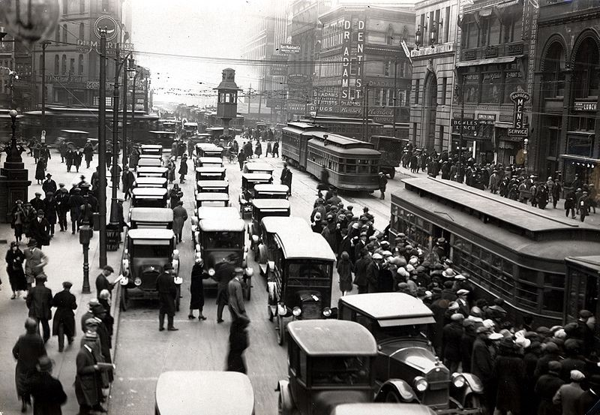
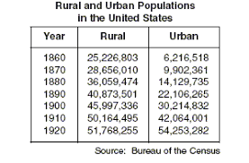
Increased Urban Population
Effects:
More access to amenities, like electricity

Slide 6
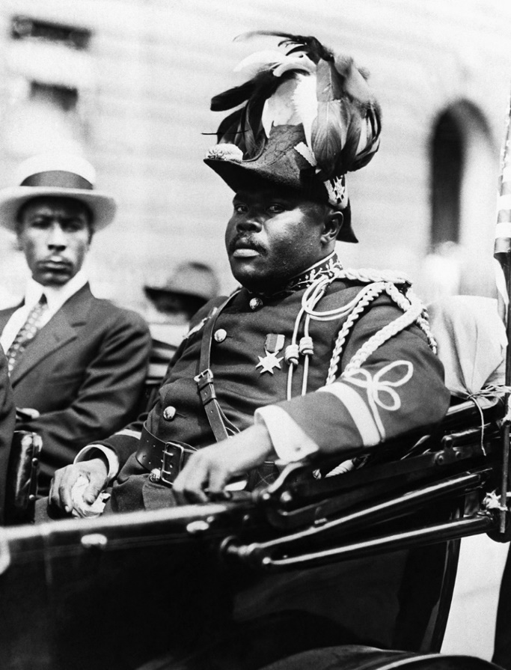
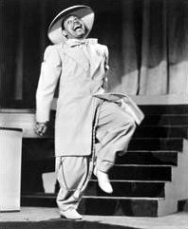
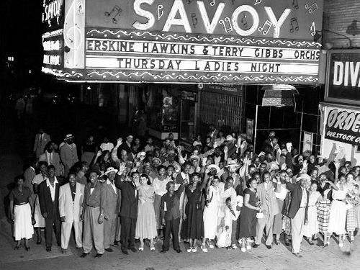
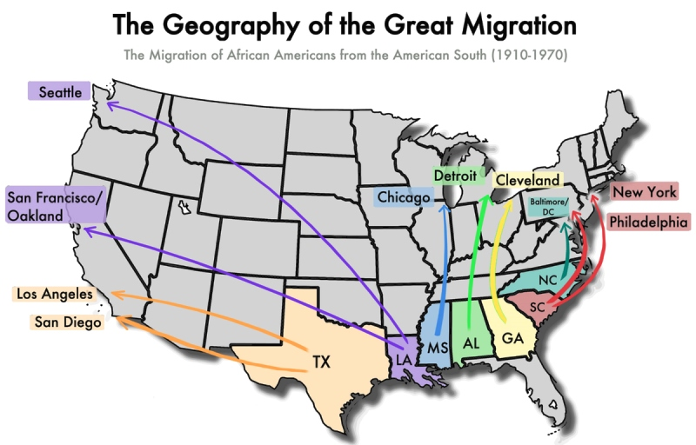
Great Migration
Effects:
Harlem Renaissance
Popularity of Marcus Garvey
Increased demand for civil rights
Red Summer
Popularity of Black culture

Slide 7
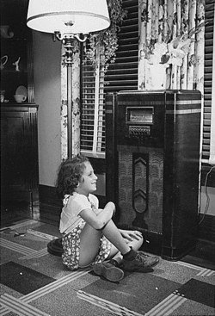
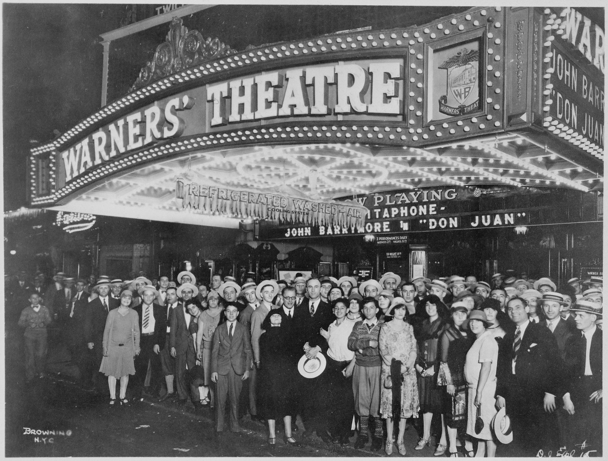
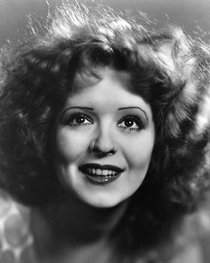
Popularity of Radio and Movies
Effects:
Homogenous national culture
Rise in celebrities
Celebrity worship

Slide 8
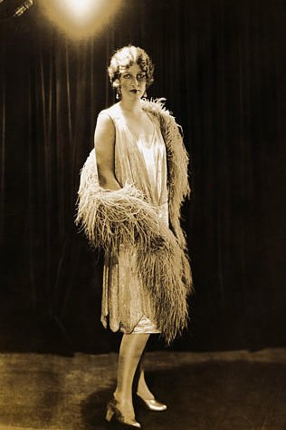
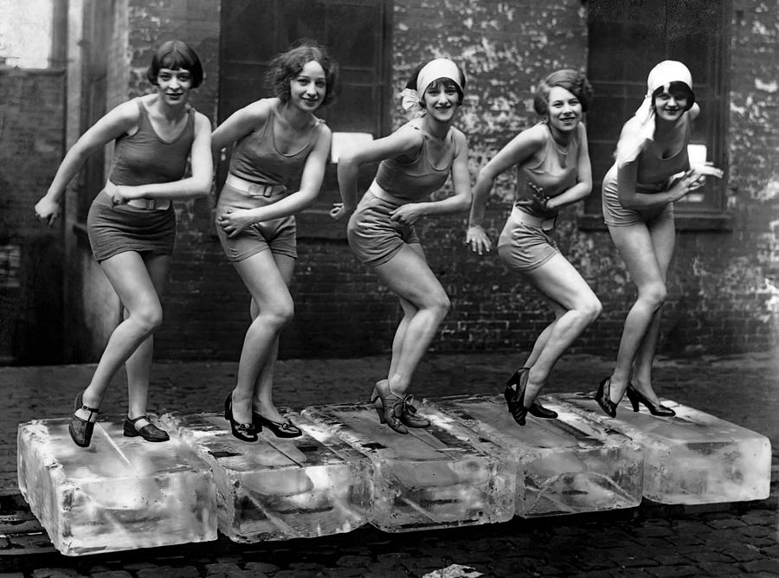
Changing Roles of Women
Effects:
Women’s suffrage
Women gain more social independence
Flappers

Slide 9
Reactions to Cultural Changes
Changes during 1920s caused many social conflicts
Nicknamed, “culture wars”
Culture War = social conflicts over changes or events in a country
Conflicts in 1920s between modernists and traditionalists

Slide 10
Modernists
Believe society should progress and change from “old school” values and traditions
Promote scientific progress and technology

Slide 11
Traditionalists
People who want a nation/culture to not change or go back to the way things were in the past.
Focus on security and traditional religious values

