Slide 1
Depth Perception

Slide 2
Depth Perception
Depth perception = ability to judge distances.
Humans develop depth perception when they learn to crawl.
Innervisions
Visual Cliff
Notes:
OBJECTIVE 5| Explain the importance of depth perception, and discuss the contribution of visual cliff research to our understanding of this ability.

Slide 3
How we judge distance
2 main methods to judge distance:
Monocular cues = requires only 1 eye
Binocular cues = requires 2 eyes

Slide 4
Binocular Cues
Retinal disparity: Images from the two eyes differ.
Your brain puts these images together to make it 3-D
This is the finger sausage thing

Slide 5
Binocular Cues
Convergence: tension in eye muscles from different distances
Close objects = eyes move inward
Faraway objects = eyes move outward
Notes:
OBJECTIVE 6| Describe two binocular cues for perceiving depth, and explain how they help the brain to compute distance.

Slide 6
Assignment
With 2 other people in class, you are going to take a photo somewhere on campus that includes as many monocular cues as possible.

Slide 7
Monocular Cues
Relative size
Interposition
Relative clarity
Texture gradient
Relative height
Relative motion (motion parallax)
Linear perspective
Light and shadow
Motion perception

Slide 8
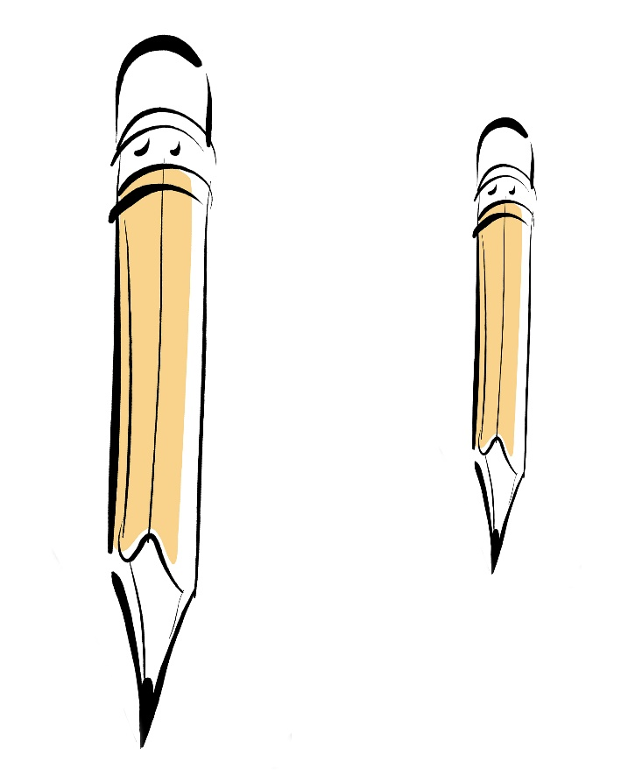
Monocular Cues
Relative Size: If two objects are similar in size, we perceive the smaller one to be further away.
Notes:
OBJECTIVE 7| Explain how monocular cues differ from binocular cues, and describe several monocular cues for perceiving depth.

Slide 9
Monocular Cues
Interposition: Objects that occlude (block) other objects tend to be perceived as closer.

Slide 10
Monocular Cues
Relative Clarity: Hazier objects appear further away compared to objects in more focus

Slide 11
Monocular Cues
Texture Gradient: Indistinct (fine) texture signals an increasing distance.
© Eric Lessing/ Art Resource, NY

Slide 12
Monocular Cues
Relative Height: Objects higher in visual field appear further away.

Slide 13
Monocular Cues
Relative motion (motion parallax): When staring at fixed point while moving…
Closer objects = move quickly in opposite direction
Further objects = move slower in same direction

Slide 14
Monocular Cues
Linear Perspective: Parallel lines appear to converge in the distance.
More convergence = more distance

Slide 15
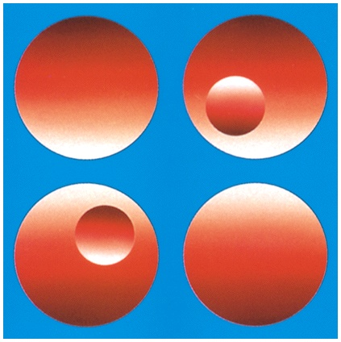
Monocular Cues
Light and Shadow: Nearby objects reflect more light into our eyes than more distant objects.
From “Perceiving Shape From Shading” by Vilayaur
S. Ramachandran. © 1988 by Scientific American, Inc.
All rights reserved.

Slide 16
Motion Perception
Motion Perception: Objects traveling towards us grow and those moving away shrink.
Notes:
OBJECTIVE 8| State the basic assumption we make in our perceptions of motion, and explain how these perceptions can be deceiving.

