Slide 1
Developmental Psych

Slide 2
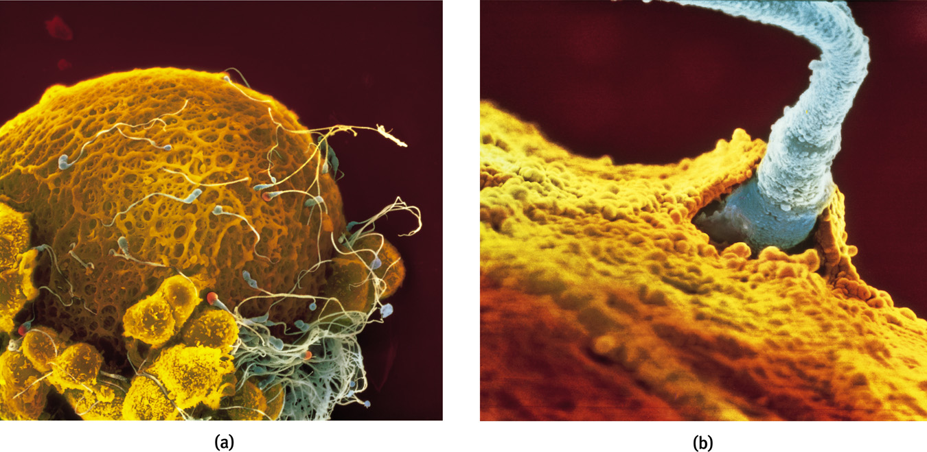
Zygote
Figure 4.1 Life is sexually transmitted

Slide 3
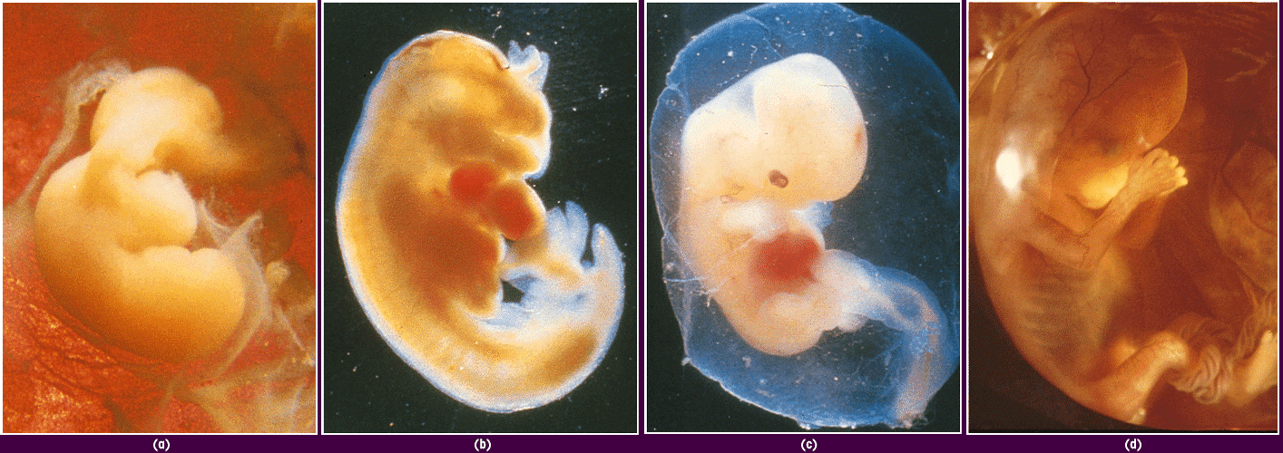
Prenatal Development and the Newborn
40 days 45 days 2 months 4 months

Slide 4
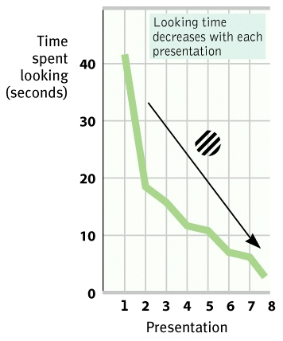
Prenatal Development and the Newborn
Habituation
decreasing responsiveness with repeated stimulation

Slide 5
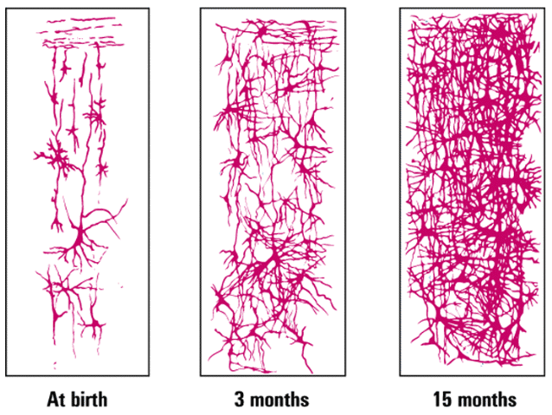
Infancy and Childhood: Physical Development
Maturation
biological growth processes relatively uninfluenced by experience
At birth
3 months
15 months
Cortical Neurons

Slide 6
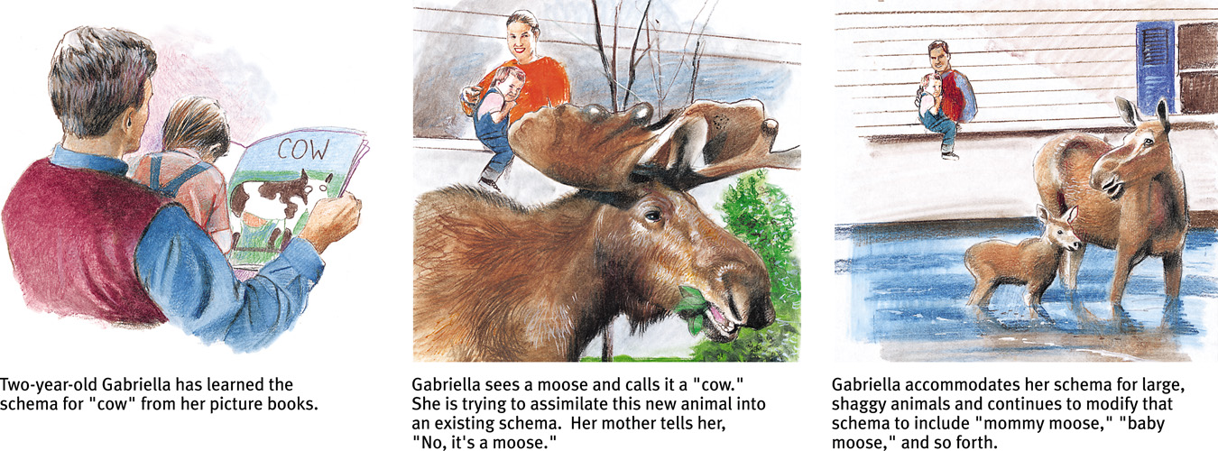
Schema Development

Slide 7
Piaget’s Stages of Cognitive Development
Typical Age
Range
Description
of Stage
Developmental
Phenomena
Birth to nearly 2 years
Sensorimotor
Experiencing the world through
senses and actions
Object permanence
Stranger anxiety
About 2 to 6 years
Preoperational
Representing things
with words and images
but lacking logical reasoning
Pretend play
Egocentrism
Language development
About 7 to 11 years
Concrete operational
Thinking logically about concrete
events; grasping concrete analogies
and performing arithmetical operations
Conservation
Mathematical transformations
About 12 through
adulthood
Formal operational
Abstract reasoning
Abstract logic
Potential for moral reasoning

Slide 8
Object Permanence

Slide 9
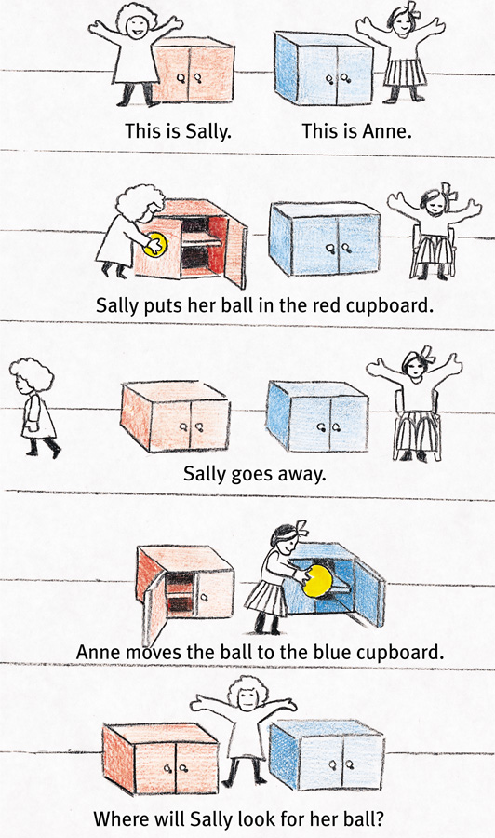
Theory of Mind

Slide 10
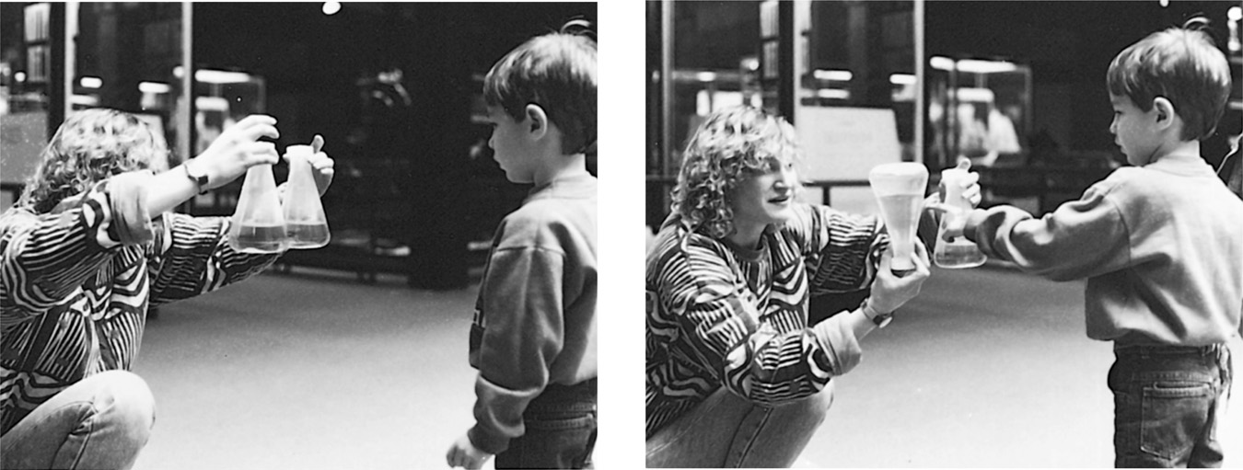
Conservation

Slide 11
Lev Vygotsky
Other theory of cognitive development
Development happens thru interaction w/others and language
Scaffolding = assistance to learner
Zone of Proximal Development = the difference between what child can do alone and child can do w/help from teacher

Slide 12
Social Development
Harry Harlow – Monkey attachment studies
Mary Ainsworth – Attachment studies (infants)
Konrad Lorenz – Imprinting
Diana Baumrind – studies on parenting styles
Erik Erikson – psychosocial stages of development

Slide 13
Attachment Studies: Harlow
Physical contact is key for secure attachment

Slide 14
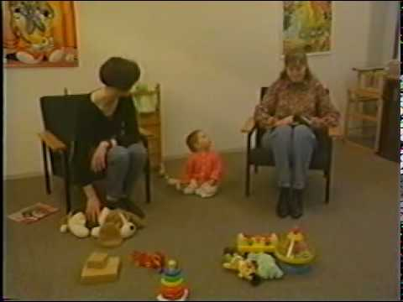
Attachment Studies: Ainsworth
Strange Situation experiments
Types of Attachment:
Secure – cry until mom comes back, then is fine
Avoidant – doesn’t cry when mom leaves or returns
Ambivalent – cries until mom returns, then is mad

Slide 15
Parenting Styles
Authoritarian Permissive Authoritative

Slide 16
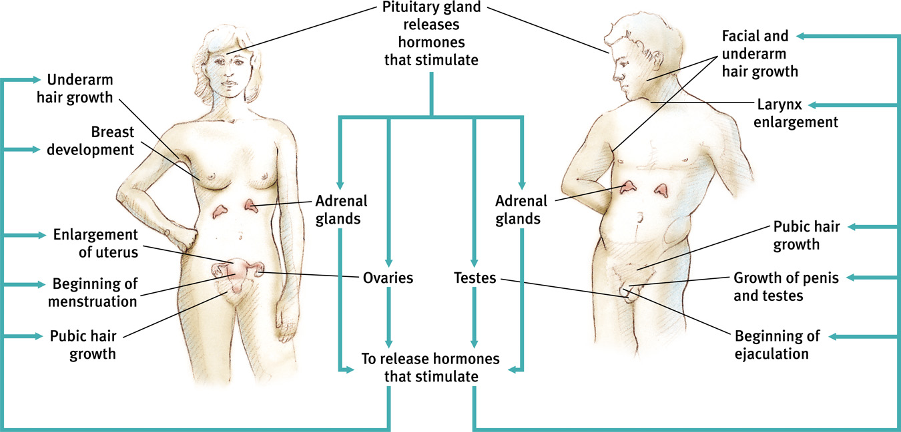
Adolescence
Starts when you hit puberty ends when you’re independent

Slide 17
Lawrence Kohlberg’s Theory of Moral Development
Agre Range | Stage | Morality based on
0 – 9 years old | Preconventional | 1) Avoiding punishment 2) Gaining a reward
9 – 20 years old | Conventional | 1) Gaining approval 2) Avoiding disapproval 3) Duty and guilt to maintain social order
20+ years old or Maybe never… | Postconventional | 1) Agreed upon rights 2) Personal ethical beliefs

Slide 18
Carol Gilligan’s Stages of Moral Development
Morality based on…
Stage One: Individual Survival
Stage Two: Self-sacrifice
Stage Three: Equality towards others
Gilligan theory is seen as the feminist critique of Kohlberg’s theory of morality

Slide 19
