Slide 1
Emotion Chapter 13

Slide 2
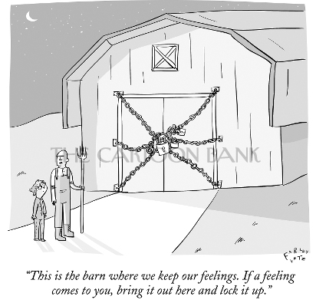

Slide 3
James-Lange Theory
The James-Lange Theory proposes…
- physiological activity precedes the emotional experience.

Slide 4
Cannon-Bard Theory
Cannon-Bard Theory proposes…
- an emotional experience and the body's arousal take place simultaneously (but separately).
Notes:
1) Cannon suggested that body’s responses were not distinct enough to evoke different emotions. 2) Physiological responses seemed too slow to trigger sudden emotions.

Slide 5
Two-Factor Theory
The Two-Factor Theory suggests…
- Emotions have two factors–physical arousal and cognitive label.

Slide 6
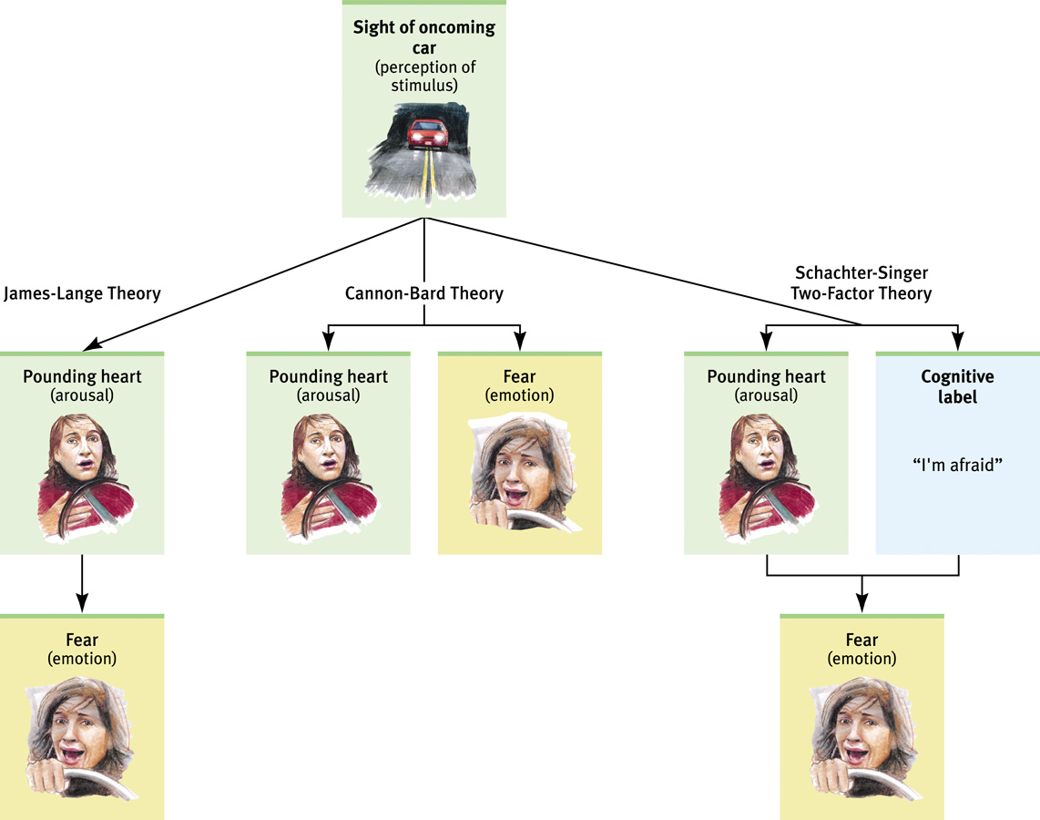

Slide 7
Physiological Responses During Emotions
Notes:
OBJECTIVE 2| Describe the role of the autonomic nervous system during emotional arousal.

Slide 8
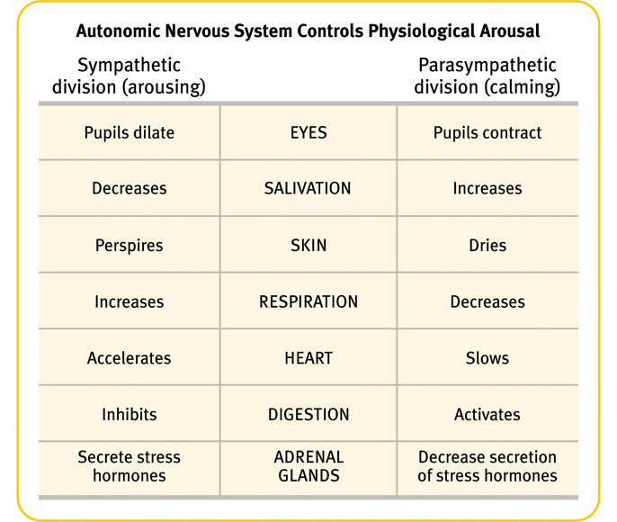

Slide 9
Physiological Similarities
Physiological responses related to the emotions of fear, anger, love, and boredom are very similar.
Excitement and fear involve a similar
physiological arousal.
Notes:
OBJECTIVE 4| Name three emotions that involve similar physiological arousal.

Slide 10
Physiological Differences
The amygdala shows differences in activation during the emotions of anger and rage. Activity of the left hemisphere (happy) is different from the right (depressed) for emotions.
Notes:
OBJECTIVE 5| Describe some physiological and brain pattern indicators of specific emotions.

Slide 11
Cognition Can Define Emotion
An arousal response to one event spills over into our response to the next event. Called the spillover effect.
Arousal from a soccer match can fuel anger, which may lead to rioting.
Notes:
OBJECTIVE 6| Explain how spillover effect influences our experience of emotion.

Slide 12
Cognition Does Not Always Precede Emotion
A subliminally presented happy face can encourage subjects to drink more than when presented with an angry face (Berridge & Winkeilman, 2003).
Emotions are felt directly through the amygdala (a) or through the cortex (b) for analysis.
Notes:
OBJECTIVE 7| Distinguish the two alternate pathways that sensory stimuli may travel when triggering an emotional response.

Slide 13
Nonverbal Communication
Most of us are good at deciphering emotions through non-verbal communication. In a crowd of faces a single angry face will “pop out” faster than a single happy face (Fox et al. 2000).
Notes:
OBJECTIVE 8| Describe some of the factors that affect our ability to decipher non-verbal cues.

Slide 14
Gender, Emotion, and Nonverbal Behavior
Women are much better at discerning nonverbal emotions than men. When shown sad, happy, and scary film clips women expressed more emotions than men.
Notes:
OBJECTIVE 9| Describe some gender differences in perceiving and communicating emotions.

Slide 15
Detecting and Computing Emotion
Most people find it difficult to detect deceiving emotions. Even trained professionals like police officers, psychiatrists, judges, and polygraphists detected deceiving emotions only 54% of the time.
Dr. Paul Elkman, University of California at San Francisco
Which of Paul Ekman’s smiles is genuine?
Notes:
OBJECTIVE 10| Discuss the research on reading and misreading facial and behavioral indicators of emotion.

Slide 16
Culture and Emotional Expression
When culturally diverse people were shown basic facial expressions, they did fairly well at recognizing them (Ekman & Matsumoto, 1989).
Notes:
OBJECTIVE 11| Discuss the culture-specific and culturally universal aspects of emotional expression, and explain how emotional expressions can enhance survival.

Slide 17
Analyzing Emotion
Analysis of emotions are carried on different levels.

Slide 18
Experienced Emotion
Izard (1977) isolated 10 emotions. Most of
them are present in infancy, except for contempt,
Shame, and guilt.
Bob Daemmrich/ The Image Works
Tom McCarthy/ Rainbow
Lew Merrim/ Photo Researchers, Inc.
Nancy Brown/ The Image Bank
Marc Grimberg/ The Image Bank
Michael Newman/ PhotoEdit
Notes:
OBJECTIVE 13| Name the 10 basic emotions, and describe two dimensions psychologists use to differentiate emotions.

Slide 19
Dimensions of Emotion
People generally divide emotions into
two dimensions.

Slide 20
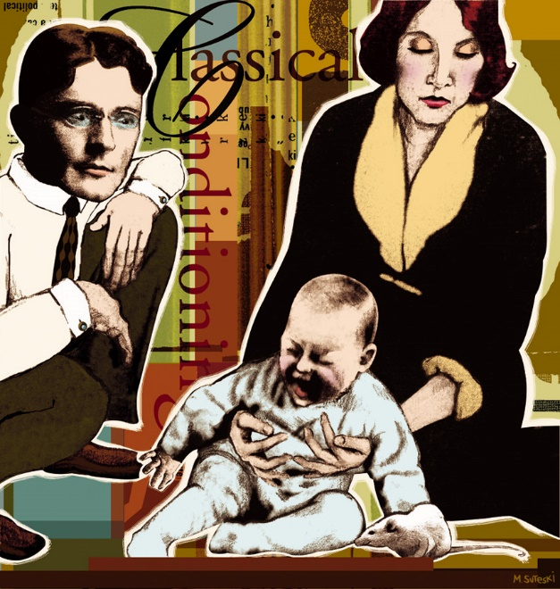
Learning Fear
We learn fear in two ways, either through conditioning and/or through observation.
Some fears are easier to learn than others. The amygdala in the brain associates emotions like fear with certain situations.
Notes:
OBJECTIVE 14| State two ways we learn our fears.

Slide 21
Causes of Anger
People generally become angry with friends who commit wrongdoings, especially if they are willful, unjustified, and avoidable.
People are also angered by foul odors, high temperatures, traffic jams, and aches and pains.

Slide 22
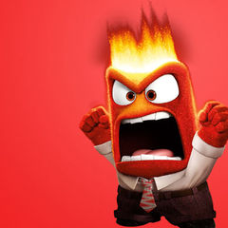
Catharsis Hypothesis
Venting anger through action or fantasy achieves an emotional release or “catharsis.”
Not always true. Expressing anger breeds more anger, and through reinforcement it is habit-forming.

Slide 23
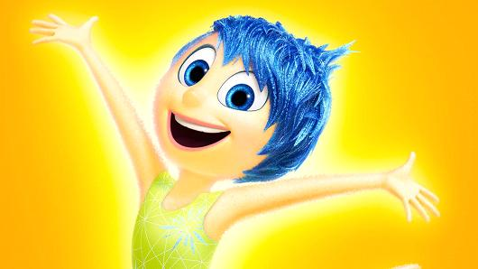
Happiness
People who are happy perceive the world as being safer. They are able to make decisions easily, are more cooperative, rate job applicants more favorably, and live healthier, energized, and more satisfied lives.
Notes:
OBJECTIVE 17| Describe how the feel-good do-good phenomenon works, and discuss the importance of research on subjective well-being.

Slide 24
Feel-Good, Do-Good Phenomenon
When we feel happy we are more willing to help others.

Slide 25
Subjective Well-Being
Subjective well-being is the self-perceived feeling of happiness or satisfaction with life. Research on new positive psychology is on the rise.
http://web.fineliving.com

Slide 26
Wealth and Well-being
Many people in the West believe that if they were wealthier, they would be happier. However, data suggests that they would only be happy temporarily.
Notes:
OBJECTIVE 19| Summarize the findings on the relationship between affluence and happiness.

Slide 27
Does Money Buy Happiness?
Wealth is like health: Its utter absence can breed misery, yet having it is no guarantee of happiness.

Slide 28
Fluctuating States of Being
Adaptation-Level Phenomenon: Like the adaptation to brightness, volume, and touch, people adapt to income levels. “Satisfaction has a short half-life” (Ryan, 1999).
Happiness is not only relative to our past, but also to our comparisons with others. Relative Deprivation is the perception that we are relatively worse off than those we compare ourselves with.
Notes:
OBJECTIVE 20| Contrast the effects on happiness of the adaptation-level and the relative-deprivation principles.

Slide 29
Psychology and Health
Behavioral Medicine
interdisciplinary field that integrates behavioral and medical knowledge and applies that knowledge to health and disease
Health psychology
A field of psychology that contributes to behavioral medicine. The field studies stress-related aspects of disease.

Slide 30
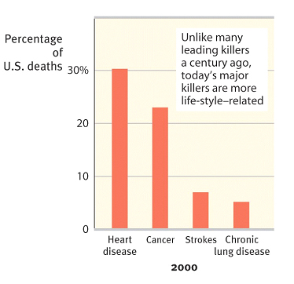
Stress: Good and Bad
Stress can be adaptive. In a fearful or stress- causing situation, we can run away and save our lives.
Stress can be maladaptive. If it is prolonged (chronic stress), it increases our risk of illness and health problems.

Slide 31
Stress and Stressors
Stress is the process by which we perceive and respond to certain events, called stressors, that we appraise as threatening or challenging.
Bob Daemmrich/ The Image Works

Slide 32
The Stress Response System
Canon proposed that the stress response was marked by outpouring of epinephrine and norepinephrine from the inner adrenal glands, increasing heart and respiration rates, mobilizing sugar and fat, and dulling pain.
Notes:
OBJECTIVE 3| Identify and describe the dual-track system by which our body responds to stress, and give the three phases of the general adaptation syndrome.

Slide 33
The Stress Response System

Slide 34
General Adaptation Syndrome
According to Selye, a stress response to any kind of
stimulation is similar. The stressed individual goes
through three phases.

Slide 35
Stressful Life Events
Catastrophic Events
earthquakes, combat stress, floods
Life Changes
death of a loved one, divorce, loss of job, promotion
Daily Hassles
rush hour traffic, long lines, job stress, burnout
Notes:
OBJECTIVE 4| Discuss the health consequences of catastrophes, significant lie changes, and daily hassles.

Slide 36
Personality Types
Type A is a term used for competitive, hard-driving, impatient, verbally aggressive, and anger-prone people. Type B refers to easygoing, relaxed people (Friedman and Rosenman, 1974).
Type A personalities are more likely to develop
coronary heart disease.

Slide 37
Pessimism and Heart Disease
Pessimistic adult men are twice as likely to develop heart disease over a 10-year period (Kubzansky et al., 2001).

Slide 38
Stress & Susceptibility to Disease
A psychophysical illness is any stress-related physical illness such as hypertension or headaches. Hypochondriasis is a misinterpretation of normal physical sensations as symptoms of disease.
Notes:
OBJECTIVE 6| Distinguish between a psychophysical illness and hypochondriasis.

Slide 39
Stress and the Immune System
B lymphocytes fight bacterial infections, T lymphocytes attack cancer cells and viruses, and microphages ingest foreign substances. During stress, energy is mobilized away from the immune system making it vulnerable.
Lennart Nilsson/ Boehringer Ingelhein International GmbH
Notes:
OBJECTIVE 7| Describe the effect of stress on immune system functioning.

Slide 40
Perceived Control
Research with rats and humans indicates that the absence of control over stressors is a predictor of health problems.
Notes:
OBJECTIVE 12| Describe how a perceived lack of control can affect health.

