Slide 1
Beginning of the End of the Cold War
The “Evil Empire” Goes Down

Slide 2
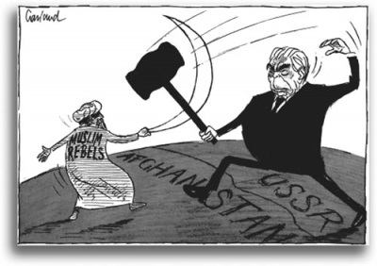
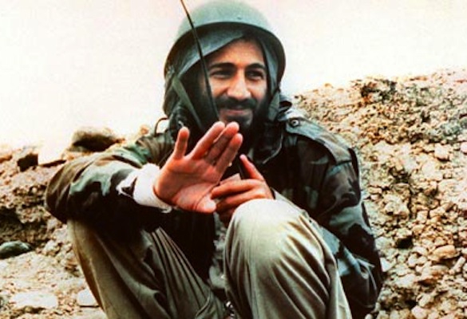
USSR During the 1970s
Increases military spending
Expands military
Intervenes in other countries
Invades Afghanistan

Slide 3
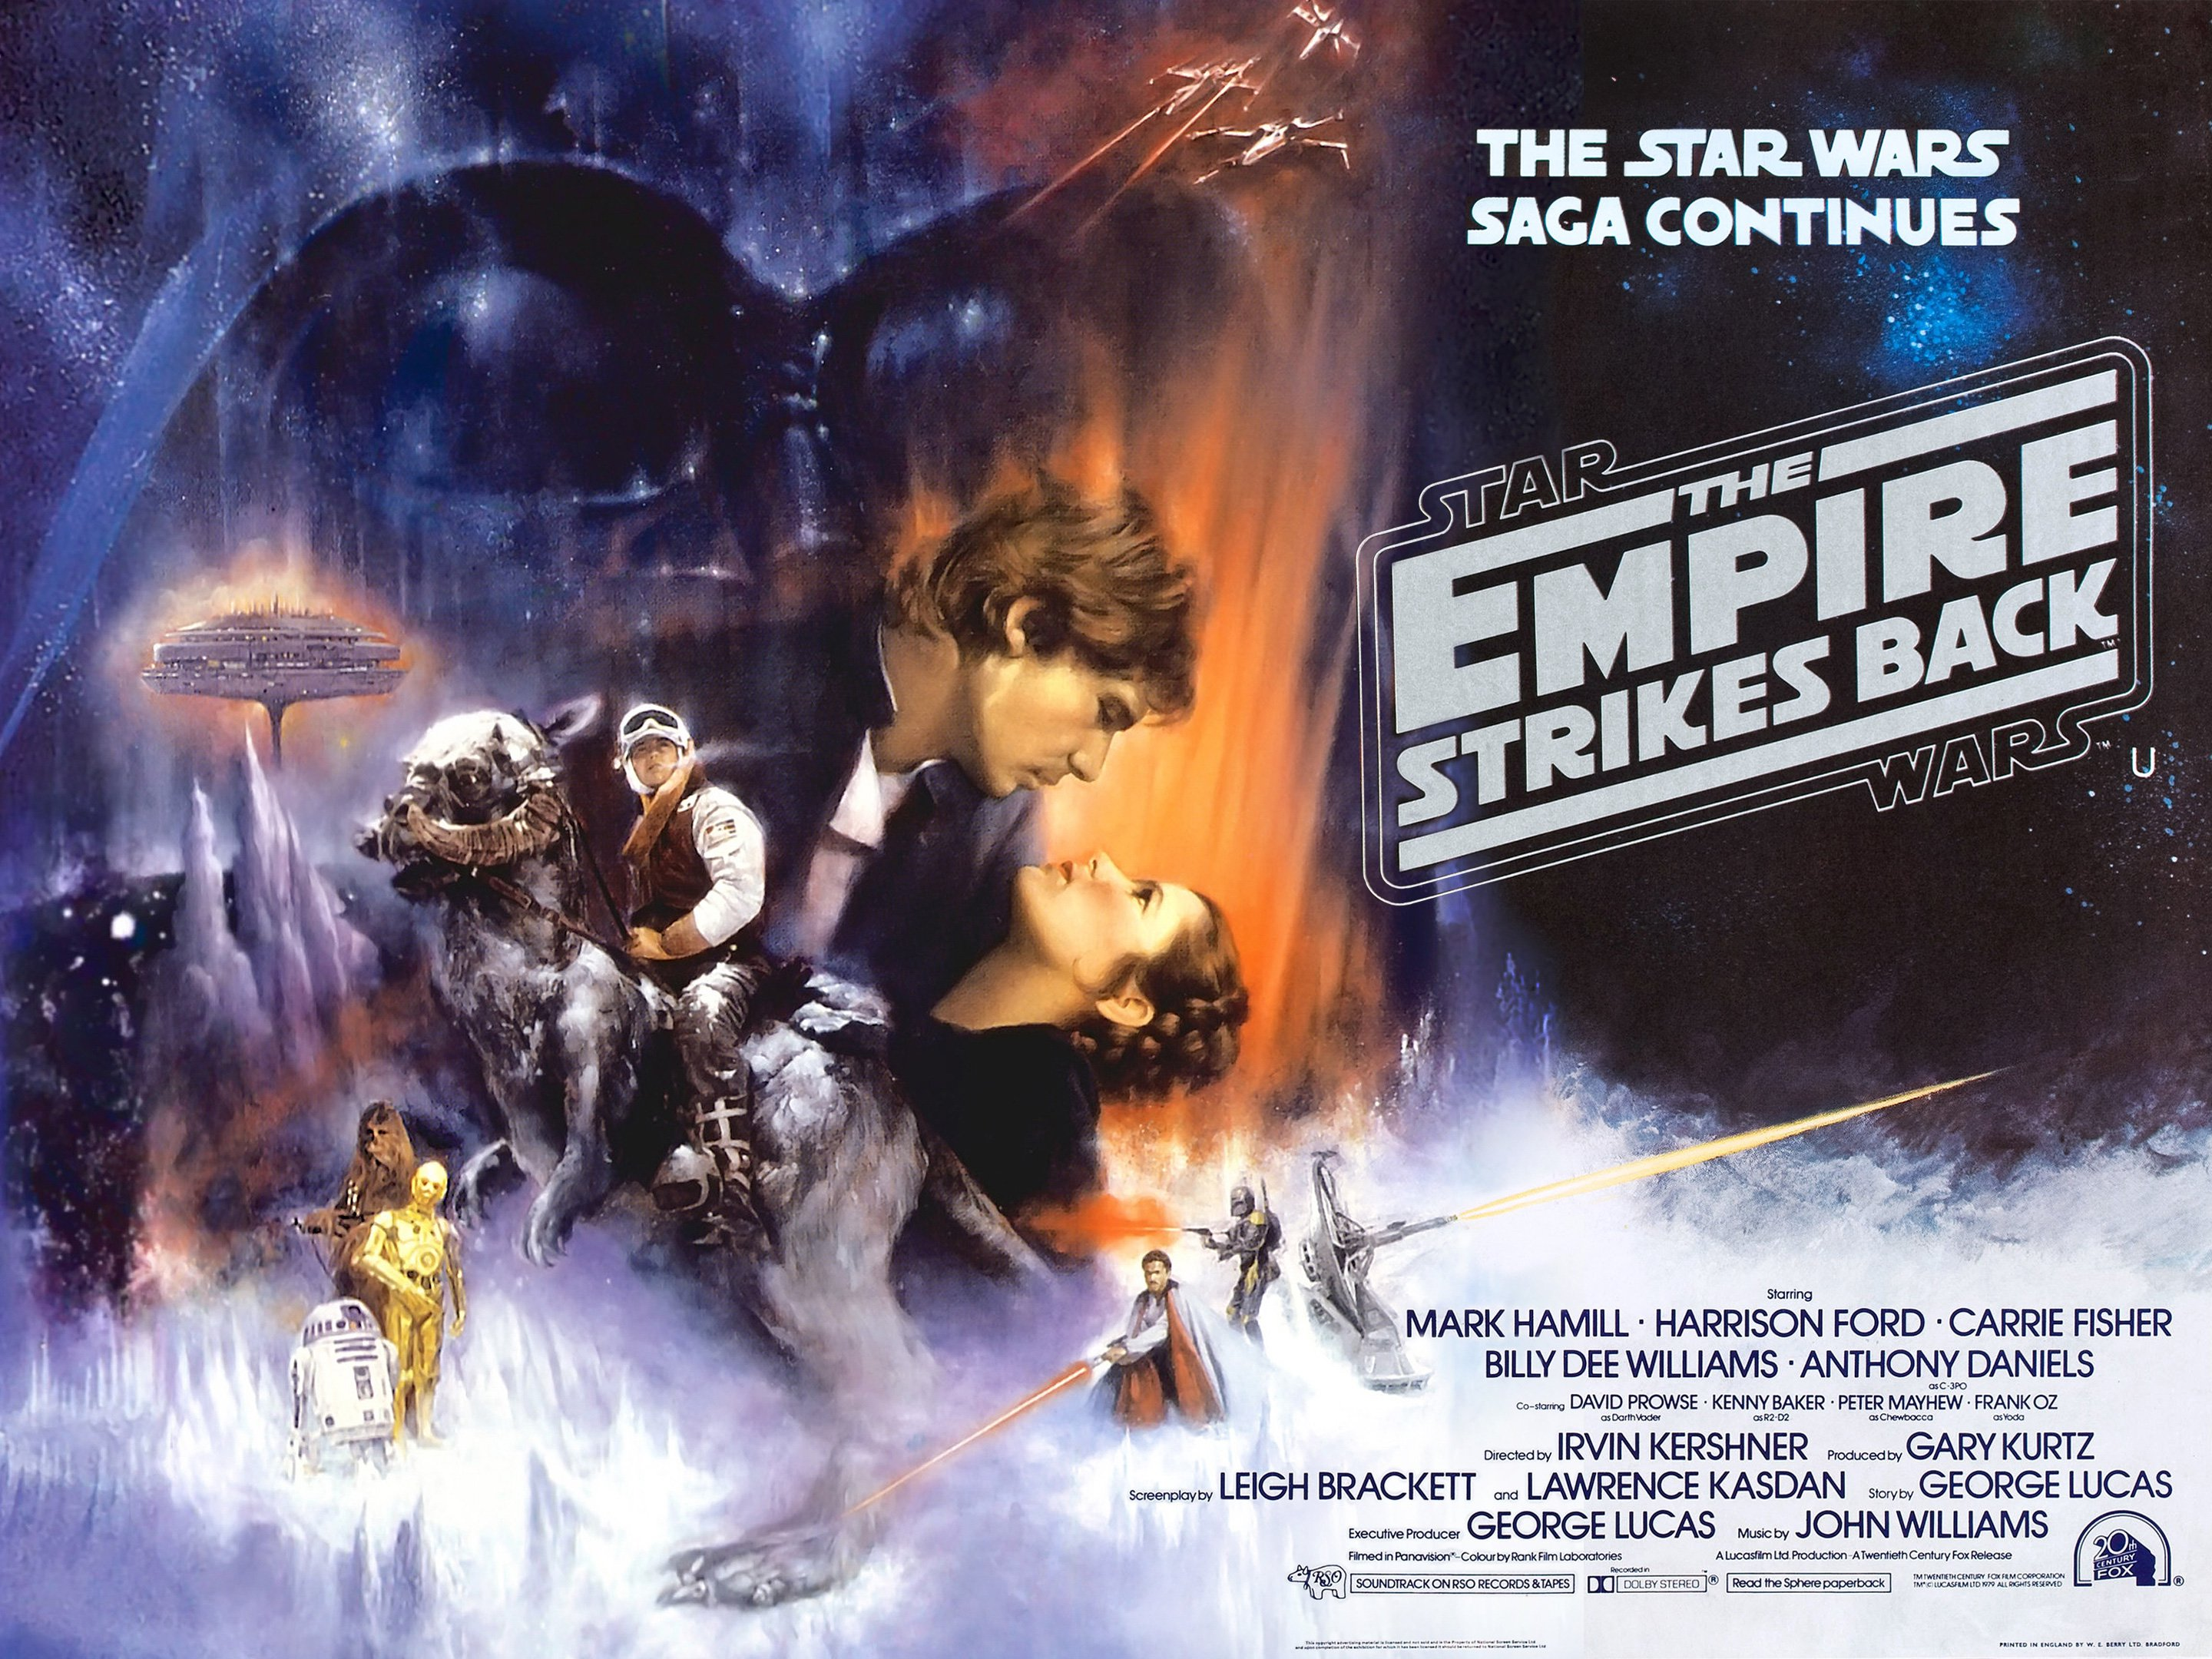
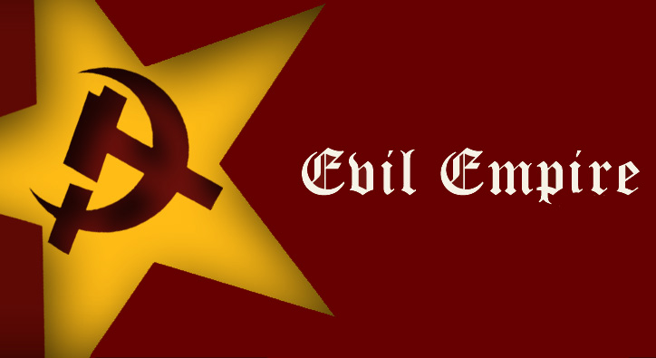
Reagan Intensifies Cold War
Reagan takes hard stance against the USSR
Increases military spending
Moves more nukes to Central Europe
Calls USSR an “Evil Empire”
Plans for how US will survive nuclear attack

Slide 4
Reagan Increases Military Spending
1983 – Announces Strategic Defense Initiative (SDI)
Outer space nuclear defense system…with lasers!
Opponents called it the “Star Wars” Program
Highly controversial
USSR tries to compete…

Slide 5
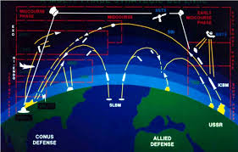

Slide 6
US Gets Involved Overseas
Nicaragua
Sandanistas take over Nicaragua
US train Contras to retake Nicaragua
1983 US invades Grenada
Communist party takes power after assassination
US invades and installs new govt
First military conflict since Vietnam War

Slide 7
Iran-Contra Affair
1984 - Congress forbids US assistance to Contras
US secretly gets money and gives it to Contras
Some money came from illegal weapons sales to Iran
Scandal breaks open in 1986…political corruption?
George HW Bush pardons all involved in 1992

Slide 8
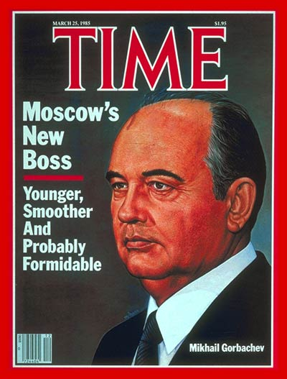
New Soviet Leadership
Mikhail Gorbachev leads USSR in 1985
Younger generation of Soviets
Implements:
Glasnost: new ideas and less political repression
Perestroika: restructuring process of USSR’s economic and political system
He’s open to changing things up.

Slide 9
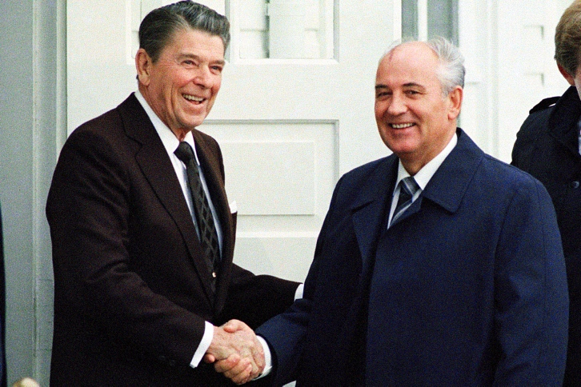
Reagan and Gorbachev
Reagan challenges Gorbachev publically
“Mr.Gorbachev, tear down this Wall!”
Meet in Iceland to discuss nuclear limitations
Reagan not so tough in person
Intermediate Nuclear Force Agreement (INF) of 1987

Slide 10
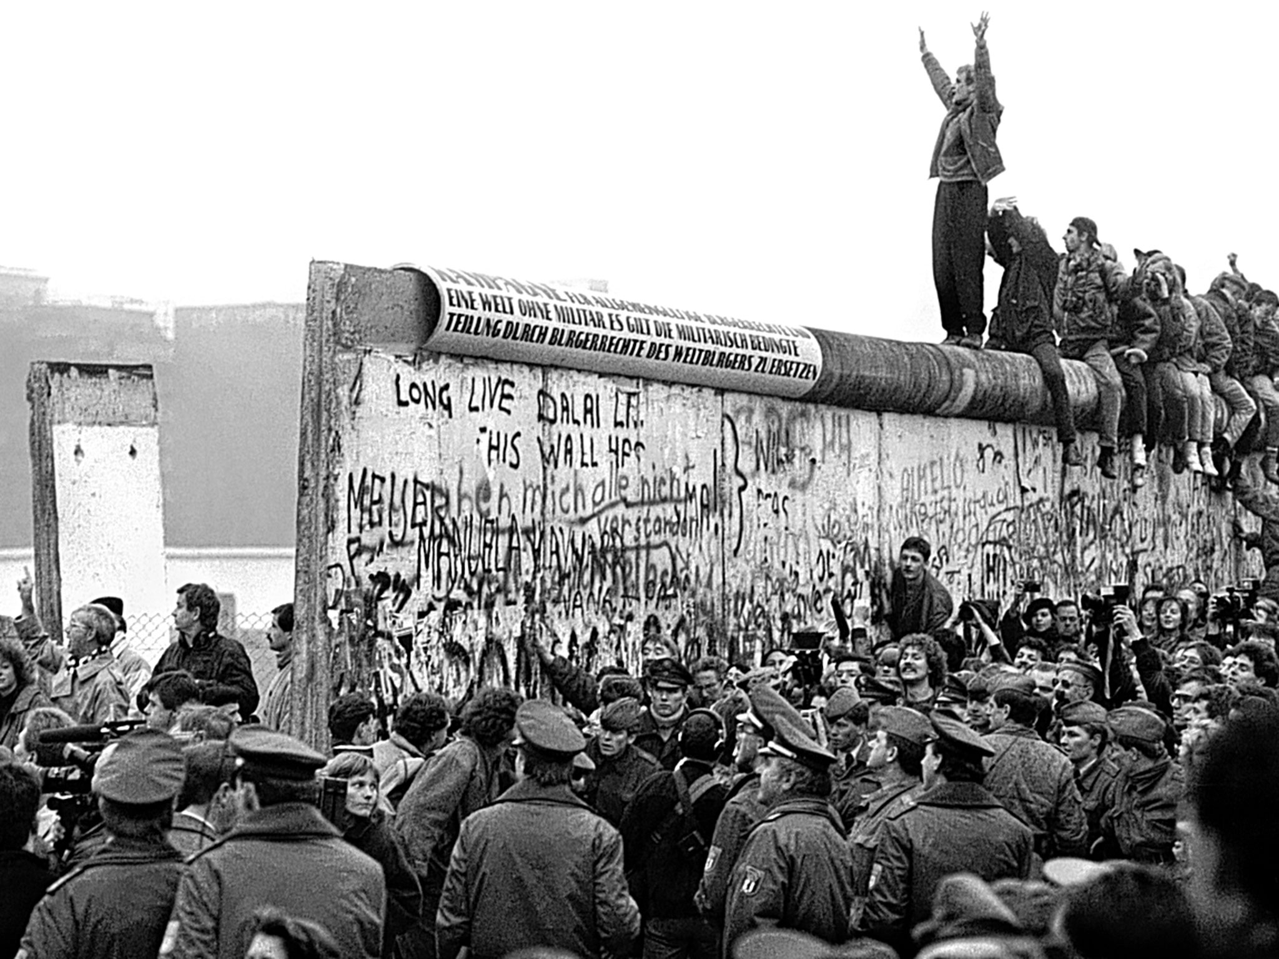
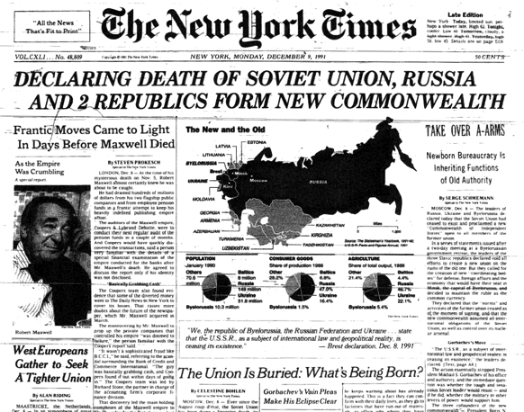
End of the USSR
Serious political changes happen soon after Reagan leaves
Satellite states vote for independence
USSR dissolves in 1991 officially
Berlin Wall falls in 1990

Slide 11
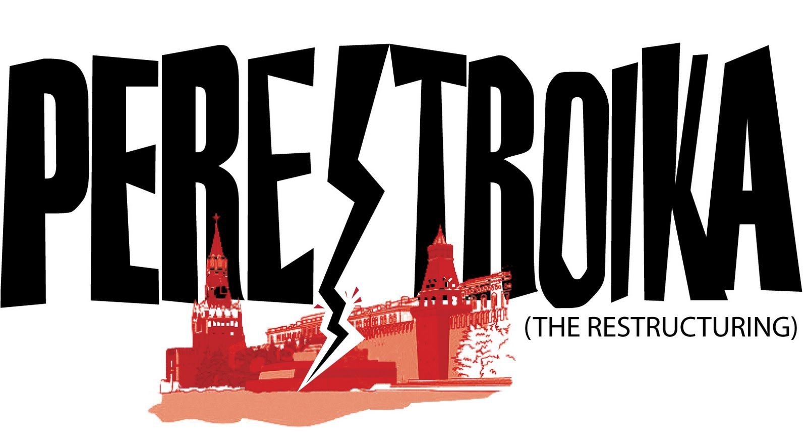
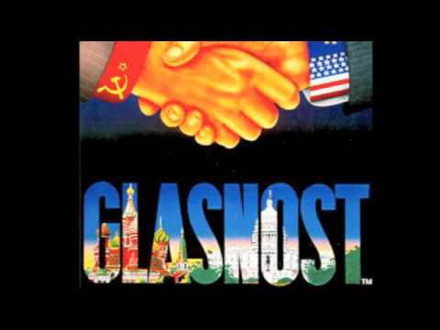
What ended the Soviet Union?
Causes:
War in Afghanistan
Increased military spending
Willingness to change
Desire for independence of satellite states

Slide 12
Did the US win the Cold War or did the Soviet Union lose it?

