Slide 1
Fourteen Points and the League of Nations

Slide 2
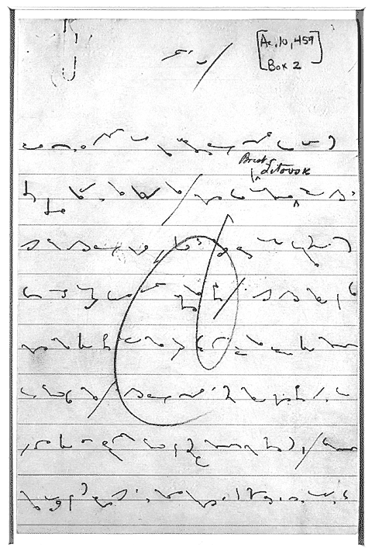
The Fourteen Points
Wilson’s plan for WWI peace treaty
Big ideas:
No secret alliances
Free use of the seas
Free trade
Reduce military size
League of Nations formed to prevent future world wars

Slide 3
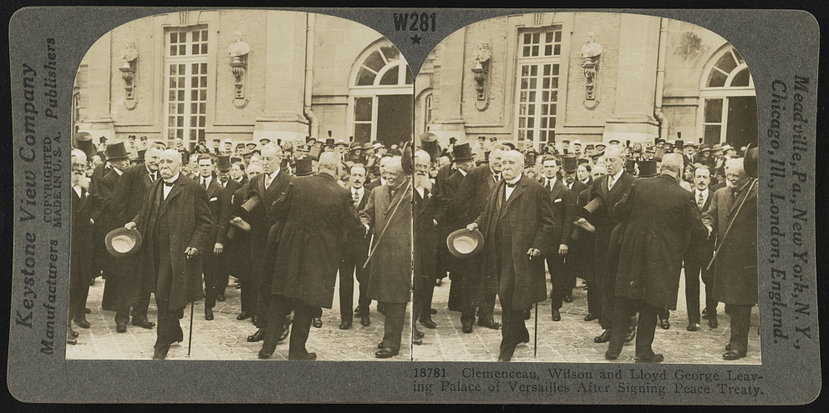
Treaty of Versailles
Great Britain and France dominated peace negotiations
They wanted revenge on Germany
League of Nations was only Point included in treaty

Slide 4
Ratifying the Treaty of Versailles
Treaties can be made by President
BUUUUUUT, they have to be ratified by the Senate
If not ratified, they don’t count…

Slide 5
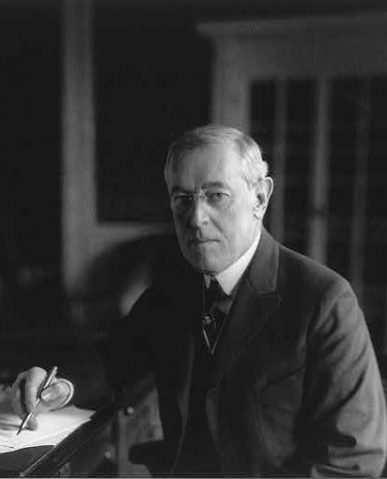
Democrats
Supported the Treaty of Versailles
Believed League of Nations would help prevent future wars
Led by Woodrow Wilson

Slide 6
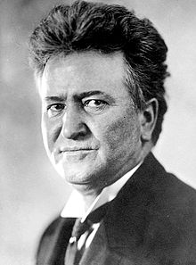
Irreconcilables
Republicans that completely opposed the treaty
Believed League of Nations would promote imperialism of other countries
Led by Senator Robert LaFollette

Slide 7
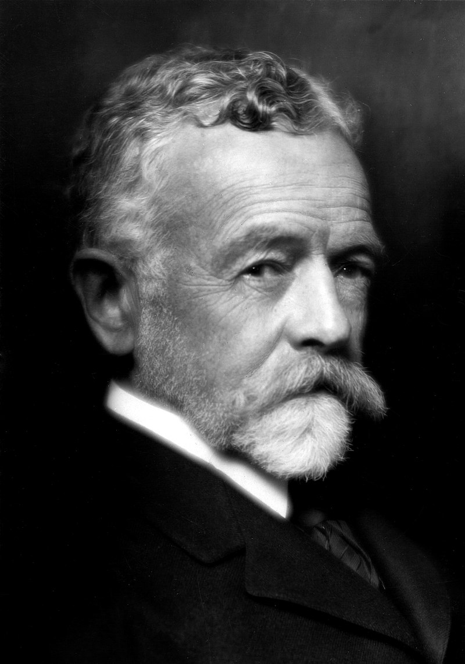
Reservationists
Opposed parts of the treaty (the League of Nations), but not all of it
Believed League of Nations would get US involved in foreign wars.
Led by Senator Henry Cabot Lodge Sr.

