Slide 1
Gilded Age Political Issues
Patronage, Trusts, Money, and Tariffs

Slide 2
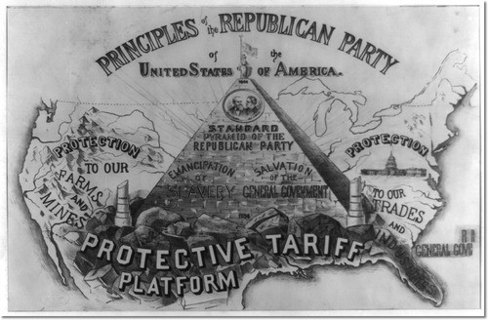
The Tariff
What was it?
Tax on imported goods
Protected American businesses
Why was it a problem?
US businesses charged more
Helped create monopolies

Slide 3
The Tariff
Govt. Reforms?
McKinley Tariff Act INCREASED tariff
Impact?
Made products more expensive
Businesses benefitted most
Popular backlash by the poor

Slide 4
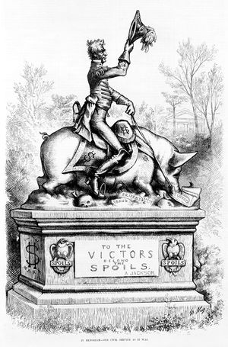
Patronage
What is it?
Giving political favors to supporters
a.k.a. the Spoils System
Why was it a problem?
Govt jobs given to unqualified candidates
Ineffective government

Slide 5
Patronage
Govt Reforms?
Pendleton Civil Service Act
Applicants had to pass govt test
Created Civil Service Commission
Success?
Helped stop some patronage
Didn’t apply to most govt jobs

Slide 6
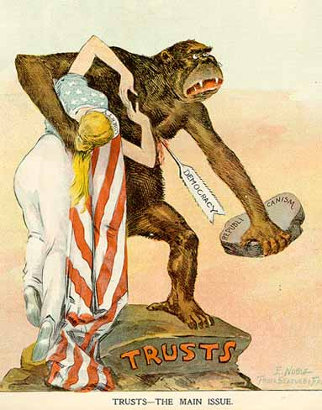
Trusts
What is it?
Business that impedes competition
A.k.a – a monopoly
Why is it a problem?
Consumers are exploited
Products are bad
Prices are high

Slide 7
Trusts
Govt reforms?
Interstate Commerce Act
Sherman Anti-Trust Act (1890)
Success?
Not enforced against businesses
Enforced against labor unions

Slide 8
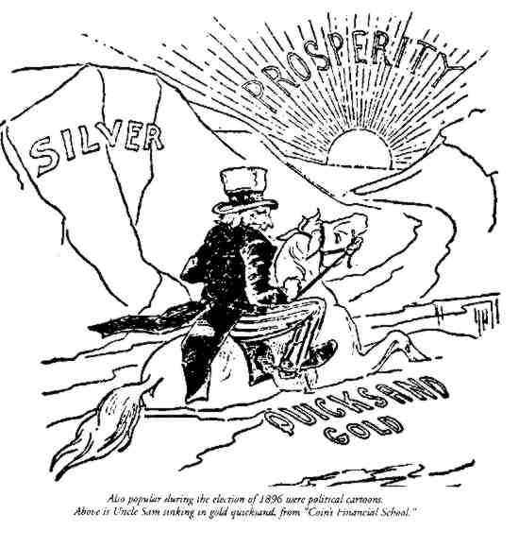
The Gold Standard
What is it?
When money is only backed up by gold
Why was it a problem for some?
Money = very deflated
Harder to pay back debt
Poor ppl had difficulty gaining wealth
Why did other really desire it?
Money = more valuable
Ppl w/money are “wealthier”

Slide 9
The Gold Standard
Govt Reforms?
Govt introduced silver to money supply twice
Success?
Govt didn’t coin enough silver to have an impact
Money supply did not improve for the poor

