Slide 1
American Imperialism
Asia & Latin America

Slide 2
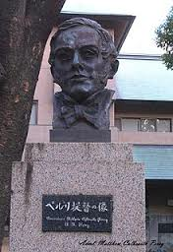
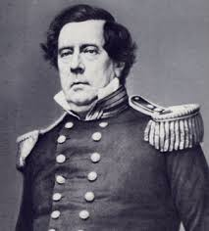
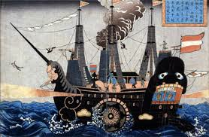
Japan
Adm. Matthew Perry sails to Tokyo bay
Threatens military force unless Japan trades w/ US
Forced opening of Japan’s markets

Slide 3
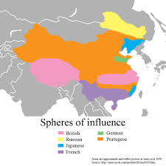
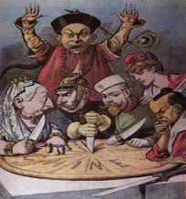
China & the Open Door Policy
US demands other nations allow equal opportunity for trade in China

Slide 4
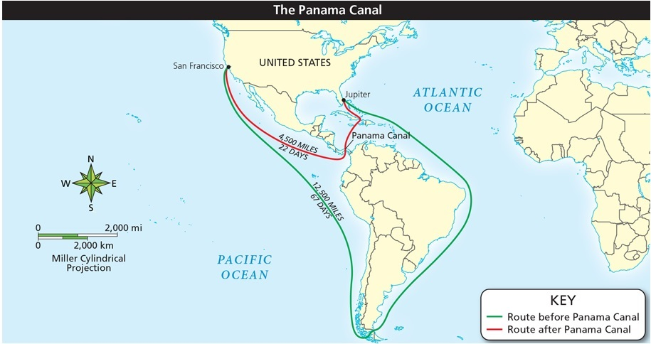
The Panama Canal
Why did people want a canal through Central America?

Slide 5
The Panama Canal
Panama part of Colombia originally
Roosevelt needs permission to build canal
Colombia refuses
Roosevelt helps start Panamanian Rebellion
Places US navy of the coast
Once independent US get Panama to agree

Slide 6
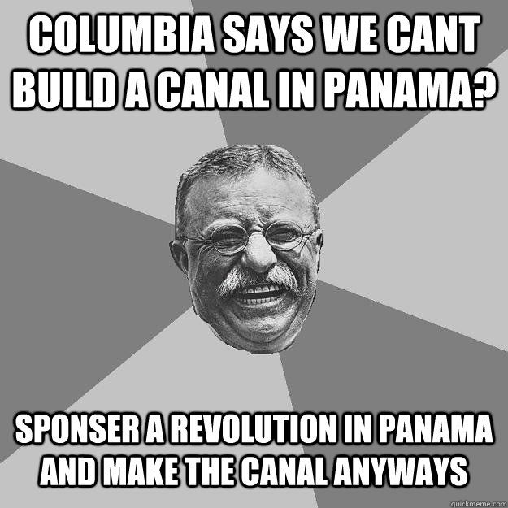
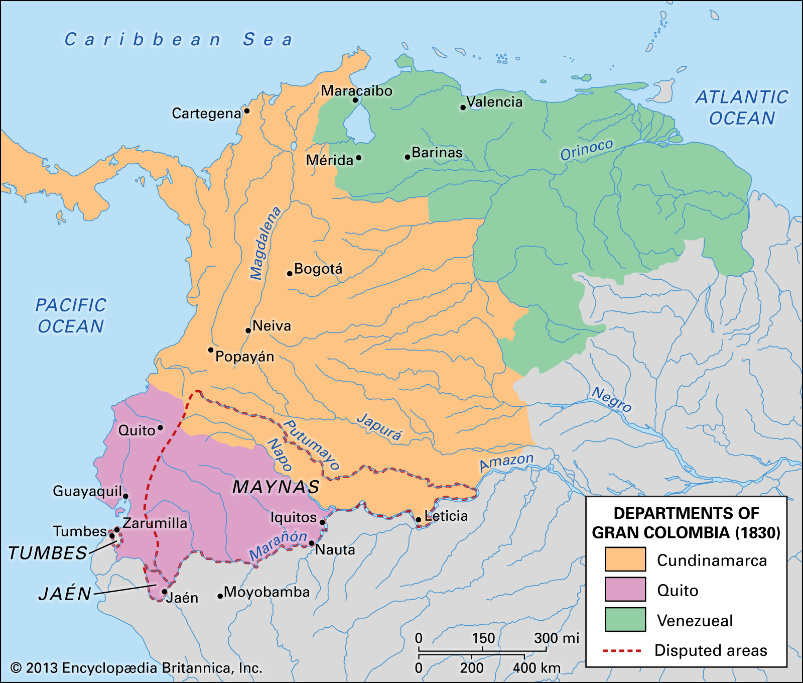

Slide 7
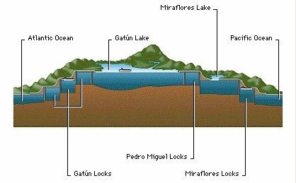
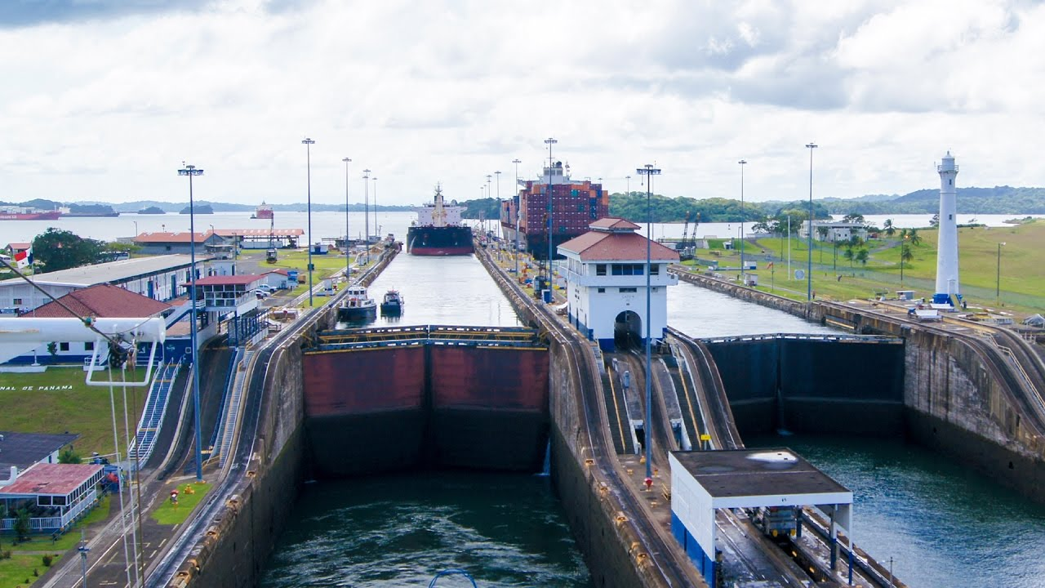
How the Panama Canal works

Slide 8
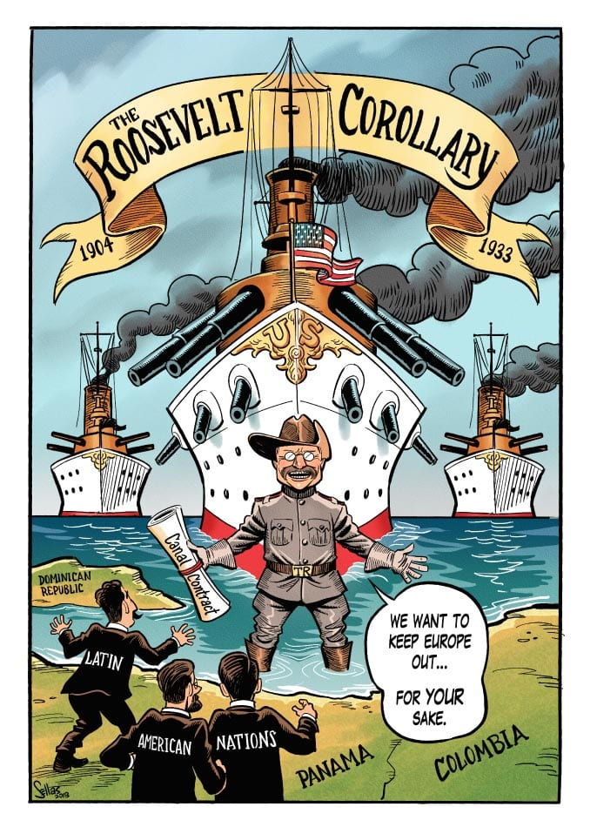
Roosevelt Corollary
Roosevelt Corollary:
US is an “international police power” in Latin America

Slide 9
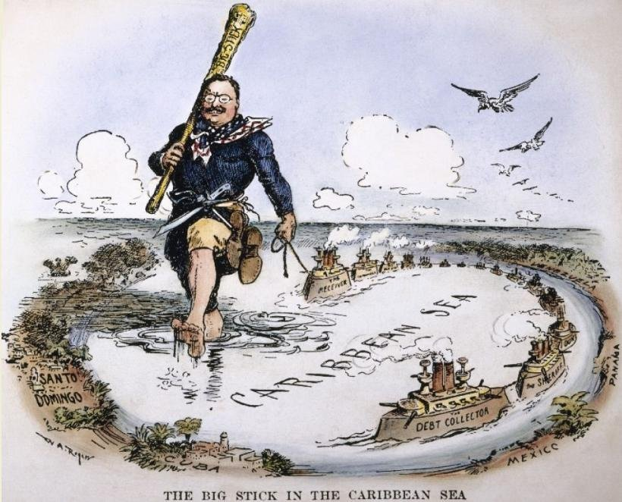
Big Stick Diplomacy
“Speak softly and carry a big stick”
What does that mean in terms of foreign policy?

Slide 10
Dollar Diplomacy
President Taft’s policy
“Substituting dollars for bullets”
Encourage US investment in Latin America

Slide 11
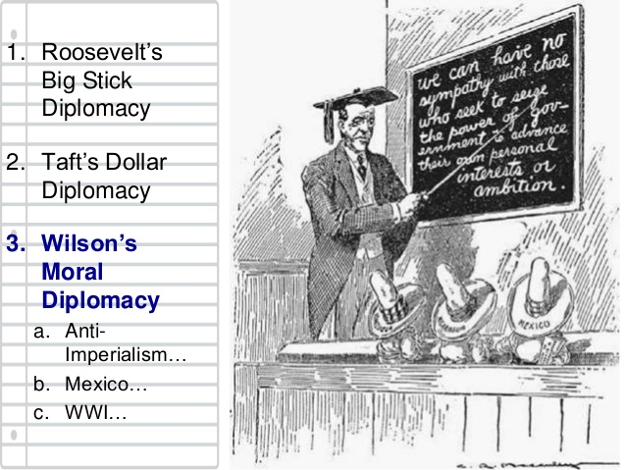
Wilson’s Moral Diplomacy
Get involved in foreign affairs to promote democracy and US values
Seemed hypocritical for opposing women’s suffrage

