Slide 1
Intelligence Chapter 11

Slide 2
What is Intelligence?
Intelligence (in all cultures) is the ability to learn from experience, solve problems, and use our knowledge to adapt to new situations.
In research studies, intelligence is whatever the intelligence test measures. This tends to be “school smarts.”
Notes:
OBJECTIVE 1| Discuss the difficulty of defining intelligence, and explain what it means to “reify intelligence.”.

Slide 3
Controversies in Intelligence
Despite general agreement among psychologists about the nature of intelligence, two controversies remain:
Is intelligence a single overall ability or is it several specific abilities?
Can we locate and measure intelligence within the brain?

Slide 4
General Intelligence
The idea that there is one overall general intelligence (g) comes from the work of Charles Spearman (1863-1945) who helped develop the factor analysis approach in statistics.
Athleticism, like intelligence, is many things
Notes:
OBJECTIVE 2| Present arguments for and against considering intelligence as on general mental ability.

Slide 5
General Intelligence
Spearman proposed that general intelligence (g) is linked to many clusters that can be analyzed by factor analysis.
Spearman’s Clusters
Verbal Intelligence
Spatial ability
Reasoning ability

Slide 6
General Intelligence
L. L. Thurstone, a critic of Spearman, analyzed his subjects NOT on a single scale of general intelligence, but on seven clusters of primary mental abilities, including:
Word Fluency
Verbal Comprehension
Spatial Ability
Perceptual Speed
Numerical Ability
Inductive Reasoning
Memory

Slide 7
General Intelligence
Later psychologists analyzed Thurstone’s data and found a weak relationship between these clusters, suggesting some evidence of a g factor.

Slide 8
Contemporary Intelligence Theories
Howard Gardner (1983, 1999) supports Thurstone’s idea that intelligence comes in multiple forms. Gardner notes that brain damage may diminish one type of ability but not others.
People with savant syndrome excel in abilities
unrelated to general intelligence.
Notes:
OBJECTIVE 3| Compare Gardner’s and Sternberg's theories of intelligence.

Slide 9
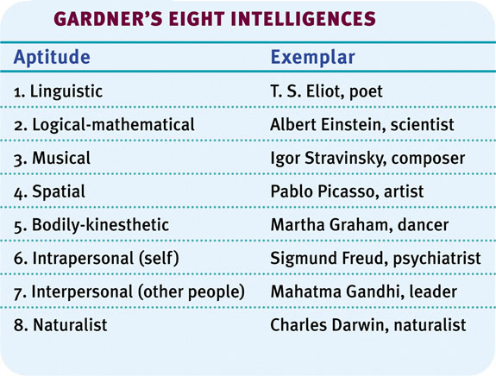
Howard Gardner
Gardner proposes eight types of intelligences and speculates about a ninth one — existential intelligence. Existential intelligence is the ability to think about the question of life, death and existence.

Slide 10
Robert Sternberg
Sternberg (1985, 1999, 2003) also agrees with Gardner, but suggests three intelligences rather than eight.
Analytical Intelligence: Intelligence that is assessed by intelligence tests.
Creative Intelligence: Intelligence that makes us adapt to novel situations, generating novel ideas.
Practical Intelligence: Intelligence that is required for everyday tasks (e.g. street smarts).

Slide 11
Emotional Intelligence
Emotional intelligence is the ability to perceive, understand, and use emotions (Salovey and colleagues, 2005).
Notes:
OBJECTIVE 4| Describe the four aspects of emotional intelligence, and discuss criticisms of this concept.

Slide 12
Emotional Intelligence: 4 Components
Component | Description
Perceive emotion | Recognize emotions in faces, music and stories
Understand emotion | Predict emotions, how they change and blend
Manage emotion | Express emotions in different situations
Use emotion | Utilize emotions to adapt or be creative

Slide 13
Emotional Intelligence: Criticism
Gardner and others criticize the idea of emotional intelligence and question whether we stretch this idea of intelligence too far when we apply it to our emotions.

Slide 14
Intelligence and Creativity
Creativity is the ability to produce ideas that are both novel and valuable. It correlates somewhat with intelligence.
Expertise
Imaginative Thinking
Adventuresome Personality
Intrinsic Motivation
A Creative Environment
Notes:
OBJECTIVE 5| Identify the factors associated with creativity, and describe the relationship between creativity and intelligence.

Slide 15
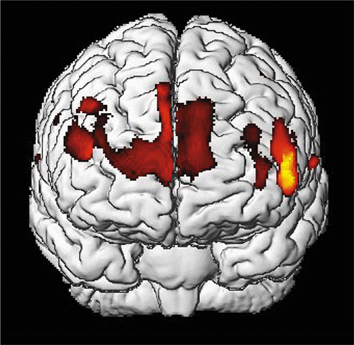
Is Intelligence Neurologically Measurable?
Recent Studies indicate some correlation (about +.40) between brain size (head size too!) and intelligence.
Gray matter concentration in people with high intelligence.
Notes:
OBJECTIVE 6| Describe the relationship between intelligence and brain anatomy.

Slide 16
Brain Function
Studies of brain functions show that people who score high on intelligence tests perceive stimuli faster, retrieve information from memory quicker, and show faster brain response times.
People with higher intelligence respond correctly and quickly to
the above question.
Notes:
OBJECTIVE 7| Discuss the findings on the correlations between perceptual speed, neural processing speed, and intelligence.

Slide 17
Assessing Intelligence
Psychologists define intelligence testing as a method for assessing an individual’s mental aptitudes and comparing them with others using numerical scores.
Notes:
OBJECTIVE 8| Define intelligence tests and discuss the history of intelligence testing.

Slide 18
Alfred Binet
Alfred Binet and his colleague Théodore Simon practiced a more modern form of intelligence testing by developing questions that would predict children’s future progress in the Paris school system.

Slide 19
Lewis Terman
In the US, Lewis Terman adapted Binet’s test for American school children and named the test the Stanford-Binet Test. The following is the formula of Intelligence Quotient (IQ), introduced by William Stern:

Slide 20
Aptitude and Achievement Tests
Aptitude tests are intended to predict your ability to learn a new skill and achievement tests are intended to reflect what you have already learned.
Notes:
OBJECTIVE 9| Distinguish between aptitude and achievement tests, and describe the modern test of mental abilities, such as the WAIS.

Slide 21
David Wechsler
Wechsler developed the Wechsler Adult Intelligence Scale (WAIS) and later the Wechsler Intelligence Scale for Children (WISC), an intelligence test for preschoolers.

Slide 22
WAIS
WAIS measures overall intelligence and 11 other aspects related to intelligence that are designed to assess clinical and educational problems.

Slide 23
Principles of Test Construction
For a psychological test to be acceptable it must fulfill the following three criteria:
Standardization
Reliability
Validity

Slide 24
Standardization
Standardizing a test involves administering the test to a representative sample of future test takers in order to establish a basis for meaningful comparison.
Notes:
OBJECTIVE 10| Discuss the importance of standardizing psychological tests, and describe the distribution of scores in a normal curve.

Slide 25
Normal Curve
Standardized tests establish a normal distribution of scores on a tested population in a bell-shaped pattern called the normal curve.

Slide 26
Flynn Effect
In the past 60 years, intelligence scores have risen steadily by an average of 27 points. This phenomenon is known as the Flynn effect.

Slide 27
Reliability
A test is reliable when it yields consistent results. To establish reliability researchers establish different procedures:
Split-half Reliability: Dividing the test into two equal halves and assessing how consistent the scores are.
Reliability using different tests: Using different forms of the test to measure consistency between them.
Test-Retest Reliability: Using the same test on two occasions to measure consistency.
Notes:
OBJECTIVE 11| Explain what it means to say that a test is reliable.

Slide 28
Validity
Reliability of a test does not ensure validity. Validity of a test refers to what the test is supposed to measure or predict.
Content Validity: Refers to the extent a test measures a particular behavior or trait.
Predictive Validity: Refers to the function of a test in predicting a particular behavior or trait.
Notes:
OBJECTIVE 12| Explain what it means to say that a test is valid, and describe two types of validity.

Slide 29
Stability or Change?
Intelligence scores become stable after about seven years of age. In numerous studies, stability of intelligence scores have been determined (Angoff, 1988; Deary et al., 2004).
Notes:
OBJECTIVE 13| Describe the stability of intelligence scores over the life span.

Slide 30
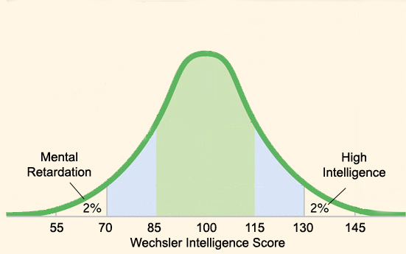
Extremes of Intelligence
70 or Below: Mental Retardation
130 or Above: “Gifted”
Notes:
OBJECTIVE 14| Discuss the two extremes of the normal distribution of intelligence.

Slide 31
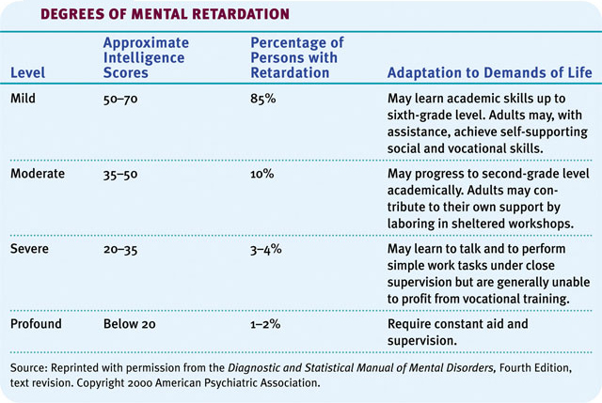
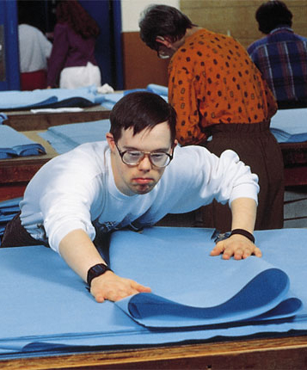
Mental Retardation
Mental Retardation defined by low intelligence test score AND inability to live without assistance from others (for basic tasks).
Mental Retardation NOT THE SAME as Autism

Slide 32
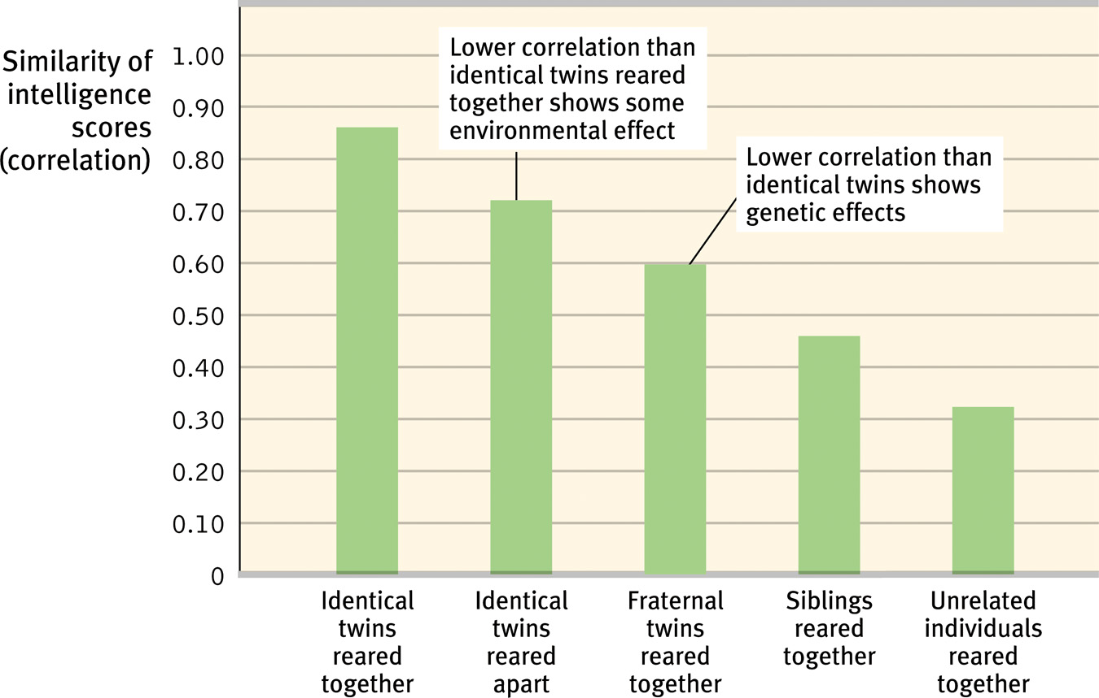
Genetic Influences on Intelligence
Studies of twins, family members, and adopted children together support the idea that there is a significant genetic contribution to intelligence.
Notes:
OBJECTIVE 15| Discuss the evidence for the genetic contribution to individual intelligence, and explain what psychologists mean by the heritability of intelligence.

Slide 33
Adoption Studies

Slide 34
Environmental Influences
Studies of twins and adopted children also show the following:
Fraternal twins raised together tend to show similarity in intelligence scores.
Identical twins raised apart show slightly less similarity in their intelligence scores.
Notes:
OBJECTIVE 16| Discuss the evidence for environmental influences on individual intelligence.

Slide 35
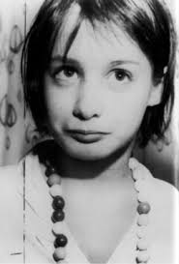
Early Intervention Effects
Neglect from caregivers leads children to develop a lack of personal control over the environment, and it impoverishes their intelligence.

Slide 36
Schooling Effects
Schooling is a key example of environmental influences on education.
To increase readiness for schoolwork,
projects like Head Start facilitate leaning.

Slide 37
Group Similarities and Differences
Racial groups differ in their average intelligence scores.
High-scoring people (and groups) are more likely to attain high levels of education and income.
Notes:
OBJECTIVE 17| Describe ethnic similarities and differences in intelligence test scores, and discuss some genetic and environmental factors that might explain them.

Slide 38
Racial (Group) Differences
If we look at racial differences, white Americans score higher in average intelligence than black Americans (Avery and others, 1994). European New Zealanders score higher than native New Zealanders (Braden, 1994).
White-Americans | Black-Americans
Average IQ = 100 | Average IQ = 85
Hispanic Americans

Slide 39
Reasons Why Environment Affects Intelligence
Races are remarkably alike genetically.
Race is a social category.
Asian students outperform North American students on math achievement and aptitude tests.
Today’s better prepared populations would outperform populations of the 1930s on intelligence tests.
White and black infants tend to score equally well on tests predicting future intelligence.
Different ethnic groups have experienced periods of remarkable achievement in different eras.

Slide 40
Gender Similarities and Differences
There are seven ways in which males and females differ in various abilities.
1. Girls are better spellers
2. Girls are verbally fluent and have large vocabularies
3. Girls are better at locating objects
4. Girls are more sensitive to touch, taste, and color
5. Boys outnumber girls in counts of underachievement
6. Boys outperform girls at math problem solving, but underperform at math computation
7. Women detect emotions more easily than men do
Notes:
OBJECTIVE 18| Describe gender differences in abilities.

Slide 41
The Question of Bias
Aptitude tests are necessarily biased in the sense that they are sensitive to performance differences caused by cultural differences.
However, aptitude tests are not biased in the sense that they accurately predict performance of one group over the other.
Notes:
OBJECTIVE 19| Discuss whether intelligence test are biased, and describe the stereotype threat phenomenon.

Slide 42
Stereotype Threat
A stereotype threat is a self-confirming concern that one will be evaluated based on a negative stereotype.
This phenomenon appears in some instances in intelligence testing among African-Americans and among women of all colors.
Notes:
OBJECTIVE 19| Discuss whether intelligence test are biased, and describe the stereotype threat phenomenon.

