Slide 1
Intro Psychological Disorders

Slide 2
Topics for Today
What makes something a psychological disorder?
Medical Model: Before and After
The DSM-V
Strengths and weaknesses
How does it work?

Slide 3
Quirky vs. Disordered
To be a disorder behavior, emotional regulation, and/or cognition must:
Be deviant
Cause distress
Be dysfunctional

Slide 4
Before/After the Medical Model
Before
After
Disorders = character traits or acts of god(s)
Patients seen as incurable
Patients shunned by society
Distinction between person and illness
Disorders seen as treatable
DRs try to find treatment

Slide 5
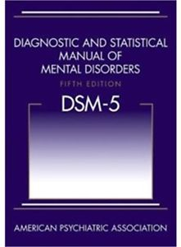
Diagnostic and Statistical Manual – 5th Edition
A.k.a – DSM V
Strengths:
Clear criteria for diagnosis
Universal language for diagnosing
Weaknesses:
Gives labels
Makes everything a disorder
Doesn’t explain origins of disorder
No treatment given

