Slide 1
Key Ideas in Perception

Slide 2
Gestalt Psychology
We have a tendency to perceive something as a gestalt (or whole).

Slide 3
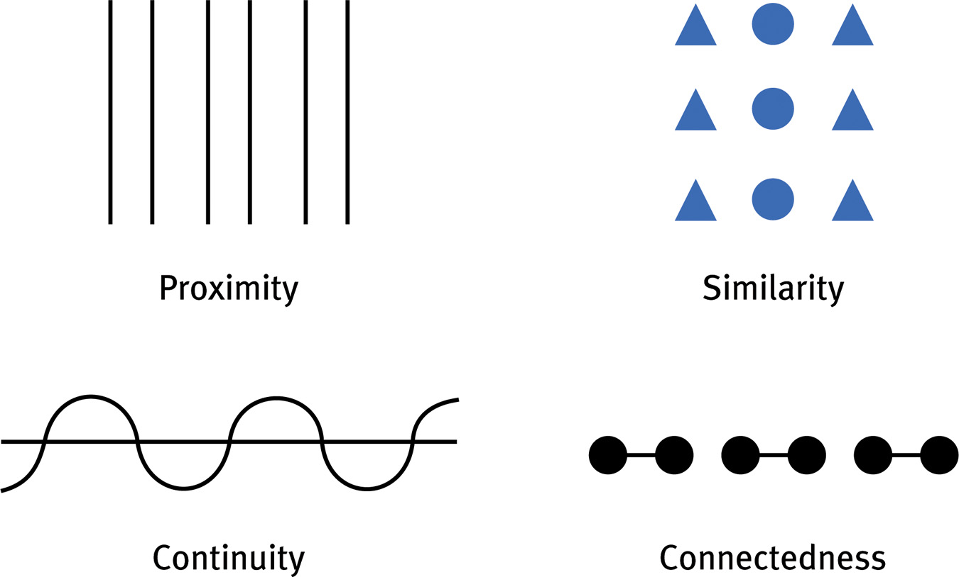
We group things by 4 basic methods

Slide 4
We also have figure-ground organization

Slide 5
Perceptual Adaptation
Visual ability to adjust to an artificially displaced visual field, e.g., prism glasses.
Courtesy of Hubert Dolezal
Notes:
OBJECTIVE 13| Explain how the research on distorting goggles increases our understanding of the adaptability of perception.

Slide 6
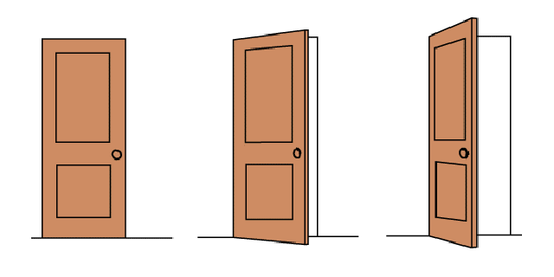
Perceptual Constancy
We continue to perceive objects as unchanged, even when they appear different.
Examples: Shape constancy and size constancy
Shape Constancy
Notes:
OBJECTIVE 9| Explain the importance of perceptual constancy.

Slide 7
Size Constancy
Perception of object’s size is unchanged, even when it appears smaller
Size Constancy
Notes:
OBJECTIVE 10| Describe the shape and size constancy, and explain how our expectations about perceived size and distance to some visual illusions.

Slide 8
Gate-Control Theory
Spinal cord contains a neurological “gate” that blocks pain signals or allows them to pass on to the brain.
“Gate” opened by the activity of pain signals traveling up small nerve fibers.
“Gate” closed by activity in larger fibers or by information coming from the brain.
Notes:
One way to treat chronic pain is to stimulate it through massage by electrical stimulation or acupuncture. Rubbing causes competitive stimulation to pain thus reduces its effect.

Slide 9
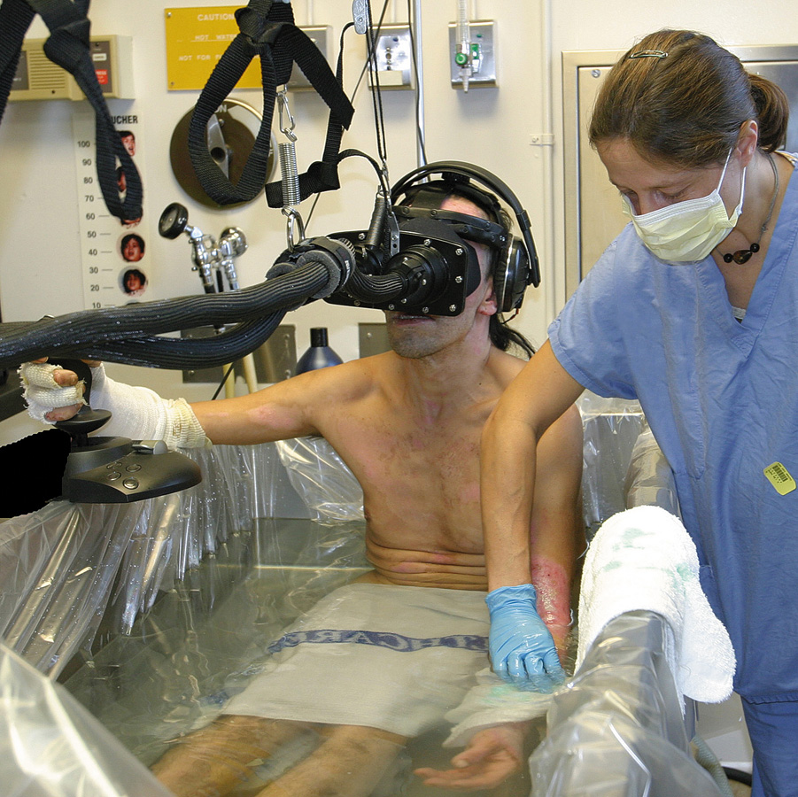
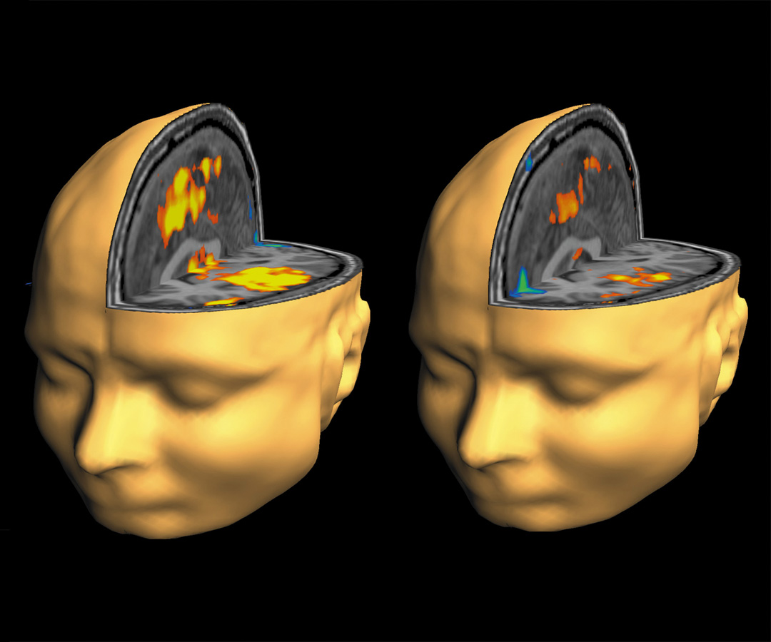
Pain Control
Pain perception can be controlled by a number of therapies including, drugs, surgery, acupuncture, exercise, hypnosis, and distraction.
Todd Richards and Aric Vills, U.W.
©Hunter Hoffman, www.vrpain.com
Notes:
Burn victims can be distracted by allowing them to engage in illusory virtual reality. Their brain scans show differences in pain perceptions.

Slide 10
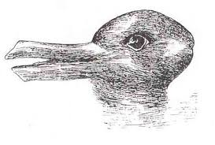

Slide 11
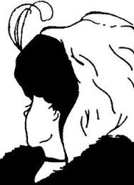

Slide 12
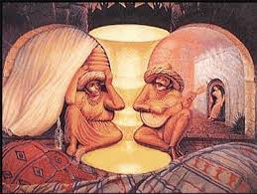

Slide 13
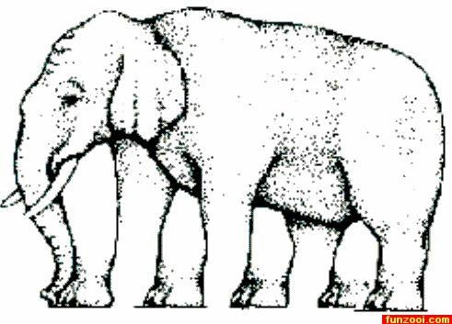

Slide 14
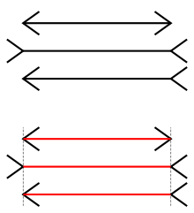
Which horizontal line is longer?

Slide 16
We group things by 4 basic methods

