Slide 1
Learning

Slide 2
Learning
Learning is a relatively permanent change in an organism’s behavior due to experience.
Types of Learning:
Classical Conditioning
Operant Conditioning
Observational Learning

Slide 3
Associative Learning
Classical Conditioning
Associating two stimuli
Operant Conditioning
Behavior strengthened by a reinforcer and weakened by a punishment

Slide 4
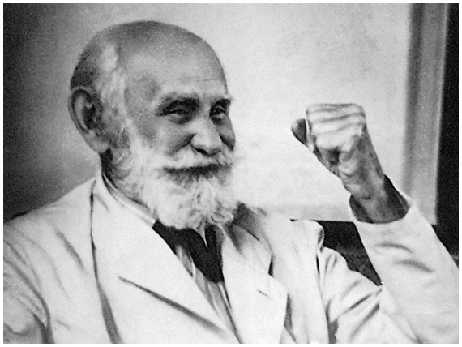
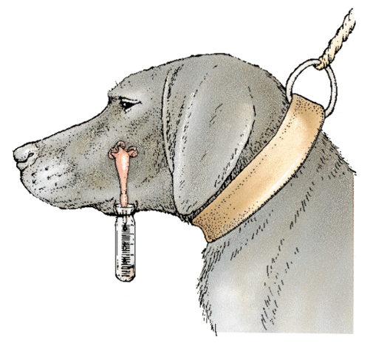
Classical Conditioning
Subject associates neutral stimulus with unconditioned stimulus
Eventually responses to both stimuli are the same

Slide 5
Classical Conditioning Terms
Neutral Stimulus
Unconditioned Stimulus (US)
Unconditioned Response (UR)
Conditioned Stimulus (CS)
Conditioned Response (CR)
Can you identify the following terms in Pavlov’s experiment?

Slide 6
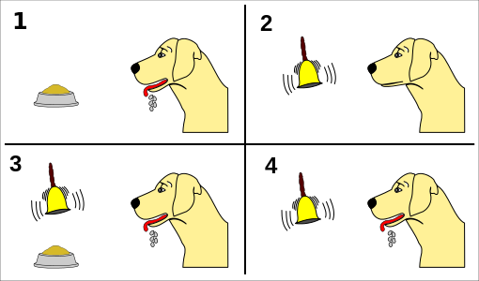

Slide 7
Classical Conditioning Terms
Acquisition
Generalization
Discrimination
Extinction
Spontaneous Recovery

Slide 8
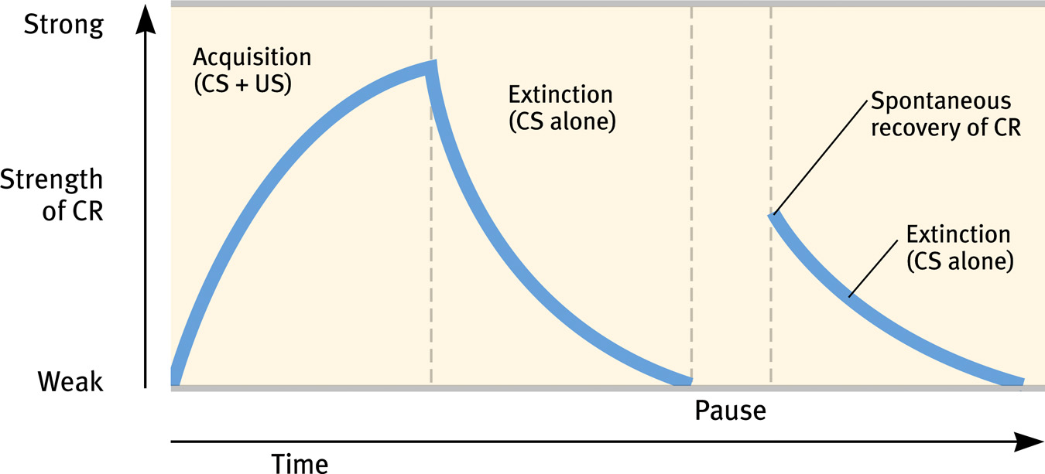

Slide 9
Need to Know Peeps for Classical Conditioning
Ivan Pavlov
John Watson
John Garcia

Slide 10
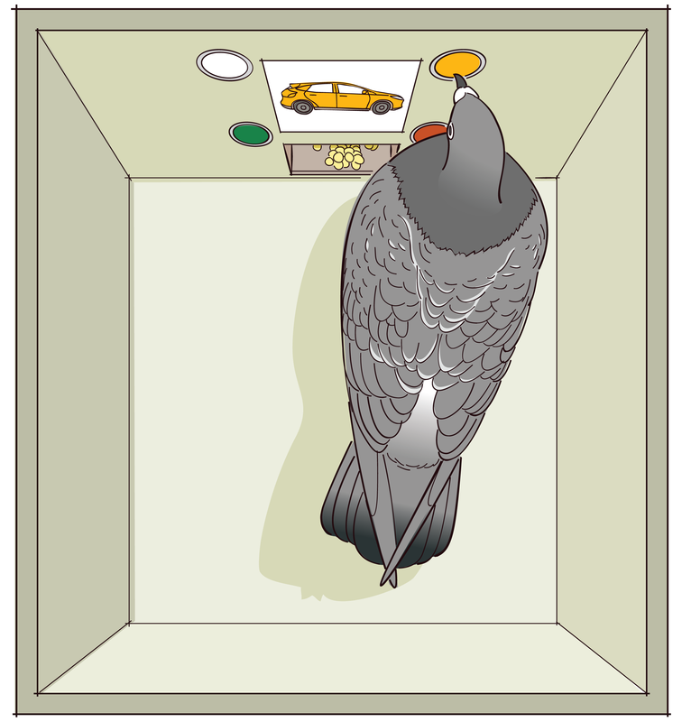
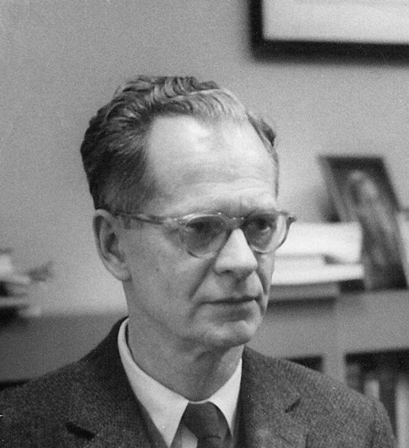
Operant Conditioning
Based on the law of effect by Thorndike

Slide 11
Influencing Behavior
Shaping = process of guiding animal to desired behavior
Reinforcement = makes behavior MORE likely to happen
Punishment = makes behavior LESS likely to happen
They can both can be positive and negative

Slide 12
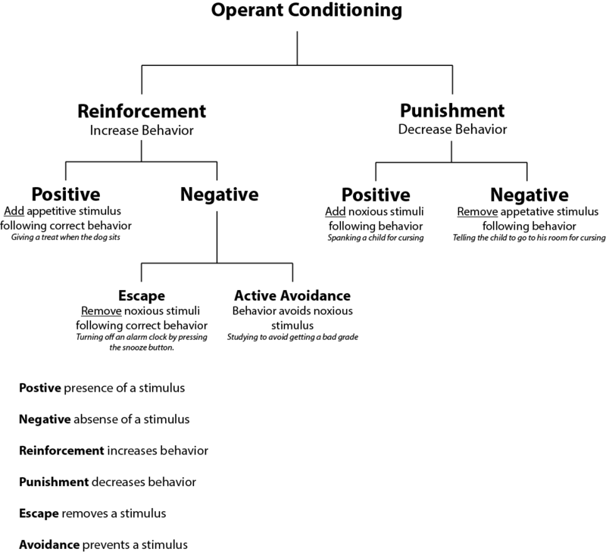

Slide 13
Other Forms of Reinforcement
Primary Reinforcer
Ex: food or drink
Conditioned Reinforcer
Ex: Money, Grades
Immediate Reinforcer
Ex: Dog gets treat for sitting down
Delayed Reinforcer
Ex: A paycheck

Slide 14
Reinforcement Schedules
Continuous = behavior reinforced every time
Partial = behavior NOT reinforced every time

Slide 15
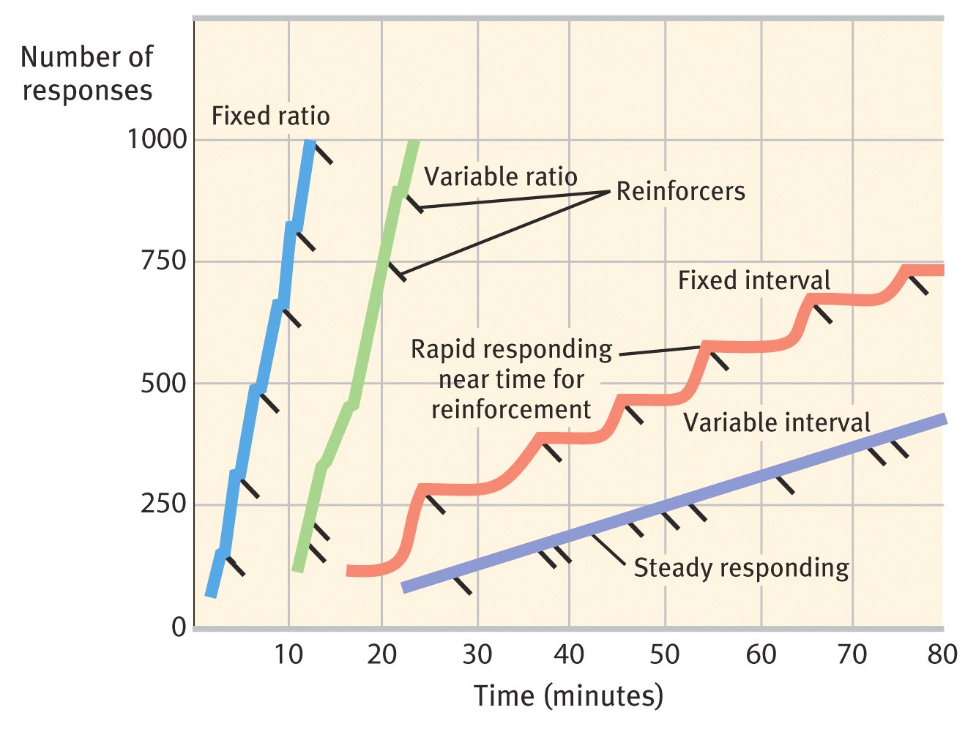
Reinforcement Schedules

Slide 16
Need to Know Peeps for Operant Conditioning
Edward Thorndike
B.F. Skinner
Marian Breland Bailey

