Slide 1
How can we assess intelligence?
12/14

Slide 2
Topics for today
History of intelligence tests
How have they changed?
Types of tests
Principles of test construction
Age and Intelligence
The Flynn Effect
Stability vs change

Slide 3
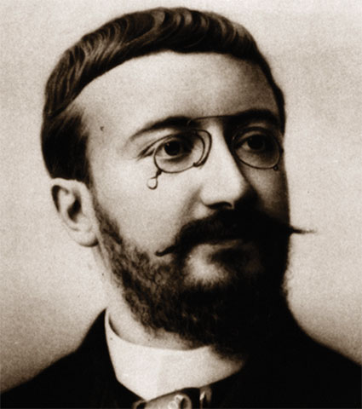
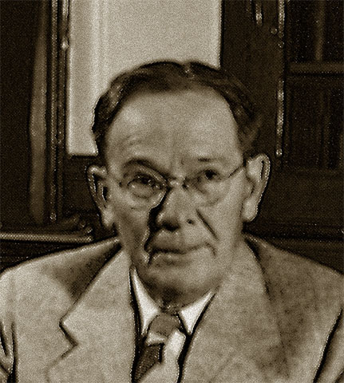
History of intelligence tests
Alfred Binet created 1st intelligence test in early 1900s
Lewis Terman modified Binet’s test to create the Stanford-Binet Test

Slide 4
How have intelligence tests changed?
Popularity of eugenics made tests controversial
Terman = eugenicist; Binet = not a eugenicist
Current intelligence test less biased against non-white races
Considered more valid
Most popular versions:
WAIS = Wechsler Adult Intelligence Scale
WISC = Wechsler Intelligence Scale for Children

Slide 5
WAIS
WAIS measures overall intelligence and 11 other aspects related to intelligence that are designed to assess clinical and educational problems.

Slide 6
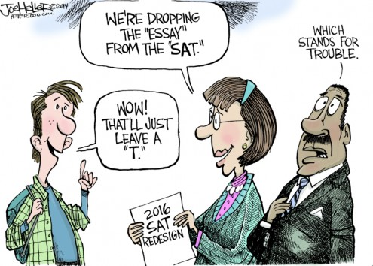
Types of Tests
Aptitude tests
Ex: SAT, ACT, intelligence tests
Achievement tests
Ex: AP Exams, final exams, unit tests and quizzes

Slide 7
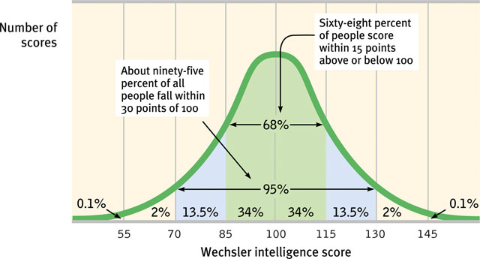
Principles of test construction: Standardization
Standardization = testing a representative sample to get meaningful basis for comparison
“What does 75% percentile mean?”
Creates normal bell curve

Slide 8
Principles of test construction: Validity
Validity = test measures what is says it’s measuring
Content validity = Refers to the extent a test measures a particular behavior or trait.
Predictive validity = Refers to the function of a test in predicting a particular behavior or trait.

Slide 9
Principles of test construction: Reliability
Reliability = a test yields consistent results
Methods for assessing reliability:
Split Test Method
Test-Retest Method
Testing with various forms of the same test

Slide 10
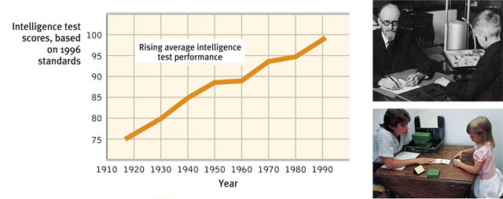
Age and Intelligence: The Flynn Effect
The average intelligence test score has increased over time
Why?

Slide 11
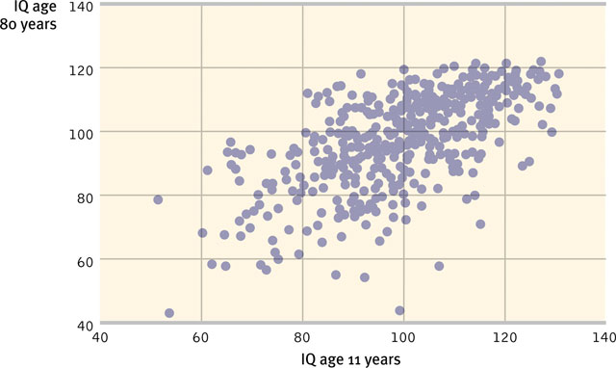
Age and Intelligence: Stability vs Change
IQ Scores tend to be stable as we age
Changes in types of intelligence:
Crystallized intelligence increases with age
Fluid intelligence decreases with age

