Slide 1
Language
12/4

Slide 2
Topics for today
What is language?
What are the structure and components of language?
When do we learn language?
How do we learn language?

Slide 3
Language
Language, our spoken, written, or gestured work, is the way we communicate meaning to ourselves and others.
M. & E. Bernheim/ Woodfin Camp & Associates
Language transmits culture.

Slide 4
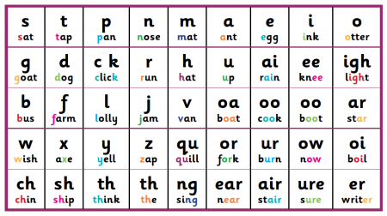
Language Structure
Phonemes: The smallest distinct sound unit in a spoken language. For example:
bat, has three phonemes b · a · t
chat, has three phonemes ch · a · t
Notes:
OBJECTIVE 11| Describe the basic structural units of language.

Slide 5
Language Structure
Morpheme: The smallest unit that carries a meaning. It may be a word or part of a word. For example:
Milk = milk
Pumpkin = pump . kin
Unforgettable = un · for · get · table

Slide 6
Structuring Language
Phonemes
Basic sounds … ea, sh.
Morphemes
Smallest meaningful units (100,000) … un, for.
Words
Meaningful units (290,500) … meat, pumpkin.
Phrase
Composed of two or more words (326,000) … meat eater.
Sentence
Composed of many words (infinite) … She opened the jewelry box.

Slide 7
Components of language: Grammar
Grammar is the system of rules in a language that enable us to communicate with and understand others.
Grammar
Semantics
Syntax

Slide 8
Semantics and Syntax
Semantics = rules by which we derive meaning from morphemes, words, and sentences.
For example: Semantic rule tells us that adding –ed to the word laugh means that it happened in the past.
Syntax = rules for ordering words into grammatically sensible sentences.
For example: In English, syntactical rule says that adjectives come before nouns; white house. In Spanish, it is reversed; casa blanca.

Slide 9
Language Development
Children learn their native languages much before learning to add 2+2.
We learn, on average (after age 1), 3,500 words a year, amassing 60,000 words by the time we graduate from high school.
Time Life Pictures/ Getty Images

Slide 10
When do we learn language?

Slide 11
How do we learn language: 3 Theories
Operant Learning
Inborn Universal Grammar: Noam Chomsky believed we have a natural ability to learn a language
Statistical Learning and Critical Periods:
Infants can determine word breaks and associated syllables thru “statistical analysis.”
These statistical analyses are learned during critical periods of child development.
Notes:
OBJECTIVE 13| Discuss Skinner’s and Chomsky’s contributions to the nature-nurture debate over how children acquire language, and explain why statistical learning and critical periods are important concepts in children’s language learning.

Slide 12
Genes, Brain, & Language
Genes design the mechanisms for a language, and experience modifies the brain.
Michael Newman/ Photo Edit, Inc.
David Hume Kennerly/ Getty Images
Eye of Science/ Photo Researchers, Inc.

Slide 13
Language & Age
Learning new languages gets harder with age.

