Slide 1
Intelligence
12/17

Slide 2
Topics for Today
Nature vs. Nurture: Intelligence
What evidence exists that intelligence is genetic?
What evidence exists that intelligence is environmental?
Group differences in intelligence
What are the causes of group differences in intelligence?
Nature
Nurture

Slide 3
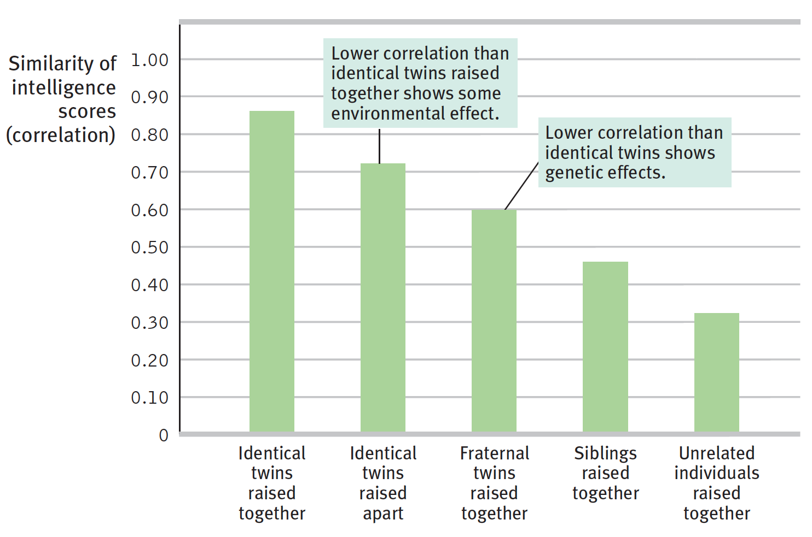
Nature vs. Nurture: Genetic factors of intelligence?
Intelligence scores more similar if you are related
Twin studies
Adoption studies

Slide 4
Nature vs. Nurture: Environmental factors of intelligence?
Neglected children have lower cognitive abilities
Genie Wiley
Adoption studies
Intensive, high quality pre-school improves performance on aptitude tests early on

Slide 5
Group differences in intelligence
Males outperform females in spatial ability and complex math
Females outperform males in verbal fluency and emotional intelligence
Whites outperform Blacks on intelligence tests
This is a very touchy and controversial topic in cognitive psychology…

Slide 6
Causes of Group Differences?
Theories:
Nature – genetic factors
This is the most controversial…
Nurture – environmental factors have caused these differences
Stereotype threat
Biased tests
Are tests biased?

