Slide 1
Mining, Cattle Ranching, and Living in the West
There’s a reason people didn’t move west for awhile…

Slide 2
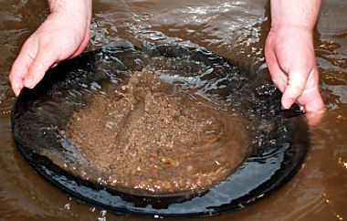
Mining
Started out inexpensive
Complex mining made it more expensive
Hydraulic Mining
Hard Rock Mining

Slide 3
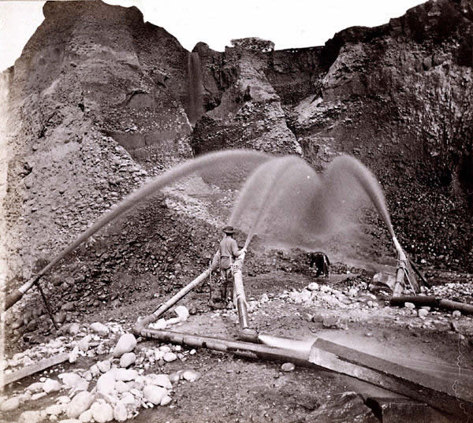
Hydraulic Mining

Slide 4
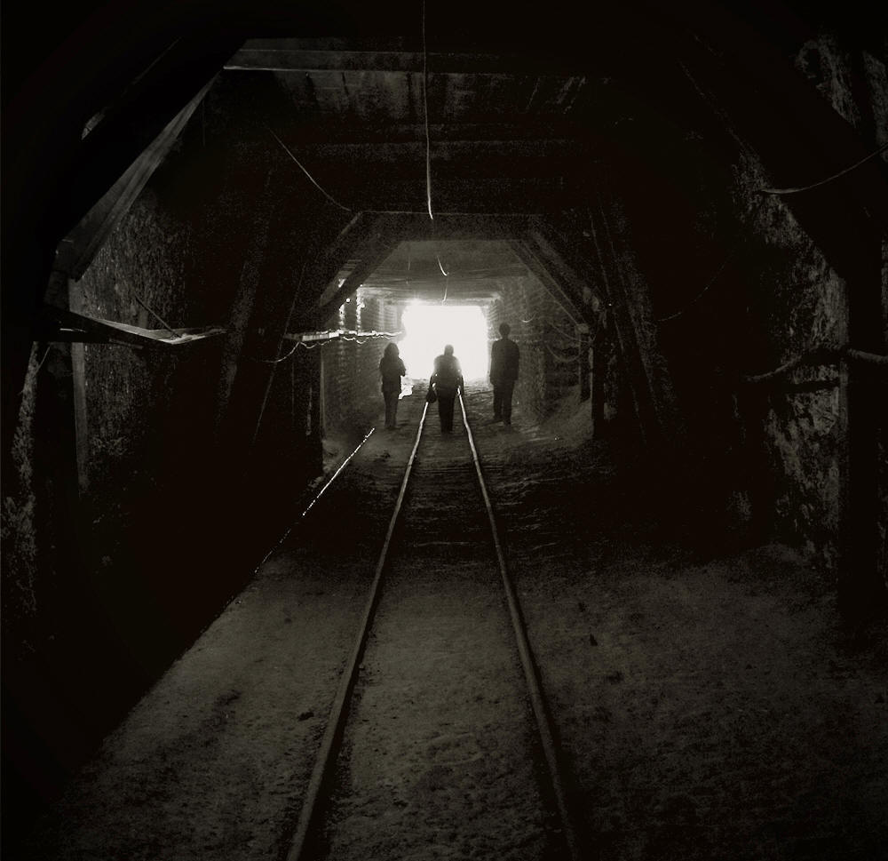
Hard-Rock Mining

Slide 5
Corporations Take Control
Complex mining requires more capital ($$)
Poor miners become unskilled laborers
Miners formed unions
Mining unions mainly unsuccessful

Slide 6
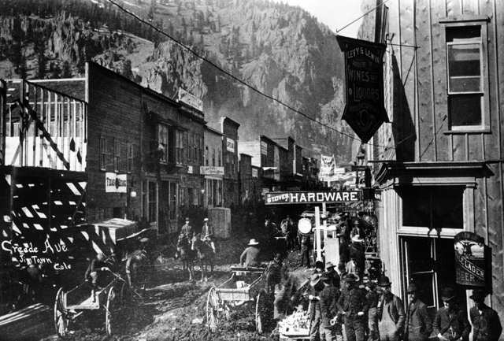
Mining Towns
Mostly made up of single men, very few women
Mostly poor, uneducated white men
Chinese and Mexican miners segregated
Saloons were social centers

Slide 7
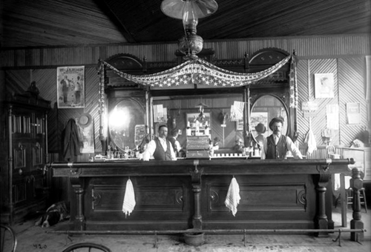

Slide 8
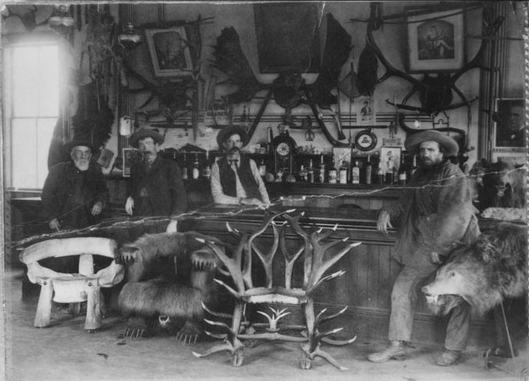

Slide 9
Cattle Ranching
Open Range – land where livestock roam freely (no fences)
Made raising cattle cheap!
Early cattle ranchers were Mexicans and then poor Whites
Chisholm Trail – route from TX to KS to ship cattle to the east.

Slide 10
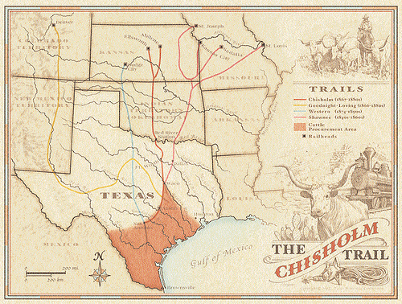

Slide 11
Corporations Take Control
Became more expensive as it became more popular
Corporations bought land and fenced it off
1st time barbed wire was used
Poor ranchers become unskilled workers
Low pay, mistreatment, etc.

Slide 12
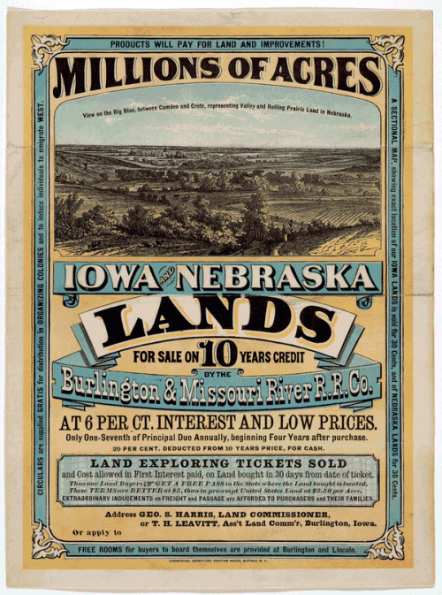
Homesteaders
Homestead Act (1862) causes people to move West
Most who moved were poor, White families

Slide 14
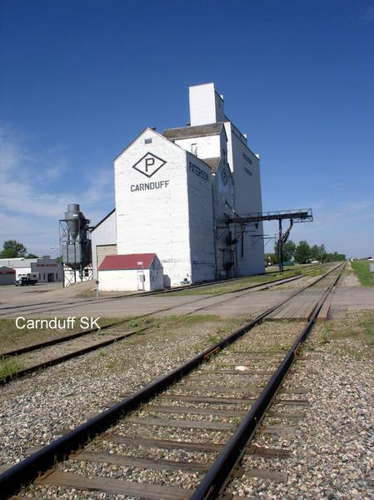
Challenges on the Prairie
Isolated
Few resources
Hard to farm
Railroads take advantage of your isolation
Native Americans

Slide 15
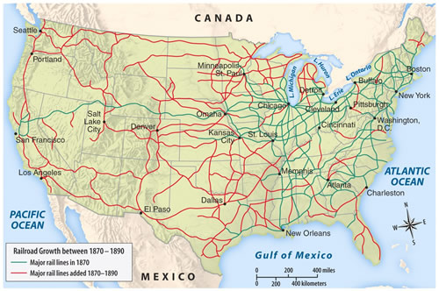

Slide 16
Farmers Protest Organize
Farmers protested mistreatment by banks, railroads, and corrupt politicians
Western farmers got political:
Created farmers alliances and the Populist Party
Created the Omaha Platform (1892)

Slide 17
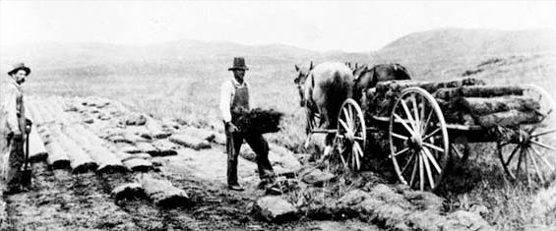
Sod Houses

Slide 18
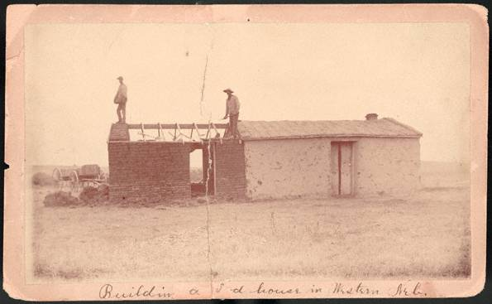

Slide 19
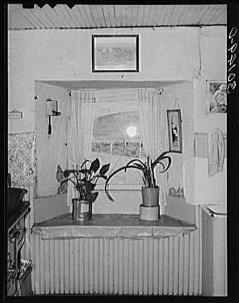

Slide 20
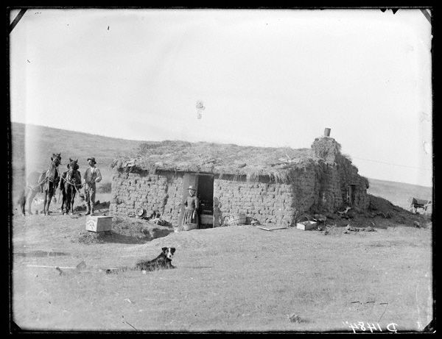

Slide 21
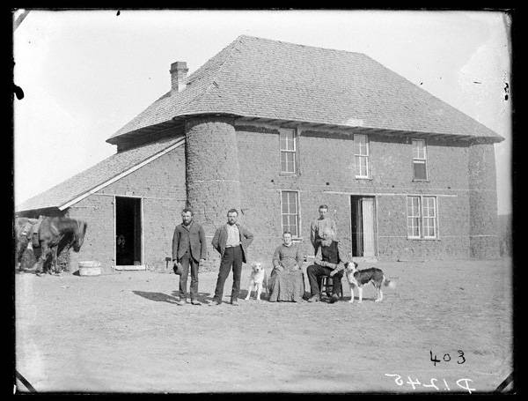

Slide 22
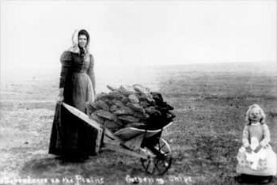

Slide 23
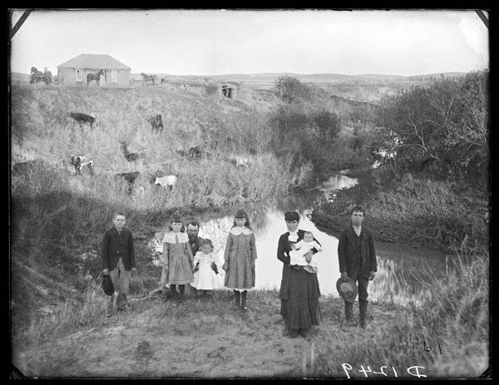

Slide 24
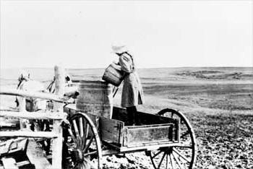

Slide 25
